Slide 1
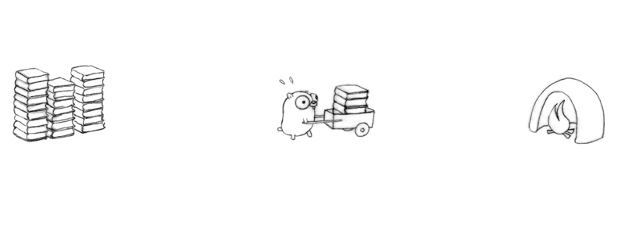
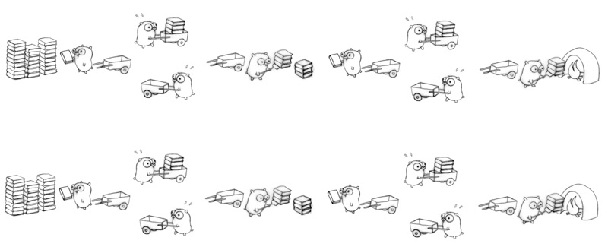
C++ Parallelisation
Concurrency
Parallelisation
Krishna Kumar

Slide 2
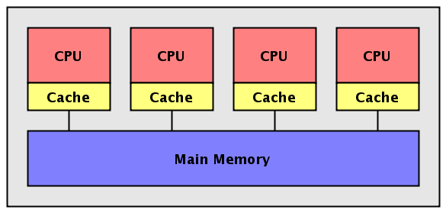

Shared memory
two threads of execution can both address the same variables in a uniform manner, hereby assigning to an element of a vector whose components are in the virtual memory of the task.
If the programmer wants thread 0 to use the value placed in the array by thread 1, he needs to use a mechanism which assures him that thread 1 has written the value before thread 0 reads it.

Slide 3
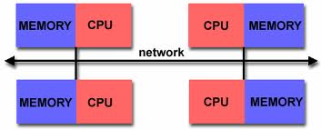
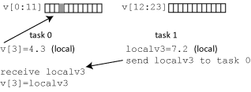
Distributed memory
Each task owns part of the data, and other tasks must send a message to the owner in order to update that data.
These may be two tasks on the same computer so that they could just share memory, but the programmer is treating them as though they were not.
Virtual address space is not shared.

Slide 4
C++ libraries for parallelisation
Shared memory
  OpenMP
  C++11 Threads
  Posix Threads
  Intel TBB
Distributed Memory
  MPI
GPU
  CUDA
  OpenCL
  OpenACC
  AMP

Slide 5

Open Multi-Processing is an API to explicitly direct multi-threaded, shared memory parallelism
Comprised of three primary API components:
  Compiler Directives – Pragmas (pre-processor macros)
  Runtime Library Routines
  Environment Variables
OpenMP is not:
  For distributed memory parallel systems (by itself)
  Guaranteed to make the most efficient use of shared memory
The programmer is responsible for synchronizing input and output.

Slide 6
Thread based parallelism
OpenMP programs accomplish parallelism exclusively through the use of threads.
A thread of execution is the smallest unit of processing that can be scheduled by an operating system.
Threads exist within the resources of a single process. Without the process, they cease to exist.
Typically, the number of threads match the number of machine processors/cores. However, the actual use of threads is up to the application.

Slide 7
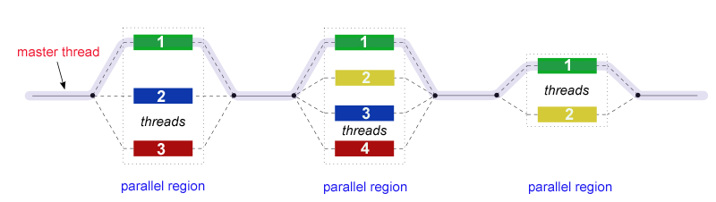
Fork – Join Model
FORK: the master thread then creates a team of parallel threads.
The statements in the program that are enclosed by the parallel region construct are then executed in parallel among the various team threads.
JOIN: When the team threads complete the statements in the parallel region construct, they synchronize and terminate, leaving only the master thread.
The number of parallel regions and the threads that comprise them are arbitrary.

Slide 8
OpenMP: General code structure
#include <omp.h>
int main () {
  int var1, var2, var3;
  // Serial code . . .
  // Beginning of parallel section. Fork a team of threads.
  //Specify variable scoping
#pragma omp parallel private(var1, var2) shared(var3) {
  // Parallel section executed by all threads
  // Run-time Library calls
  // All threads join master thread and disband
}
// Resume serial code ..
}

Slide 9
Hello World Example
“g++ -fopenmp hello.cc -o hello”

Slide 10
PARALLEL region construct
#pragma omp parallel [clause ...] newline
  private (list)
  shared (list)
  default (private|shared)
Private – Variable is private to each thread
Shared – variable is shared between threads
omp_set_num_threads(4);
A parallel region is a block of code that will be executed by multiple threads
When a thread reaches a PARALLEL directive, it creates a team of threads and becomes the master of the team. The master is a member of that team and has thread number 0 within that team.

Slide 11
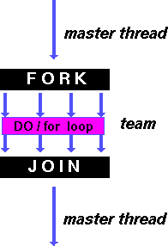
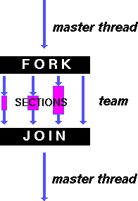
Work sharing construct
A work-sharing construct divides the execution of the enclosed code region among the members of the team that encounter it.
Work-sharing constructs do not launch new threads
There is no implied barrier upon entry to a work-sharing construct, however there is an implied barrier at the end of a work sharing construct.

Slide 12
#pragma omp for [clause ...] schedule (type [,chunk])
SCHEDULE: Describes how iterations of the loop are divided among the threads in the team.
STATIC: Loop iterations are divided into pieces of size chunk and then statically assigned to threads.
DYNAMIC: Loop iterations are divided into pieces of size chunk, and dynamically scheduled among the threads; when a thread finishes one chunk, it is dynamically assigned another.
GUIDED: Iterations are dynamically assigned to threads in blocks as threads request them until no blocks remain to be assigned. The size of the initial block is proportional to:
  number_of_iterations / number_of_threads
Subsequent blocks are proportional to
  number_of_iterations_remaining / number_of_threads

Slide 13
Example 2: Array addition
Adding two arrays of c[N] = a[N]+b[N]

Slide 14
Example 3:
Sum += a[N] * b[N]

Slide 15
What went wrong with Example 3?
Addition was happening in as and when a thread was executed.
Although the variable “sum” is shared, the print statement doesn't wait for all the threads to be completed.
OpenMP has a feature called “reduction”: A private copy for each list variable is created for each thread. At the end of the reduction, the reduction variable is applied to all private copies of the shared variable, and the final result is written to the global shared variable.
  reduction(+:result)

Slide 16
Exercise
OpenMP implementation of Matrix multiplication
Threads share row iterations according to a predefined chunk size.
C [m][n] = a[m][k] * b[k][n]

Slide 17
Atomic, Barrier and Critical
#pragma omp barrier
  to add a barrier to wait for all threads to finish before proceeding
#pragma omp critical
  Only one thread has access at a given time. Useful for writing to a memory location.
#pragma omp atomic
  the ATOMIC directive specifies that a specific memory location must be updated atomically, rather than letting multiple threads attempt to write to it. In essence, this directive provides a mini-CRITICAL section

Slide 18
References
people.ds.cam.ac.uk/nmm1/OpenMP/
https://computing.llnl.gov/tutorials/openMP/

