Slide 1
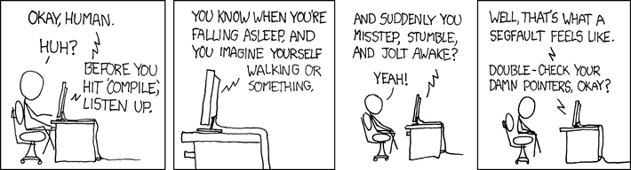
C++ Exception Handling
(https://xkcd.com/371/)
Krishna Kumar

