Slide 1

C++ Pointers (Part I)
Krishna Kumar
Every computer, at the unreachable memory address 0x-1, stores a secret. I found it, and it is that all humans ar-- SEGMENTATION FAULT
XKCD (https://xkcd.com/138/)

Slide 2
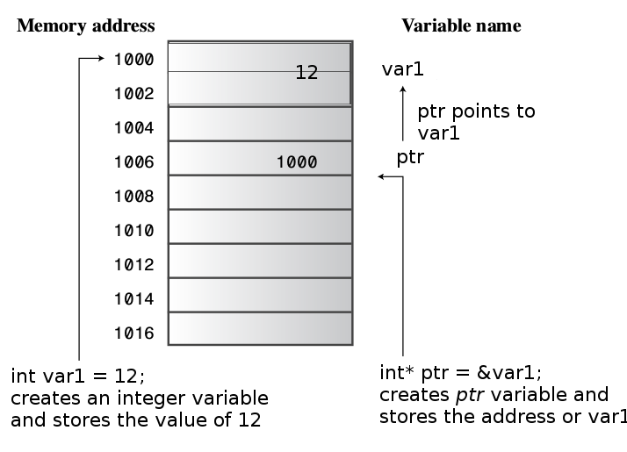
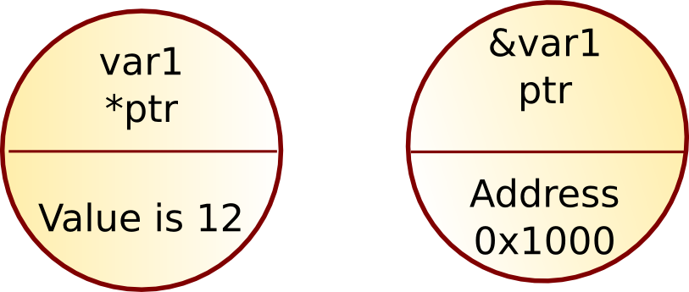
Pointer
Pointer values are memory addresses
      A pointer p can hold the address of a memory location
      A pointer points to an object of a given type
            E.g. a int* points to an int, not to a string

Slide 3
Pointer to
char* cptr; // Pointer to a char
int* iptr; // Pointer to an int
float* fptr; // Pointer to a float
MyClass* myclasspt; // Pointer to a user-defined class MyClass
int* ap[15]; // array of 15 pointers to ints
int (*fp)(char*); // pointer to function taking a char*
// argument; returns an int
int* f(char*); // function taking a char* argument; returns a
// pointer to int

Slide 4
Pointer Danger
int* ptr; // create a pointer-to-int
*ptr = 556; // place a value in never-never land
Pointer Golden Rule: Always initialize a pointer to a definite an appropriate address before you apply the dereferencing operator ( * ) to it

Slide 5
Capsule Summary
int v; //defines variable v of type int
int* p = &v; //defines p as a pointer to int
//assigns address of variable v to
// pointer p
v = 3; //assigns 3 to v
*p = 3; //also assigns 3 to v

Slide 6
Access
A pointer does not know the number of elements that it's pointing to (only the address of the first element)
  double* p1 = new double;
  *p1 = 7.3; // ok
  p1[0] = 8.2; // ok
  p1[17] = 9.4; // ouch! Undetected error
  p1[-4] = 2.4; // ouch! Another undetected error
  double* p2 = new double[100];
  *p2 = 7.3; // ok
  p2[17] = 9.4; // ok
  p2[-4] = 2.4; // ouch! Undetected error
p1
p1:
8.2
7.3
p2:
7.3

Slide 7
Access
A pointer does not know the number of elements that it's pointing to
  double* p1 = new double;
  double* p2 = new double[100];
  p1[17] = 9.4; // error (obviously)
  p1 = p2; // assign the value of p2 to p1
  p1[17] = 9.4; // now ok: p1 now points to the array of 100 doubles
p1:
[0]:
[99]:
p2:
(after the assignment)
p1:

Slide 8
Access
A pointer does know the type of the object that it's pointing to
int* pi1 = new int(7);
  int* pi2 = pi1; // ok: pi2 points to the same object as pi1
  double* pd = pi1; // error: can't assign an int* to a double*
  char* pc = pi1; // error: can't assign an int* to a char*
  There are no implicit conversions between a pointer to one value type to a pointer to another value type
  However, there are implicit conversions between value types:
  *pc = 8; // ok: we can assign an int to a char
  *pc = *pi1; // ok: we can assign an int to a char
  int * pi;
  pi = 0xB8000000; // type mismatch (You know that's an address compiler doesn't)
  pi = (int* ) 0xB8000000; // types now match ( int 2 Bytes and addr may be 4Bytes)

Slide 9
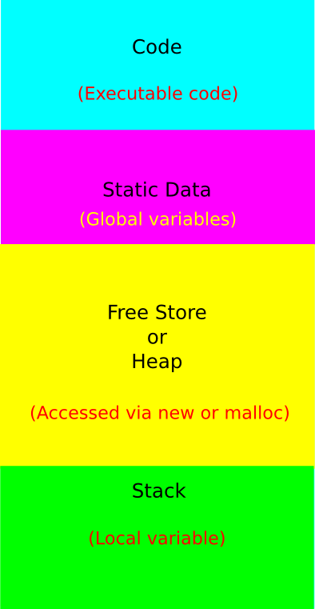
Computer Memory
Stack:
  Stores local data, return addresses, used for parameter passing
Heap:
  You would use the heap if you don't know exactly how much data you will need at runtime or if you need to allocate a lot of data
Use local variables (stack) when you can. Use dynamic allocation (heap) when you have to.

Slide 10
Stack Memory
Variables when out of scope will automatically be deallocated.
Faster to allocate in comparison to variables on the heap.
Can have a stack overflow when too much of the stack is used.
Data created on the stack can be used without pointers.
Use stack when data is not too big.

Slide 11
Heap Memory
Variables on the heap must be destroyed manually and never fall out of scope.
The data is freed with delete, delete[] or free
Slower to allocate in comparison to variables on the stack.
Data can be accessed by pointers
Can have allocation failures if too big of a buffer is requested to be allocated.
You would use the heap if you don't know exactly how much data you will need at runtime or if you need to allocate a lot of data.
Responsible for memory leaks

Slide 12
The free store
(sometimes called "the heap")
You request memory "to be allocated" "on the free store" by the new operator
  The new operator returns a pointer to the allocated memory
  A pointer is the address of the first byte of the memory
  For example
    int* p = new int; // allocate one uninitialized int
    // int* means “pointer to int”
    int* q = new int[7]; // allocate seven uninitialized ints
    // “an array of 7 ints”
    double* pd = new double[n]; // allocate n uninitialized doubles
  A pointer points to an object of its specified type
  A pointer does not know how many elements it points to
p:
q:

Slide 13
Why use free store or heap?
To allocate objects that have to outlive the function that creates them:
  For example
    double* make(int n) // allocate n ints
    {
      return new double[n];
    }
  Another example: vector's constructor
Huge data (usually greater than >1MB)

Slide 14
Pointer Danger
(when using new)
p1:
p2:
???
5
Individual elements
  int* p1 = new int; // get (allocate) a new uninitialized int
  int* p2 = new int(5); // get a new int initialized to 5
  int x = *p2; // get/read the value pointed to by p2
  // (or “get the contents of what p2 points to”)
  // in this case, the integer 5
  int y = *p1; // undefined: y gets an undefined value; don’t do that

Slide 15
Stack and Heap Memory
int foo() {
int* ptr; //<--nothing allocated yet (excluding the pointer itself, which is // allocated here on the stack).
bool b = true; // Allocated on the stack.
if(b) {
//Create 500 bytes on the stack
int buffer[500];
//Create 500 bytes on the heap
ptr = new int[500];
} //<-- buffer is deallocated here, pBuffer is not
return 0;
} //<--- oops there's a memory leak, I should have called
// delete[] ptr;

Slide 16
A problem: memory leak
double* calc(int result_size, int max) // function returns pointer to a double
{
double* p = new double[max]; // allocate another max doubles
// i.e., get max doubles from the free store
double* result = new double[result_size];
// … use p to calculate results to be put in result …
return result;
}
double* r = calc(200,100); // oops! We “forgot” to give the memory
// allocated for p back to the free store
Lack of de-allocation (usually called "memory leaks") can be a serious problem in real-world programs
A program that must run for a long time can't afford any memory leaks
Stroustrup/PPP Oct'11

Slide 17
A problem: memory leak
double* calc(int result_size, int max)
{
int* p = new double[max]; // allocate another max doubles
// i.e., get max doubles from the free store
double* result = new double[result_size];
// … use p to calculate results to be put in result …
delete[ ] p; // de-allocate (free) that array
// i.e., give the array back to the free store
return result;
}
double* r = calc(200,100);
// use r
delete[ ] r; // easy to forget
Stroustrup/PPP Oct'11

Slide 18
Memory leaks
A program that needs to run "forever" can't afford any memory leaks
  An operating system is an example of a program that “runs forever”
If a function leaks 8 bytes every time it is called, how many days can it run before it has leaked/lost a megabyte?
  Trick question: not enough data to answer, but about 130,000 calls
All memory is returned to the system at the end of the program
  If you run using an operating system (Windows, Unix, whatever)
Program that runs to completion with predictable memory usage may leak without causing problems
  i.e., memory leaks aren’t “good/bad” but they can be a major problem in specific circumstances

Slide 19
Memory leaks
Another way to get a memory leak
  void f()
  {
  double* p = new double[27];
  // …
  p = new double[42];
  // …
  delete[] p;
  }
  // 1st array (of 27 doubles) leaked
1st value
p:
2nd value

Slide 20
Memory leaks
How do we systematically and simply avoid memory leaks?
  don't mess directly with new and delete
    Use vector, etc.
  Or use a garbage collector
    A garbage collector is a program the keeps track of all of your allocations and returns unused free-store allocated memory to the free store (not covered in this course; see http://www.research.att.com/~bs/C++.html)
    Unfortunately, even a garbage collector doesn’t prevent all leaks
  Use smart_ptr (auto, unique_ptr, shared_ptr)

Slide 21
Vector class: memory leak
class vector;
void f(int x)
{
vector v(x); // define a vector
// (which allocates x doubles on the free store)
// … use v …
// give the memory allocated by v back to the free store
// but how? (vector's elem data member is private)
}

Slide 22
Vector (destructor)
// a very simplified vector of doubles:
class vector {
int sz; // the size
double* elem; // a pointer to the elements
public:
vector(int s) // constructor: allocates/acquires memory
:sz(s), elem(new double[s]) { }
~vector() // destructor: de-allocates/releases memory
{ delete[ ] elem; }
// …
};
Note: this is an example of a general and important technique:
  acquire resources in a constructor
  release them in the destructor
Examples of resources: memory, files, locks, threads, sockets

Slide 23
A problem: memory leak
void f(int x)
{
int* p = new int[x]; // allocate x ints
vector v(x); // define a vector (which allocates another x ints)
// … use p and v …
delete[ ] p; // deallocate the array pointed to by p
// the memory allocated by v is implicitly deleted here by vector's destructor
}
The delete now looks verbose and ugly
  How do we avoid forgetting to delete[ ] p?
  Experience shows that we often forget
Prefer deletes in destructors

Slide 24
Free store summary
Allocate using new
  New allocates an object on the free store, sometimes initializes it, and returns a pointer to it
    int* pi = new int; // default initialization (none for int)
    char* pc = new char('a'); // explicit initialization
    double* pd = new double[10]; // allocation of (uninitialized) array
  New throws a bad_alloc exception if it can't allocate
Deallocate using delete and delete[ ]
  delete and delete[ ] return the memory of an object allocated by new to the free store so that the free store can use it for new allocations
    delete pi; // deallocate an individual object
    delete pc; // deallocate an individual object
    delete[ ] pd; // deallocate an array
  Delete of a zero-valued pointer ("the null pointer") does nothing
    char* p = 0;
    delete p; // harmless

Slide 25
References
Bjarne Stroustrup C++
C++ Primer Plus
Object Oriented Programming in C++
http://people.ds.cam.ac.uk/nmm1/C++/index.html
http://www.thecodingforums.com/threads/stack-or-heap-for-c-object.689680/
https://stackoverflow.com/questions/79923/what-and-where-are-the-stack-and-heap#79936

