Slide 1
Memory models and compiler optimisation
Krishna Kumar

Slide 2
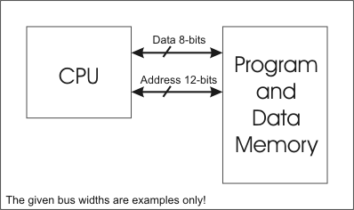
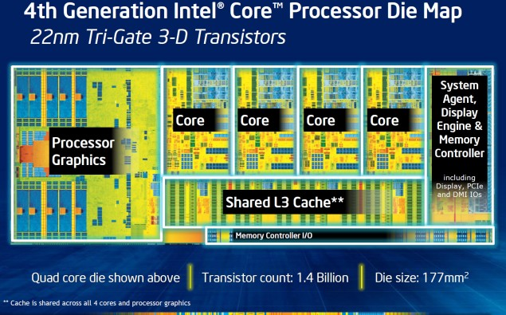
Memory model we like to program for
How it actually looks
Key Assumption:
Maintain fully coherent caches

Slide 3
Does your compiler execute the program you wrote?
Sequential consistency: Executing the program you wrote.
“the result of any execution is the same as if the operations of all the processors were executed in some sequential order, and the operations of each individual processor appear in this sequence in the order specified by its program.” - Lesslie Lamport
Compiler optimisation
Processor execution
Cache coherency
Chip / compiler design annoyingly helpful:
  It can be expensive to exactly execute what you wrote
  Often they rather do something else, that's faster.

Slide 4
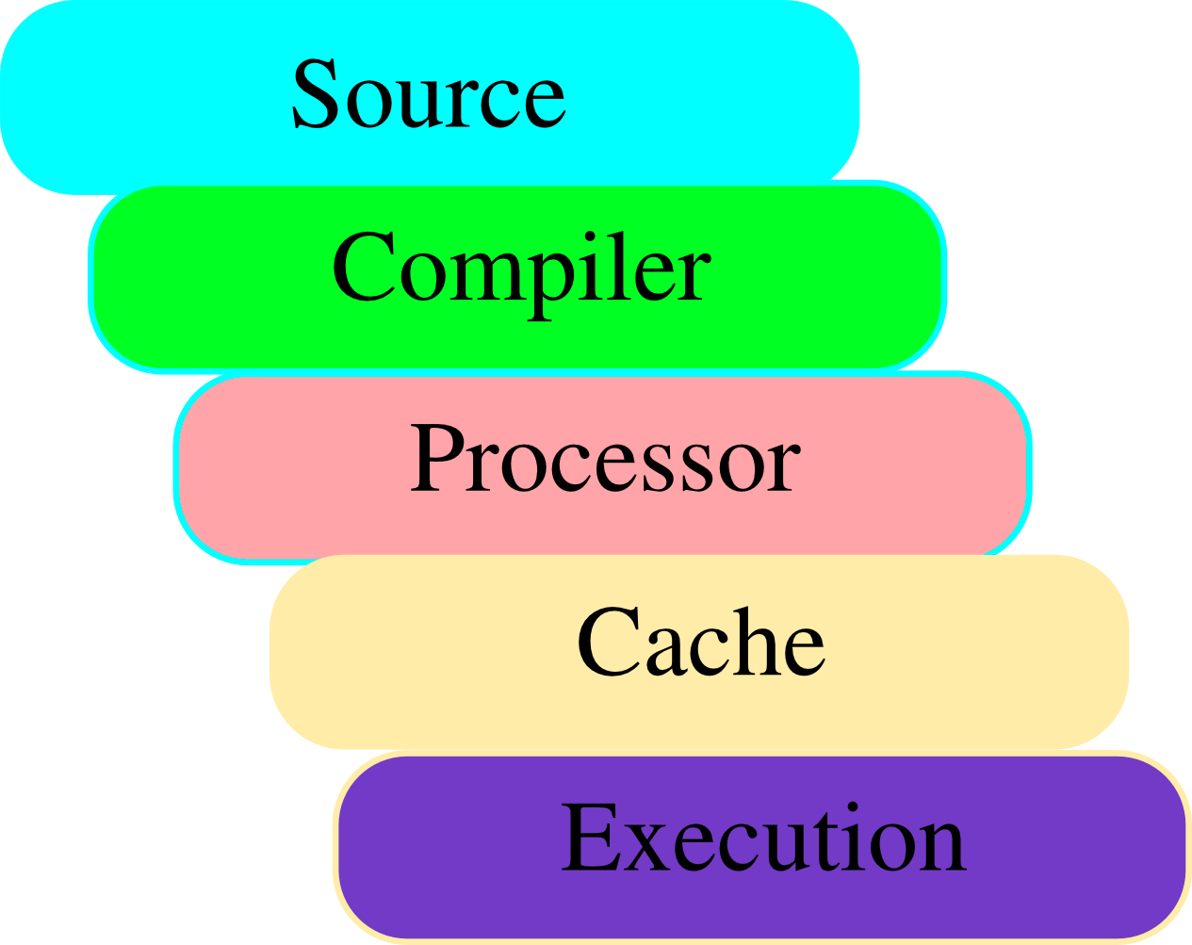
Transformation of code

Slide 5
Compiler optimisations
for (i = 0; i < rows; ++i) {
for (j = 0; j < cols; ++j){
  a[j*rows+i]+=42;
}
}
for (j = 0; j < cols; ++j) {
for (i = 0; j < rows; ++i)
{
  a[j*rows+i]+=42;
}
}

Slide 6
Dekker's and Peterson's Algorithm
Consider (flags are shared and atomic but unordered, initially set to zero.)
Thread 1:
flag1 = 1; //a: declare intent
if (flag2 != 0) // b
  // resolve contention
else
  // enter critical section
Thread 2:
flag2 = 1; //c: declare intent
if (flag1 != 0) // d
  // resolve contention
else
  // enter critical section
If a can pass b, or c can pass d, this breaks!

Slide 7
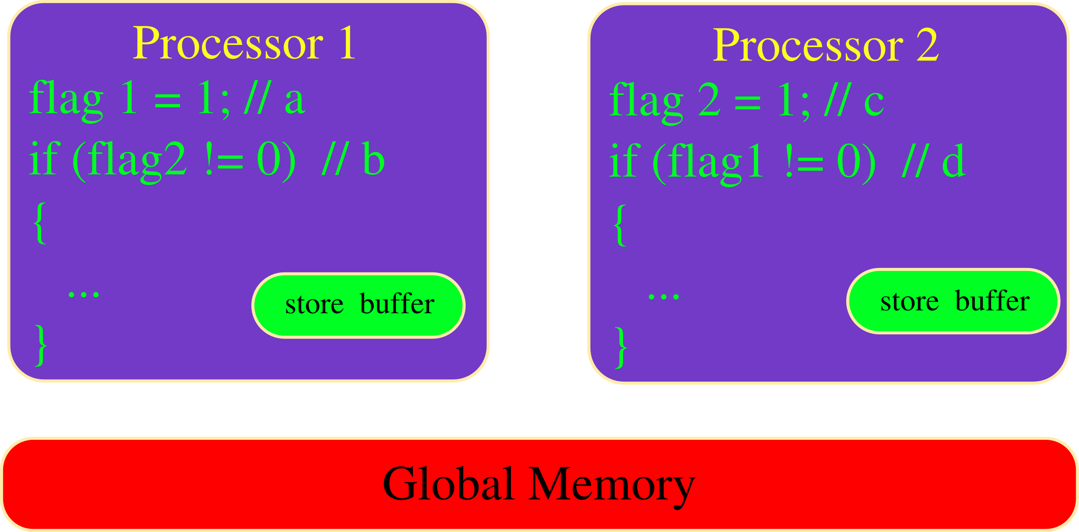
Store Buffer

Slide 8
Store Buffer
(1)
(1)
2
3
2
3

Slide 9
Compiler Optimisations
X = 1;
Y = 2;
Z = 3; // using X, Y, Z
X = 1;
Y = 2;
X = 3; // using X & Y
Z = 3;
Y = 2;
X = 1; // using X, Y, Z
Y = 2;
X = 3; // using X & Y

