Slide 1
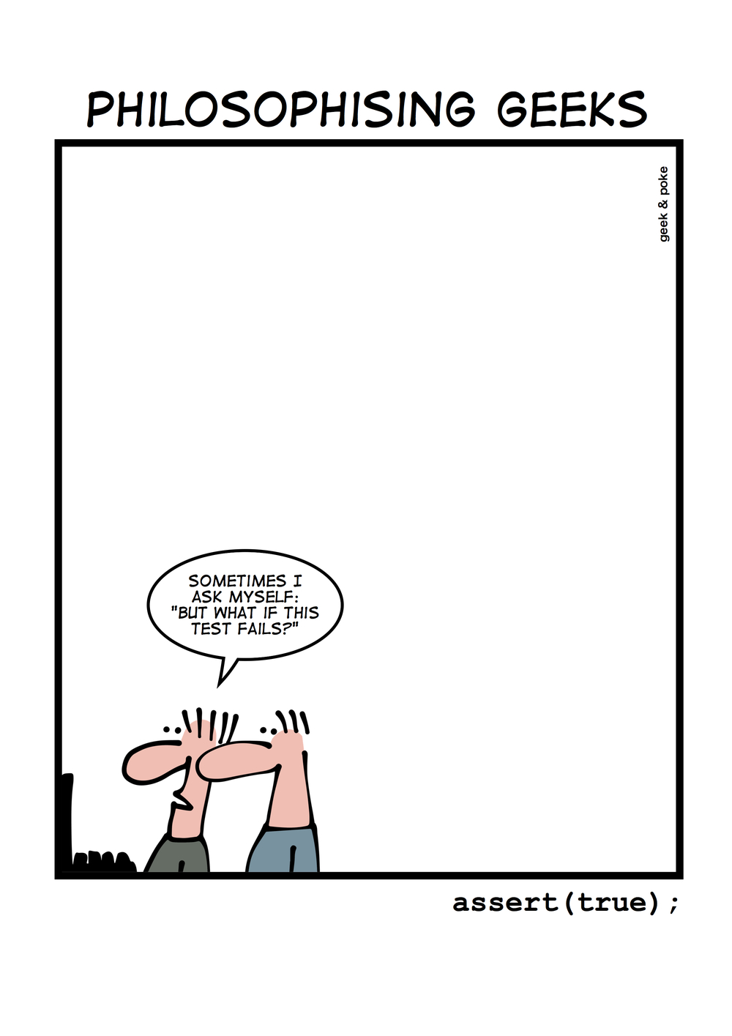
C++ Quiz
Krishna Kumar

Slide 2
Fun with Type Deduction
const int cx = 0;
auto cx2 = cx;
decltype(cx) cx3 = cx;
template <typename T>
void f1(T param);
f1(cx);
template <typename T>
void f1(T& param);
f1(cx);
template <typename T>
void f1(T&& param);
f1(cx);
Type? Why? //Type is int
Type? Why? // Const int
T's type and why?
param is a copy of cx – int
T's type and why?
Referring to a chunk of memory – const int
T's type and why?
Neat trick to allow argument forwarding – perfect forwarding
const int&

Slide 3
Fun with Type Deduction: Solution
const int cx = 0;
auto cx2 = cx;
decltype(cx) cx3 = cx;
template <typename T>
void f1(T param);
f1(cx);
template <typename T>
void f1(T& param);
f1(cx);
template <typename T>
void f1(T&& param);
f1(cx);
//Type is int
// Const int
T's type and why?
T's type and why?
T's type and why?

Slide 4
Lambda expressions - Type
const int cx = 0;
auto lam = [cx] {cx = 10;};
// Compiler generated class
class UptoCompiler {
  private:
    ??? cx;
};
// What happens here?
// type? Why?

Slide 5
Lambda expressions: Solution
const int cx = 0;
auto lam = [cx] {cx = 10;};
// Compiler generated class
class UptoCompiler {
  private:
    ??? cx;
};
// Error! Why?
// const int
The variable cx within {} is what is in the compiler generated class.
To preserve what is being passed to the hidden compiler generated class.
Programming in 2 scopes!

Slide 6
Lambda init capture: C++14
const int cx = 0;
auto lam = [cx = cx] {cx = 10;};
// Compiler generated class
class UptoCompiler {
  private:
    ??? cx;
  Public:
    void operator()() const
      { cx = 0; }
    ...
};
//Error why?
// type? Why?

Slide 7
Lambda init capture: Solution
const int cx = 0;
auto lam = [cx = cx] {cx = 10;};
// Compiler generated class
class UptoCompiler {
  private:
    ??? cx;
  Public:
    void operator()() const
      { cx = 0; }
    ...
};
// Error! Why?
// int (acts like a const int!)

Slide 8
Lambda init capture: mutable
const int cx = 0;
auto lam = [cx = cx] mutable {cx = 10;};
auto lam = [cx = cx] ()mutable {cx = 10;};
class UptoCompiler {
  private:
    ??? cx;
  Public:
    void operator()() const
      { cx = 0; }
    ...
};
//Error why?
// Standard failed to add empty() for mutable!
Type??
Int (acts like an int)! Phew!

Slide 9
Type deduction
For const int cx = 0;
Context | Type
auto | int
decltype | const int
template (T param) | int
template (T& param) | const int
template (T&& param) | const int&
lambda (by-value capture) | const int
lambda (init capture) - same as auto! | int

Slide 10
Type deduction & initialisation
int x1 = 0;
int x2(0);
int x3 = {0};
int x4 {0};
auto x1 = 0;
auto x2(0);
auto x3 = {0};
auto x4 {0};
template<typename T>
void f(T param)
f({0});
// type? Why? - int
// type? Why? - int
// type? initializer_list<int>
// type? initializer_list<int>
// type? Why?
Error!
No type “{0}”

Slide 11
Type deduction: decltype
struct Point {
  int x, y;
};
Type of Point::x? - int
Point p;
const Point& cp = p';
What is the type cp.x?
Both
  int
  const int
C++ solution
decltype(cp.x) ~ int
decltype((cp.x)) ~ const int&

Slide 12
auto to explicit type deduction
std::map<std::string, int> m;
// Why this is inefficient
for (const std::pair<std::string, int>& p : m) …
// This is optimised
for (const auto& p : m) ….

Slide 13
auto or explicit type deduction: solution
Avoid accidental temporary creation!
std::map<std::string, int> m;
// Holds object of type std::pair<const std::string, int>
// Why this is inefficient
// creates a temp on each iteration std::string is copied
for (const std::pair<std::string, int>& p : m) …
// This is optimised
// No temporaries are created
for (const auto& p : m) ….

Slide 14
Templates & function calls
template<typename T1, typename T2>
void f( T1, T2 );
template<typename T> void f( T );
template<typename T> void f( T, T );
template<typename T> void f( T* );
template<typename T> void f( T*, T );
template<typename T> void f( T, T* );
template<typename T> void f( int, T* );
template<> void f<int>( int );
void f( int, double );
void f( int );
int i; double d;
float ff; complex<double> c;
non-templates are always preferred over templates
f( i ); // invokes?
f<int>( i ); // invokes?
f( i, i ); // invokes?
f( c ); // invokes?
f( i, ff ); // invokes?
f( i, d ); // invokes?
f( c, &c ); // invokes?
f( i, &d ); // invokes?
f( &d, d ); // invokes?
f( &d ); // invokes?
f( d, &i ); // invokes?
f( &i, &i ); // invokes?

Slide 15
Templates & function calls
template<typename T1, typename T2>
void f( T1, T2 );
template<typename T> void f( T );
template<typename T> void f( T, T );
template<typename T> void f( T* );
template<typename T> void f( T*, T );
template<typename T> void f( T, T* );
template<typename T> void f( int, T* );
template<> void f<int>( int );
void f( int, double );
void f( int );
int i; double d;
float ff; complex<double> c;
f( i ); // 10
f<int>( i ); // 8 – f<int> explicit
f( i, i ); // 3
f( c ); // 2
f( i, ff ); // 1 why not 9? only exact match; ff is float not double.
f( i, d ); // 9
f( c, &c ); // 6
f( i, &d ); // 7
f( &d, d ); // 5
f( &d ); // 4
f( d, &i ); // 1
f( &i, &i ); // 3

Slide 16
Templates & function calls
// What is the output of this program?
template <class T> void f(T &i) { std::cout << 1; }
template <> void f(const int &i) { std::cout << 2; }
int main() {
  int i = 42;
  f(i);
}

Slide 17
Templates & function calls: Solution
// What is the output of this program?
template <class T> void f(T &i) { std::cout << 1; }
template <> void f(const int &i) { std::cout << 2; }
int main() {
  int i = 42;
  f(i);
}
Solution: 1
The templated function will be instantiated as void f(int&), which is a better match than f(const int&).

Slide 18
Templates & function calls II
template <int i>
void fun() {
  i = 20;
  std::cout << i;
}
int main() {
  fun<10>();
}
Result:
Compiler error in line
"i = 20;"
Non-type parameters must be const, so they cannot be modified.
Compiler error: lvalue required as left operand of assignment i = 20;

Slide 19
Inheritance - should this compile?
class Base {
  public:
    void dobasework();
};
class Derived : public Base{
  public:
    void derivedwork() {
      dobasework();
    }
};
template <typename T>
class Base {
  public:
    void dobasework();
};
template <typename T>
class Derived : public Base<T>{
  public:
    void derivedwork() {
      dobasework();
    }
};
Dependent base class
Two-phase lookup

Slide 20
Inheritance - specilaisation
template <typename T>
class Base {
  public:
    void dobasework();
};
template <typename T>
class Derived : public Base<T>{
  public:
    void derivedwork() {
      dobasework();
    }
};
// cont...
// cont…
// Possible future
// no base work
template<>
class Base<int> {};
// Fail!
Derived<int> d;
do.derivedWork();

Slide 21
Inheritance – specilaisation: solution?
template <typename T>
class Base {
  public:
    void dobasework();
};
template <typename T>
class Derived : public Base<T>{
  public:
    void derivedwork() {
      Base<T>::dobasework();
    }
};
// Base<T>:: turns off virtual function calls – not relevant here
template <typename T>
class Base {
  public:
    void dobasework();
};
template <typename T>
class Derived : public Base<T>{
  public:
    void derivedwork() {
      this->dobasework();
    }
};
// Lookup only in the current

Slide 22
Templates & Inheritance
struct Base{
  int x;
  template <int Trange>
  virtual void print() {
    std::cout << Trange + x + 1; }
};
struct Derived : public Base {
  template <int Trange>
  void print() {
    std::cout << Trange + x + 2; }
};
int main() {
  Base* p = new Derived;
  p->x = 1;
  p->print<5>();
}
// Result -Error code doesn't compile!
// Member function template cannot be virtual
struct Base{
  int x;
  template <int Trange>
  void print() {
    std::cout << Trange + x + 1; }
};
struct Derived : public Base {
  template <int Trange>
  void print() {
    std::cout << Trange + x + 2; }
};
int main() {
  Base* p = new Derived;
  p->x = 1;
  p->print<5>();
}
// Result – Base class - 7
// For Derived* - Derived - 8

Slide 23
Template specialisation
template <class T>
T max (T &a, T &b) {
  std::cout << "generic";
  return (a > b)? a : b;
}
template <>
int max <int> (int &a, int &b) {
  std::cout << "specialised";
  return (a > b)? a : b;
}
int main () {
  int a = 10, b = 20;
  std::cout << max <int> (a, b);
}
Which one will be called?
Result:
  Specialised 20
This is an example of template specialization. Sometime we want a different behaviour of a function/class template for a particular data type. For this, we can create a specialized version for that particular data type.

Slide 24
Namespace – Output?
namespace foo {
  void bar() {
    x++;
    std::cout << x;
  }
  int x;
}
int main() {
  foo:x = 0;
  foo::bar();
}
namespace foo {
  int x;
}
namespace foo {
  void bar() {
    x++;
    std::cout << x;
  }
}
int main() {
  foo:x = 0;
  foo::bar();
}

Slide 25
Namespace – Solution
namespace foo {
  void bar() {
    x++;
    std::cout << x;
  }
  int x;
}
int main() {
  foo:x = 0;
  foo::bar();
}
// Error: Names used in a namespace must be declared before before their use
namespace foo {
  int x;
}
namespace foo {
  void bar() {
    x++;
    std::cout << x;
  }
}
int main() {
  foo:x = 0;
  foo::bar();
}
// Result: 1

Slide 26
ADL (Argument Dependent Lookup)
Which of the following functions are found when called in main during name lookup?
namespace standards {
  struct datastructure { };
  void foo(const datastructure& ds) { }
  void bar() {}
}
int main() {
  standards::datastructure ds;
  foo(ds);
  bar();
}

Slide 27
Koenig or ADL : Solutioin
namespace standards {
  struct datastructure { };
  void foo(const datastructure& ds) { }
  void bar() {}
}
int main() {
  standards::datastructure ds;
  foo(ds);
  bar();
}
// Result = foo();
This is called koenig lookup or argument dependent name lookup. In this case, the namespace 'standards' is searched for a function 'foo' because its argument 'ds' is defined in that namespace. For function 'bar', no additional namespaces are searched and the name is not found.

Slide 28
Lvalue reference - I
int& fun() {
  static int x = 10;
  return x;
}
int main() {
  fun() = 30;
  std::cout << fun();
}
Guess the output
10
30
Compiler error

Slide 29
Lvalue reference – I (Solution)
int& fun() {
  static int x = 10;
  return x;
}
int main() {
  fun() = 30;
  std::cout << fun();
}
Result : 30
When a function returns by reference, it can be used as lvalue.
Since x is a static variable, it is shared among function calls and the initialization line "static int x = 10;" is executed only once. The function call fun() = 30, modifies x to 30. The next call "cout << fun()" returns the modified value.

Slide 30
Lvalue reference - II
int& fun() {
  int x = 10;
  return x;
}
int main() {
  fun() = 30;
  std::cout << fun();
}
Guess the output
10
30
Compiler error

Slide 31
Lvalue reference – II (Solution)
int& fun() {
  int x = 10;
  return x;
}
int main() {
  fun() = 30;
  std::cout << fun();
}
Result : 10
When a function returns by reference, it can be used as lvalue.
Since x is a local variable, every call to fun() will have use memory for x and call “fun() = 30" will not effect on next call.
Or
Segmentation fault
warning: reference to local variable ‘x’ returned [-Wreturn-local-addr]

Slide 32
Rvalue reference – Output?
Case I
int main() {
  int x = int() = 3;
  std::cout << x;
}
Output:
  Compiler Error
  Undefined
  3
Case II
int main() {
  int&& x = int();
  x = 3;
  std::cout << x;
}
Output:
  Compiler Error
  Undefined
  3

Slide 33
Rvalue reference – Solution
What is it output?
int main() {
  int x = int() = 3;
  std::cout << x;
}
int() creates a temporary variable which is an rvalue. The temporary variable that is created can not be assigned to since it is an rvalue. Thus this code should not compile
int main() {
  int&& x = int();
  x = 3;
  std::cout << x;
}
int() creates a temporary variable.
int&& is a universal reference
Result: 3

Slide 34
References
Scott Meyers “The last thing D needs”
Herb Sutter's Guru of the Week
http://geeksquiz.com/c-plus-plus/
http://www.mycppquiz.com/

