Slide 1
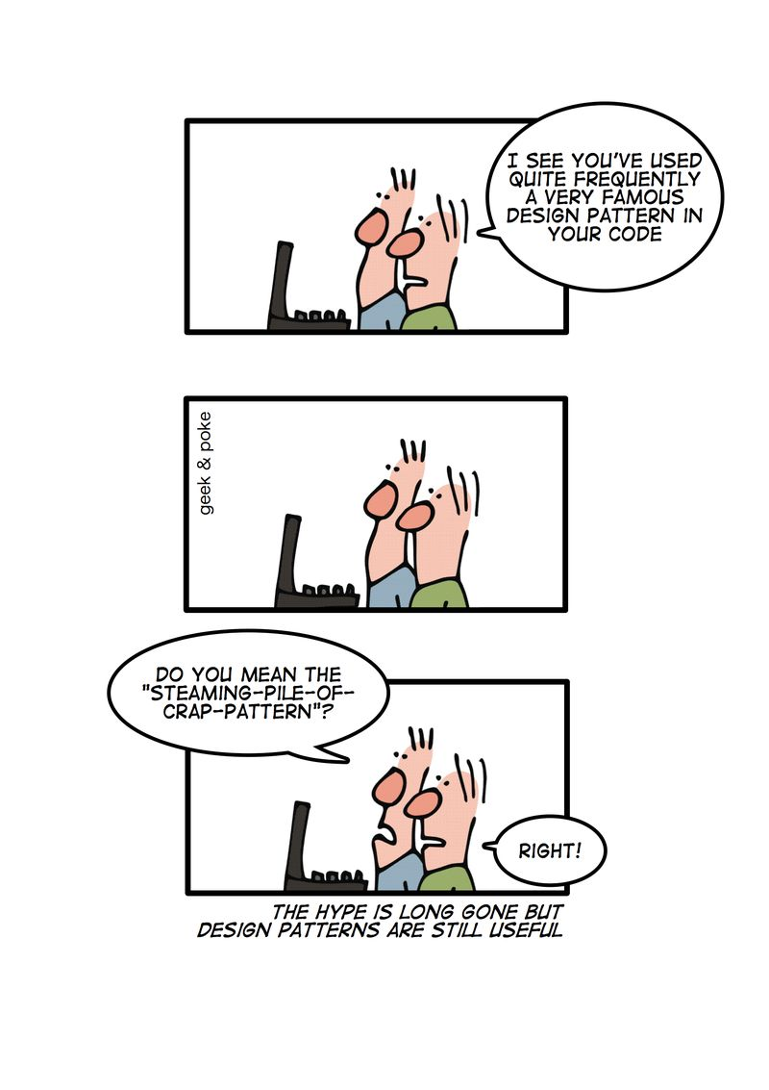
Software Development:
Design Pattern
“Program to an interface, not an implementation”
Abstract Factory Pattern
Krishna Kumar

Slide 2
Specifications:
We have an order processing unit, where we handle products from both Singapore and Europe. Develop a code to compute (print) the tax and shipment fees for each country.
Shipment fees:
  Singapore: $ 39.99
  Europe: $ 4.99
Tax fees:
  Singapore: $ 19.99
  Europe: $ 49.99

Slide 3
Let's look at a procedural implementation
See bad_code
Some of the Issues:
  Use of preprocessors
  Not modular
  The following code depends entirely on the order in which the new Shipping fee and tax are defined.
    fcountry[0]->compute(); //Shipping fee? (sure?)
    fcountry[1]->compute(); //Tax? (sure?)
  Error checking?
  No data encapsulation anyone can call display_finance()

Slide 4
How to make it better?
Let's start by looking at the common features.
  Shipment fees
  Tax
Do we know, when a particular type would be required by the client?
  No, so we need something more abstract.
  Shipment fees and Tax should be abstract base classes from which, we can derive for specific countries.
The derived classes are for specific cases (products) for Europe and Singapore. These classes are called concrete classes.
Why are they in the same class?

Slide 5
References
http://www.codeproject.com/Articles/331304/Understanding-and-Implementing-Abstract-Factory
http://sourcemaking.com/design_patterns/abstract_factory
http://www.netobjectives.com/resources/books/design-patterns-explained/
http://www.sourcetricks.com/2008/05/c-factory-pattern.html
http://www.bogotobogo.com/DesignPatterns/abstractfactorymethod.php

