Slide 1

Tuple & Variadic Templates
Krishna Kumar

Slide 2
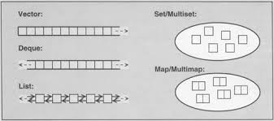
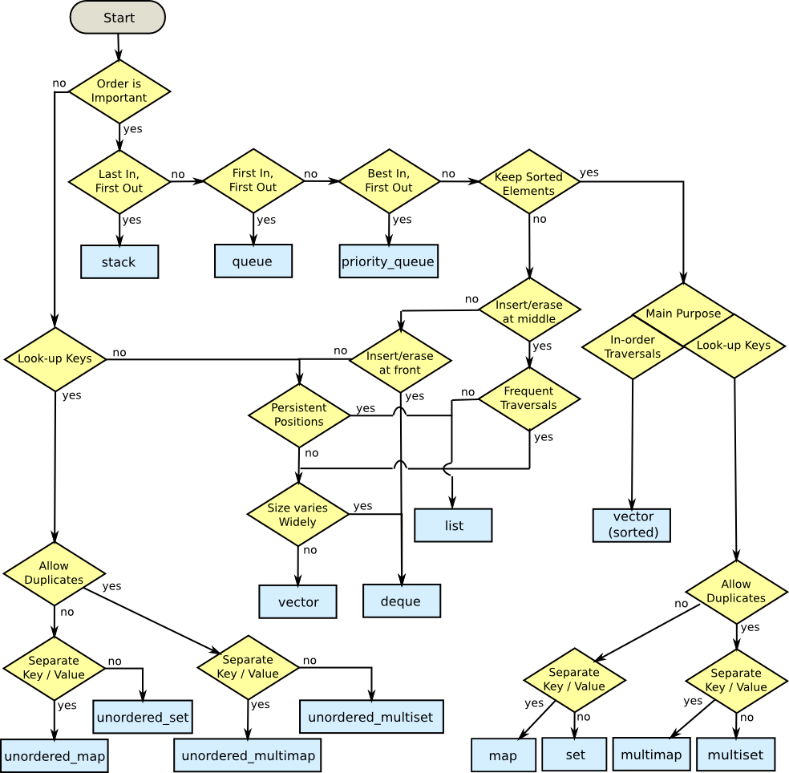
STL Containers

Slide 3
Tuple
Tuples are objects that pack elements of -possibly- different types together in a single object, just like pair objects do for pairs of elements, but generalized for any number of elements.
One way to imagine using a tuple is to hold a row of data in a database. The row might contain the attributes of a person, such as the person's name, account number, address, and so on. All the elements might have different types, but they all belong together as one row.
Conceptually, they are similar to plain old data structures (C-like structs) but instead of having named data members, its elements are accessed by their order in the tuple.
The selection of particular elements within a tuple is done at the template-instantiation level, and thus, it must be specified at compile-time, with helper functions such as get and tie.

Slide 4
Manipulating a tuple
Tuple Function | Explanation
make_tuple | Pack values in a tuple
forward_as_tuple | Pack Rvalue reference in the tuple
std::get<i>(mytuple) | Get element “i” in the tuple - mytuple
std::tie | Unpack values from a tuple
tuple_size<decltype(mytyple)>::value | Size of tuple
tuple_element<i, decltype(mytuple)>::type | Get element type of element “i” in mytuple
tuple_cat ( mytuple, std::tuple<int,char>(mypair) ) | Concatenate tuples

Slide 5
Tuple implementation
a class or function template to accept some arbitrary number (possibly zero) of “extra” template arguments.
This behaviour can be simulated for class templates in C++ via a long list of defaulted template parameters.
Tuple implementation:
  struct unused;
  template <typename T1 = unused,typename T2 = unused,
          typename T3 = unused, typename T4 = unused,
          /∗up to∗ / typename TN = unused>
  class tuple;
This tupletype can be used with anywhere from zero to N template arguments. Assuming that N is “large enough”, we could write:
  typedef tuple<char, short, int, long, long long> integraltypes;

Slide 6
Tuple implementation (cont...)
Of course, this tuple instantiation actually contains N − 5 unused parameters at the end, but presumably the implementation of tuple will somehow ignore these extra parameters. In practice, this means changing the representation of the argument list or providing a host of partial specializations:
  template <>
  class tuple<> { / ∗ handle zero-argument version. ∗ / } ;
  Template < typename T1 >
  Class tuple <T1>{/ ∗ handle one-argument version. ∗ /} ;
  Template < typename T1, typename T2>
  Class tuple <T1, T2> {/∗ handle two-argument version. ∗ /};
Unfortunately, it leads to a huge amount of code repetition, very long type names in error message.
It also has a fixed upper limit on the number of arguments that can be provided.

Slide 7
Variadic templates
Variadic templates let us explicitly state that tuple accepts one or more template type parameters
  template <typename... Elements> class tuple;
The ellipsis to the left of the Elements identifier indicates that Elements is a template type parameter pack.
A parameter pack is a new kind of entity introduced by variadic templates.
Unlike a parameter, which canonly bind to a single argument, multiple arguments can be “packed” into a single parameter pack.
Eg., declare an array class that supports an arbitrary number of dimensions:
  template <typename T, unsigned PrimaryDim, unsigned... Dim>
  class array { /* implementation */ };
  array<double, 3, 3> rotation_matrix; // 3 x 3 matrix

Slide 8
Packing and Unpacking Parameter Packs
To do anything with parameter packs, one must unpack (or expand) all of the arguments in the parameter pack into separate arguments, to be forwarded on to another template.
  template <typename... Args> struct count;
Basis case, zero arguments:
  template<>
  struct count<> {
    static const int value = 0;
  };

Slide 9
Packing & Unpacking (recursive)
The idea is to peel off the first template type argument provided to count, then pack the rest of the arguments into a template parameter pack to be counted in the final sum:
  template <typename T, typename... Args>
  struct count<T, Args...> {
    static const int value = 1 + count<Args...>::value;
  }
Whenever the ellipsis occurs to the right of a template argument, it is acting as a meta-operator that unpacks the parameter pack into separate arguments.
In the expression count <Args...>::value, this means that all of the arguments that were packed into Args will become separate arguments to the count template.
The ellipsis also unpacks a parameter pack in the partial specialization count<T, Args...>, where template argument deduction packs “extra” parameter passed to count into Args.
For instance, the instantiation of count<char, short, int>would select this partial specialization, binding T to char and Args to a list containing short and int.

Slide 10
Tuple implementation – Variadic template
template<typename... Elements>
class tuple; template<typename Head, typename... Tail >
class tuple < Head, Tail... > : private tuple < Tail... > {
  Head head;
  public:
    /∗ implementation ∗/
  };
template<>
class tuple<> {
  /∗zero-tuple implementation∗/
};

Slide 11
Variadic function
Variadic template parameters to functions have almost the same syntax as for classes, the only difference being that variadic function arguments can also be passed. For example, in the following code, the function output prints all its arguments separated by spaces.
  template <typename T>
  void output(T&& t) { std::cout << t; }
  template <typename First, typename... Args>
  void output(First&& f, Args&&... args) {
    std::cout << f << " ";
    output(std::forward<Args>(args)...);
  }
  output(1, 2, 45); // Will print 1 2 45
typename... Args is called a template parameter pack, and Args.. args is called a function parameter pack

Slide 12
Variadic templates for forwarding
Constructor is a commonly used construct that is inherently "variadic" when viewed from a template parameter point of view.
Given a generic type T, to invoke the constructor of T, we may need to pass in an arbitrary number of arguments.
Unlike function types that specify their arguments at compile time, given just a generic type T we don't know which constructor(s) it has and how many arguments the constructor accepts.
  std::unique_ptr<FooType> f = std::make_unique<FooType>(1, "str", 2.13);
  template<typename T, typename... Args>
  unique_ptr<T> make_unique(Args&&... args) {
  return unique_ptr<T>(new T(std::forward<Args>(args)...));
  }

Slide 13
References
Bjarne Stroustrup's “C++ Programming Language 4ed”
Scott Meyer's “Effective Modern C++”
Herb Sutter's Exceptional C++ and More Exceptional C++
C++ Templates: the Complete Guide
http://eli.thegreenplace.net/2014/variadic-templates-in-c/#id1
http://lbrandy.com/blog/2013/03/variadic_templates/
http://www.open-std.org/jtc1/sc22/wg21/docs/papers/2006/n2080.pdf

