Slide 1

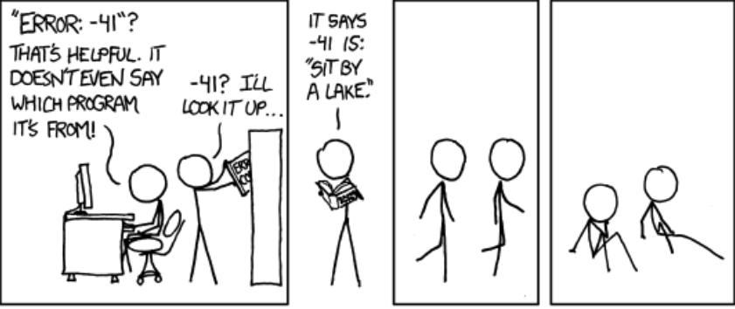
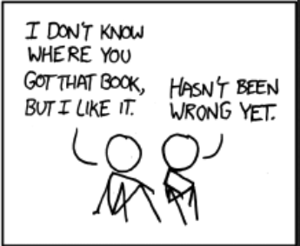
C++ Exception Handling (Part II)
http://xkcd.com/1024/
Krishna Kumar

Slide 2
Exceptions: They are not errors!
“some part of the system couldn’t do what it was asked to do”
Catching Exception:
void f() {
  try {
    throw E {};
  }
  catch(H) {
    // when do we get here?
  }
}

Slide 3
Catching Multiple Exceptions
try {
// Code to Try
}
catch(arg_1) {
// One Exception
}
catch(arg_2) {
// Another Exception
}

Slide 4
Object lifetimes
// Example code
{
Parrot& perch = Parrot();
}
When does an object's lifetime begin?
  When its constructor completes successfully and returns normally. That is, when control reaches the end of the constructor body or completes an earlier return statement
When does an object's lifetime end?
  When its destructor begins. That is, when control reaches the beginning of the destructor body

Slide 5
Constructor exception
{ Parrot& perch = Parrot(); }
The state of the object before its lifetime begins is exactly the same as after its lifetime ends: There is no object.
What does emitting an exception from a constructor mean?
  It means that construction has failed, the object never existed, its lifetime never began. Indeed, the only way to report the failure of construction—namely, the inability to correctly build a functioning object of the given type—is to throw an exception. Incidentally, this is why a destructor will never be called if the constructor didn't succeed—there's nothing to destroy

Slide 6
What exactly happens when a constructor emits an exception?
class C : private A
{
B b_;
};
In the C constructor, how can you catch an exception thrown from the constructor of a base subobject (such as A ) or a member object (such as b_ )?

Slide 7
Function try blocks
C::C()
try
: A ( /*...*/ ), b_( /*...*/ ) {}
catch( ... )
{
// We get here if either A::A() or B::B() throws.
}
If A::A() succeeds and then B::B() throws, the language guarantees that A::~A() will be called to destroy the already-created A base subobject before control reaches this catch block
Is this needed at all? In C++, if construction of any base or member subobject fails, the whole object's construction must fail.

Slide 8
Morals about function try blocks
Moral #1: Constructor function try block handlers are only good for translating an exception thrown from a base or member subobject constructor. They are not useful for any other purpose.
Moral #2: Destructor function try blocks have little or no practical use. Destructor should NEVER emit an exception.
Moral #3: All other function try blocks have no practical use.
Moral #4: Always perform unmanaged resource acquisition in the constructor body, never in initializer lists, i.e., Resource Allocation Is Initialisation (RAII).

