Slide 1
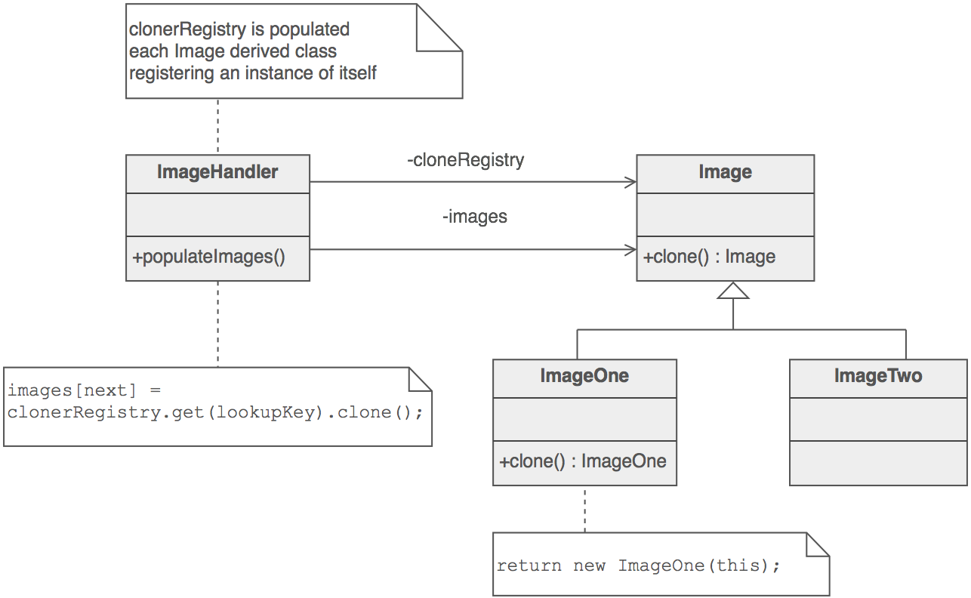
Prototype Design Pattern
Krishna Kumar

Slide 2
When to use Prototype?
When creating your programs, you'll probably led to instantiate objects of significant size in memory.
Create a large object poses little problems. But create several following may lead to kill the performance of your application.
The solution is to copy the base object, the prototype, and then change what needs to be for the new object meets the needs.

Slide 3
Prototype
class Prototype
{
public:
virtual ~Prototype();
virtual Prototype* Clone() const = 0;
};
// Implementation
ClassProduct* ClassProduct::Clone() const {
// copy constructor
return (new ClassProduct(*this));
}

Slide 4
Example
Develop a code to create multiple SQL DB
  Login
  Passwd
  db name

Slide 5
Example 2
Develop a code to create new documents
  XML Document
  Word File
  Spreadsheet
Using (Prototype + Factory)
Using templates for generalisation

Slide 6
Home Assignment
Create 2 course module
  Online course
    C++
    Java
    .Net
  Offline course
    Event Management
    Professional Ethics
    Communication Skills

