Slide 1

C++ Pointers
Krishna Kumar
Every computer, at the unreachable memory address 0x-1, stores a secret. I found it, and it is that all humans ar-- SEGMENTATION FAULT
XKCD (https://xkcd.com/138/)

Slide 2
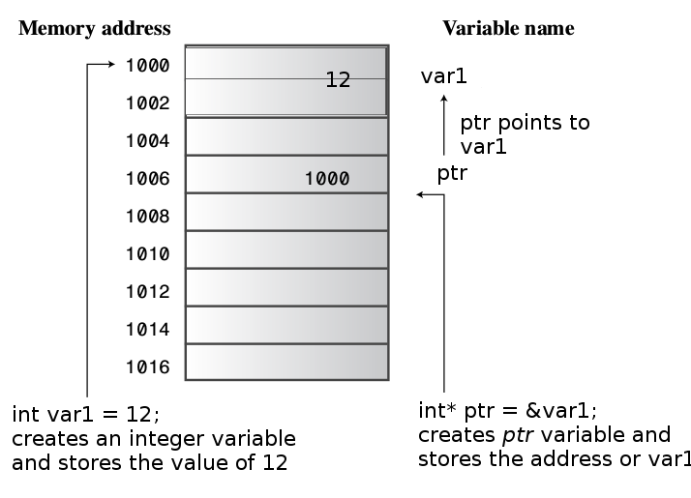
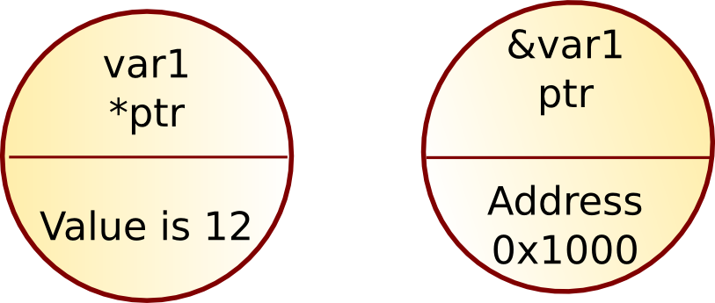
Pointer
Pointer values are memory addresses
      A pointer p can hold the address of a memory location
      A pointer points to an object of a given type
            E.g. a double* points to a double, not to a string

