Slide 1
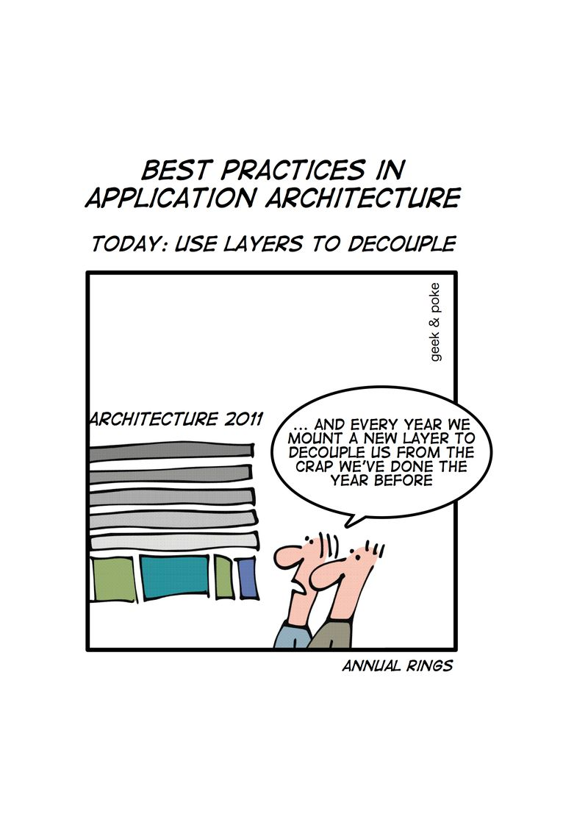
RTTI, Metaprogramming, Traits & Policy
Krishna Kumar

Slide 2
Run Time Type Information
RTTI refers to the ability of the system to report on the dynamic type of an object and to provide information about that type at runtime (as opposed to at compile time).
Terminologies:
  Casting from a base class to a derived class is often called a downcast because of the convention of drawing inheritance trees growing from the root down.
  Similarly, a cast from a derived class to a base is called an upcast.
  A cast that goes from a base to a sibling class, like the cast from Bbwin dow to Ival_box , is called a crosscast

Slide 3
dynamic_cast<T*>(p)
Works on pointers and references.
Consider
class Interface {
public:
virtual void GenericOp() = 0;// pure virtual function
};
class SpecificClass : public Interface {
public:
virtual void GenericOp();
virtual void SpecificOp();
};
Let's say that we also have a pointer of type Interface* ptr_interface;

Slide 4
dynamic_cast<T&>(p)
Supposing that a situation emerges that we are forced to presume but have no guarantee that the pointer points to an object of type SpecificClass and we would like to call the member SpecificOp() of that class.
SpecificClass* ptr_specific = dynamic_cast<SpecificClass*>(ptr_interface);
if( ptr_specific ){ // our suspicions are confirmed -- it really was a SpecificClass
ptr_specific->SpecificOp();
}else{ // our suspicions were incorrect -- it is definitely not a SpecificClass.
ptr_interface->GenericOp();
};
dynamic_cast, the program converts the base class pointer to a derived class pointer and allows the derived class members to be called. If the pointer that you are trying to cast is not of the correct type, then dynamic_cast will return a null pointer.
SpecificClass& ref_specific = dynamic_cast<SpecificClass&>(ref_interface);
References throw bad::cast exception, instead of a nullptr.

Slide 5
typeid (object)
The typeid operator, used to determine the class of an object at runtime.
It returns a reference to a std::type_info object, which exists until the end of the program, that describes the "object".
If the "object" is a dereferenced null pointer, then the operation will throw a std::bad_typeid exception.
The use of typeid is often preferred over dynamic_cast<class_type> in situations where just the class information is needed, because typeid, applied on a type or non de-referenced value is a constant-time procedure
It is generally only useful to use typeid on the dereference of a pointer or reference (i.e. typeid(*ptr) or typeid(ref)) to an object of polymorphic class type (a class with at least one virtual member function).
This is because these are the only expressions that are associated with run-time type information. The type of any other expression is statically known at compile time.

Slide 6
Overview of Templates
Function templates
template <class T> //typename T
void swap (T& x, T& y) {
  T temp = x;
  x = y;
  y = temp;
}
Function call
double a = 100., b = 1000.;
swap(a, b);

Slide 7
Templates & Class
// primary class template
template <typename T1, typename T2>
class MyClass {
...
  T1 variable;
  T2 fn(T1& arg);
};
// Specialisation
template<>
class Stack<std::string> {
private:
  // elements
  std::deque<std::string> elems;
public:
void push(std::string const&);
  ...
};

Slide 8
Member Type Aliases
The template argument name, T , is only accessible to the template itself, so for other code to refer to the element type, we must provide an alias.
typedefs don’t support templatization, but alias declarations do.
Alias templates avoid the “::type” suffix and, in templates, the “typename” prefix often required to refer to typedefs.
C++14 offers alias templates for all the C++11 type traits transformation
template<typename T>
class Vector {
public:
  using value_type = T;
  using iterator = Vector_iter<T>;
  // ...
};

Slide 9
Virtual Member Functions
Member function templates cannot be declared virtual.
This constraint is imposed because the usual implementation of the virtual function call mechanism uses a fixed-size table with one entry per virtual function.
However, the number of instantiations of a member function template is not fixed until the entire program has been translated.
In contrast, the ordinary members of class templates can be virtual because their number is fixed when a class is instantiated:
template <typename T>
class Dynamic {
public:
virtual ~Dynamic();
/* OK: one destructor per instance of Dynamic<T> */
template <typename T2>
virtual void copy (T2 const&);
/* ERROR: unknown number of instances of copy() given an instance of Dynamic<T> */
};

Slide 10
Requiring Member Functions
You want to write a class template C that can be instantiated only on types that have a member function named Clone() that takes no parameters and returns a pointer to the same kind of object.
// T must provide T* T::Clone() const
template<typename T>
class C
{
  // ...
};
It's obvious that if C writes code that just tries to invoke T::Clone() without parameters, then such code will fail to compile if there isn't a T::Clone() that can be called without parameters.It's obvious that if C writes code that just tries to invoke T::Clone() without parameters, then such code will fail to compile if there isn't a T::Clone() that can be called without parameters.

Slide 11
Initial attempt (sort of requires clone)
// T must provide /*...*/ T::Clone( /*...*/ )
template<typename T>
class C {
public:
  void SomeFunc( const T* t ) {
    // ...
    t->Clone();
  }
};
The first problem with this exmple is that In a template, only the member functions that are actually used will be instantiated. If SomeFunc() is never used, it will never be instantiated.
Put it in the constructor? What about multiple constructors?

Slide 12
How about in the destructor?
There is only one destructor, right?
// T must provide /*...*/ T::Clone( /*...*/ )
template<typename T>
class C {
public:
  ~C() {
    const T t; // kind of wasteful, plus also requires
          // that T have a default constructor
    t.Clone();
  }
};
just trying to call T::Clone() without parameters would also succeed in calling a Clone() that has defaulted parameters and/or does not return a T* for eg., void T::Clone().

Slide 13
Alternative way
// T must provide T* T::Clone() const
template<typename T>
class C {
  bool ValidateRequirements() const {
    T* (T::*test)() const = &T::Clone;
    test; // suppress warnings about unused variables
    return true;
  }
public:
  ~C() {// in C's destructor (easier than putting it in every C constructor):
    assert( ValidateRequirements() );
  }
};

Slide 14
Constraints
template<class Container>
void draw_all(Container& c) { for_each(c.begin(),c.end(),mem_fun(&Shape::draw)); }
If there is a type error, it will be in the resolution of the fairly complicated for_each() call. For example, if the element type of the container is an int, then we get some kind of obscure error related to the for_each() call (because we can't invoke Shape::draw() for an int).
To catch such errors early, we can write:
template<class Container>
void draw_all(Container& c) {
Shape* p = c.front(); // accept only containers of Shape*s
for_each(c.begin(),c.end(),mem_fun(&Shape::draw));
}
The initialization of the spurious variable "p" will trigger a comprehensible error message from most current compilers.

Slide 15
Constraints
template<class Container>
void draw_all(Container& c) {
  typedef typename Container::value_type T;
  Can_copy<T,Shape*>(); // accept containers of only Shape*s
  for_each(c.begin(),c.end(),mem_fun(&Shape::draw));
}
This makes it clear that I'm making an assertion. The Can_copy template can be defined like this:
template<class T1, class T2> struct Can_copy {
  static void constraints(T1 a, T2 b) { T2 c = a; b = a; }
  Can_copy() { void(*p)(T1,T2) = constraints; }
};
Can_copy checks (at compile time) that a T1 can be assigned to a T2. Can_copy<T,Shape*> checks that T is a Shape* or a pointer to a class publicly derived from Shape or a type with a user-defined conversion to Shape*.

Slide 16
Constraints Classes
// HasClone requires that T must provide T* T::Clone() const
template<typename T>
class HasClone {
public:
  static void Constraints() {
    T* (T::*test)() const = &T::Clone;
    test; // suppress warnings about unused variables
  }
  HasClone() { void (*p)() = Constraints; }
};
template<typename T>
class C : HasClone<T> { // … };
The idea is simple: Every C constructor must invoke the HasClone<T> default constructor, which does nothing but test the constraint. If the constraint test fails, most compilers will emit a fairly readable error message. The HasClone<T> derivation amounts to an assertion about a characteristic of T in a way that's easy to diagnose.

Slide 17
The Problem
In the iostream library, the interface to streambuf (as in stdio before it) depends on a value of EOF which is distinct from all character values. In traditional libraries, therefore, the type of EOF was int, and the function that retrieves characters returned an int:
class streambuf {
  int sgetc(); // return the next character, or EOF.
  int sgetn(char*, int N); // get N characters.
};
What happens when we parameterize streambuf on the character type? We need not only a type for the character, but for the type of the EOF value. Here's a start:
template <class charT, class intT>
class basic_streambuf {
  intT sgetc();
  int sgetn(charT*, int N);
};
The extra template parameter clutters things up. Users of iostream don't care what the end-of-file mark is, or its type, and shouldn't need to care. Worse, what value should sgetc() return at end-of-file? Must this be another template parameter? The effort is getting out of hand.

Slide 18
Traits technique
“a class that encapsulates a set of types and functions necessary for template classes and template functions to manipulate objects of types for which they are instantiated.”
template <class charT>
struct ios_char_traits { };
// Specialisation
struct ios_char_traits<char> {
typedef char char_type;
typedef int int_type;
static inline int_type eof() { return EOF; }
};

Slide 19
Traits technique
Notice that ios_char_traits<char> has no data members; it only provides public definitions. Now we can define our streambuf template:
template <class charT>
class basic_streambuf {
public:
typedef ios_char_traits<charT> traits_type;
typedef traits_type::int_type int_type;
int_type eof() { return traits_type::eof(); }
...
int_type sgetc();
int sgetn(charT*, int N);
};

Slide 20
Another example Traits
template <class numT>
struct float_traits { };
struct float_traits<float> {
typedef float float_type;
enum { max_exponent = FLT_MAX_EXP };
static inline float_type epsilon() { return FLT_EPSILON; }
};
struct float_traits<double> {
typedef double float_type;
enum { max_exponent = DBL_MAX_EXP };
static inline float_type epsilon() { return DBL_EPSILON; }
};

Slide 21
Accumulating a Sequence
Let's first assume that the values of the sum we want to compute are stored in an array, and we are given a pointer to the first element to be accumulated and a pointer one past the last element to be accumulated.
template <typename T>
T accum (T const* beg, T const* end) {
T total = T(); // assume T() actually creates a zero value
while (beg != end) {
total += *beg;
++beg;
}
return total;
}

Slide 22
Accumulating a sequence: Implementation
int main() {
  // create array of 5 integer values
  int num[]={1,2,3,4,5};
  // print average value
  std::cout << "the average value of the integer values is "
        << accum(&num[0], &num[5]) / 5 << '\n';
  // create array of character values
  char name[] = "templates";
  int length = sizeof(name)-1;
  std::cout << "the average value of the characters in “ << name << “ is "
<< accum(&name[0], &name[length]) / length << '\n';
}
the average value of the integer values is 3
the average value of the characters in "templates" is -5 (expected ASCII 97 - 102)
Total is also of type char

Slide 23
Trait class
An alternative approach to the extra parameter is to create an association between each type T for which accum() is called and the corresponding type that should be used to hold the accumulated value. This association could be considered characteristic of the type T, and therefore the type in which the sum is computed is sometimes called a trait of T. As is turns out, our association can be encoded as specializations of a template:
template<typename T>
class AccumulationTraits;
template<>
class AccumulationTraits<char> {
  public:
  typedef int AccT;
};

Slide 24
Parameterized Traits
The use of traits in accum() in the previous section is called fixed, because once the decoupled trait is defined, it cannot be overridden in the algorithm. There may be cases when such overriding is desirable. For example, we may happen to know that a set of float values can safely be summed into a variable of the same type, and doing so may buy us some efficiency.
In principle, the solution consists of adding a template parameter but with a default value determined by our traits template. In this way, many users can omit the extra template argument, but those with more exceptional needs can override the preset accumulation type. The only bee in our bonnet for this particular case is that function templates cannot have default template arguments.
For now, let's circumvent the problem by formulating our algorithm as a class. This also illustrates the fact that traits can be used in class templates at least as easily as in function templates. The drawback in our application is that class templates cannot have their template arguments deduced. They must be provided explicitly. Hence, we need the form
Accum<char>::accum(&name[0], &name[length])

Slide 25
Policy and policy class
So far we have equated accumulation with summation. Clearly we can imagine other kinds of accumulations. For example, we could multiply the sequence of given values. Or, if the values were strings, we could concatenate them. Even finding the maximum value in a sequence could be formulated as an accumulation problem.
In all these alternatives, the only accum() operation that needs to change is total += *start.
This operation can be called a policy of our accumulation process. A policy class, then, is a class that provides an interface to apply one or more policies in an algorithm.

Slide 26
Policy
template <typename T, typename Policy = SumPolicy,
typename Traits = AccumulationTraits<T> >
class Accum {
public:
typedef typename Traits::AccT AccT;
static AccT accum (T const* beg, T const* end) {
AccT total = Traits::zero();
while (beg != end) {
Policy::accumulate(total, *beg);
++beg;
}
return total;
}
};

Slide 27
References
Bjarne Stroustrup's “C++ Programming Language 4ed”
Scott Meyer's “Effective Modern C++”
Herb Sutter's Exceptional C++ and More Exceptional C++
C++ Templates: the Complete Guid
http://www.gotw.ca/publications/mxc++-item-4.htm
http://accu.org/index.php/journals/442
http://www.cs.rpi.edu/~musser/design/blitz/traits.html
http://www.cantrip.org/traits.html
http://erdani.com/publications/traits.html
http://erdani.com/publications/traits_on_steroids.html

