Slide 1
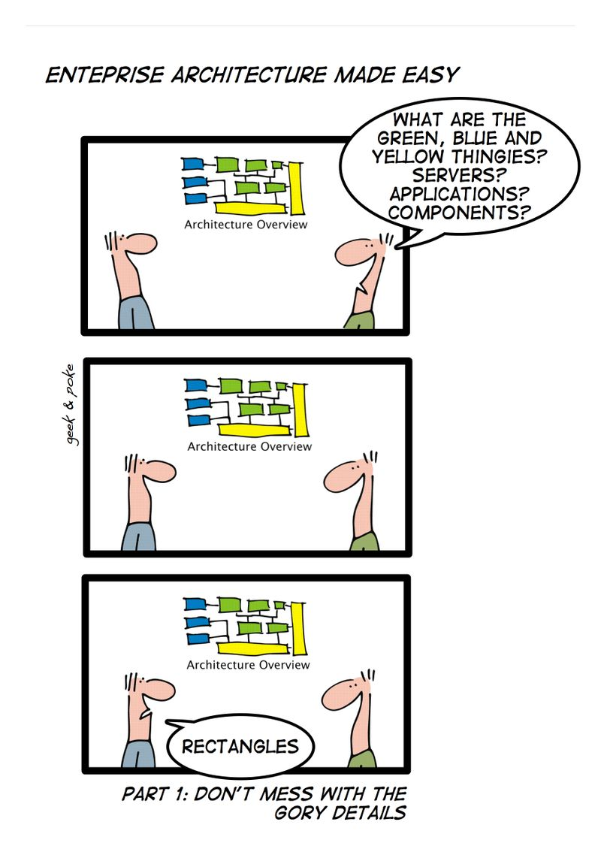
Tuple & Variadic Templates
Krishna Kumar

Slide 2
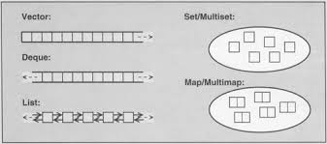
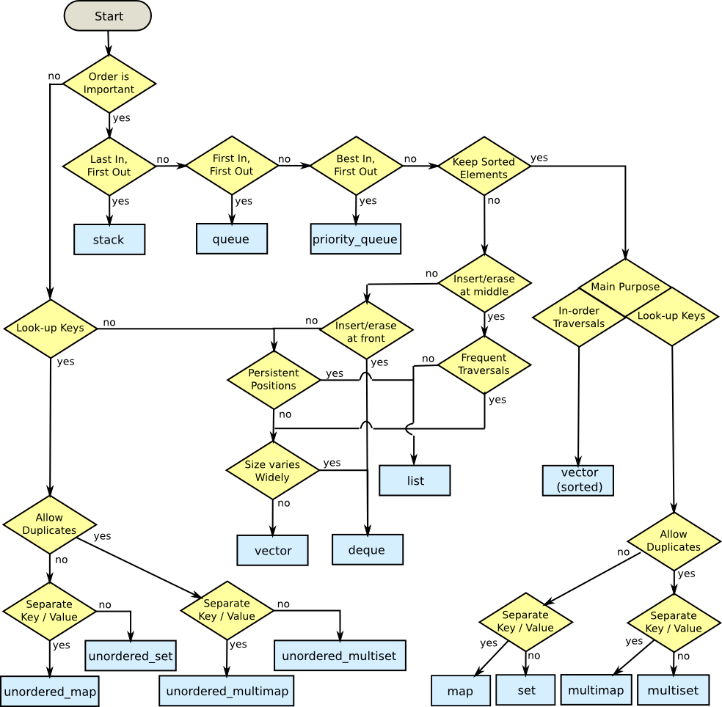
STL Containers

Slide 3
Tuple
Tuples are objects that pack elements of -possibly- different types together in a single object, just like pair objects do for pairs of elements, but generalized for any number of elements.
One way to imagine using a tuple is to hold a row of data in a database. The row might contain the attributes of a person, such as the person's name, account number, address, and so on. All the elements might have different types, but they all belong together as one row.
Conceptually, they are similar to plain old data structures (C-like structs) but instead of having named data members, its elements are accessed by their order in the tuple.
The selection of particular elements within a tuple is done at the template-instantiation level, and thus, it must be specified at compile-time, with helper functions such as get and tie.

Slide 4
Manipulating a tuple
Tuple Function | Explanation
make_tuple | Pack values in a tuple
forward_as_tuple | Pack Rvalue reference in the tuple
std::get<i>(mytuple) | Get element “i” in the tuple - mytuple
std::tie | Unpack values from a tuple
tuple_size<decltype(mytyple)>::value | Size of tuple
tuple_element<i, decltype(mytuple)>::type | Get element type of element “i” in mytuple
tuple_cat ( mytuple, std::tuple<int,char>(mypair) ) | Concatenate tuples

Slide 5
References
Bjarne Stroustrup's “C++ Programming Language 4ed”
Scott Meyer's “Effective Modern C++”
Herb Sutter's Exceptional C++ and More Exceptional C++
C++ Templates: the Complete Guide
http://www.open-std.org/jtc1/sc22/wg21/docs/papers/2006/n2080.pdf

