Slide 1
Sampling Circuit
Presented By-
Zainab Patel
Karan Shah
Srishti Shukla
Nirali Shah

Slide 2
NEED FOR SAMPLING
A CT signal cannot be processed in the digital processor or computer.
To enable digital transmission of CT signals.

Slide 3
DEFINITION OF SAMPLING
Sampling is the reduction of a continuous signal to discrete signal. A common example is a conversion of a sound wave to a sequence of samples. A sample refers to a value or set of values at a point in time and/or space.
Sampling can be done for functions varying in space, time, or any other dimension and similar results are obtained in two or more dimensions.

Slide 4
Nyquist Rate &Interval
The no of samples required for sampling is determined by Nyquist rate.
When the sampling rate becomes exactly equal to ‘2W’ samples/sec , for a given band width of W hertz, then it is called Nyquist rate
Nyquist interval is the time interval between any two adjacent samples when sampling rate is Nyquist rate.

Slide 5
Effects Of Under Sampling [Aliasing]
When the high Frequency interferes with low frequency and appears as low frequency , then the phenomenon is called Aliasing.
Aliasing can be avoided by following two methods
Sampling rate Fs > 2W
When the sampling rate is made higher than 2W, then the spectrums will not overlap and there will be sufficient gap between the individual spectrums.
Bandlimiting the signal
Low pass filter is used before sampling the signals . The output of low pass filter is strictly bandlimited and there are no frequency components higher than W. And hence there will be no Aliasing.

Slide 6
Types of
Sampling
Impulse
Sampling
Chopper
Sampling
Rectangular
Pulse
Sampling

Slide 7
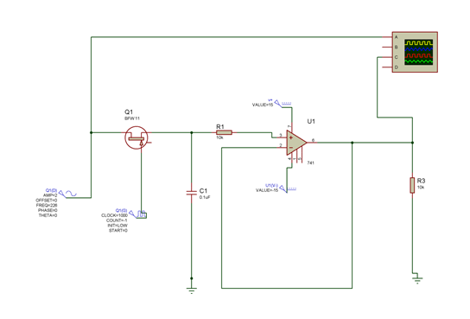
Simulation Of Circuit On Proteus

Slide 8
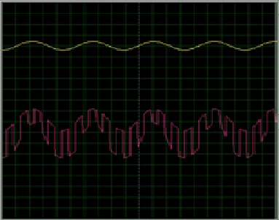
OUTPUT OF SIMULATION IN PROTEUS

Slide 9
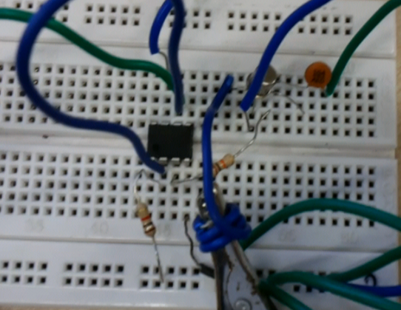
Implementation Of Circuit On Bread board

Slide 10
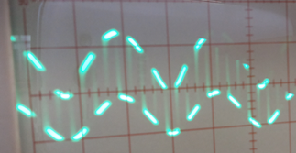
OUTPUT ON CRO

Slide 11
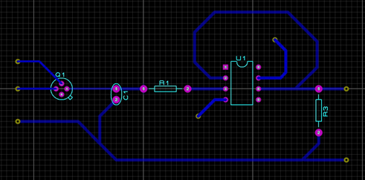
DESIGNING OF PCB LAYOUT

Slide 12
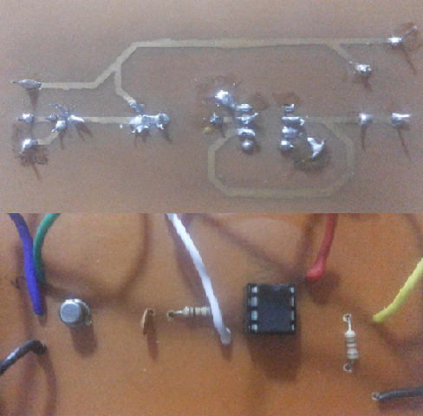
SOLDERED PCB LAYOUT

Slide 13
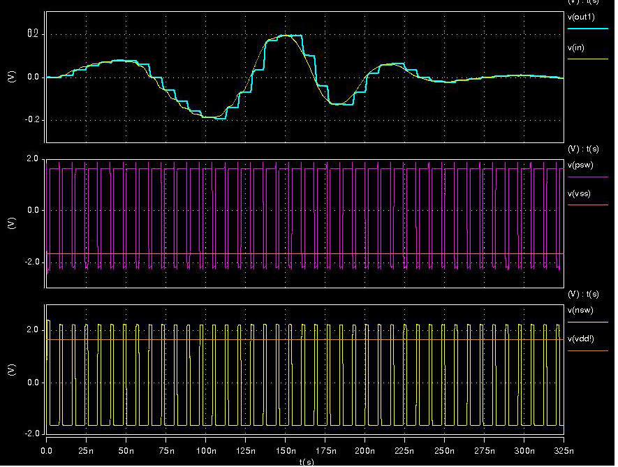
IMPROVISED OUTPUT VIA DIFFERENT COMPONENTS

Slide 14
Application
Of
Sampling
3D
sampling
Audio
sampling
Bit
depth
Video
sampling

Slide 15
Thank You

