Slide 1


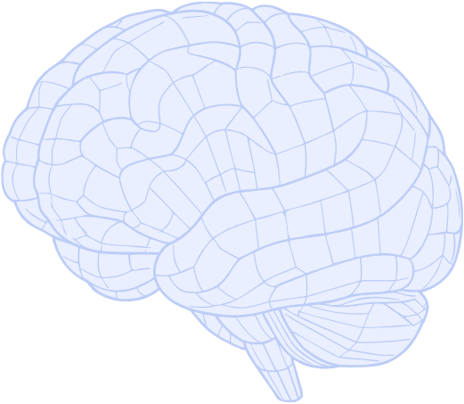

Company Name
Practical AI training for professionals
AI Roadmap

Slide 2
Overview of Today’s Session
Part 1
Part 2
Part 3
Part 4
Concepts
Applications
Details that are related to the relevant information.
Prompt
Details that are related to the relevant information.
Guidelines
Details that are related to the relevant information.
Details that are related to the relevant information.
Add a short description
Add a short description
Add a short description
Add a short description
Add a short description
Add a short description
Add a short description
Add a short description

Slide 3

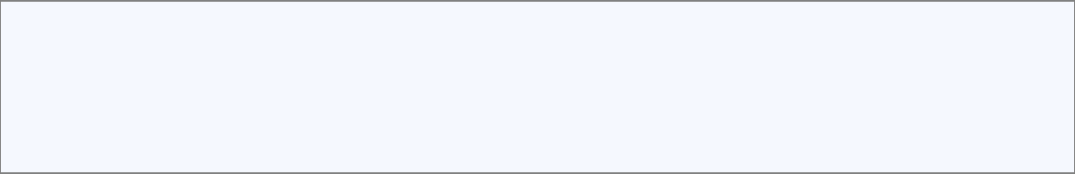
In what situations did you use it?
Add more details about your design project. Enter relevant details here.Add more details about your design project. Add more details about your design project.

Slide 4

Why AI Now?
Explain the relevant details that are related to the relevant information. Add a short description about the topic. Explain the relevant details that are related to the relevant information.

Slide 5



Key Output Types of AI
Core definition
Short description about the topic. Relevant details that are related to the information. Short description.
Core definition
Output types
Short description about the topic. Relevant details that are related to the information. Short description.
Add a short description about the topic. Explain the relevant details that are related to the information.
Modern AI
Short description about the topic. Relevant details that are related to the information. Short description.

Slide 6




Key Output Types of
Generative AI
Please enter relevant details here
Please add a short description about the topic. Explain the relevant details that are related to the relevant information. Relevant details that are related to the information. Please add a short description about the topic.
Text
Information
Image
Idea
Relevant details that are related to the relevant information.
Relevant details that are related to the relevant information.
Relevant details that are related to the relevant information.
Relevant details that are related to the relevant information.
Add a short description
Add a short description
Add a short description
Add a short description
Add a short description
Add a short description
Add a short description
Add a short description

Slide 7

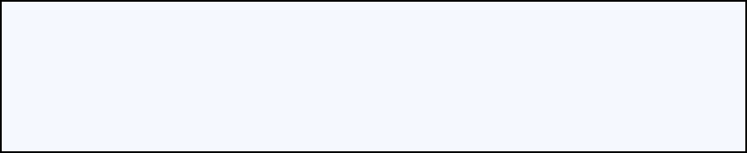
AI Use Cases
The fastest way to understand Gen AI is to see real examples
1. Review the outcome created by AI
2. Learn how to write the prompt that produces it

Slide 8
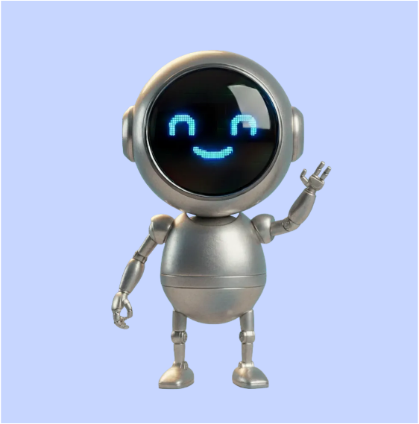
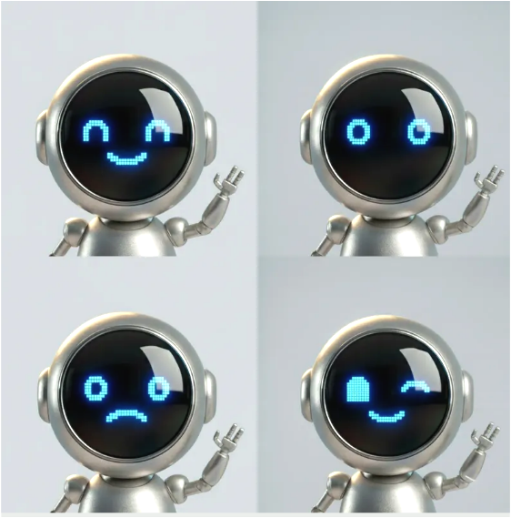
AI Use Cases
Before
After
Add a short description about the topic. Explain the relevant details that are related to the relevant information. Add a short description about the topic. Explain the relevant details that are related to the relevant information.
Add a short description about the topic. Explain the relevant details that are related to the relevant information.
Add a short description about the topic. Explain the relevant details that are related to the relevant information.

Slide 9





Major Benefits of Using AI
Item A
Item B
100
50
90%
Improved work focus
Add a short description about the topic. Explain the relevant details that are related to the relevant information. Add a short description about the topic. Explain the relevant details that are related to the relevant information. Add a short description about the topic. Explain the relevant details that are related to the relevant information. Add a short description about the topic. Explain the relevant details that are related to the relevant information.
40%
0
Keyword
Keyword

Slide 10








Role-based AI Applications
Marketing
Sales
Short description about the topic.
Explain the relevant details that are related to the relevant information.
Short description about the topic.
Explain the relevant details that are related to the relevant information.
Operations/HR
Project Execution
Short description about the topic.
Explain the relevant details that are related to the relevant information.
Short description about the topic.
Explain the relevant details that are related to the relevant information.

Slide 11








Role-based AI Workflow
Improved work focus
Add a short description about the topic. Explain the relevant details that are related to the relevant information. Explain the relevant details that are related to the relevant information.
Step 1
Step 2
Step 3
Input
Generate
Edit
Apply
Add a short description about the topic.
Add a short description about the topic.
Add a short description about the topic.
Add a short description about the topic.

Slide 12
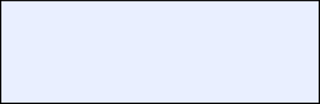

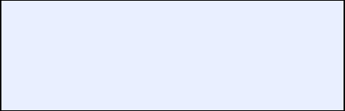

Practice 1: Prompt Writing
Start
Step 1
Step 2
Step 3
Step 4
Share the completed prompt
Add constraints
Provide context and purpose
Description about the topic. Relevant details that are related to the relevant information.
Define the role
Description about the topic. Relevant details that are related to the relevant information.
Description about the topic. Relevant details that are related to the relevant information.
Description about the topic. Relevant details that are related to the relevant information.

Slide 13


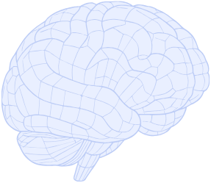

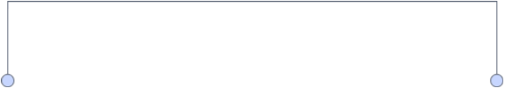
Case Study
Problem Overview
Relevant details that are related to the information. Short description about the topic.
Process of using AI
Relevant details that are related to the information. Short description about the topic.
Main Keyword
Final work outcome
Relevant details that are related to the information. Short description about the topic.

Slide 14







Basic Principles for Using AI Safely
Check for copyright
Explain the relevant details that are related to the relevant information.
AI Use Transparency
Work Changes
Data Alert
AI is a “support tool,”
and final decisions must be made by humans.
Explain the relevant details that are related to the relevant information.
Explain the relevant details that are related to the relevant information.

Slide 15









Comparison of AI Tool Types
Conversational AI
Analytical Insight AI
Explain the relevant details that are related to the relevant information
Explain the relevant details that are related to the relevant information.
Main
Keyword
Office-integrated AI
Summary-focused AI
Explain the relevant details that are related to the relevant information
Explain the relevant details that are related to the relevant information.

Slide 16

Next Steps
Advanced prompt training
Please click on the reference link provided to access additional information and resources.
Role-Based Case Studies
Please click on the reference link provided to access additional information and resources.
Practice template downloads
Please click on the reference link provided to access additional information and resources.
Team application guides
Please click on the reference link provided to access additional information and resources.

Slide 17
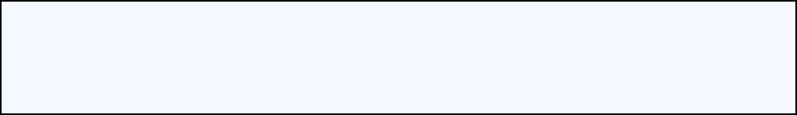
Thank you
The AI techniques you learned today will help improve your work efficiency.
Try applying it right away, even in small ways.

