Slide 1
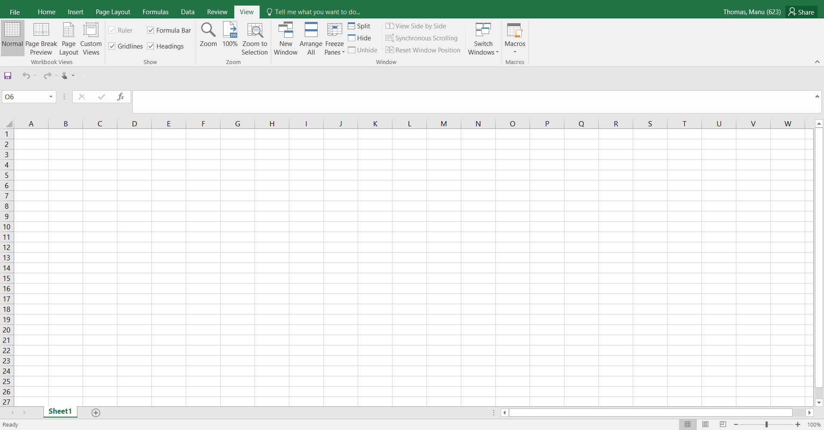
Basic Excel Operations

Slide 2

Agenda :-
Introduction to Excel
Overview of Excel Functions and Features.
Format Cells
Find & Select
Data Validation Features
Flash Fill in Excel
Pivots & Charts Excel
Basic Formulas
Text Columns
Shortcuts

Slide 3
Introduction
Microsoft Excel is one of the most used software applications of all time. Hundreds of millions of people around the world use Microsoft Excel. You can use Excel to enter all sorts of data and perform financial, mathematical or statistical calculations.
Excel applications can be linked / connect with other office applications to automate day to day works. Ex: Mail Merge.

Slide 4
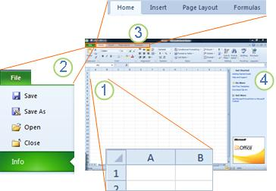
Overview of Excel Functions and Features
1.Columns (labeled with letters) and rows (labeled with numbers) make up the cells of your worksheet
2. Clicking the File tab opens the Backstage view of your workbook, where you can open and save files, get information about the current workbook, and perform other tasks that do not have to do with the content of the workbook, such as printing it or sending a copy of it in e-mail.
3. Each tab in the ribbon displays commands that are grouped by task. You'll probably spend most of your time using the Home tab, when you're entering and formatting data. Use the Insert tab to add tables, charts, pictures, or other graphics to your worksheet. Use the Page Layout tab to adjust margins and layout, especially for printing
4. The pane along the side of the Excel Starter window includes links to Help and shortcuts to templates and clip art, to give you a head-start on creating workbooks for specific tasks

Slide 5
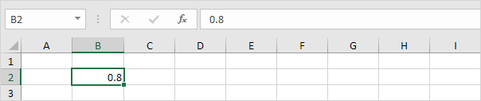
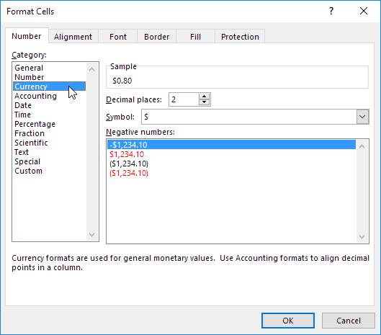
Format Cells
When we format cells in Excel, we change the appearance of a number without changing the number itself. We can apply a number format (0.8, $0.80, 80%, etc) or other formatting (alignment, font, border, etc).
1. Enter the value 0.8 into cell B2 and select Cell B2.
2.Right click, and then click Format Cells (or press CTRL + 1)
3.For example, select Currency.

Slide 6
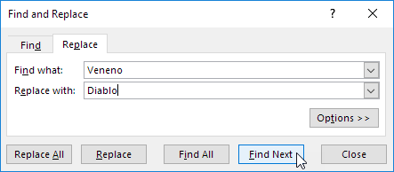
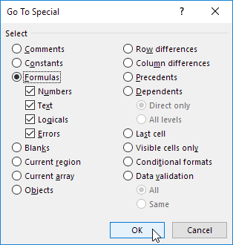
Find and Select
You can use Excel's Find and Replace feature to quickly find specific text and replace it with other text. You can use Excel's Go To Special feature to quickly select all cells with formulas, comments, conditional formatting, constants, data validation, etc.
Find - To quickly find specific text, execute the following steps
Replace - To quickly find specific text and replace it with other text, execute the following steps.
Go To Special - You can use Excel's Go To Special feature to quickly select all cells with formulas, comments, conditional formatting
, constants, data validation

Slide 7

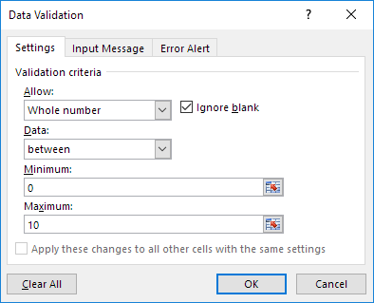
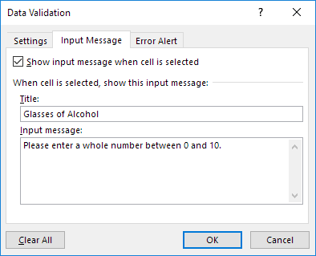
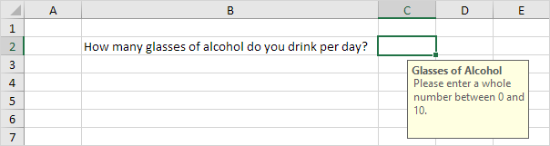
Data Validation
When setting up a workbook for your users, you may often want to control information input into specific cells to make sure all data entries are accurate and consistent. Among other things, you may want to allow only particular data type such as numbers or dates in a cell, or limit numbers to a certain range and text to a given length.
Excel Data Validation is a feature that restricts (validates) user input to a worksheet. Technically, you create a validation rule that controls what kind of data can be entered into a certain cell.
- Select cell C2 &On the Data tab, in the Data Tools group, click Data Validation.
In the Allow list, click Whole number.
In the Data list, click between.
Enter the Minimum and Maximum values
On the Input Message tab
Check 'Show input message when
cell is selected'.
2. Enter a title.
3. Enter an input message.
Data Validation Result

Slide 8
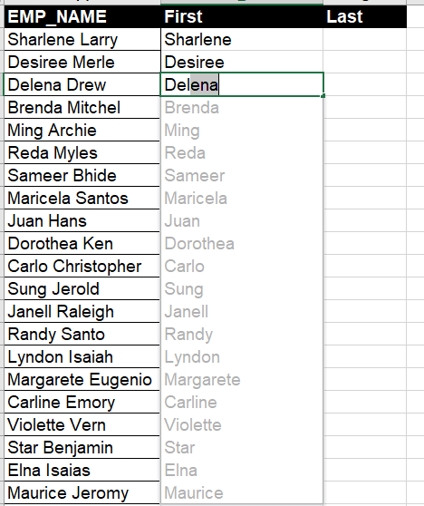
Flash Fill in Excel
Flash Fill automatically fills your data when it senses a pattern. For example, you can use Flash Fill to separate first and last names from a single column or combine first and last names from two different columns
Note: -Flash Fill is only available in Excel 2013 and later.

Slide 9
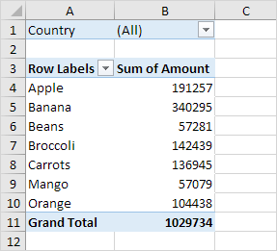
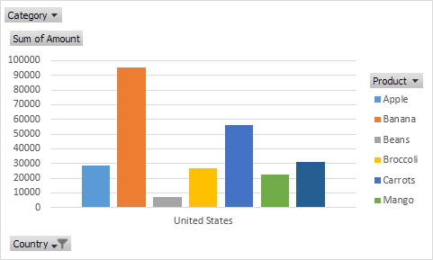
Pivots & Charts in Excel
Pivot Tables & Data Bars - A pivot table is a data summarization tool that is used in the context of data processing.
Pivot Charts - A pivot chart is the visual representation of a pivot table in Excel.

Slide 10
Basic Formulas
1. SUM - =SUM(A1:A3)
2. UPPER & LOWER - =UPPER( text )
3. AVERAGE - =AVERAGE(A1:A3)
4. TODAY - =TODAY()-10
5. AutoSum - AutoSum
6. NOW - =NOW()

Slide 11
Text to Columns
Select the cell or column that contains the text you want to split.
Select Data > Text to Columns.
In the Convert Text to Columns Wizard, select Delimited > Next.
Select the Delimiters for your data. For example, Comma and Space. You can see a preview of your data in the Data preview window.
Select Next.
Select the Column data format or use what Excel chose for you.
Select the Destination, which is where you want the split data to appear on your worksheet.
Select Finish.

Slide 12
Excel Shortcuts
Ctrl+N: - Create a new workbook
Ctrl+S: - Save a workbook
Ctrl+W: - Close a workbook
Ctrl+F4: - Close Excel
Ctrl+Z: - Undo an action
Ctrl+F: - Search in a spreadsheet, or use Find and Replace
More shortcuts are available in below excel sheet

Slide 13


