Slide 1
INTRODUCTION TO STATISTICS
Session 3
April 24th 2017
Madoka Takeuchi

Slide 2
Descriptive statistics
When doing research, it is important to describe the data that you will be working with.
The most fundamental information that should be reported are-
The size of the sample/data
The center of the sample/data
The spread of the the sample/data
The shape and distribution of the sample/data

Slide 3
Review: Measures of Center
 | Always exist | Use all the data | Affected by extreme data
Mean | Yes | Yes | Yes
Median | Yes | Yes | No
Mode | No | No | No
The Mean is used in computing other statistics, such as the variance
-It is often not appropriate for skewed distributions
The Median is the center number and is good for skewed distributions because it is resistant to change.

Slide 4
Review: Measures of Spread
Range -simplest measure of variation
Range= Maximum-minimum
Since the range only uses the largest and smallest values, it is greatly affected by extreme values
Variance- uses all the data
We want to see how much each point is deviated from the mean- could subtract each data point from the mean, sum all the differences and divide by N to find the average deviation in the data- average deviation
The problem with the average deviation is that the summation is always zero
Σ(x-μ）/ N

Slide 5

Review: Measures of Spread cont`d
To keep the deviation from the mean from summing to zero, square each individual deviations from the mean- called the variance
σ²=Σ(x-μ)²/N
There is a problem with variances since the deviations were squared resulting in the units also being squared- can be easily fixed by taking the square root- called the Standard deviation

Slide 6
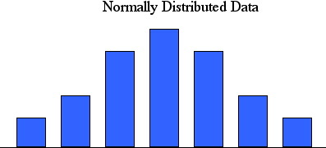
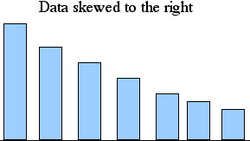
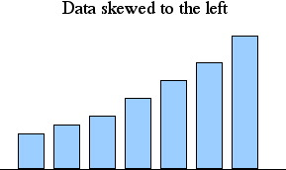
Measures of Shape
A histogram is a visual aid that can show the shape of the data
Mean= Median
Median< Mean
Mean < Median

Slide 7
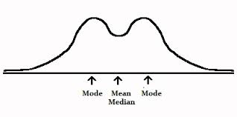
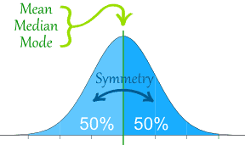
Normal Distribution
Properties
Mean= median
Symmetrical
Unimodal- single peak

Slide 8
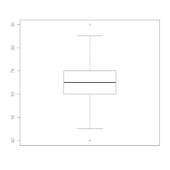
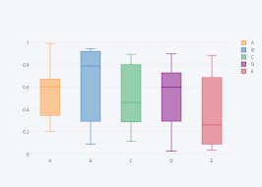
Boxplot
We saw that outliers affect the measures of center and spread.
Often, outliers are easiest to identify on a boxplot

Slide 9
SPSS: Histogram
ANALYZE> FREQUENCIES>CHART>HISTOGRAMS
Option to show normal curve on the histogram
Bar chart is very similar to histogram
Histogram is always in frequencies but bar chart can be in percentages
Build a bar chart to see the difference!

Slide 10
SPSS: Boxplot
GRAPHS>LEGACY DIALOGS>BOXPLOT
Choose simple
In the data in chart are box choose:
summary of separate variables- when want to get summary of the variable- i.e boxplot of weight
Summary for groups of cases- when want to get a boxplot for a variable separate by category- i.e. boxplot of weight by gender
Need to define category in the category axis box

Slide 11
In class exercise- SPSS
Data was collected on 12 students regarding average daily hours spent watching tv and hours of sleep
Input the data into spss
Describe the data-give the sample size, measures of center, measures of spread for each variable
By looking at the relationship between the mean the median, what can be said about the distribution for the hours spent watching tv and hours of sleep?

Slide 12
Initials | year | tv | sleep
AB | 1 | 3 | 6
BC | 4 | 6 | 7
CD | 1 | 2 | 5
DE | 2 | 4 | 6
EF | 2 | 5 | 8
FG | 2 | 3 | 5
GH | 2 | 4 | 6
HI | 2 | 2 | 6.5
IJ | 2 | 3 | 7
JK | 1 | 1 | 3.5
KL | 1 | 3 | 12
LM | 2 | 3 | 6

