Slide 1
INTRODUCTION TO STATISTICS
Session 4
May 1st 2017
Madoka Takeuchi

Slide 2
Review: Measures of Center
 | Always exist | Use all the data | Affected by extreme data
Mean | Yes | Yes | Yes
Median | Yes | Yes | No
Mode | No | No | No
The Mean is used in computing other statistics, such as the variance
-It is often not appropriate for skewed distributions
The Median is the center number and is good for skewed distributions because it is resistant to change.

Slide 3
Initials | year | tv | sleep
AB | 1 | 3 | 6
BC | 4 | 6 | 7
CD | 1 | 2 | 5
DE | 2 | 4 | 6
EF | 2 | 5 | 8
FG | 2 | 3 | 5
GH | 2 | 4 | 6
HI | 2 | 2 | 6.5
IJ | 2 | 3 | 7
JK | 1 | 1 | 3.5
KL | 1 | 3 | 12
LM | 2 | 3 | 6

Slide 4
In class exercise- SPSS
Data was collected on 12 students regarding average daily hours spent watching tv and hours of sleep
Input the data into spss
How was the initial variable inputted?
Describe the data-give the sample size, measures of center, measures of spread for each variable
By looking at the relationship between the mean the median, what can be said about the distribution for the hours spent watching tv and hours of sleep?
Distribution can be visualized using graphs- boxplot/histograms…

Slide 5
SPSS: Histogram
ANALYZE> FREQUENCIES>CHART>HISTOGRAMS
Option to show normal curve on the histogram
Bar chart is very similar to histogram
Histogram is always in frequencies but bar chart can be in percentages
Build a bar chart to see the difference!

Slide 6
SPSS: Boxplot
GRAPHS>LEGACY DIALOGS>BOXPLOT
Choose simple
In the data in chart are box choose:
summary of separate variables- when want to get summary of the variable- i.e boxplot of weight
In the previous exercise- boxplot of hours of TV/sleep
Summary for groups of cases- when want to get a boxplot for a variable separate by category- i.e. boxplot of weight by gender
Need to define category in the category axis box
In the previous exercise- boxplot of hours of TV/sleep by year

Slide 7
Central Limit Theorem (CLT)
The central limit theorem explains why many distributions tend to be close to the normal distribution.
the central limit theorem states that the distribution of the sum (or average) of a large number of independent, identically distributed variables,(data points) will be approximately normal distributed.

Slide 8
Central Limit Theorem (CLT)
CLT- if sufficiently large random samples are taken with replacement from a population with mean μand standard deviation σ, the distribution of means of the samples will be approximately normally distributed.
This will hold even if the source population is skewed- however n>30
If the source population is normally distributed- n can be less than 30

Slide 9
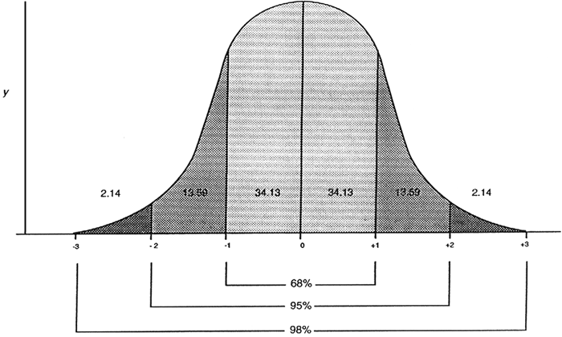
Empirical rule
The empirical rule is only valid for bell-shaped (normal) distributions.
Approximately 68% of the data values fall within (+) one standard deviation of the mean.
Approximately 95% of the data values fall within (+) two standard deviations of the mean.
Approximately 99.7% of the data values fall within (+) three standard deviations of the mean.

Slide 10
Association of Data
When exploring data, we are often interested in the relation between the variables.
i.e. Is there a relation between age and weight?
Did a company`s marketing strategy increase sales?
Is owning a pet associated to longer life?
In this lecture, will focus on the relation between two variables

Slide 11
Response and Explanatory variables
Response Variable/dependent variable
measures the outcome
denoted as y
Explanatory Variable/ independent variable
explains the change in the response variable
may be the cause of change in the response variable
denoted as x
y=ax+b

Slide 12
Examples
A study looks at the affects of alcohol consumption on heart disease
Response variable- death due to heart disease
Explanatory variable- number of alcohol drinks consumed
A study observing the association of fast food and obesity
Response variable?
Explanatory variable?

Slide 13
Causation vs. Association
A study shows that there is a relationship between the hours worked and income earned- increased working hours is associated with an increase in income.
BUT, does this mean that fewer hours spent at work results in lower pay?

Slide 14
Causation vs. Association/Correlation
Causation
Definition- relationship between two events where one event is affected by the other- one event is the result of the occurrence of the other event- cause and effect
one event, or variable, increases or decreases as a result of other events
one event is 100 percent certain to cause the other event
Association/correlation
Definition- “the relationship between things that happen or change together.”
Although there may be a relationship between two events, one event does not necessarily 100% cause the other event
Correlation- the relationship between the events/variables is linear

Slide 15
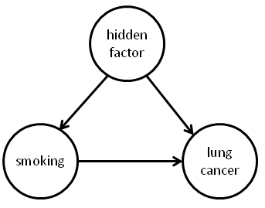
Causation or Correlation?
Smoking and lung cancer?
We often say that smoking causes lung cancer, but not everyone who smokes develops lung cancer.
Statistically- There is a strong correlation between smoking and lung cancer
Excessive overeating and weight gain
One can say that excessive overeating causes weight gain since close to 100% of people who overeat will gain weight
Can this be debated?
Statistically is this correlation?

Slide 16
Example
A study looks at the association between the number of hours spent studying for a test and test score
A small study collected hours spent studying and test score data from 10 students
What is the response/dependent variable?
What is the explanatory/independent variable?

Slide 17
Data from the 10 students-
hours spent studying and actual test score
Student | Hours spent | Test Score
1 | 1 | 81
2 | 5 | 75
3 | 7 | 89
4 | 10 | 88
5 | 3 | 65
6 | 5 | 92
7 | 6 | 71
8 | 2 | 78
9 | 1 | 54
10 | 0 | 68

Slide 18
Student dataset in SPSS
Input the previous data into SPSS
After inputting the data, want to visualize the data points
In SPSS: Graphs→ Chart Builder→ Scatter/dot
y/dependent variable= score
x/independent variable= time

Slide 19
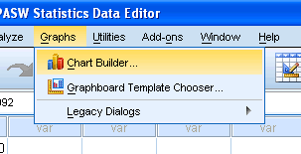
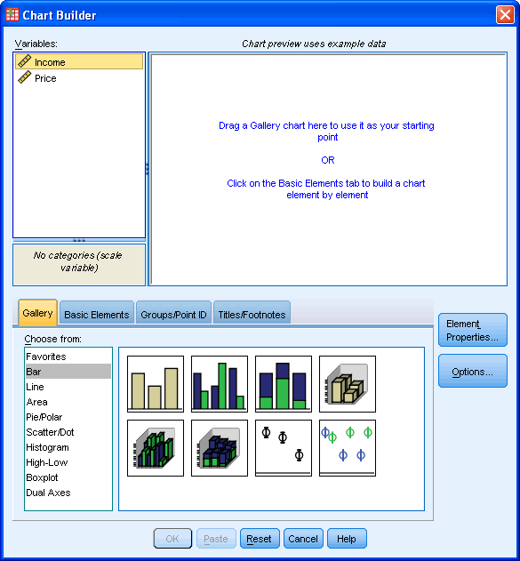
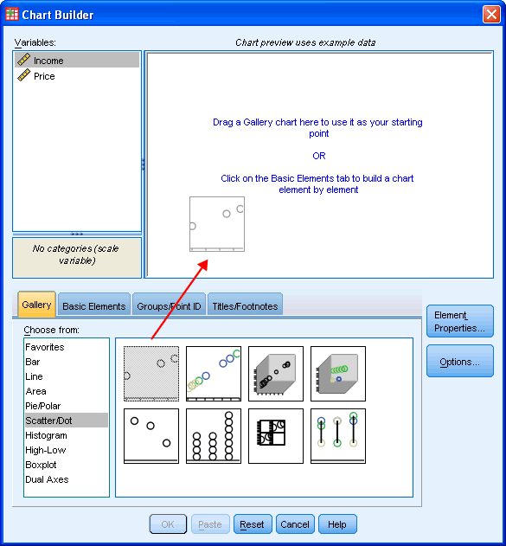
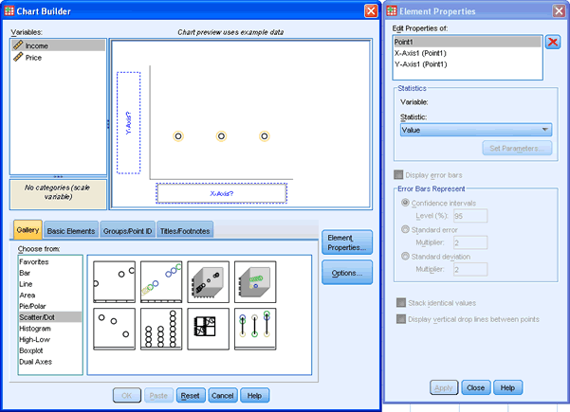
1.Graphs→ Chart Builder
2. Select Scatter/Dot and drag the simple scatter into the Chart Preview Area

Slide 20
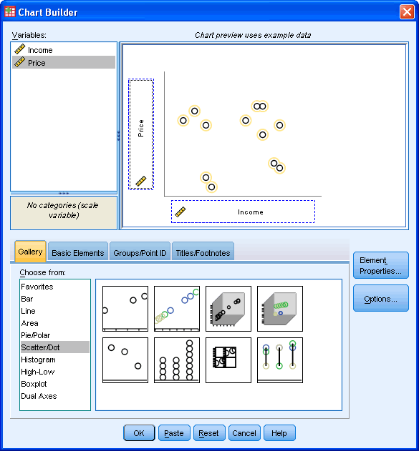
Drag the Independent/explanatory variable into the “x-axis?” box
-in our example drag “time” into the “x-axis?” box
Drag the Dependent/Response variable into the “y-axis?” box
-in our example drag “score” into the “y-axis?” box

Slide 21
Student | Hours spent | Test Score
1 | 1 | 81
2 | 5 | 75
3 | 7 | 89
4 | 10 | 88
5 | 3 | 65
6 | 5 | 92
7 | 6 | 71
8 | 2 | 78
9 | 1 | 54
10 | 0 | 68
(x_{4,}, y₄)

Slide 22
Positive/Negative Association
Positive Association- increasing the independent variable increases the dependent variable
Negative Association-increasing the independent variable decrease the dependent variable

Slide 23
Correlation Coefficient
Statistical correlation is measured using the correlation coefficient (r) which describes the degree of relationship between two variables
r- takes on a value from -1 to 1
r<0 -indicates a negative relationship between the variables
when one variable increases the other variable decreases, or when one variable decreases the other variable increases
r>0 indicates a positive relationship between the variables
when one variable decreases the other also decreases, or when one variable increases the other also increases
r=0 indicates that there is no relationship between the variables.

Slide 24
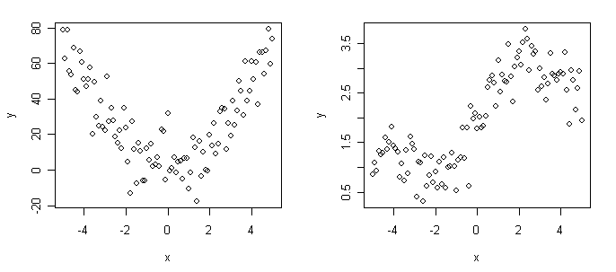
Correlation Coefficient cont`d
r has no units
r is not a proportion or percent-
r=0.8 is not twice as strong of a correlation as r=0.4
r can be misleading – low r does not mean that there is no relation- always plot data to understand the association of the data

Slide 25
Positive correlation (positively linear)
R=0.9617
R=0.5179

Slide 26
Negative Correlation (Negatively Linear)
R=-0.9377
R=-0.3732

Slide 27
No Correlation
r= -0.1032

Slide 28
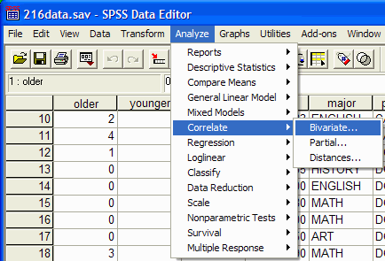
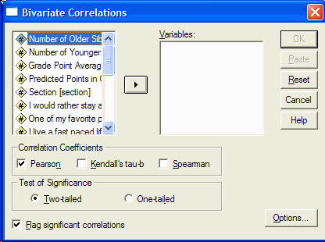
Correlation Coefficient in SPSS
Analyze→ Correlate→ Bivariate
In the variables box select the two variables that are interest (time, score)
In the Correlation Coefficient box, Select Pearson

Slide 29
How is how the data correlated from the example?
r=0.6

