Slide 1
INTRODUCTION TO STATISTICS
Session 5
May 8th 2017
Madoka Takeuchi

Slide 2
Review: Response and Explanatory variables
Response Variable/dependent variable
measures the outcome
denoted as y
Explanatory Variable/ independent variable
explains the change in the response variable
may be the cause of change in the response variable-not necessarily the cause
denoted as x
Y=ax+b

Slide 3
Review: Causation vs Association
Causation- changes in one variable directly (100%) causes changes in the other variable
i.e when you exercise the amount of calories you burn increases→ exercise directly causes the increase in calorie burn
Association- relationship between two variables.
i.e. cloudy weather is associated with rainfall, but cloudy weather does not 100% result in rain,cloudy weather does not cause rain
Association (correlation) does not imply causation

Slide 4
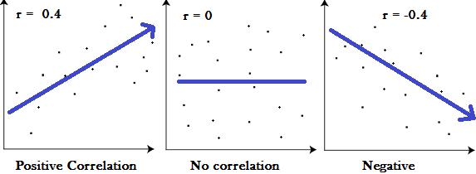
Review: Correlation
Association refers to the general relationship between two variables. Correlation refers a linear relationship between the variables.
Correlation is a measure of association.
Correlation Coefficient (r), measures the strength and the direction of a linear relationship between two variables
tells us how closely data in a scatterplot fall along a straight line.
Ranges from 1 to -1 , 0 meaning there is no linear relationship between the variables.
r=1,indicates that the variables are positively linearly related and the scatterplot falls almost along a straight line with positive slope
r=-1,indicates that the variables are negatively linearly related and the scatter plot almost falls along a straight line with negative slope

Slide 5
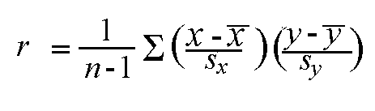
Correlation Coefficient (Pearson Correlation Coefficient)
Although SPSS can easily calculate the correlation coefficient, must understand the equation
n= number of paired data
S_{x}=sample standard deviation of the x values
S_{y}= sample standard deviation of the y values

Slide 6
Study- Want to know if aging and weight gain is associated
Data from 5 random people-
What is the explanatory variable (x)?
What is the response variable (y)?
 | Age | Weight
1 | 23 | 50
2 | 38 | 51
3 | 60 | 63
4 | 30 | 49
5 | 45 | 54

Slide 7
Correlation coefficient calculation
Need to calculate the sample mean of the independent and dependent variables
After the sample means are calculated, calculate the sample standard deviation of the independent and dependent variables.
Plug the sample means and standard deviations into the correlation coefficient equation

Slide 8
n=5
Mean of the x values= (23+38+60+30+45)/5
= 39.2
SD of x= √((23-39.2)²+(38-39.2)²+(60-39.2)²+(30-39.2)²+(45-39.2)²/4)
= √((-16.2)²+ (-1.2)²+ (20.8)²+ (-9.2)²+(5.8)²/4))
=√203.6
=14.27
Mean of the y values= ( 50+51+63+49+54)/5
= 53.4
SD of y= 5.68
r= (1/4) {[(23-39.2)/14.26]*[(50-53.4)/5.68)}+{[(38-39.2)/14.26]*[(51-53.4)/5.68]}
+ {[(60-39.2)/14.26]*[(63-53.4)/5.68]}+{[(30-39.2)/14.26]*[(49-53.4)/5.68]}
+ {[(45-39.2)/14.26]*[(54-53.4)/5.68]}
= 0.9296
Please check in SPSS

Slide 9
Regression Analysis
regression analysis= The study of the analysis of data aimed at discovering how one or more variables (independent variables, explanatory variables) are associated with the values of other variables (called dependent or response variables)
Linear regression - finding the best-fitting straight line through the data.
The best-fitting line is called a regression line.

Slide 10
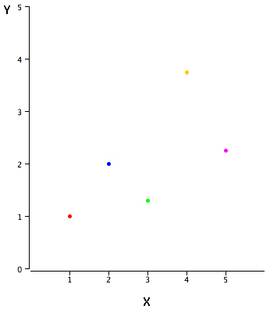
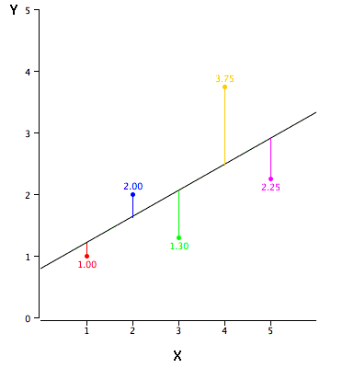
Example data
X | Y
1 | 1
2 | 2
3 | 1.3
4 | 3.75
5 | 2.25
Simple linear regression- predict scores on one variable from the scores on a second variable
Points are the actual data
Black line is the regression line and consists of the predicted score on Y for each possible value of X

Slide 11
-The error of prediction for a point is the value of the point minus the predicted value
-The vertical lines from the points to the regression line represent the errors of prediction.
-The red point is very near the regression line
-error of prediction is small
-The yellow point is much higher than the regression line
-error of prediction is large

Slide 12
Errors of Prediction
X | Y | Y’ | Y-Y’ | (Y-Y’)²
1 | 1 | 1.2 | -.2 | 0.040
2 | 2 | 1.62 | .38 | 0.144
3 | 1.3 | 2.04 | -.74 | 0.548
4 | 3.75 | 2.46 | 1.29 | 1.664
5 | 2.25 | 2.9 | -.65 | 0.423
Y’- predicted value
Y-Y’- errors of prediction
Simple linear regression can over-predict or under-predict the response variables.
The aim is to find the best fitting line to the data
best fitting line is the line that minimizes the sum of the squared errors of prediction

Slide 13
Least Square Regression Line
Least squares line minimizes the squared distances between the line and the data points, thus this line is most likely the line that best fits the data.
The slope of the least square line is connected to the correlation coefficient of the data.
Slope= r (S_{y}/S_{x}) where S_{y}= SD of Y
S_{x}= SD of X
When slope > 0 – there is a positive trend — that is, as x increases, y tends to increase
When slope < 0- – there is a negative trend — that is, as x increases, y tends to decrease

Slide 14
Intercept
Every least squares line passes through the mean x coordinate and mean y coordinate thus can calculate the intercept
After solving for the slope(a), plug in mean y coordinate and mean x coordinate into the equation y= ax+ b and solve for a to get the intercept
b= y-ax

Slide 15
Regression line equation
From the study of aging and weight gain, we calculated the mean of x, mean of y, SD of x, SD of Y and the correlation coefficient
Mean x=39.2 Mean y=53.4
SD x=14.27 SD y=5.68
r= 0.9296
Slope= r (S_{y}/S_{x})
= 0.9296 (5.68/14.27)
=.367
Intercept = y-slope(x)
=53.4- (.367)(39.2)
=39.014
Equation for the regression line y= .367x+ 39.014

Slide 16
Prediction model
Once the regression equation is calculated, we can use this equation as a prediction model
given a particular value of x, we can predict what the value of y would be (y along the line at x)
Predicted y value is denoted as
Example- from the age and weight equation we can predict the weight of a 30 yr old
= .367(30)+39.014
= 50.024

Slide 17
Residuals
The errors of prediction are also referred to as residuals and are denoted as e
Residuals= measure the error of each observation away from what the model predicts them to be
e= actual data value- predicted data value
In the age and weight data, a 30 yr weighed 49kg, however using the calculated regression equation, we predicted that the weight of a 30yr would be around 50kg
The residual e= 49-50
=-1

Slide 18
r²
The square of the correlation coefficient, r², is a useful value in linear regression
r²=fraction of the variation in one variable that may be explained by the other variable.
If a correlation of 0.8 is observed between two variables (i.e, age and weight), then a linear regression model attempting to explain either variable in terms of the other variable will account for 64% of the variability in the data.
Example: the correlation coefficient for crime rate and unemployment rate was found to be 0.42 thus r² is approximately 0.18
Interpretation: the regression line explains 18% of the variability in violent crime rate, or leaves 82% unexplained.

Slide 19
Going back to the previous study of aging and weight gain…
 | Age | Weight
1 | 23 | 50
2 | 38 | 51
3 | 60 | 63
4 | 30 | 49
5 | 45 | 54
Lets check the linear regression line we calculated using SPSS

Slide 20
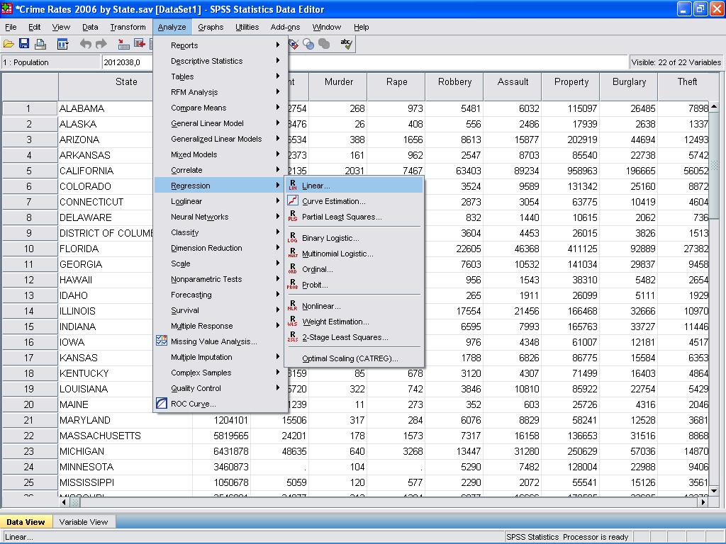
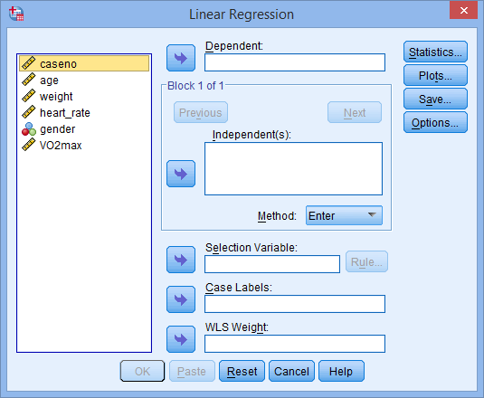
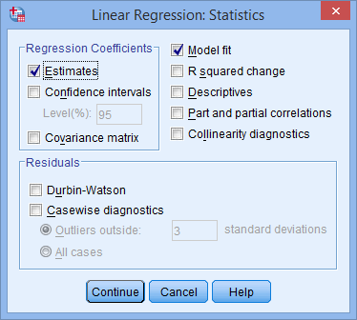
Linear Regression in SPSS
Step 1
Analyze→ Regression→ Linear
Step 2
Select dependent variable and independent variable
Step 3
Click statistics button and select estimates and model fit

Slide 21
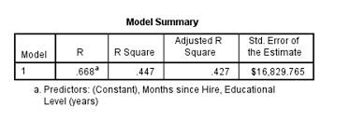
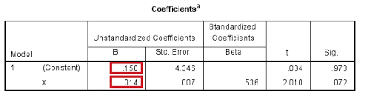
Understanding the output
First table of interest is the model summary- provides r and r²
To calculate the regression equation, look at the Coefficients table
The constant is the intercept and the value for x is the coefficient for the slope- the equation for the above data would be
y= ______x + constant

Slide 22
The equation we calculated by hand was
y= .367x+ 39.014
What is the regression equation from SPSS???
Are the equations the same?

