Slide 1
Ar Line Swap Gas Purge
SW3P 유기종
2019.09.09

Slide 2
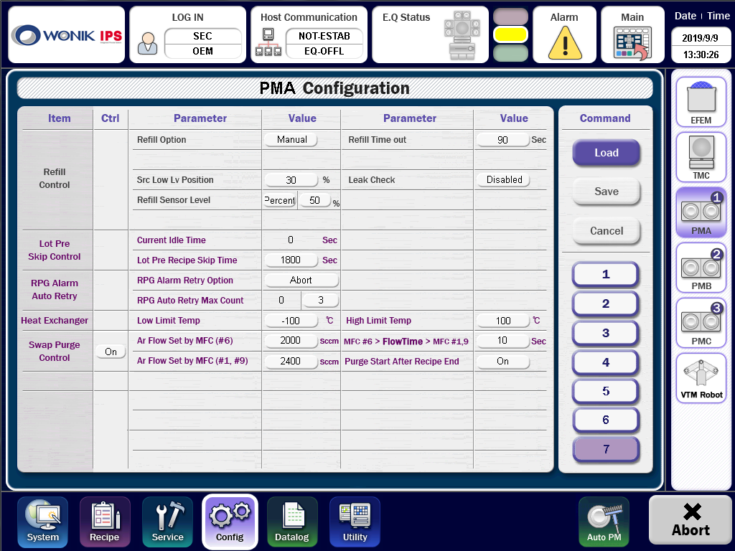
Ar Line Swap Gas Purge
Parameter Setting
MFC #6 Set Value
Swap Gas SEQ Delay Time

Slide 3
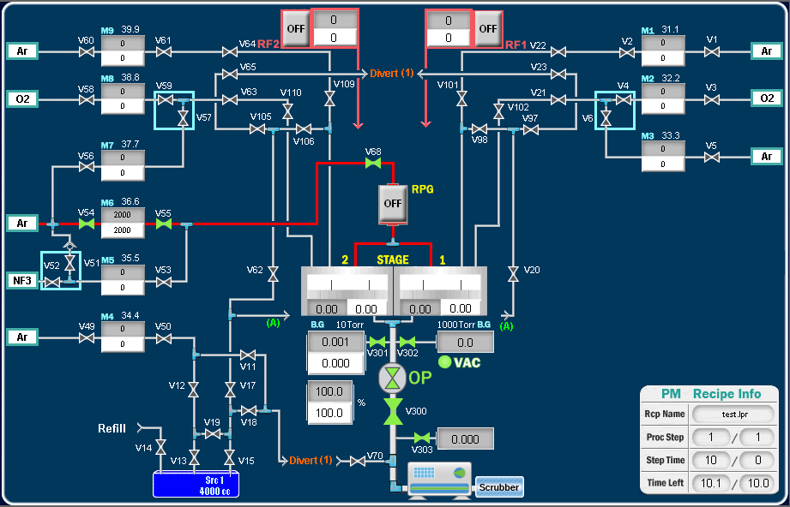
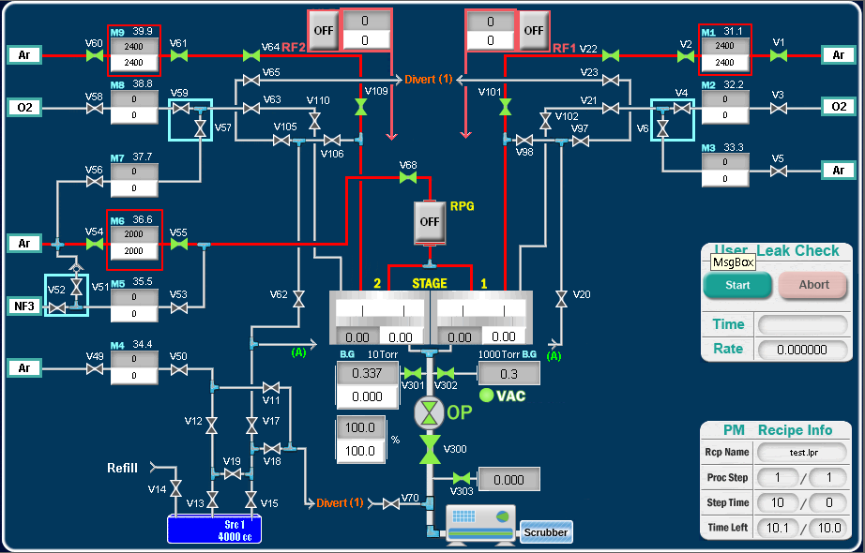
Ar Line Swap Gas Purge
Swap Gas Sequence
- MFC #6 RPG Ar Gas Flow -> Delay -> MFC #1 & #9 Ar Gas Flow
①
②
③
② Flow Time Delay
①
③
③
※ Swap Purge Control
- Swap Purge Use / Not Use
※ Purge Start After Recipe End
- On : Recipe End -> Purge Start
- Off : Purge Start -> Wafer Pick

