Slide 1

MarketEdge: A Time on Market Prediction Tool
Kevin Kuc, Leo Le, Nick Bermingham
Notes:
My name is Nick, and alongside my group members Kevin and Leo we will be presenting our progress on MarketEdge: A Time on Market Prediction Tool

Slide 2

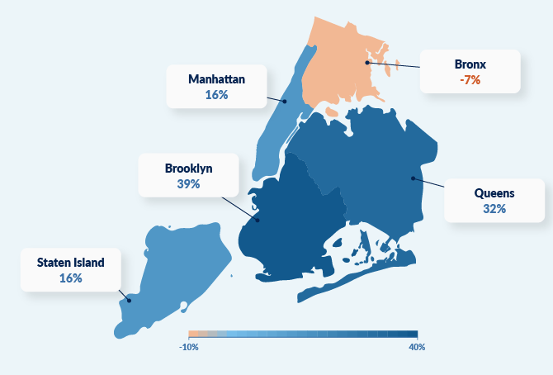

Zip Code Variability
Notes:
Many prediction tools in the real estate market operate at a national or even regional level, (click) providing broad trends that often fail to capture the nuances that exist from one zip code to another. But there's significant variability in market behavior across different zip codes, even within the same city. (click) For example, while Queens New York might be experiencing a sharp increase in property values, the Bronx might seeing a decline. This variability highlights the need for more granular, zip code-level analysis to make informed decisions in today’s real estate market.

Slide 3
Time on Market Importance
Impact | Statistic | Explanation
Cost of Prolonged Listings | 5-10% less than original asking price after 60 days | Prolonged listings lead to price reductions, impacting seller’s profit margins.
Holding Costs | 1-2% of home’s value per month | Holding costs accumulate rapidly, reducing profits and increasing expenses.
Market Timing | Higher likelihood of selling at or above asking price within first two weeks | Accurate pricing and market timing are crucial for maximizing returns.
Buyer Fatigue | Decline in buyer interest by 50% or more after first month | Prolonged listings lead to diminished interest and less favorable offers.
Impact on Real Estate Investments | 2-3% reduction in annual ROI per extra month on market | Extended time on the market significantly reduces ROI for investors.
Notes:
Accurately predicting how long a property will stay on the market is crucial for maximizing financial outcomes. (click) Here are five key reasons why: (click before each)
1. Cost of Prolonged Listings: Homes that sit on the market for more than 60 days often sell for 5-10% less than the original asking price.
2. Holding Costs: The longer a property remains unsold, the more the holding costs add up, typically around 1-2% of the home’s value per month.
3. Market Timing: Homes that sell within the first two weeks have a higher likelihood of achieving or even exceeding the asking price.
4. Buyer Fatigue: Interest from buyers tends to drop significantly—by 50% or more—after a property has been on the market for a month.
5. Impact on Real Estate Investments: For investors, every extra month a property is on the market can reduce the annual ROI by 2-3%.

Slide 4



Market Research
Real estate analytics market projected at $22 billion by 2027.
Current focus: Pricing models by major players (Zillow, Redfin).
Gap in the market: Need for zip code-specific time on market predictions.
Opportunity: Unique tool offering localized insights, filling a critical gap in real estate analytics.
Notes:
The real estate analytics market is highly competitive, with major players like Zillow and Realtor.com providing various predictive tools. However, most existing solutions focus primarily on broader market trends or pricing models and often fail to account for the granular, zip code-level variations that can significantly impact the time a property stays on the market. Our research shows that there is a gap in the market for a tool that can provide such localized predictions. By integrating zip code-specific housing metrics with our predictive model, we can offer a unique value proposition that addresses this gap. This tool would not only help users make better-informed decisions but also position itself as a key differentiator in a rapidly growing market, offering insights that current broad-spectrum tools do not.

Slide 5
Target users
Individual end users
Business entity
Broker
Realtor
Home owner
Real Estate Agents and Firms
Notes:
There are 2 categories of target users we want this product to serve. The first category is the individual users who are looking for a reliable but quick experience to support their works. Those individuals are licensed brokers, realtors and home owners who work independently to buy or sell properties. The second category is business entity such as real estate firms where there can be multiple real estate agents working on multiple listings. The target user would require a more expanded capacity in which they can upload their portfolios of properties. So as we build our models and products out, these are the 2 users will have in mind

Slide 6
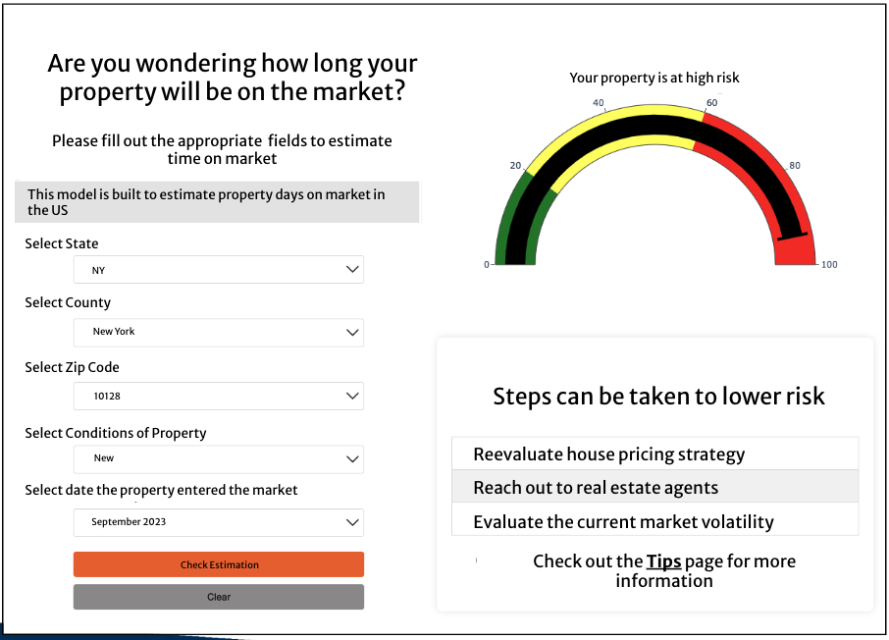
MVP
Output recommendations
Data Input
Notes:
This is a brainstorm sketch of the MVP where our product would have an interactive page to input their property’s information in such as the location, zip code, date, property’s condition. And when finish filling out and press the Check Estimation button, a score matrix or some sort of prediction mechanism will be outputted similarly to the image above shown in the right. Red would indicate that the property is in high risk and potentially have higher selling time. Same logic for yellow and green in which the property has a high probability to be sold and will be off the market soon. In the bottom right, we’re thinking to put some recommendations of the next steps based in the score matrix you receive. So in this example, since the score is red, the page recommends the users to reevaluate the pricing strategy and have a more aggressive approach.

Slide 7
Data
There are 2 major public data set we are planning to explore:
Realtor Residential data: Data in this Realtor.com library is based on the most comprehensive and accurate database of MLS-listed for-sale homes in the industry
56 metrics
2M + data points
Organized by Zip, County, Metro, State and National level
Zillow Housing Data: Zillow provides a comprehensive set of real estate data targeting different uses from analyzing and forecasting home values to reporting on market and listings availability
8 sub-dataset focusing on different aspects such as for-sale listings, median days to pending on market, etc
Formatted in time-series for 337 zip codes
Notes:
There are 2 main public data set we found and planning to do more in-dept EDA in the next coming weeks. The first one is data from realtor.com which is a website similar to zillow that offers a place for buyers and sellers to look for properties. Realtor.com has compiled a dta library that is based on the most comprehensive and accurate databbased of MLS which is a very popular website among real estate agents. The second dataset is from

Slide 8
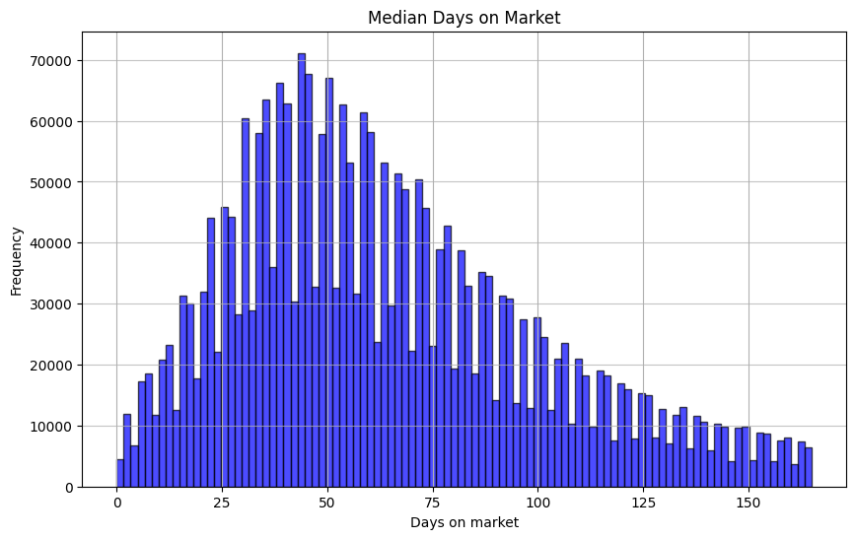
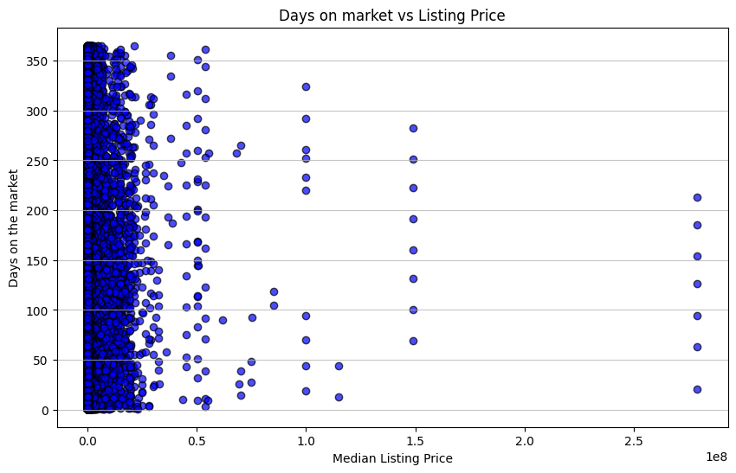
Data (Realtor)

Slide 9
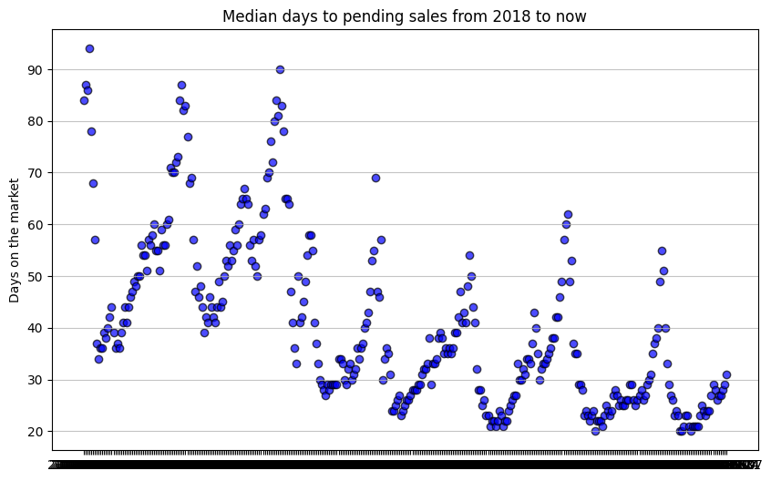
Data (Zillow)

Slide 10
Data Next Step
Finalize metric research
Interviews with SMEs this wednesday
Conduct literature review
In-depth EDA of the Realtor and Zillow data sets
Data cleanliness
Data transformation
Data architecture and pipeline
Huggingface model → endpoint → lambda function → GUI

Slide 11
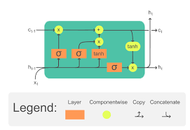
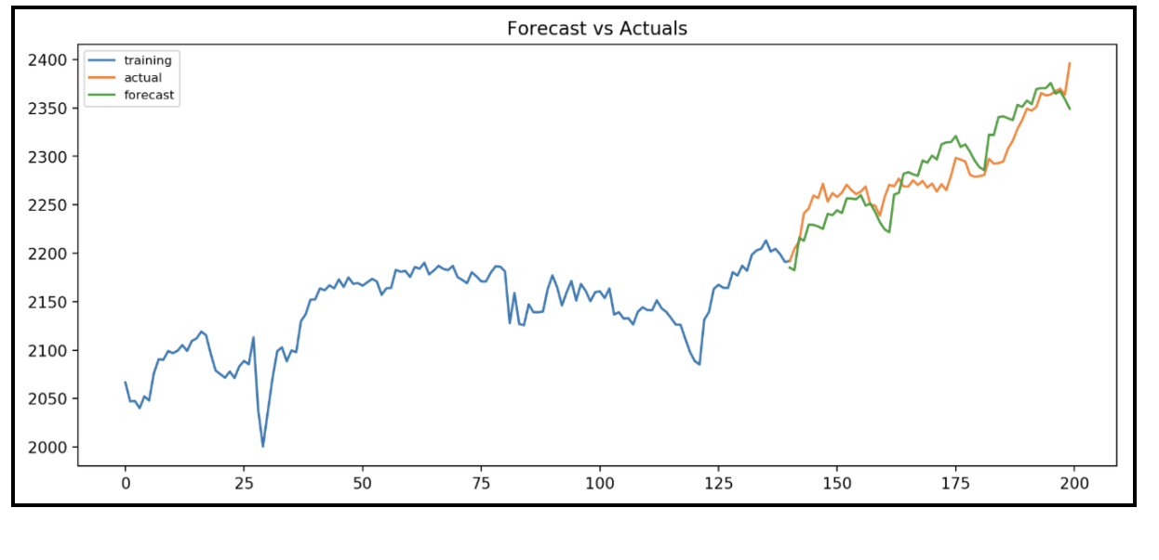
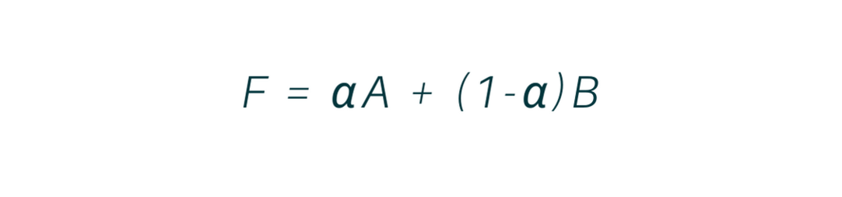
Algorithms
Simple Exponential Smoothing
AutoRegressive Integrated Moving Average (ARIMA)
Long Short-Term Memory (LSTM)
Notes:
(click) We plan on starting with a Simple Exponential Smoothing model, which forecasts the number of days a property will stay on the market by weighing recent zip code-level market valuations more heavily. This method provides a basic yet effective baseline for predicting market dynamics.
(click) Next, we move to an ARIMA (AutoRegressive Integrated Moving Average) model. This is well-suited for time series data and captures the temporal dependencies in zip code-level valuations to predict days on the market. It accounts for trends and seasonality, offering more refined predictions based on historical valuation data.
(click) Finally, we employ a Long Short-Term Memory (LSTM) neural network. LSTM is a type of recurrent neural network (RNN) that excels at modeling sequential data and long-term dependencies. By feeding in monthly historical data on zip code valuations, the LSTM can predict the number of days a property will stay on the market with high accuracy, even in complex and fluctuating markets.
These models, progressively increasing in sophistication, enable us to leverage historical market data to make precise predictions about property market time, tailored to each zip code.

Slide 12

Project Planning
Date (1 wk) | Task Completed
9/29/24 - 10/6/24 | Data Cleansing/Exploratory Data Analysis (EDA) complete (Nick/Leo), React Template of GUI complete (Kevin)
10/6/24 - 10/13/24 | Baseline model complete (Nick/Leo), GUI complete with planned API calls (Kevin)
10/13/24 - 10/20/24 | Independent ML models ½ complete (Nick/Leo/Kevin)
10/20/24 - 10/27/24 | ML models complete and model selected (Nick/Leo/Kevin)
10/27/24 - 11/3/24 | Selected model fine tuning (Nick/Leo/Kevin)
11/3/24 - 11/10/24 | Selected model fine tuning (Nick/Leo), Sagemaker/lambda exploration (Kevin)
11/17/24 - 11/24/24 | Deploy model (Nick/Leo), Prep AWS for model import (Kevin)
11/24/24 - 12/1/24 | Connect the backend to the frontend (Nick/Leo/Kevin)
12/1/24 - 12/8/24 | Practice Presentation
12/8/24 - 12/9/24 | Final Presentation due

Slide 13


Ethics & Considerations
Bias and Fairness
Privacy
Transparency and Accountability
Impact on Housing Market Dynamics
Over-reliance on Technology
Notes:
Features like neighborhood location or zip code may unintentionally reflect historical discrimination. It's important to analyze the data for bias and either adjust or exclude potentially problematic features.
Protect the personal and sensitive data of homeowners and buyers
Be transparent about the factors the model considers and explain its predictions in understandable terms. Homeowners should know why the model predicts a certain timeframe.
The model’s predictions could influence the behavior of buyers, sellers, and real estate professionals. For example, if widely adopted, the model could alter market behaviors in ways that benefit certain participants over others
Ensure that stakeholders understand that the model is a tool to assist decision-making, not replace human judgment.

Slide 14

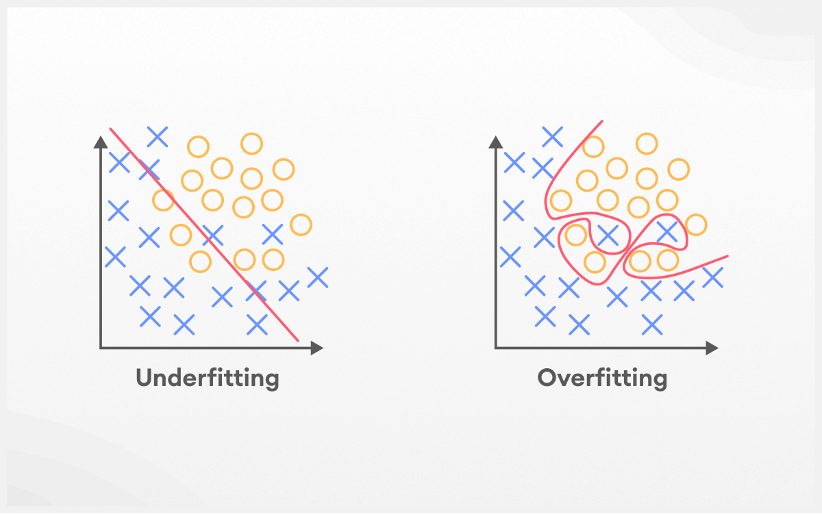
Challenges
Scoping down Project
Data
Availability
Shifting Trends
Modeling
Overfitting
Explainability
Deployment
Connecting the front/backend
Notes:
Data Availability: Accessing high-quality, comprehensive real estate data can be difficult. You may need to deal with incomplete, outdated, or region-specific datasets.
Shifting trends: State of the economy, interest in renting vs. buying will be an external factor we will have to consider for our model
Overfitting: There's a risk that the model could overfit historical data, making it less generalizable to future market conditions. Balancing model complexity with generalization is essential.
Explainability: Complex machine learning models (e.g., neural networks) may offer high accuracy but lack transparency. Explaining how predictions are made will be critical for user trust.
Deployment: Lack of experience within the group using lambda functions and Sagemaker

Slide 15

Conclusion
Problems to address: Uncertainty around the time a property remains on the market significantly affects home sale outcomes. Current models often fail to incorporate local factors that can influence these outcomes. There is a growing need for a predictive model that combines location-specific features to provide more accurate predictions and enhance decision-making in real estate transactions
Notes:
Impact of Uncertainty on Home Sales
uncertainty regarding how long a property will stay on the market significantly impacts decision-making for both buyers and sellers.
This uncertainty can affect the timing of sales, pricing strategies, and overall transaction outcomes.
Issue with Current Models
Existing predictive models lack key components.
factors are critical to understanding why some properties remain on the market longer.
Need for Enhanced Predictive Models

Slide 16
Questions

