Slide 1
Kaggle 4. Car price prediction
Presented by Kseniya Kudzelich

Slide 2
Stages of the work performed:
01
02
Data understanding
Data preparation
03
04
Modeling
Evaluation

Slide 3
01
Data understanding
Visualization of unique values, distribution of feature values, relationships between features

Slide 4
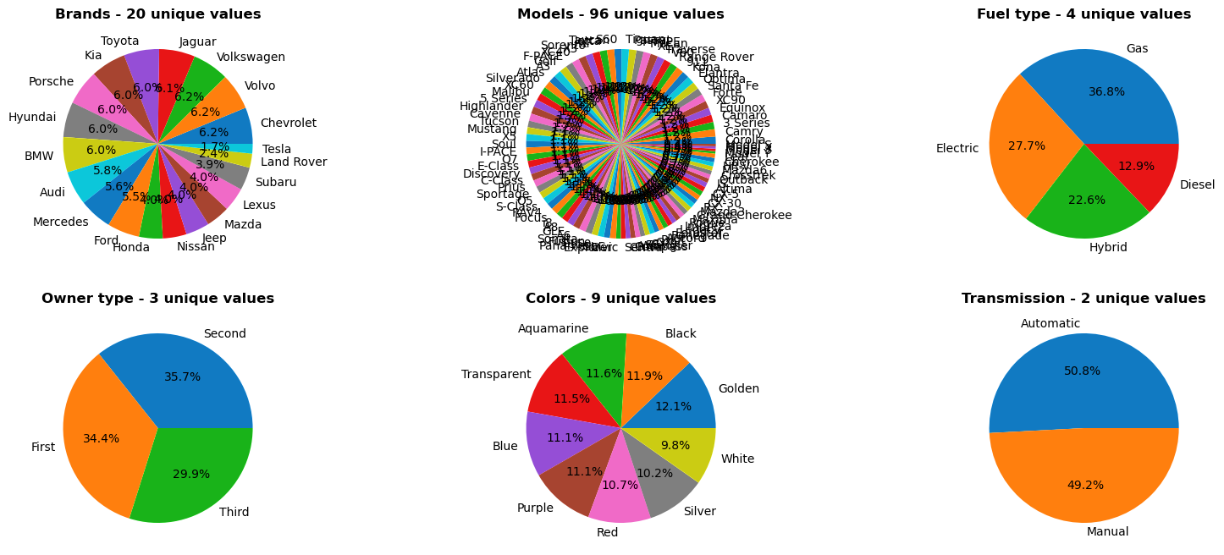
Unique values for categorical features

Slide 5
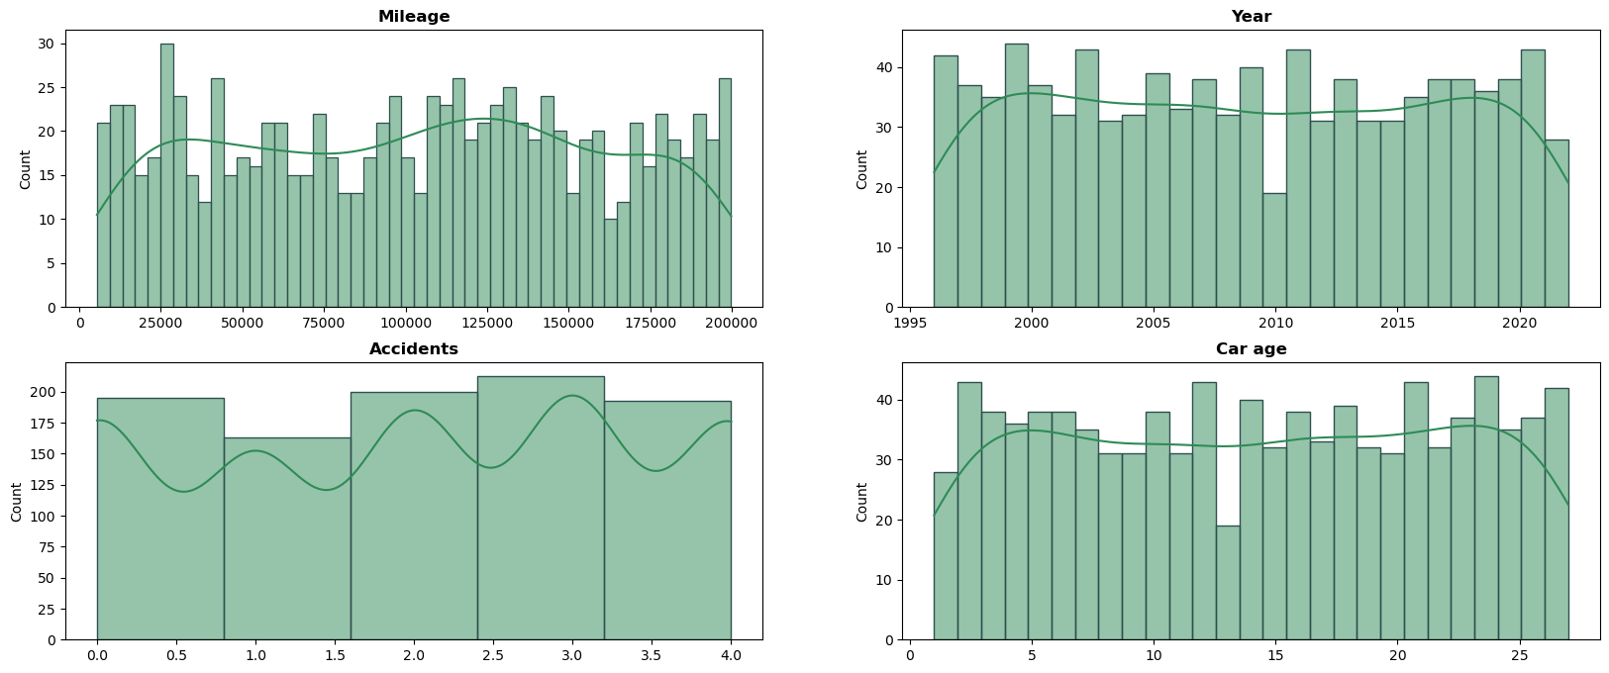
Distribution of numerical features

Slide 6
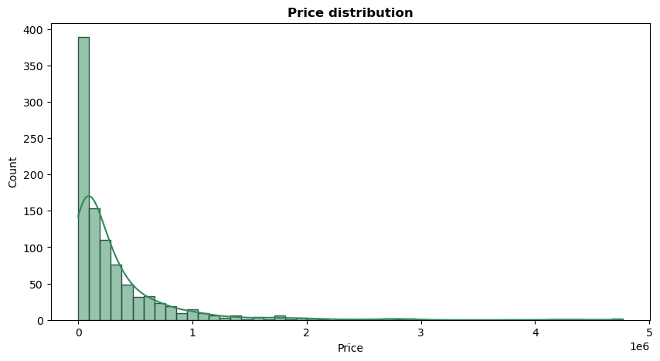
Price distribution

Slide 7
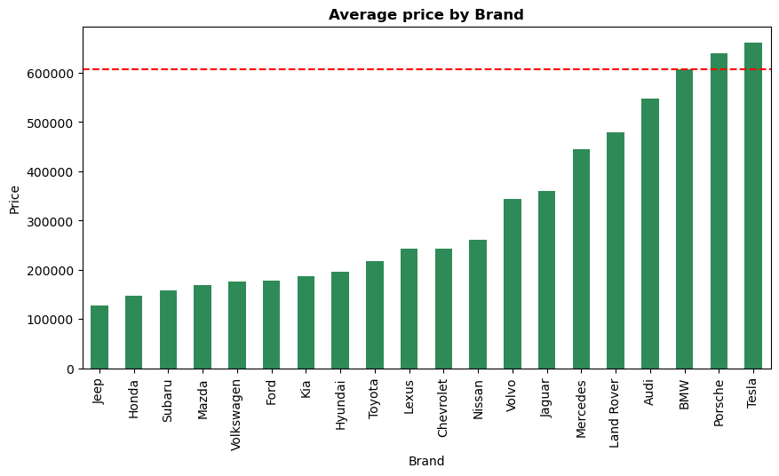
Average price by brand
TOP 3 brands:
Tesla
Porsche
BMW

Slide 8
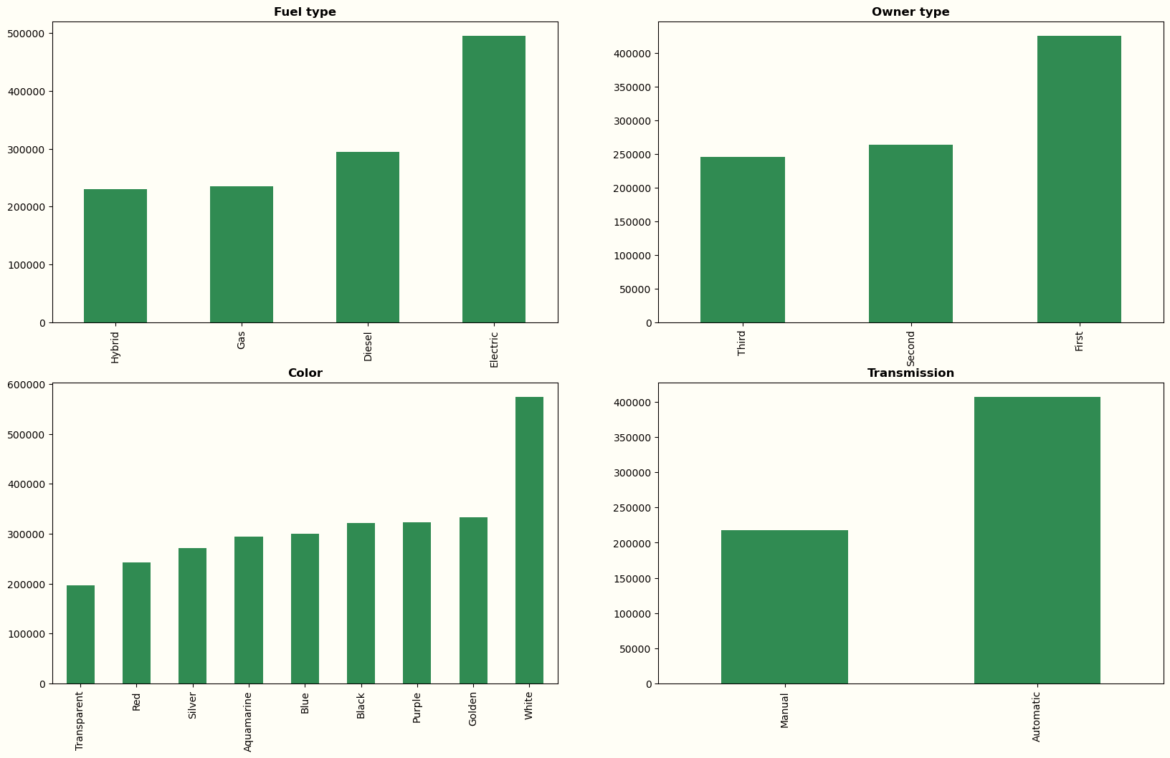
Average price by other categorical features

Slide 9
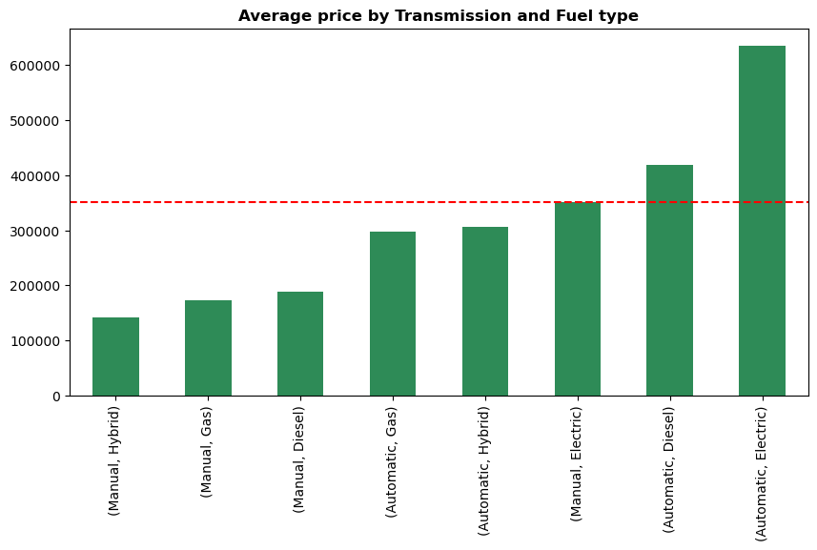
Average price by transmission and fuel type
TOP 3:
Automatic + Electric
Automatic + Diesel
Manual + Electric

Slide 10
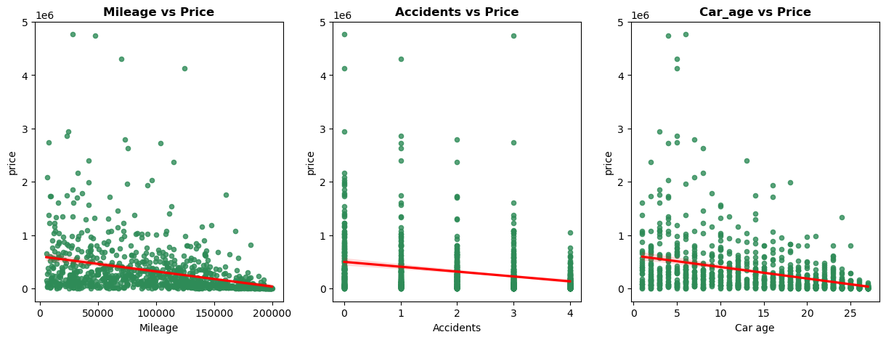
Average price by mileage, accidents, car age

Slide 11
02
Data preparation
Adding new features, encoding features, splitting data into train, validation and test sets, scaling features

Slide 12
New features:
Mileage per year
Accidents per year
Transmission + fuel type
Year range based on percentiles:
(1996 – 2002, 2003 – 2009, 2010 – 2016, >=2017)
Mileage category based on percentiles:
(Low: <= 53395.0, Middle: 53395.0 – 105917.5, High: 105917.5 – 147803.50, Very high: >= 147803.50)

Slide 13
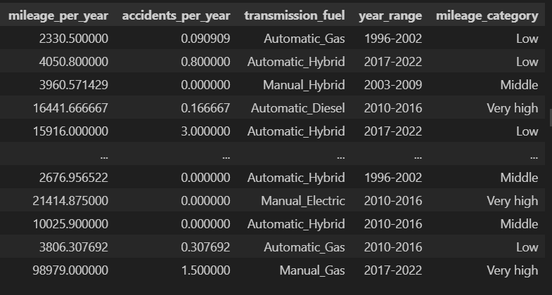

Slide 14
Encoding categorical features:
Ordinal encoder:
Brand (categories=([['Jeep', 'Honda', 'Subaru‘ , … , 'BMW', 'Porsche', 'Tesla']]))
Owner type (categories=([['Third', 'Second', 'First']]))
Transmission-fuel (categories=([['Manual-Hybrid', 'Manual-Gas‘ , … , 'Automatic-Diesel', 'Automatic-Electric']]))
Year range (categories=([['1996-2002', '2003-2009', '2010-2016', '2017-2022']]))
Mileage category (categories=([['Very high', 'High', 'Middle', 'Low']]))

Slide 15
Splitting data into train, validation and test sets:
Test set – the last 20% lines from df
(mean price in the test set – 267,893.7187)
Validation set – 20% of remaining df
Train set – the remaining df

Slide 16
Scaling all features:
MinMaxScaler(feature range=(-1, 1))

Slide 17
03
Modeling
Using of various models, selection of optimal parameters, using Optuna and MLflow

Slide 18
The results of different models on the validation set:
 | Linear regression | Polynomial regression (degree = 6) | SVR (kernel = linear) | Random Forest
MAE | 206,157.89 | 158,146.42 | 267,836.97 | 109,217.37
MAPE | 30.12 | 5.90 | 10.32 | 1.34

Slide 19
Gradient boosting with default hyperparams on the validation set :
MAE – 118,134.77
MAPE – 1.88

Slide 20
Optuna results:
 | MAE minimization | MAPE minimization
MAE | 76,643.14 | 77,659.66
MAPE | 1.06 | 0.71

Slide 21
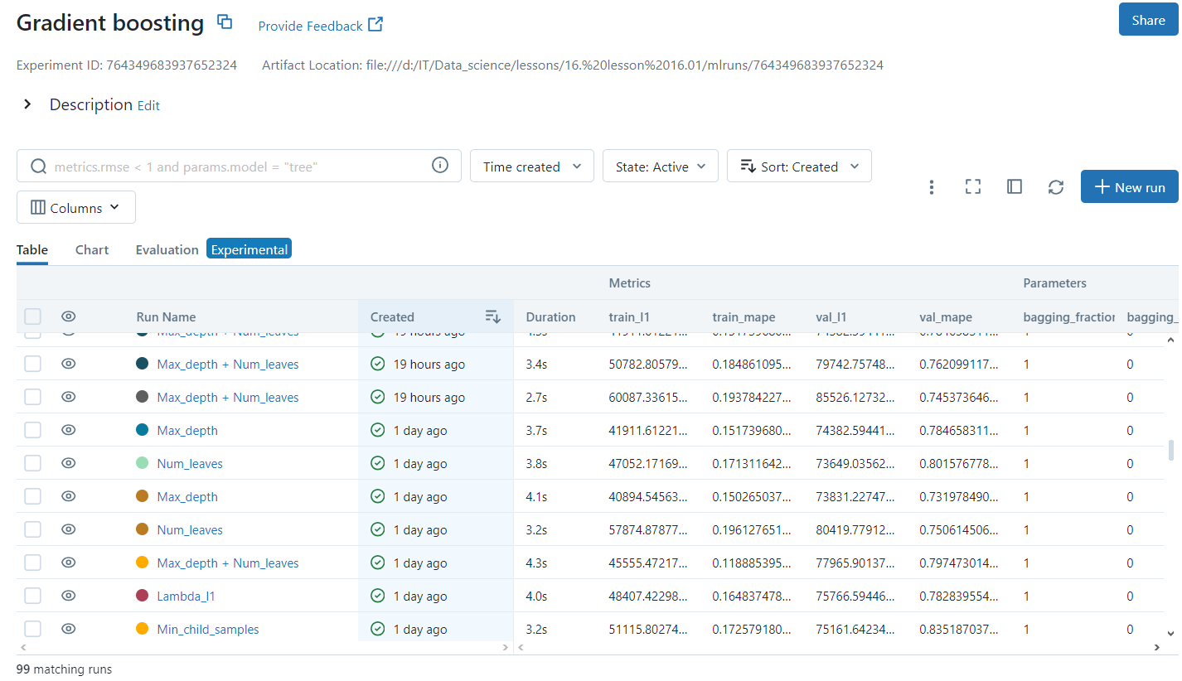
Mlflow:

Slide 22
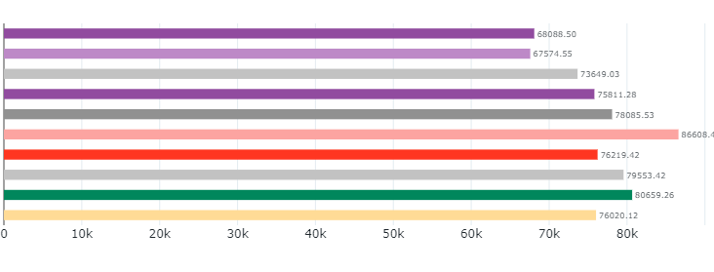
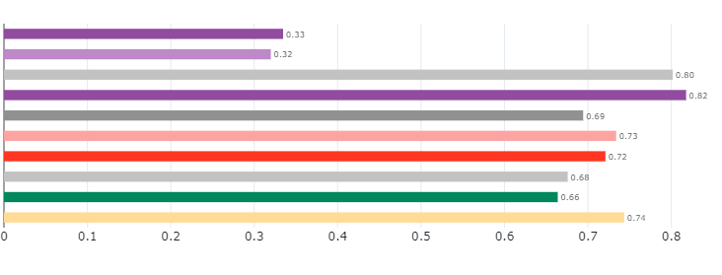
Mlflow (the last 10 runs):
MAE
MAPE

Slide 23
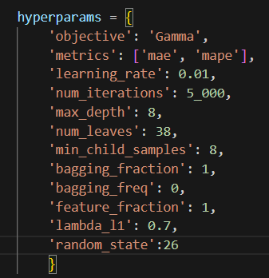
My hyperparams:

Slide 24
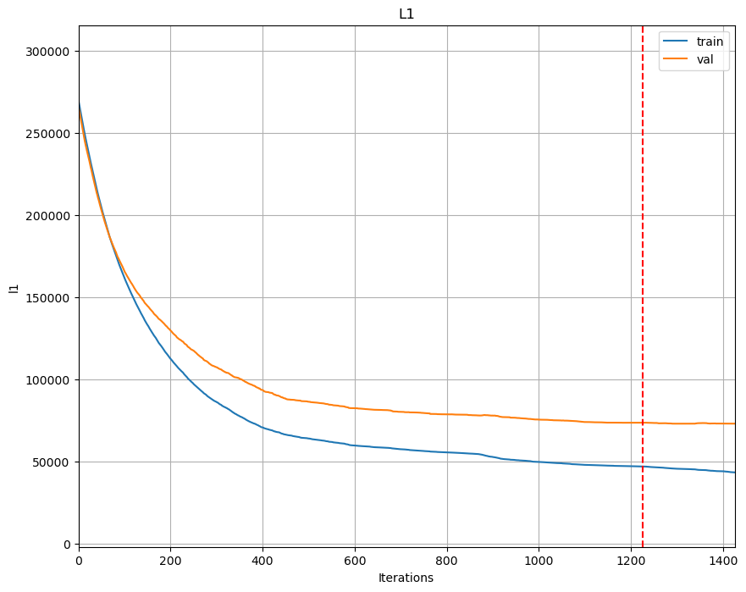
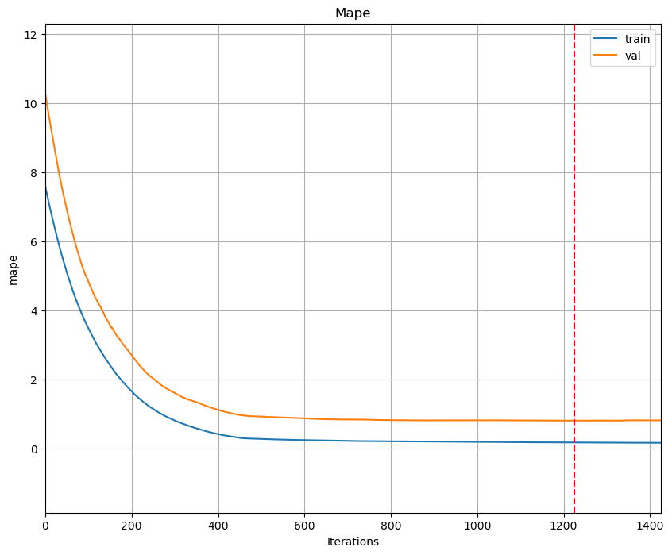
Gradient boosting on the validation set (Loss L1):

Slide 25
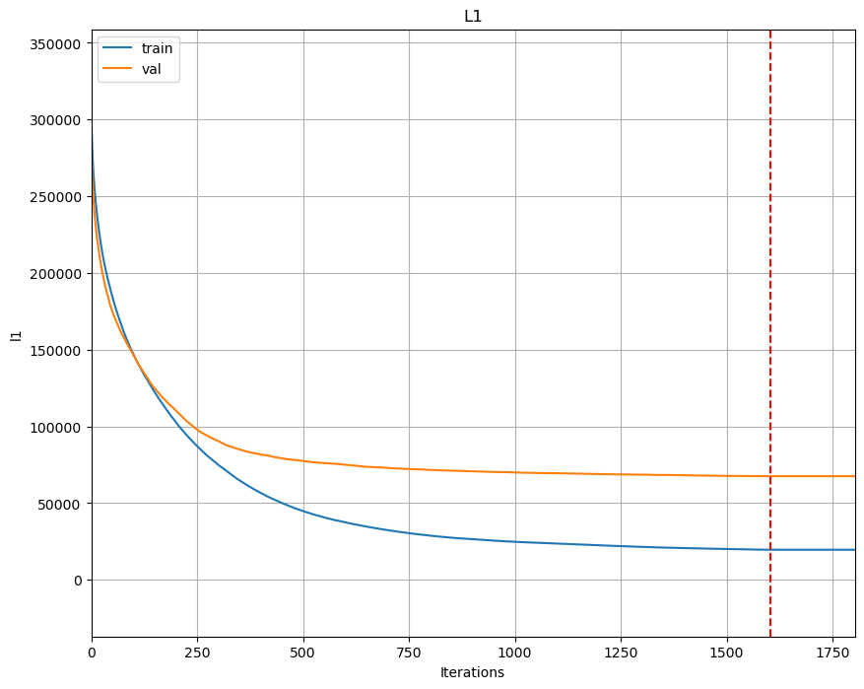
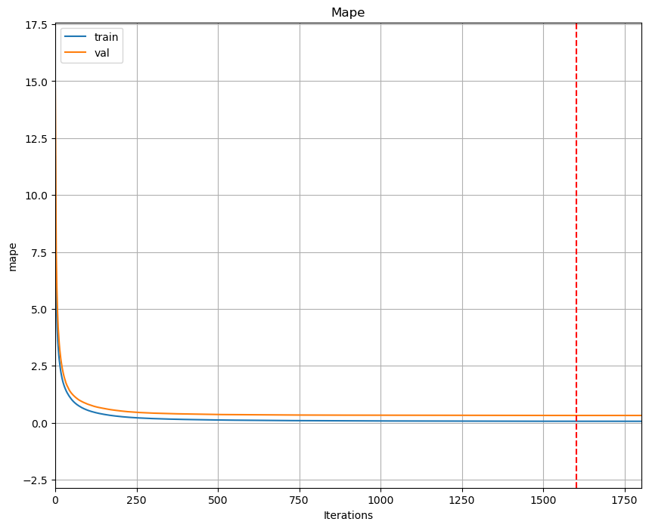
Gradient boosting on the validation set (Loss Gamma):

Slide 26
My best results on the validation set:
 | L1 loss | Gamma loss
MAE | 73,649.03 | 67,574.55
MAPE | 0.80 | 0.32

Slide 27
04
Evaluation
Evaluating model results on a test set using metrics MAE and MAPE

Slide 28
My results on the test set:
 | L1 loss | Gamma loss
MAE | 73,644.41 | 64,829.25
MAPE | 1.71 | 0.42

Slide 29
Thanks for your attention!

