Slide 1





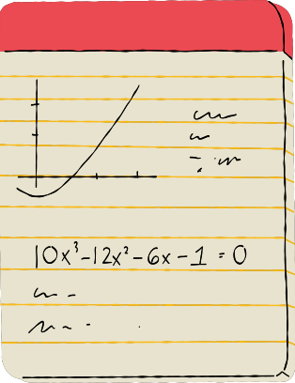




HANDWRITTEN DIGIT RECOGNITION
Kseniya Kudzelich

Slide 2
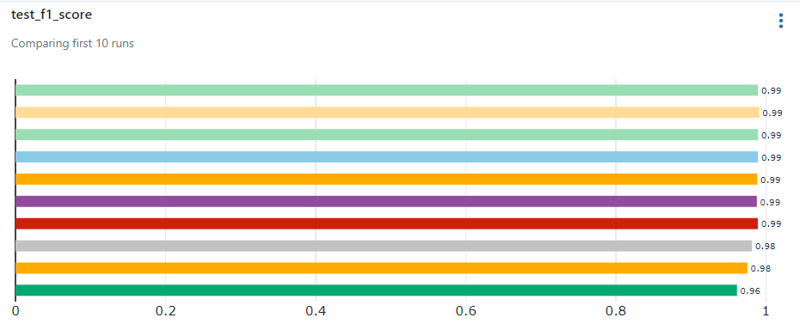

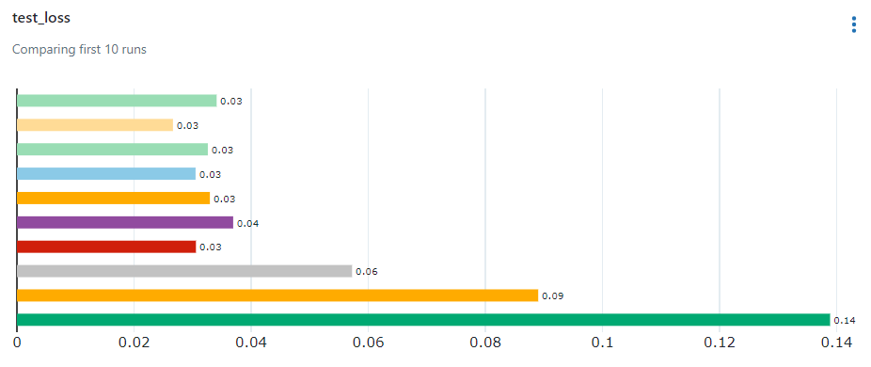
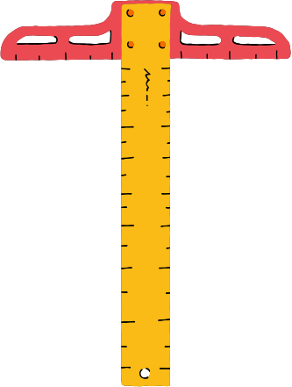
MLFlow

Slide 3


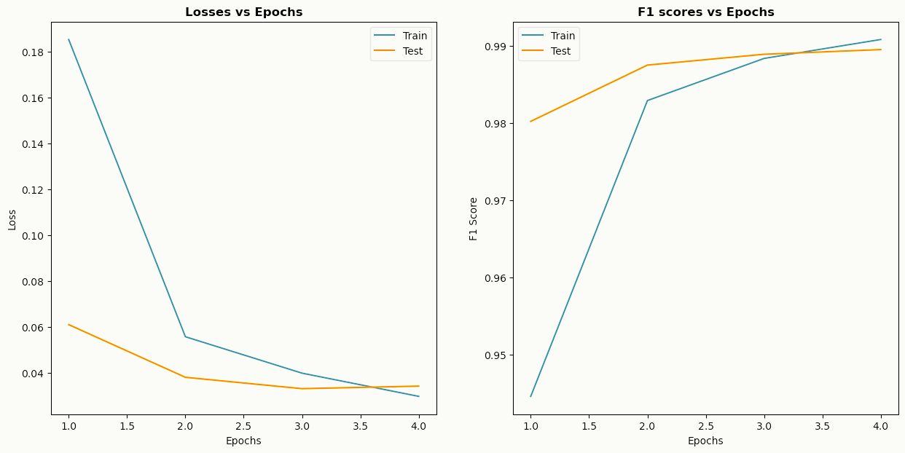






Losses and F1 scores VS Epochs
Loss: 0.0341 F1 score: 0.99

Slide 4
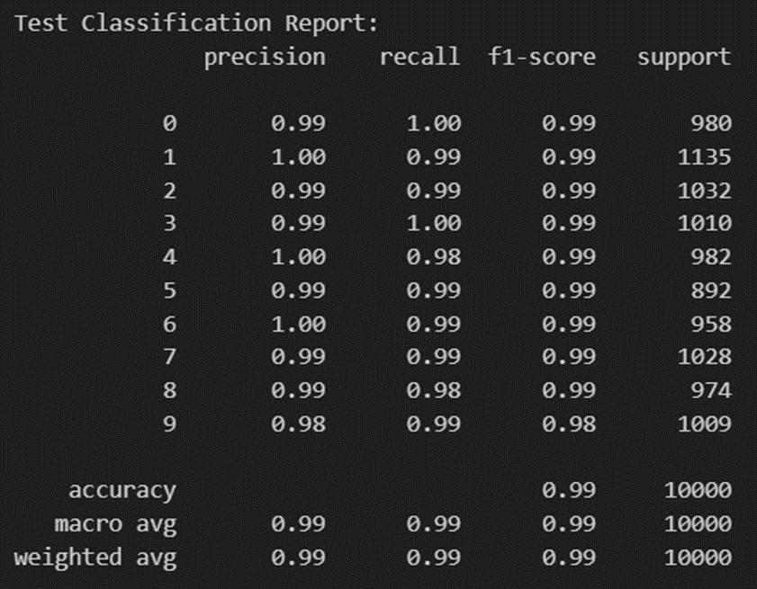

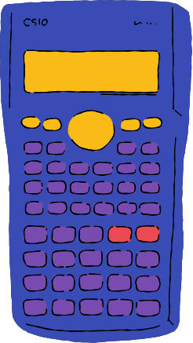
Classification Report

Slide 5

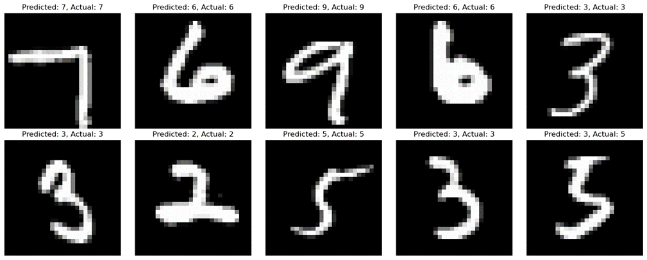

Predicted VS Actual labels
on randomly selected images

Slide 6
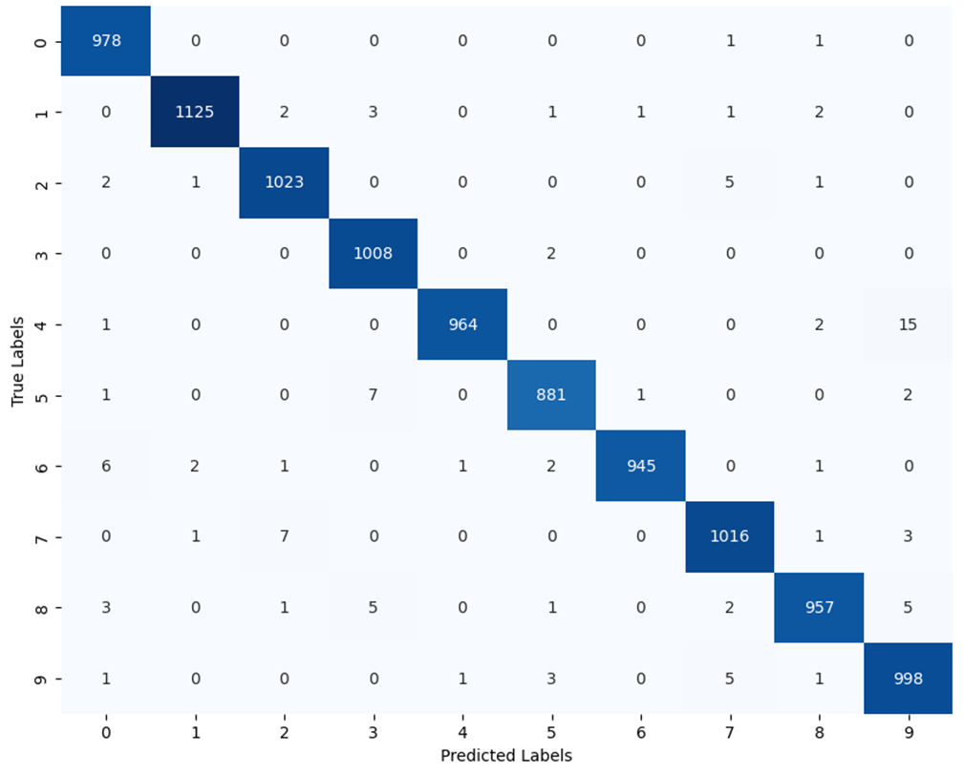

CONFUSION MATRIX

Slide 7


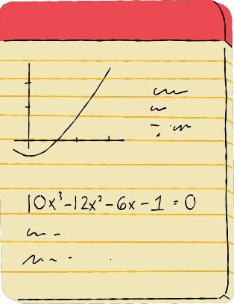
THANK YOU!

