Slide 1
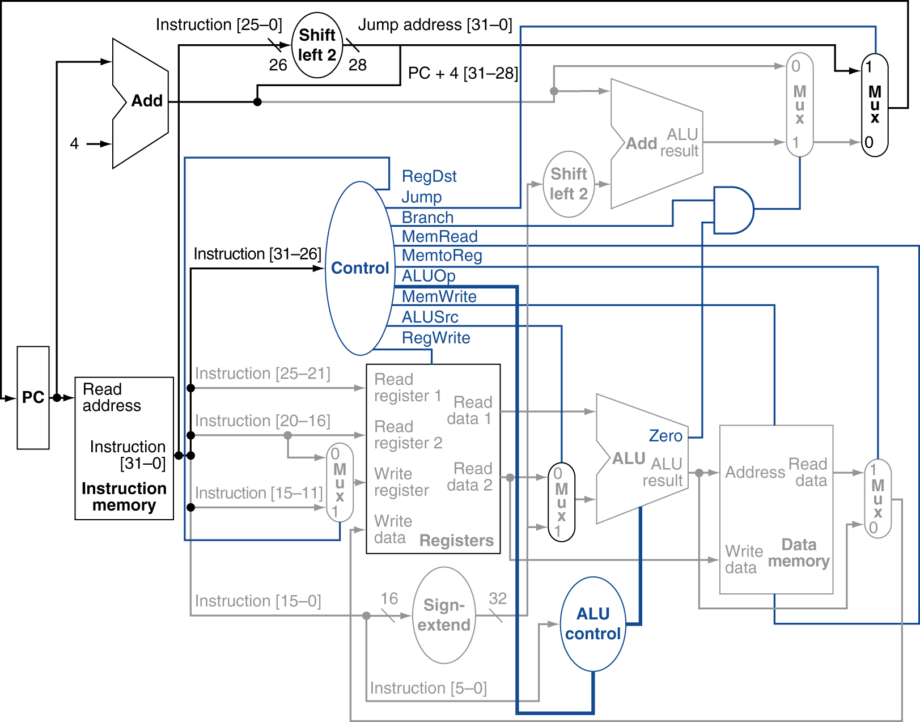
Mandatory assignment 2:
MIPS Simulator
INF-2200 Fall 2023
Lars Ailo Bongo (lars.ailo.bongo@uit.no)
14.09.23

Slide 2
Implement a pipelined binary code simulator for a subset of the MIPS architecture
j | jump
beq | branch equal
bne | branch not equal
lui | load upper intermediate
slt | set less than
lw | load word
sw | store word
add | add
addu | add unsigned
addi | add intermediate
addiu | add intermediate unsigned
sub | subtract
subu | sub unsigned
and | binary and
or | binary or
nor | binary nor
break | break execution
Datapath and controller as described in textbook
  Chapter 4.1 - 4.8 (not including dynamic branch prediction)
  (Chapters 1 - 3 and Appendix B)
For the design review you should understand:
  Pipeline concept
  MIPS instruction format
  Binary operations
  Data and control hazards

Slide 3
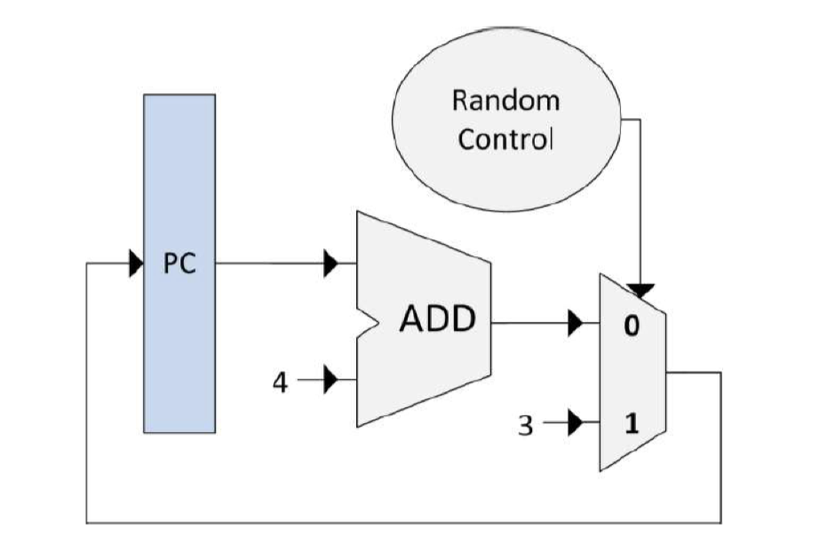
Pre-code implements a simple control and data path
Adder
Constant
Mux
PC (Modify to handle hazards)
Random Control (useless)
Test Element (example in mux.py)

Slide 4
All control and datapath elements are subclasses of the CPUElement class
Table data structures for:
Input data
Output data
Input control signals
output control signals
Interface:
__init__: Constructor.
connect: initialize data and control paths
readinput
readControlSignals
writeOutput
setControlSignals
getOutputValue: read output data from previous iteration
getControlSignal: get control signal from previous iteration

Slide 5
Your tasks (1)
Implement a subclass for each type of element in your control or data path
  Elements are subclasses of CPUElement (pre-code)
  CPU Elements are connected in a MIPSSimulator class
Implement initializeMemory()
  InstructionMemory and DataMemory instances initialized by reading binary data from a file

Slide 6
The simulator
Initialization:
Create an object for each control and datapath element.
Connect the elements by specifying input and output data and signals.
For each cycle:
For each element, call readControlSignals() and readInput()
For each element, call writeOutput() and setControlSignals()
Check if the break instruction has been encountered and exit the loop if so.
On completion:
Print the content of the registers and the number of cycles that were executed.

Slide 7
.mem programs
# structure:
# 'TestName' 'destination(register/address)' 'value' 'exception'
> Test_lw 12 42 !trap
0x0000000000000000 0x3C0904DC lui $t1, 0x4dc
0x0000000000000004 0x214A57F4 addi $t2, $t2, 0x57f4
0x0000000000000008 0x01495825 or $t3, $t2, $t1 #data dependency#
0x000000000000000c 0x8D6C0000 lw $t4, ($t3)
0x0000000000000010 0x00000000 nop
0x0000000000000014 0x00000000 nop
0x0000000000000018 0x00000000 nop
0x000000000000001c 0x0000000D break
0x0000000004dc57f4 0x0000002A #DATA MEM# 42
MIPS binary code
We provide 16 simple + 3 more advanced programs
We provide assembly comments for readability, but you should only use the binary codes

Slide 8
Your tasks (2)
Add support for break instruction
Figure out correct order to read from and write to the different elements
Select and implement and approach to handle data hazards
  Read-after-write
  Load-use
  Others?
Handle control hazards
  Branching
  Others?

Slide 9
Testing
We provide (unit) test for MIPS instructions
We provide 3 simple binary programs
We do not provide integration tests
You can run these using pytest or using Github pipeline

Slide 10
Your tasks (3)
Implement (integration) tests that demonstrate that your simulator works correctly
Implement tests demonstrating that you handle control and data hazards

Slide 11
Your tasks (4)
Write report
  IMRaD structure
  Describe your simulator design and implementation
  Discuss hazards handling approach
  Describe your new tests
  Describe (if any) bugs and known issues
Feel free to use ChatGPT to write the report

Slide 12
Deliverables and practicalities
Same procedure as for assignment 1
  Group assignment
  Github for handout and handin
Design review
  Each group will have a meeting with their TA
  You should prepare a short presentation about how you plan to solve the assignment
  Pass / no-pass grade

