Slide 1
Functional programming, IO monad
And other buzz words...

Slide 2
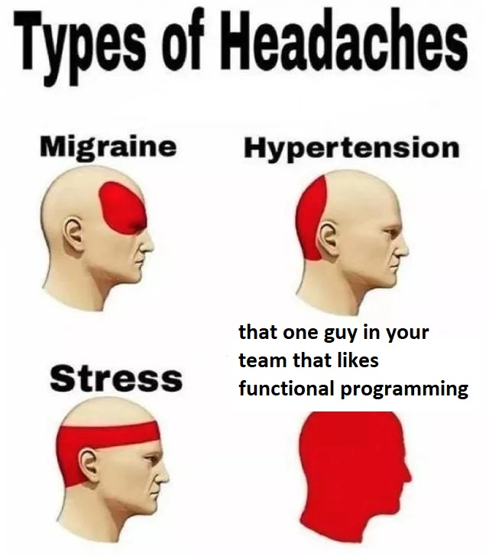

Slide 3
Why should we care about funtional programming?
... since we do not use it in our project?

Slide 4

Broadens perspectives
Improves abstractional thinking
To brag about it

Slide 5
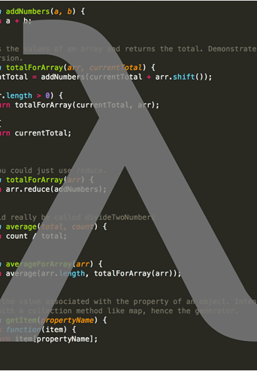
Functional Programming

Slide 6
Paradigms / key koncepts
Immutability – no existing value will ever change
Pure functions – no side effects, always returning the same value given the same input - deterministic
Lazy evaluation – values are calculated only when they are needed. Delay till „end of the world”

Slide 7
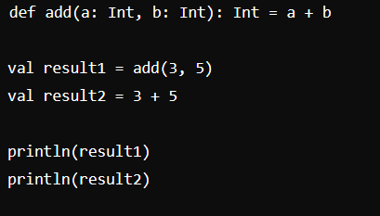
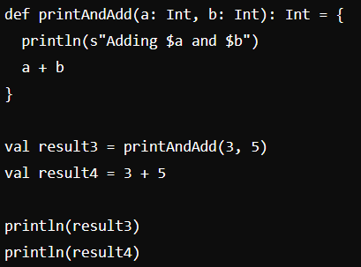
Paradigms / key koncepts cnt.
Referential Transparency – expression can be awalys changed with its return value, without any effect on the program outcome

Slide 8
Pros | Cons
Improved modularity | Learning curve
Easier to reason about | Performance
Easier to test | Abstract code
Scalabe | Fewer frameworks and tools

Slide 9
There is way more...
Category theory
Functors, applcatives, monads
Traversable
Currying
Partials
...

Slide 10

monad

Slide 11
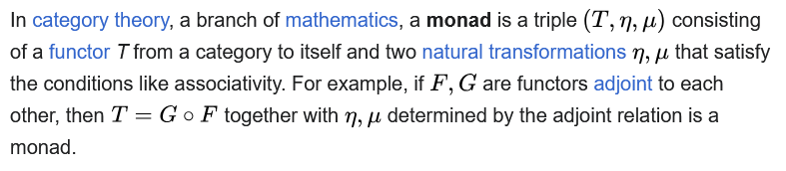
Monad
https://en.wikipedia.org/wiki/Monad_(category_theory)

Slide 12


Monad
https://en.wikipedia.org/wiki/Monad_(category_theory)

Slide 13
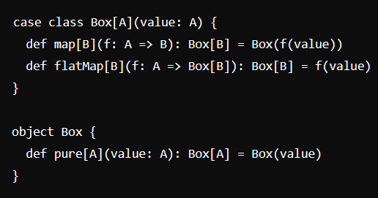
MONAD cnt.
It simply has to implement 3 funtions:
.map()
.flatMap()
.pure()
Eg.: Option, Either, List

Slide 14
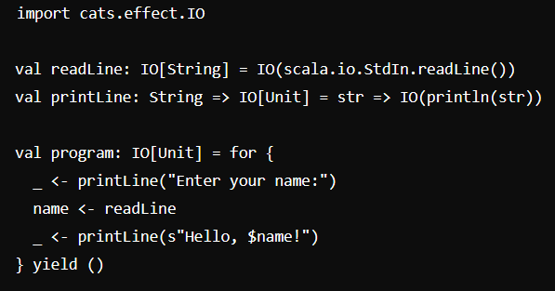

IO Monad
Adds .unsafeRunSync()
Eg. CatsEffect – IO, ZIO
We can treat program as description of computations, not computations itself.

Slide 15
Key takeaways
FP is not only about high-order functions
FP makes it easier to write better code
Easier to test
Easier to reason about
Modular
Monads are simple – there are just 3 simple functions
IO Monad allow as to treat program as description of computations

Slide 16
Further read
Youtube / Bartosz Milewski
https://www.scala-exercises.org/
ZIO
Cats

Slide 17
Thank you

