Slide 1
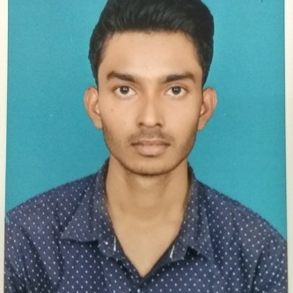



Kishan Kumar
Analyst/Software Engineer
Bachelor of Engineering
Computer Science : 2017 - 2021
Skills
Java | Java Basics, OOPS, Generics, Collections, Arrays, Loops, Lambda Exp.
Spring REST | Implementation of GET, POST, PUT & DELETE, Exception Handling.
Spring Boot Microservices | Spring Boot Starters, annotations, Swagger API.
Spring Cloud | Eureka server.
Tools | Git, Postman, IDE
Angular | Components, Services, Modules, Routing, Forms & Validation, Testing using Jasmine & Karma
Database | MongoDB No Sql Basics.
UI Tech | HTML 5 & CSS 3,JavaScript, ES6 & TypeScript.
Add On skills | Communications, Peer learning, Quick grasping.
Bangalore
Kishan.e.kumar@capgemini.com
+91 8294252003
A4
Full Stack Developer
Hands on experience in creating microservices with Springboot, Spring Security, Spring Cloud API Gateway, Eureka server.
Experience in creating documentation with Java docs and swagger and in unit testing using Junit, Mockito.
Creating Single page Web Application in Angular with angular routing and navigation.
Hands on experience in implementing Angular with TypeScript, JavaScript, NodeJS & spring boot.
E-Commerce Shopping Cart Application
Completed case study of Shopping Cart Application along with Zuul API, Eureka server , swagger UI and Angular for user interface.
Technologies used : java with Spring boot framework, MongoDB and AngularJS.
Check out my work on GitHub & Video Profile

