Slide 1
Parallax Propeller
by Kyle Kurzhal

Slide 2
Background/Contributions
Parallax Inc. was founded in 1987 by Chip Gracey and Lance Walley
In 1992, Parallax created the BASIC Stamp 1 (great for learning and hobbyists)
Then, based on the BASIC Stamp model, the Propeller microcontroller was developed in 2006
Parallax has been greatly involved in electronics education
Stamps in Class program in 1997
Released source code of executable portions of ROM (2008)
Parallax Propeller 1 released as open source hardware under the GNU v3.0 (2014)

Slide 3
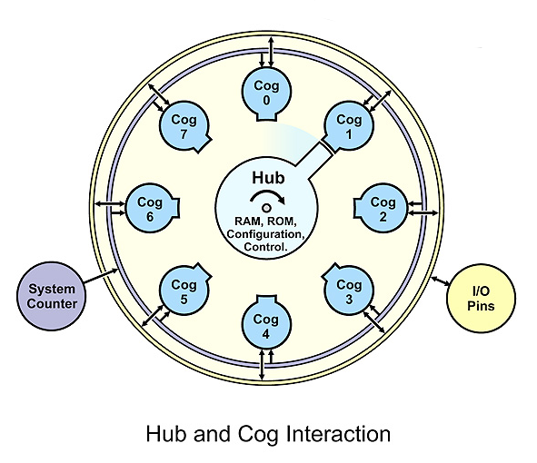
General Facts/Unusual Features
Up to 80 MHz with low power usage
8 processors, each called a “Cog”
Up to 20 MIPS
Independent from other Cogs, allowing parallelization
Centrally shared memory, called the “Hub”
Contains RAM/ROM
Mutually exclusive – only accessible in round-robin fashion to each Cog for two cycles
Runs at half the system clock speed
Timing of instruction executions is extremely important

Slide 4
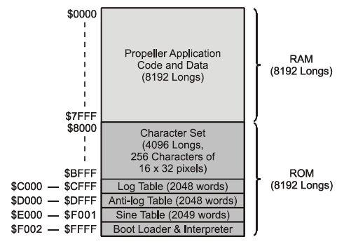
Memory Specifications
Cog RAM/registers
2 KB each
Long addressable
Addresses $000-$1FF
Main/Hub RAM/ROM
32 KB apiece
Byte (8-bit), Word (2-byte), Long (2-word) addressable
Addresses $0000-$7FFF (RAM) and $8000-$BFFF (ROM)
ROM contains character definitions, Log and Anti-Log tables, a Sine table, a boot loader, and the Spin interpreter
Data stored in Little Endian format

Slide 5
Registers
512, 32-bit registers per Cog
496 general purpose registers (addresses $000-$1EF)
16 special purpose registers (addresses $1F0-$1FF)
Registers are also considered to be RAM
May store entire instructions, data values, or addresses

Slide 6
Data Types
Binary (denoted with a beginning “%”)
Quaternary (denoted with a beginning “%%”)
Decimal integers
Decimal floating-points (denoted with “e” for scientific notation or with “.” for decimals)
Hexadecimal (denoted with a beginning “$”)
Characters

Slide 7
Instruction Set
RISC-based architecture
Two main languages
Spin (interpreted from Hub RAM)
Propeller Assembly (stored directly in Cog registers)
Instructions
Logic
Arithmetic
Control
I/O
Hub

Slide 8
Instruction Format
32-bit instructions
Spin
Interpreter stored in registers
Execution instructions fetched from Hub RAM
Propeller Assembly
Instruction - bits 31-26
Effects (flags) - bits 25-22
Execution condition (If statement) - bits 21-18
Destination register - bits 17-9
Source register or 9-bit immediate value - bits 8-0

Slide 9
Addressing Modes
Spin
Direct addressing
Indirect addressing
Indexed addressing for special purpose register array (SPR)
A form of base-relative addressing for certain instructions
Propeller Assembly
Direct addressing
Indirect addressing
Immediate addressing – denoted by '#' in source register

Slide 10
I/O
32 I/O pins
28 general purpose
4 special purpose (until after boot-up)
May be simultaneously accessible
Direction register – controls if a pin is considered output and if the associated Cog may output to it.
INA register – input register
OUTA register – output register
Dependent upon the programmer

Slide 11
Electronic Resources
http://www.parallax.com/company/about-us
http://forums.parallax.com/showthread.php/101483-Propeller-ROM-source-code-HERE>
http://forums.parallax.com/showthread.php/135599-Converting-bytes-to-Strings
http://hackaday.com/2014/08/07/parallax-propeller-1-goes-open-source/
http://www.tceaconvention.org/2014/handouts/Proposal141400.pdf
http://www.parallax.com/sites/default/files/downloads/P8X32A-Web-PropellerManual-v1.2_0.pdf
http://www.parallax.com/sites/default/files/downloads/P8X32A-Propeller-Datasheet-v1.4.0_0.pdf
http://makezine.com/2014/08/06/parallaxs-propeller-1-silicon-goes-open-source/>.

Slide 12
Github
Presentation document and slideshow at:
https://github.com/kkurzhal/CS_311

