Slide 1
DengAI: Predicting Disease Spread
27th August 2021

Slide 2
Agenda
Problem Statement
Approach & Assumptions
Data Exploration , Visualization, and Understanding the data
Feature Extraction from Raw Data
Feature Engineering based on Correlation
Run Different Models , compare model performance and propose the best model based on performance metrics (MAE and RMSE)
Predict based on the best model
Final Observation
Future Enhancements

Slide 3
Problem Statement
Dengue fever is a mosquito-borne disease that occurs in tropical and sub-tropical of the world. It may cause symptoms such as flu, fever, rash etc. In Severe cases – It may cause severe bleeding, low blood pressure, and even death.
Because it is caused by mosquitos, the transmission of Dengue are correlated to Climatic variables such as temperature and precipitation.
Dengue incidences follows seasonal transmission patterns followed by cyclic larger epidemics. Because these epidemics are unpredictable, The objective of “DengAI” model will be forecasting key metrics “total_cases” of outbreak – by using historic climatic variables of the past (cyclic and seasonal time series from the past)

Slide 4
Approach & Assumptions
First Step before we build any predictive model is Data Preparation.
Data Exploration (data distribution), visualization, and Understanding the data
Cleaning the data and dealing with outliers and missing values , and
Scaling the data - Scaling helps in model convergence and avoiding bias (one feature more important than other due to scale). I am planning to use models (Linear regression, Decision Tree , Random Forest, and Negative Binomial Distribution) - which may not require scaling .
We should explore correlation among predictors - if predictors are highly correlated - we may think of reducing / combining feature space. We will use PCA (which will require Scaling) to reduce highly correlated features ( to avoid multicollinearity). PCA will require scaling of data
We will Analyze and model SanJuan and Iquitos data separately - as climatic condition and feature are quite different and cyclic across Cities – It makes sense to build and deploy the model in isolation
We will run different models on underlying data set, find the best model based on performance metrics (MAE and RMSE) and predict total_cases on test data set
Please refer “Readme.txt” for running the model. Please refer inline comments for contextual information

Slide 5
Data Exploration
We have missing climatic data cases for SanJuan and Iquitos. We have imputed the data (forward and back filled)
For missing time series data, we have forward filled it
For climatic daily data, we resampled it to weekly. While weekly resampling, we have taken weekly mean. To be consistent with ISO calendar, we have assumed week to start on Monday
There are specific years (such as 1/1/2005) which ends on Weekend. As we are consistently following ISO calendars (based on external Climatic data) – we decided to map the data to include first week data

Slide 6
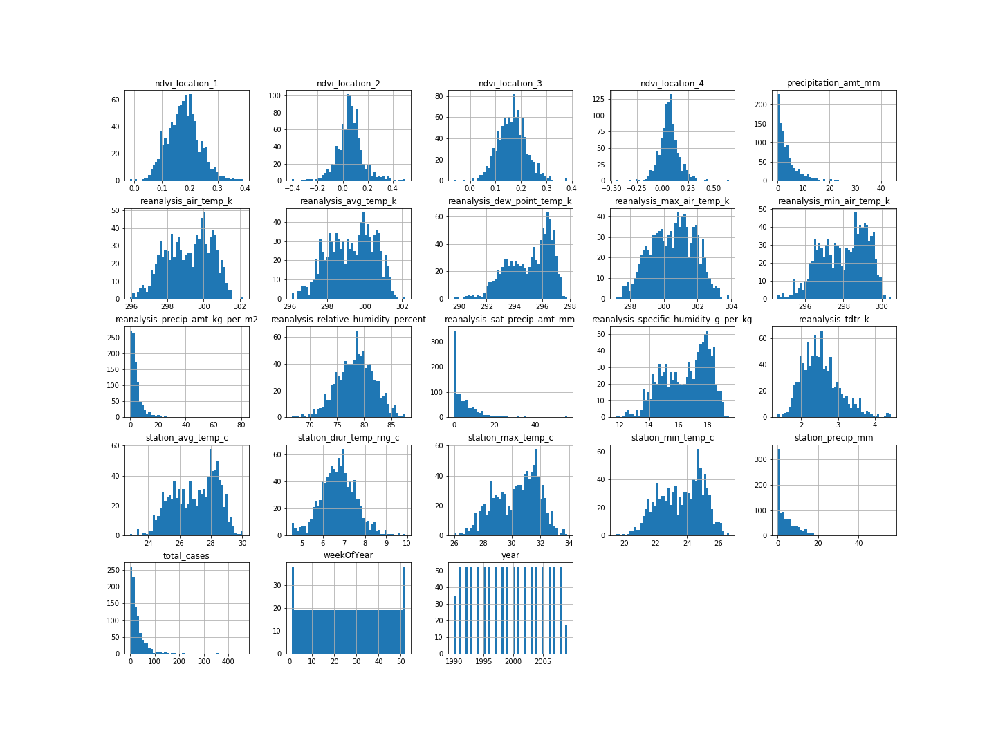
Data Exploration – SanJuan - Histogram

Slide 7
Data Exploration – SanJuan – Data Distribution - Observations
Year , WeekofYear are not in feature list - hence we will ignore its data distribution
Features such as 'station_precip_mm', 'precipitation_amount_mm', 'reanalysis_precip_amt_kg_per_m2' , 'reanalysis_sat_precip_amt_mm' are tail heavy (not normally distributed). As precipitations are seasonal, it is expected to be tail heavy
Other features appear to follow normal distribution
From Histogram, It is observed that there are no significant Outliers for any of the predictors
"total_cases" is our label (Observed cases). It is tail heavy - in consistent with outbreak spike

Slide 8
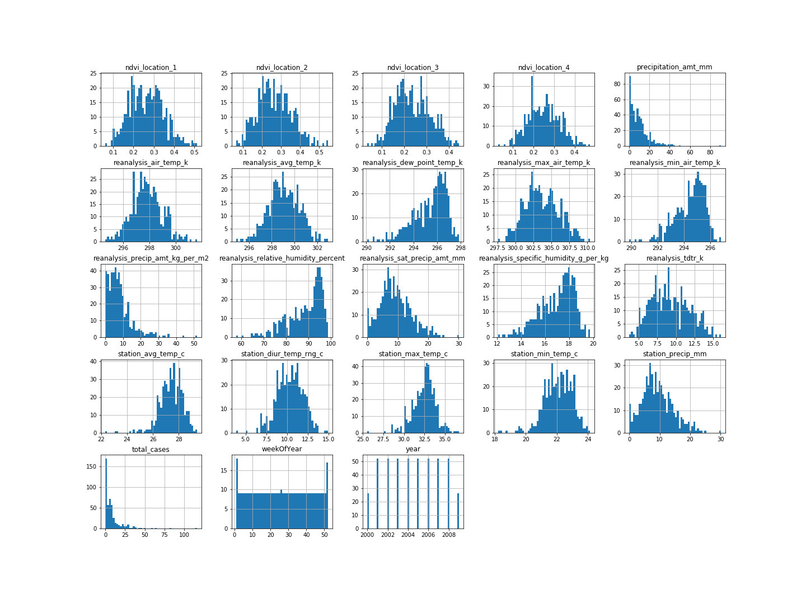
Data Exploration – Iquitos - Histogram

Slide 9
Data Exploration – Iquitos – Data Distribution - Observations
Year , WeekofYear are not in feature list - hence we will ignore its data distribution
Features such as 'precipitation_amount_mm', 'reanalysis_precip_amt_kg_per_m2' are tail heavy (not normally distributed). As precipitation are seasonal, it is expected to be tail heavy
Other features appear to follow normal distribution
From Histogram, It is observed that there are no significant Outliers for any of predictors
"total_cases" is our label (Observed cases). It is tail heavy - in consistent with outbreak spike

Slide 10
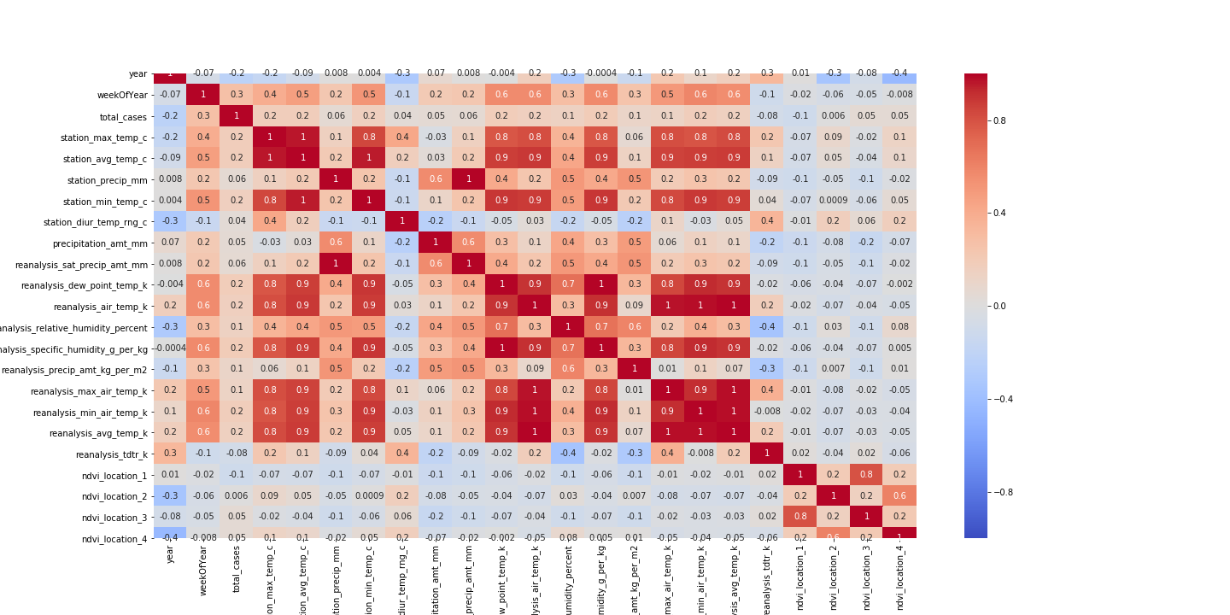
Data Correlation Heatmap - SanJuan

Slide 11
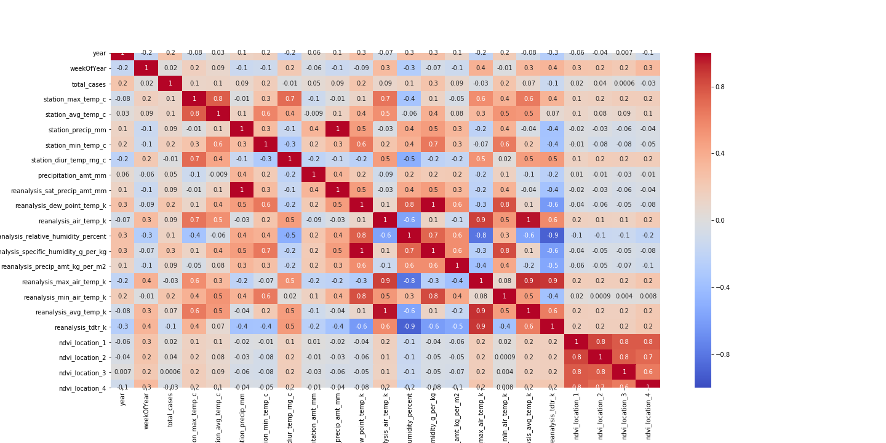
Data Correlation Heatmap - Iquitos

Slide 12
Data Correlation – Observations – SanJuan & Iquitos
We are not observing *significant* Correlation of label - 'total_cases' (observed cases) with other features.
Many of the temperature data are strongly correlated, which is expected. But the `total_cases` variable doesn't have many obvious strong correlations.
Interestingly, `total_cases` seems to only have weak correlations with other variables. Many of the climate variables are much more strongly correlated. Interestingly, the vegetation index also only has weak correlation with other variables.
Any modelling based on highly correlated features will be biased - hence we will eliminate feature correlation through PCA
These correlations may give us some hints as to how to improve our model (we will leverage it later).
Let's take a `sorted` look at `total_cases` correlations - which will provide us further insight

Slide 13
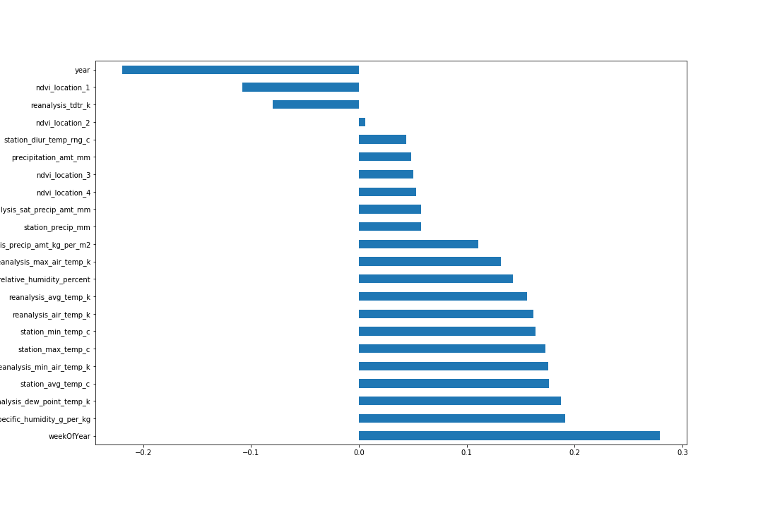
Data Correlation – Sorted Bar Graph – San Juan

Slide 14
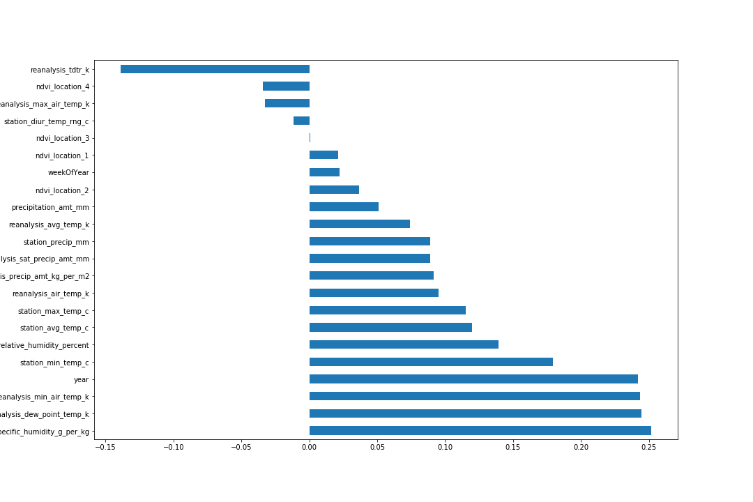
Data Correlation – Sorted Bar Graph – Iquitos

Slide 15
Data Correlations – Further Observations
The wetter the better
The correlation strengths differ for each city, but it looks like `reanalysis_specific_humidity_g_per_kg` and `reanalysis_dew_point_temp_k` are the most strongly correlated with `total_cases`. This makes sense. we know mosquitos thrive _wet_ climates, the wetter the better.
Hot and heavy
As minimum temperatures, maximum temperatures, and average temperatures rise, the `total_cases` of dengue fever tend to rise as well.
Sometimes it rains, so what
Interestingly, the `precipitation` measurements bear little to no correlation to `total_cases`, despite strong correlations to the `humidity` measurements, as evident by the heatmaps above.
Manually extracted features
Precisely _none_ of these correlations are very strong. Also, there could be potentially **non-linear** relations, but out-of-the-box correlation measures linear dependence.
Based on above, we may leverage below target features to a specific distribution model
`reanalysis_specific_humidity_g_per_kg`
`reanalysis_dew_point_temp_k`
`station_avg_temp_c`
`station_min_temp_c`

Slide 16
Select and Train Models
Once we have Cleaned and pre-processed the data - we are ready to run models.
This is a regression model - based on Climate Data Varaiable - we are predicting continuous data variable *total cases* of Dengue
For regression models - we will choose among Linear Regression , Decision Tree and Random Forest. We will try to find best parameters for Random Forest
As there are correlation among features, we will use PCA to reduce dimensions (up to 95 % Accuracy) and fit PCA dimensions to a Linear Regression models
Further, we will try to leverage Poission or Negative Regression model - in our pursuit of finding an optimal model
We will be using cross validation - to remove any biasedness due to data distribution.
For Model performance, we will leverage mean absoluter error (MAE) or Root Mean Square Error (RMSE), As RMSE is impacted by outlier, MAE becomes a good choice. However, as we have not observed any of outliers - we should be fine with any of performance measures
As we have to choose among models - we will split the data in training (80 % of data) and test ( 20 % of data). We will choose the model - which has the best performance measure
Based on performance measures (MAE and RMSE) , we will fit the best model to predict *total_cases* on test time period.

Slide 17
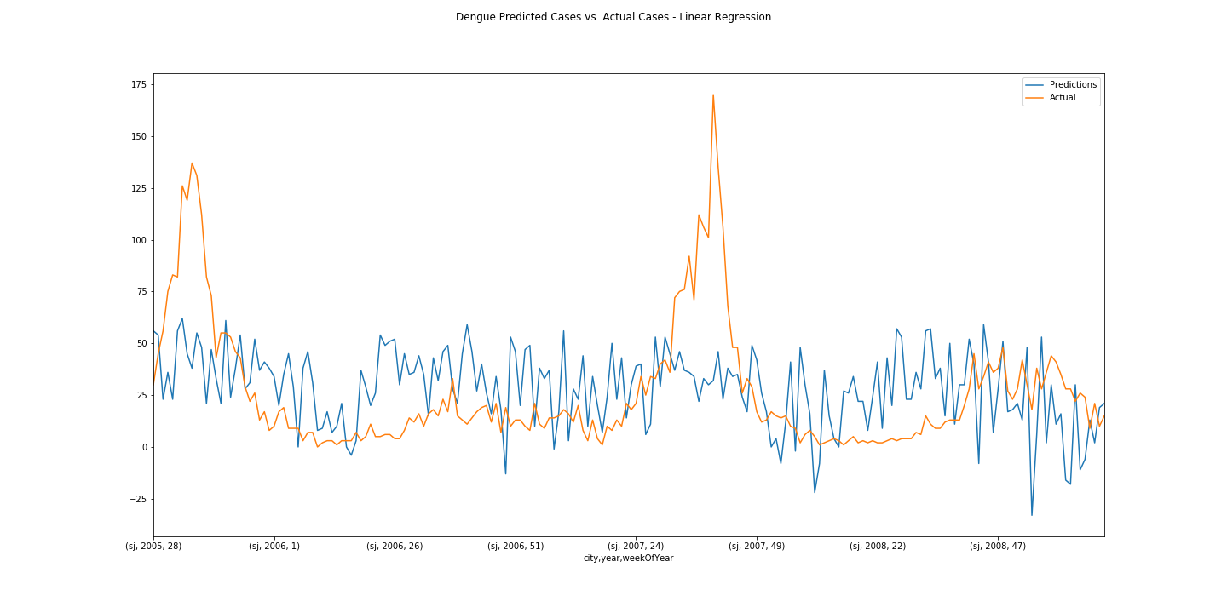
Linear Regression – SanJuan

Slide 18
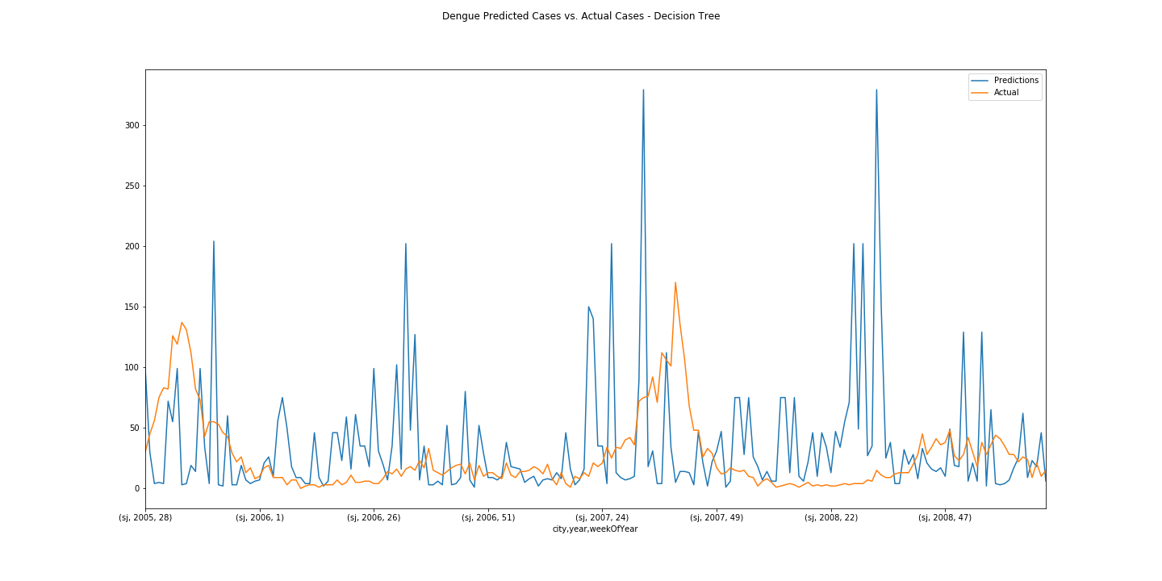
Decision Tree - SanJuan

Slide 19
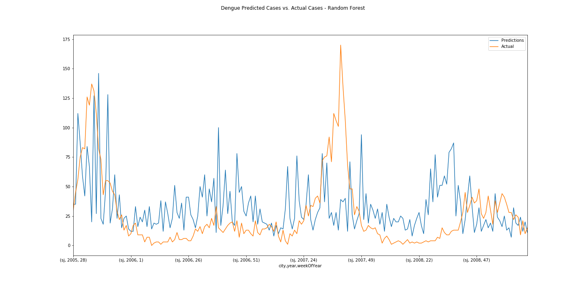
Random Forest - SanJuan

Slide 20
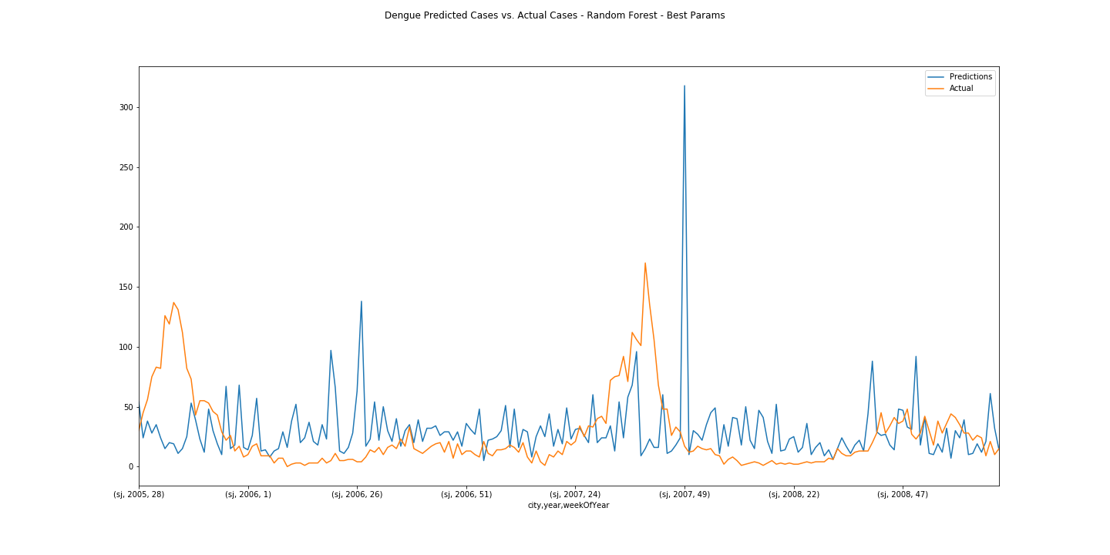
Random Forest with best params – SanJuan

Slide 21
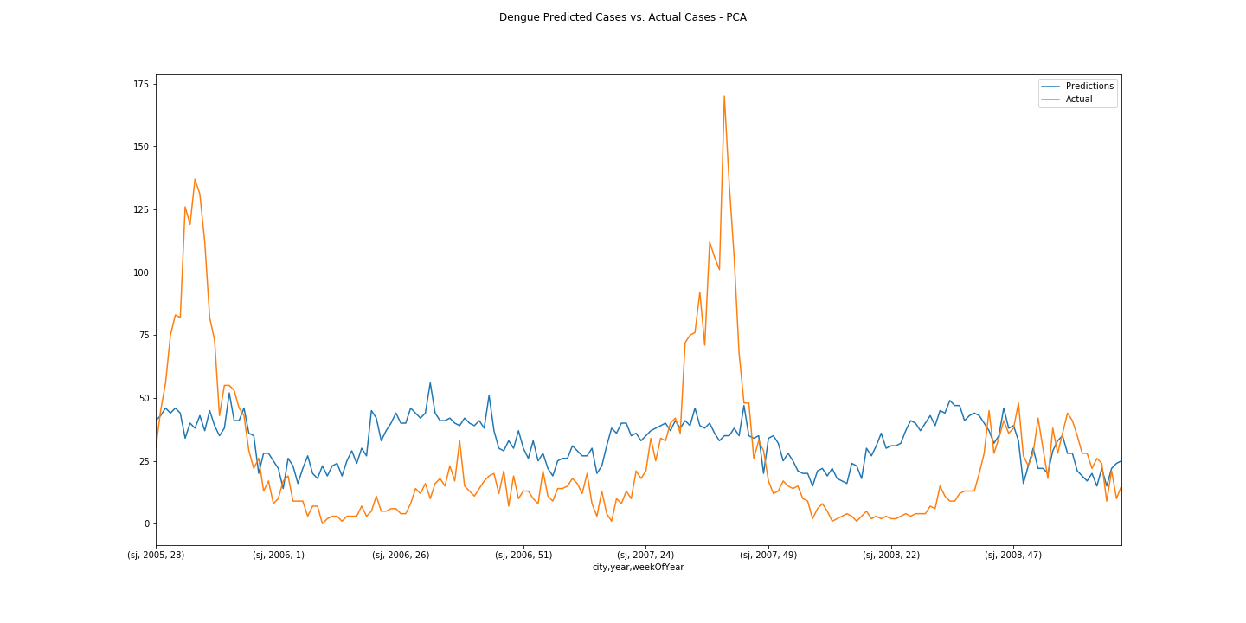
PCA - SanJuan

Slide 22
Observations on Model Run
We started with Linear Regression; We observed features are correlated to each other . In Spite of multi collinearity, we got one of the best model performance with Linear Regression
PCA is the best performing model - as expected (It has eliminated correlation among features and has used only first 2 Principal Components with 95% of explained variance ratio). Reduced PCA dimensions are fit with Linear Regression to find the best fit.
Decision Tree is overfitting (Evident from fitted vs actual Graph) the model and hence the worst performing
Random Forest has intermediate performance results. Using Random Forest with Best Features did not improve results significantly. Further tree Randomization may help.

Slide 23
Can we do better than it?
If we know Underlying distribution of data, we may be able to model it better
Distribution of labels
Our target variable, `total_cases` is a non-negative integer, which means we're looking to make some **count predictions**. Standard regression techniques for this type of prediction include : 1. Poisson regression , 2. Negative binomial regression
Which technique will perform better depends on many things, but the choice between Poisson regression and negative binomial regression is pretty straightforward.
Poisson regression fits according to the assumption that the mean and variance of the population distribution are equal.
When they aren't, specifically when the variance is much larger than the mean, the negative binomial approach is better. The negative binomial regression simply lifts the assumption that the population mean and variance are equal, allowing for a larger class of possible models.
We Observe that label *total_counts* variance (2521.44) is quite larger than the mean (33.43) and hence we will apply negative binomial distribution in pursuit of finding best performing model

Slide 24
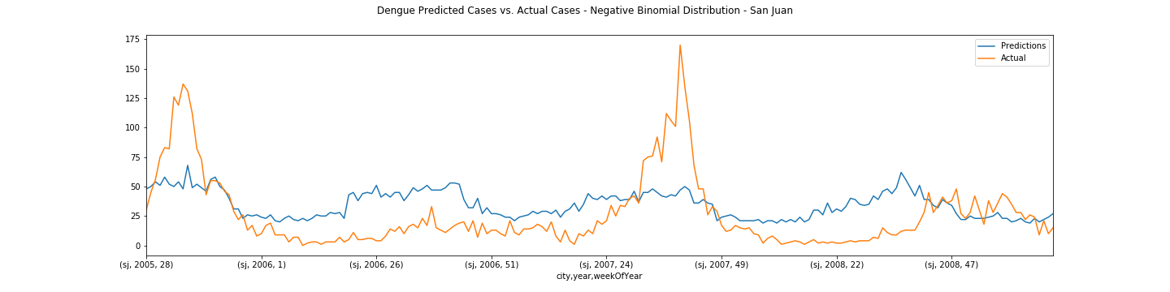
Negative Binomial Model - SanJuan

Slide 25
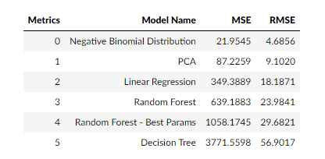
Performance Metrics Data - SanJuan

Slide 26
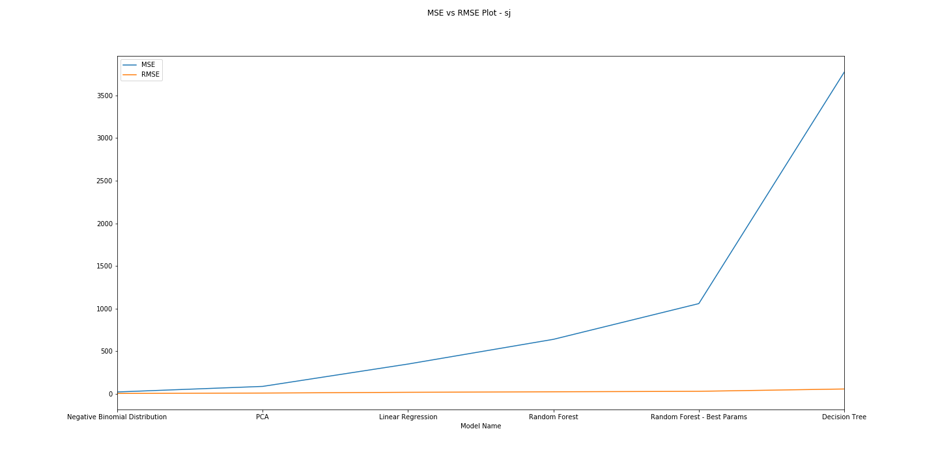
Performance Metrics – MAE vs. RMSE Plot - SanJuan

Slide 27
Model Observations - SanJuan
Based on model runs, we observe that Negative Binomial model has best performing metrics
We will fit this model to predict *total_cases* of dengue in test data set.
Please refer file (output/ SanJuanPredictions_NegativeBinomial.csv) for *prediction* data
Please refer “Readme.txt” for further details

Slide 28
Model Details - Iquitos
We will re-run models for Iquitos
Subsequent slides has model Actual Vs Fitted plot
For Iquitos – We are observing that *Negative Binomial Distribution* is not the best performing model
PCA with 95% of explained variance ratio fitted with Linear Regression is the best performing model for Iquitos
Please refer file (output/ IquitosPredictions_PCA.csv) for *prediction* data
Please refer “Readme.txt” for further details

Slide 29
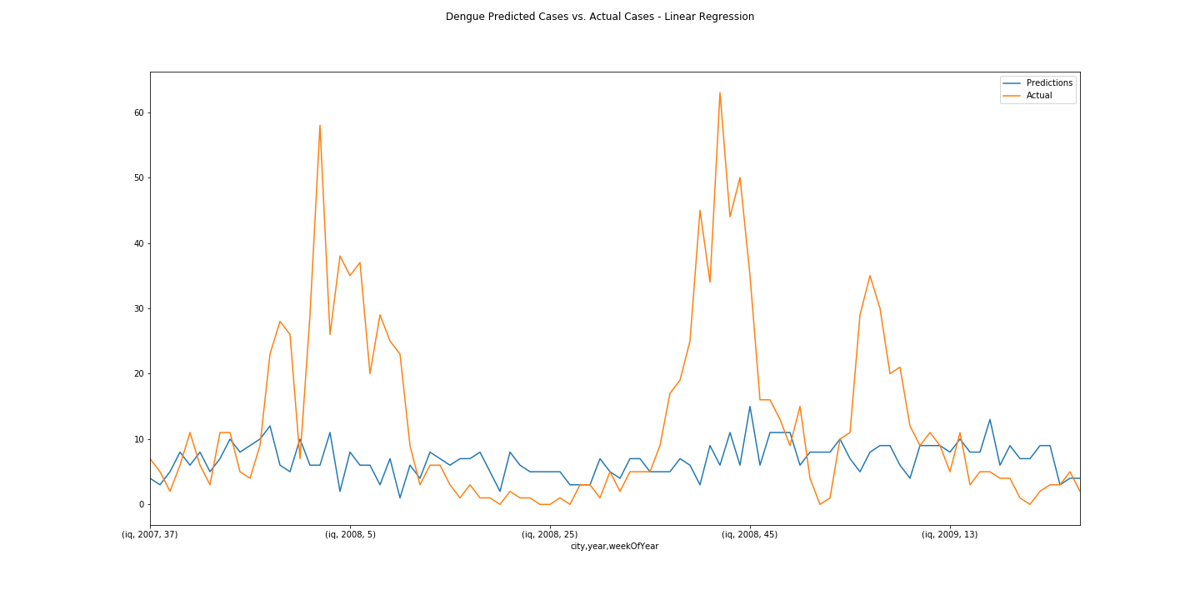
Linear Regression - Iquitos

Slide 30
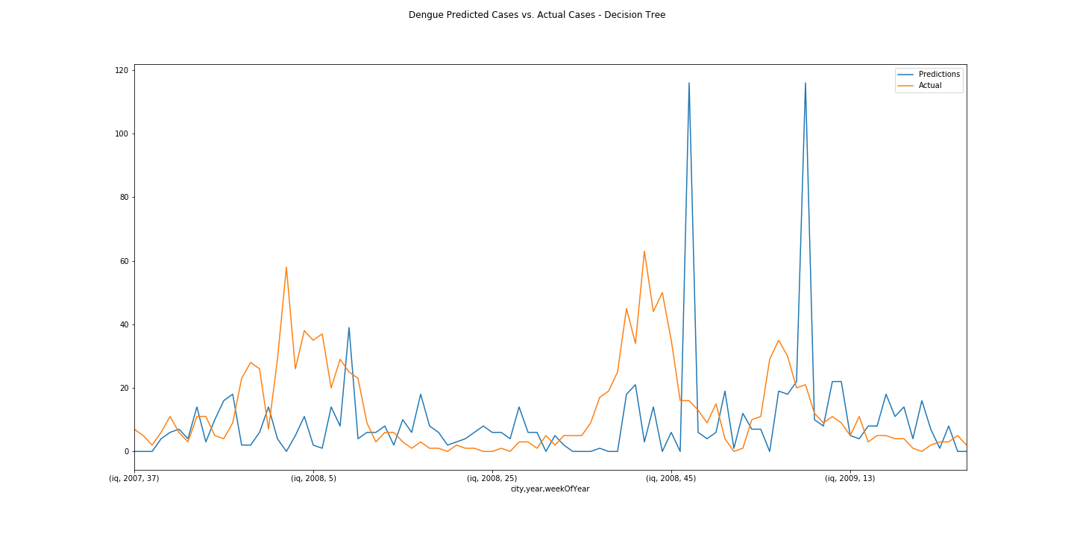
Decision Tree - Iquitos

Slide 31
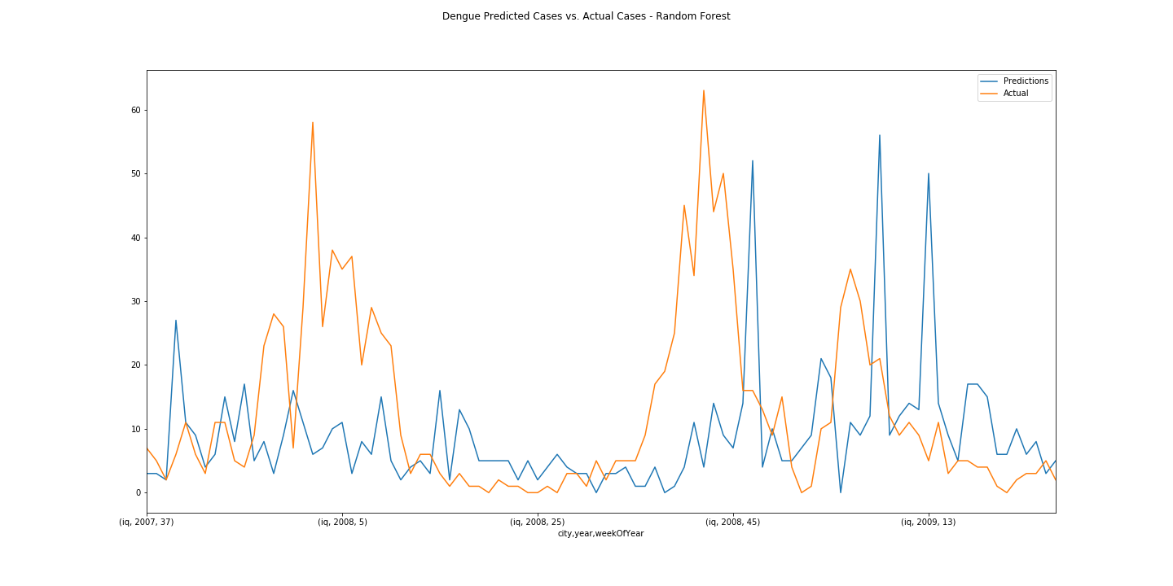
Random Forest - Iquitos

Slide 32
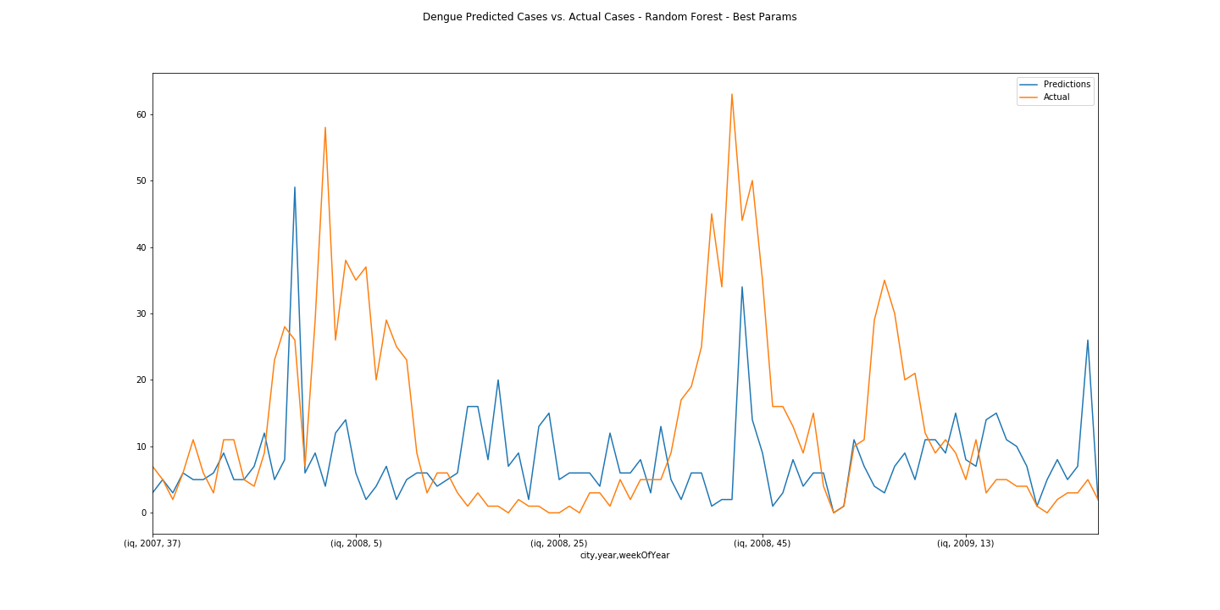
Random Forest best params - Iquitos

Slide 33
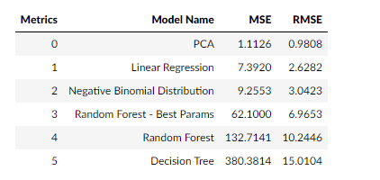
Performance Metrics Data - Iquitos

Slide 34
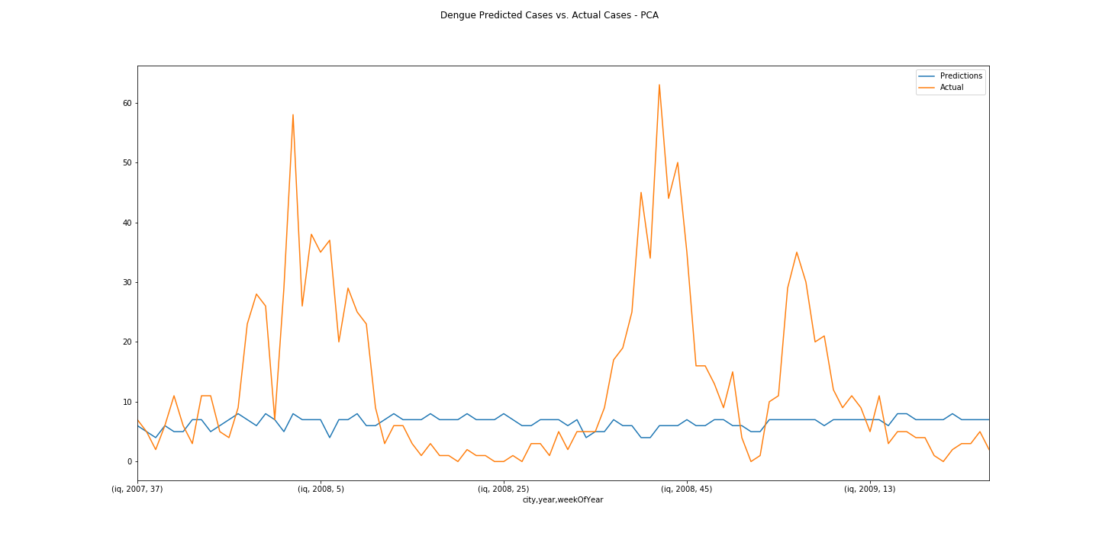
PCA - Iquitos

Slide 35
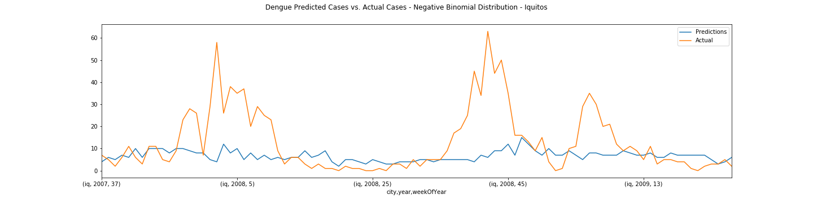
Negative Binomial Model - Iquitos

Slide 36
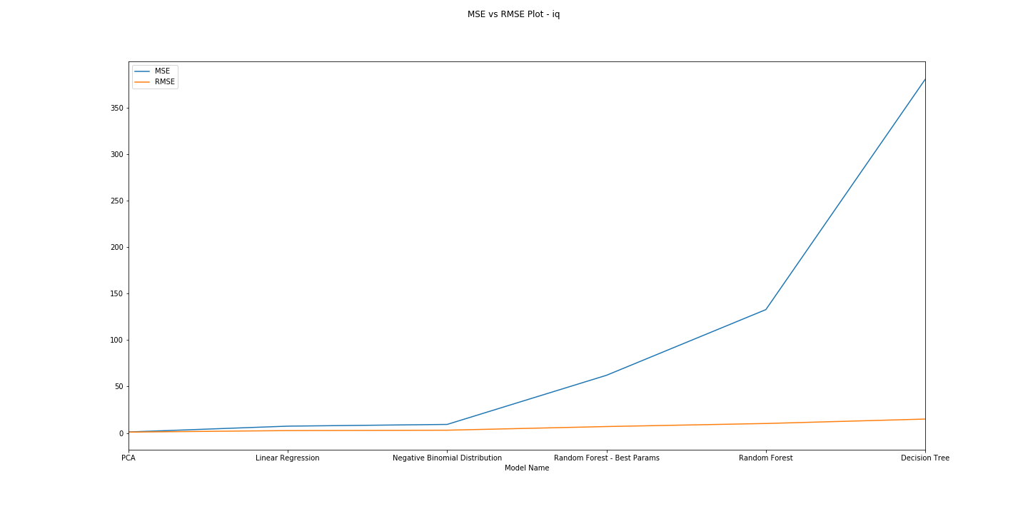
Performance Metrics – MAE vs. RMSE Plot - Iquitos

Slide 37
Final Observations
Negative Binomial Distribution is the best performing model for San Juan and .PCA is the best performing model for Iquitos. We have performed predictions based on these best performing models.
Further improvements
This is a time Series model and there is *trend and seasonality* in total_cases. We should try exponential smoothing model to remove trend and seasonality , test for time series being stationary and explore any further performance improvement.
We should have created train data set (to fit the model), validation data set ( to find the best performing model) , and test data set (to measure performance). However, due to small data set , we did not follow this.
We predicted (forecasted) only point estimates of *total_cases*. We could not do probability distribution of peak cases on 4 weeks cycle.
Reflecting on our performance
We see that our model in blue does track the seasonality of Dengue cases. However, the timing of the seasonality of our predictions has a mismatch with the actual results. One potential reason for this is that our features don't look far enough into the past--that is to say, we are asking to predict cases at the same time as we are measuring precipitation.
Because dengue is mosquito born, and the mosquito lifecycle depends on water, we need to take both the life of a mosquito and the time between infection and symptoms into account when modeling dengue. This is a critical avenue to explore when improving this model.
The other important error is that our predictions are relatively consistent--we miss the spikes that are large outbreaks.
One reason is that we don't take into account the contagiousness of dengue. A possible way to account for this is to build a model that progressively predicts a new value while taking into account the previous prediction (Naïve Bayes model). By training on the dengue outbreaks and then using the predicted number of patients in the week before, we can start to model this time dependence that the current model misses.

