Slide 1
Semantic GenAI for BI
Manager takeaway
Teaser deck from notebook evidence: how the semantic layer converts raw fields into governed metrics, and how Gemini produces grounded answers from deterministic data.
The semantic layer eliminates guesswork on field names, formulas, and filters.
The notebooks show deterministic KPIs first, then LLM narration and NL translation on top.
This is the right path for trustworthy BI over operational data.
Raw records
Canonical fields
Governed metrics
10
7
3
JSON sample loaded
Staged contract
Registry validated
Notebook checks
Validated answer
LLM role
29/29
$15.5M
Translate + narrate
20 phase-1 + 9 Gemini
net_margin_exposure
Not raw math
Notes:
[Sources] - Notebook evidence from phase1_validation.ipynb and gemini_integration_test.ipynb in kkveena/GenAIBI main branch. - GitHub URLs: https://github.com/kkveena/GenAIBI/blob/main/notebooks/phase1_validation.ipynb and https://github.com/kkveena/GenAIBI/blob/main/notebooks/gemini_integration_test.ipynb

Slide 2
Evidence
What the two notebooks validated
A compact proof that the architecture already works as a governed vertical slice
phase1_validation.ipynb
gemini_integration_test.ipynb
Loads 10 raw JSON records through the DuckDB adapter.
Builds a canonical staging contract with 7 fields: call_id, account_id, margin_amount_usd, collateral_amount_usd, net_val, status_name, event_at.
Registers 3 governed metrics and 3 governed dimensions.
Validates deterministic queries, FastAPI endpoints, lineage, and fail-closed behavior.
Ends with 20/20 checks passed.
Tests Gemini client connectivity and grounded narration.
Translates natural-language questions into governed metric requests.
Exercises the /nl-query API end to end: question → translation → execution → answer.
Supports translate-only mode and safe fallback when Gemini is unavailable.
Ends with 9/9 checks passed when the API key is configured.
Representative translation
Core result
Breaches
Calls
1 Q: What is the net margin exposure for January 2025? 2 → metric: net_margin_exposure 3 → grain: month 4 → start_date: 2025-01-01 5 → end_date: 2025-01-31
$15.5M
5
10
Notes:
[Sources] - phase1_validation.ipynb notebook summary and outputs. - gemini_integration_test.ipynb notebook summary and outputs. - GitHub URLs: https://github.com/kkveena/GenAIBI/blob/main/notebooks/phase1_validation.ipynb ; https://github.com/kkveena/GenAIBI/blob/main/notebooks/gemini_integration_test.ipynb

Slide 3
Flow
How the semantic layer makes BI answers trustworthy
The LLM is constrained to reasoning over governed business objects instead of inventing SQL over raw fields
Raw JSON / SQL
Canonical staging
Semantic registry
Deterministic API
Gemini layer
id, acct_id, mc_amt, st_cd, event_ts
call_id, margin_amount_usd, status_name, event_at
metrics, dimensions, default filters
/metrics, /query-metric, /explain-metric, /nl-query
translate question and narrate result
What changes with the semantic layer?
The model no longer has to infer that mc_amt means margin amount or that st_cd=4 means CONFIRMED.
Filters, formulas, grain, and metric names are governed once and reused everywhere.
Natural language becomes a safe front end to deterministic computation, rather than a source of hallucinated logic.
Notes:
[Sources] - Architecture and field examples derived from phase1_validation.ipynb and gemini_integration_test.ipynb. - GitHub URLs: https://github.com/kkveena/GenAIBI/blob/main/notebooks/phase1_validation.ipynb ; https://github.com/kkveena/GenAIBI/blob/main/notebooks/gemini_integration_test.ipynb

Slide 4
Contract
From raw fields to a canonical contract
The notebook proves that we can replace opaque source names with human-readable business terms before the LLM ever sees the data
Raw source fields
Canonical staged fields
Business meaning
id
acct_id
mc_amt
collateral_val
st_cd
event_ts
Source
Canonical
4 → CONFIRMED
5 → PENDING
0 → CANCELLED
net_val = margin_amount_usd − collateral_amount_usd
event_at standardized for time grain
id
→
call_id
acct_id
→
account_id
mc_amt
→
margin_amount_usd
collateral_val
→
collateral_amount_usd
mc_amt - collateral_val
→
net_val
st_cd
→
status_name
Exactly as the notebook loaded them from margin_transactions.json
event_ts
→
event_at
LLM sees these names
Notes:
[Sources] - Raw and canonical field names from phase1_validation.ipynb staged data validation cells. - GitHub URL: https://github.com/kkveena/GenAIBI/blob/main/notebooks/phase1_validation.ipynb

Slide 5
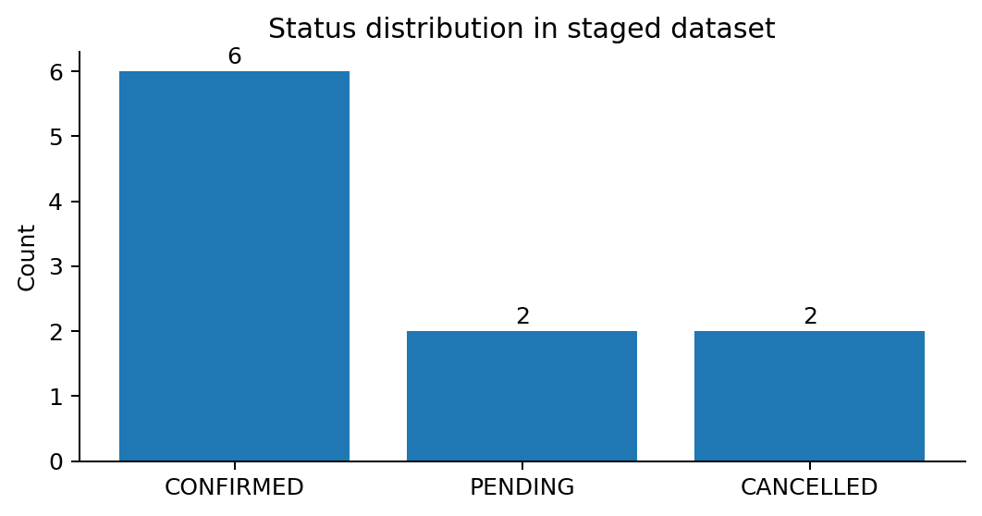
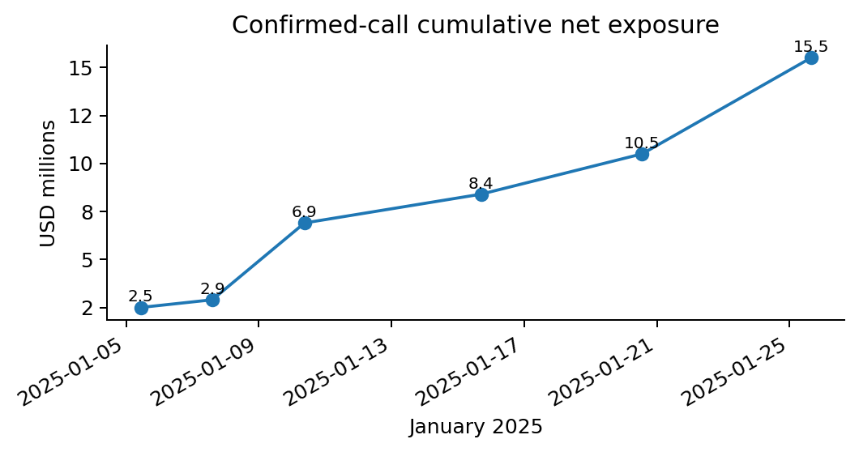
Validation
Validation evidence from the staged dataset
The semantic layer starts with data discipline: record count, status mapping, net value computation, and unique identifiers all pass
Notebook assertions that passed
10 raw records loaded
7 canonical fields present
Status mapping 4/5/0 validated
net_val formula validated on every row
call_id uniqueness validated
Daily grain returned 6 confirmed days
Filter by PENDING returned 2 calls
Date range Jan 1–15 returned 5 calls
All 20 phase-1 validation checks passed
Notes:
[Sources] - Status distribution, cumulative exposure, and validation facts derived from phase1_validation.ipynb outputs. - GitHub URL: https://github.com/kkveena/GenAIBI/blob/main/notebooks/phase1_validation.ipynb

Slide 6
Registry
The governed semantic registry
Metrics and dimensions are centrally defined before any question reaches the LLM
Governed metrics
Governed dimensions + guardrails
net_margin_exposure
high_risk_breaches
total_margin_calls
event_at (time)
status_name (categorical)
account_id (categorical)
Unknown metrics are rejected.
Unknown filter dimensions are rejected.
$15.5M
5
10
sum(net_val), default status_name=CONFIRMED
count_distinct(call_id), confirmed only
count_distinct(call_id), all statuses
Representative explain-metric response
1 Metric: net_margin_exposure 2 Formula: sum(net_val) 3 Default filter: status_name=CONFIRMED 4 Source model: stg_margin_calls
Fail-closed behavior matters
The notebook explicitly passes on 404/400-style rejection for invented metrics and bogus filters.
Notes:
[Sources] - Metric and dimension registry facts from phase1_validation.ipynb semantic registry validation and API explain-metric outputs. - GitHub URL: https://github.com/kkveena/GenAIBI/blob/main/notebooks/phase1_validation.ipynb

Slide 7
Results
Deterministic KPI results come directly from data
This is the key architecture point: the semantic layer computes, and the LLM reports
KPI 1 — net_margin_exposure
KPI 2 — high_risk_breaches
KPI 3 — total_margin_calls
$15,500,000
5
10
6 confirmed calls in Jan 2025
Confirmed calls above $5M
All statuses in Jan 2025
Manual check embedded in the notebook
1 Confirmed calls used in net exposure: 2 MC-001: 7.5M - 5.0M = 2.5M 3 MC-002: 3.2M - 2.8M = 0.4M 4 MC-003: 12.0M - 8.0M = 4.0M 5 MC-005: 6.0M - 4.5M = 1.5M 6 MC-007: 8.2M - 6.1M = 2.1M 7 MC-009: 15.0M - 10.0M = 5.0M 8 Total = 15.5M
Why this matters for managers
The number is reproducible from the data, not just “plausible sounding.”
The formula is explicit and reviewable.
The same metric can power APIs, dashboards, and LLM responses.
Notes:
[Sources] - KPI values and manual verification comments from phase1_validation.ipynb deterministic metric query section. - GitHub URL: https://github.com/kkveena/GenAIBI/blob/main/notebooks/phase1_validation.ipynb

Slide 8
API
API layer keeps the answer auditable
The notebook proves that every answer can expose metric, filters, source, staging model, and optional narration
Available governed endpoints
Request
Response
1 POST /query-metric 2 { 3 "metric": "net_margin_exposure", 4 "grain": "month", 5 "filters": {}, 6 "start_date": "2025-01-01", 7 "end_date": "2025-01-31" 8 }
1 { 2 "rows": [{"period": "2025-01-01", "value": 15500000.0}], 3 "lineage": { 4 "source": "raw_app_data.margin_transactions", 5 "staging_model": "stg_margin_calls", 6 "metric_name": "net_margin_exposure" 7 }, 8 "narration": null 9 }
GET /health
GET /metrics
GET /dimensions
POST /query-metric
POST /explain-metric
POST /nl-query
Guardrails shown in notebook
Unknown metric returns HTTP 404 with allowed metric list.
Invalid filter dimension returns HTTP 400 with allowed dimension list.
Narration can be disabled entirely without affecting the deterministic result.
All 3 metric endpoints and all 3 dimension endpoints passed in the validation notebook.
Notes:
[Sources] - Endpoint list, request/response structure, lineage, and error handling from phase1_validation.ipynb FastAPI integration tests. - GitHub URL: https://github.com/kkveena/GenAIBI/blob/main/notebooks/phase1_validation.ipynb

Slide 9
Gemini
Gemini adds explanation, not calculation
The LLM value is in translation and narration after the semantic layer has already computed the correct answer
Deterministic result first
Gemini narration from the notebook
Structured result
“The `net_margin_exposure` for January 2025 is 15,500,000.00. This result is based on a monthly grain and filtered by `status_name=CONFIRMED`.”
1 Metric: net_margin_exposure 2 Grain: month 3 Filters: status_name=CONFIRMED 4 Rows: [{"period": "2025-01-01", "value": 15500000.0}]
This is the controlled payload handed to the narration layer.
Rule of thumb
Grounded in metric name
Grounded in time grain
Grounded in explicit filter
No free-form math required
Semantic layer computes metric names, filters, grain, and rows.
LLM summarizes the answer for humans.
This sharply reduces hallucination risk.
Notes:
[Sources] - Gemini narration output from gemini_integration_test.ipynb narration section. - GitHub URL: https://github.com/kkveena/GenAIBI/blob/main/notebooks/gemini_integration_test.ipynb

Slide 10
NL translation
Natural language becomes a governed request
The notebook shows Gemini mapping user intent into the metric vocabulary, rather than writing arbitrary SQL
Representative examples from gemini_integration_test.ipynb
User question
Translated request
What is safe about it
What is the total net margin exposure for January 2025?
metric=net_margin_exposure
grain=month
start=2025-01-01
end=2025-01-31
Uses governed metric name and explicit date range
How many margin calls were there in total?
metric=total_margin_calls
filters={}
no dates extracted
Maps directly to count metric, not to raw table scan logic
Show me the total margin calls with status PENDING
metric=total_margin_calls
filters={status_name:PENDING}
Extracts a governed dimension filter rather than inventing a column
Notes:
[Sources] - Natural-language translation examples from gemini_integration_test.ipynb translation section. - GitHub URL: https://github.com/kkveena/GenAIBI/blob/main/notebooks/gemini_integration_test.ipynb

Slide 11
End to end
End-to-end proof: question → translation → execution → right answer
The /nl-query notebook test is the clearest teaser for stakeholders
Question
Translated request
Execution
Result
Narration
What is the net margin exposure for January 2025?
metric=net_margin_exposure
grain=month
Jan 1–31 2025
/query-metric against staged governed data
15,500,000.00
Grounded business sentence
Notebook output
1 POST /nl-query 2 Question: What is the net margin exposure for January 2025? 3 Result rows: [{"period":"2025-01-01","value":15500000.0}] 4 Narration: The net_margin_exposure ... is 15,500,000.00 ...
Notes:
[Sources] - End-to-end /nl-query execution output from gemini_integration_test.ipynb. - GitHub URL: https://github.com/kkveena/GenAIBI/blob/main/notebooks/gemini_integration_test.ipynb

Slide 12
Takeaway
What this teaser proves — and what comes next
Recommended message for manager and squad
What is already proven
Recommended next build
The semantic layer pattern works on a realistic vertical slice: source ingestion, canonicalization, metrics, API, and lineage.
The LLM can already produce grounded narration and translate natural language into governed requests.
The strongest proof point is that the answer is right because the semantic layer computed it, not because the model improvised.
Expand from formal dbt to Apache Iceberg semantic models / governed APIs.
Add tool calling so the LLM invokes governed query tools instead of generating raw SQL.
Add evals for translation accuracy, metric correctness, filter correctness, and narrative grounding.
Keep the same design principle: deterministic computation first, LLM assistance second.
Manager summary: this is not “LLM guessing over BI.” It is a governed semantic layer with LLMs acting as translators and narrators on top of trusted data.
Notes:
[Sources] - Summary synthesized from phase1_validation.ipynb and gemini_integration_test.ipynb outputs and notebook pass/fail summaries. - GitHub URLs: https://github.com/kkveena/GenAIBI/blob/main/notebooks/phase1_validation.ipynb ; https://github.com/kkveena/GenAIBI/blob/main/notebooks/gemini_integration_test.ipynb

