Slide 1
Summit
CU-Boulder’s Next-Generation Supercomputer
Thomas Hauser Peter Ruprecht thomas.hauser@colorado.edu peter.ruprecht@colorado.edu
www.rc.colorado.edu
Notes:
Introduce yourself. Supercomputing at CU started 5 yrs ago with Janus. Time for a refresh, and a rethink of what capabilities the machine should be designed for.

Slide 2
Outline
Overview of project and general architecture
More details about types of compute nodes
Other hardware: Omni-Path interconnect and GPFS scratch filesystem
Getting the most out of Summit
Differences with Janus
Installation and availability schedule
Early access
Own a part of Summit
Questions and discussion
Notes:
Jump in with questions any time ... hope to leave plenty of time for discussion at the end.

Slide 3
Summit: CU-Boulder’s Next-Generation Supercomputer
Funded via an NSF MRI grant awarded jointly to CU-Boulder and CSU
Installed and running by fall semester 2016
Available to any CU-Boulder researcher
Theoretical peak performance around 450 TFLOPS* (compared with about 170 for Janus)
Mix of established and cutting-edge technology
Expected 5-year useful lifetime
Principal vendor and integrator is Dell
*trillion floating point operations per second
Notes:
$2.7M combined grant award; $3.5M total purchase price; difference made up by institutional matching funds
Will be installed in CU's HPCF

Slide 4
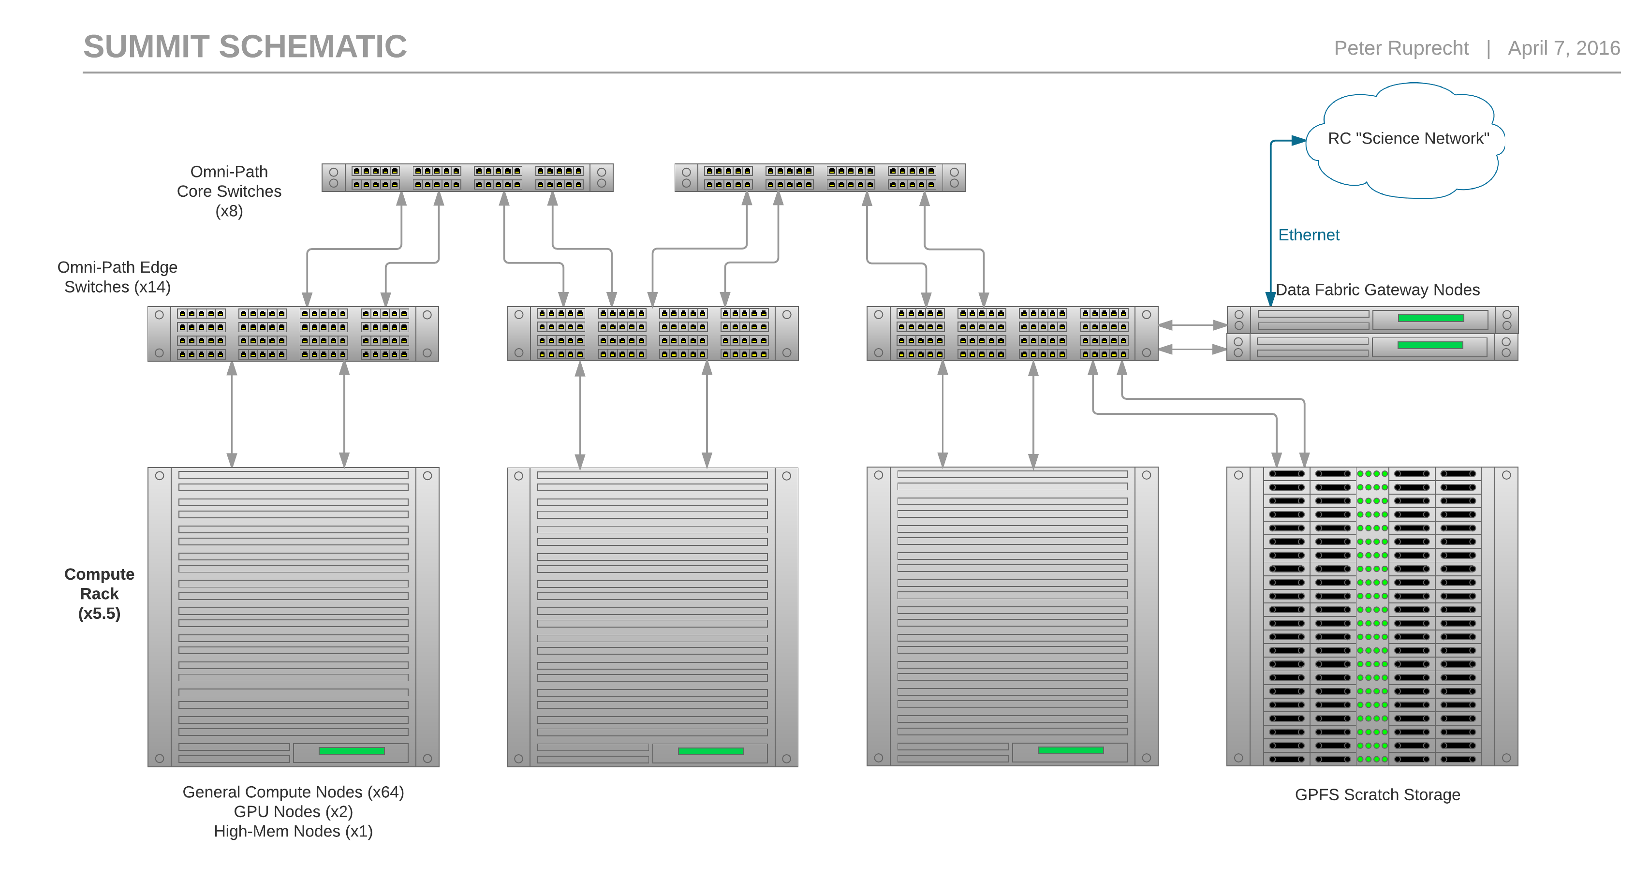
Notes:
Interconnect is what makes the cluster of compute nodes into a supercomputer

Slide 5
Summit: Node Types
380 general compute nodes
24 real cores and 128 GB RAM
local SSD
10 GPGPU/visualization nodes
2x NVIDIA K80 GPUs
5 High-memory nodes
2 TB RAM each
20 Xeon Phi (“Knights Landing”) nodes
Phi installed directly in CPU socket; not a separate card
72 cores / 288 threads “many core”
installed in second phase, late fall 2016
Notes:
Only about 1/3 as many general compute nodes as Janus but each is much more capable.
Phi processors are directly attached to the OPA fabric - data doesn't travel over the system bus and through a network card

Slide 6
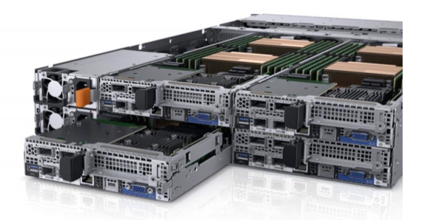
Dell C6320 Compute Node
Image: Dell.com
Notes:
4 blades in 2 rack units

Slide 7
Omni-Path (OPA) Interconnect
Cutting-edge network product from Intel
Same role as the InfiniBand fabric on Janus
Also carries NFS traffic from /home, /projects, /work ...
100 Gb/s bandwidth
Extremely low latency for MPI performance
Fat-Tree topology with 8 core switches and 32 nodes per edge switch (easily expandable)
"Islands" of 32 nodes fully non-blocking
2:1 blocking factor between islands
Notes:
OPA is source of delay in Summit delivery
Non-blocking: any node can talk at full bandwidth to any other node

Slide 8
GPFS Scratch Storage
1 PB of high-performance scratch storage
GPFS for parallel access and improved small-file performance
Directly-attached to OPA fabric
Expandable to about 2 PB; performance also scales up as more drives are added
DataDirect Networks SFA14K "GridScaler" appliance with embedded file servers
Expect >20 GB/s parallel throughput and >10K file creations per second
Available on login nodes and data-transfer nodes, but not on non-Summit compute nodes

Slide 9
Getting the most out of Summit
Any application that you have built for Janus will need to be recompiled
Applications ideally should take advantage of multi-core / many-core architectures
Performance improvements in latest processors are mainly through more cores and SIMD* rather than faster clock speed
Applications should be parallelized and “vectorized” … otherwise Summit may seem slower than Janus
*single instruction on multiple data
Notes:
Can't increase clock frequency, so add more cores and do more work per cycle

Slide 10
Vectorization overview
Vectorizing a computation lets it take advantage of SIMD instruction sets
That is, during one CPU cycle a single CPU core can do an operation on several data objects (16 at once in the case of Summit)
The compiler can auto-vectorize some loops; the programmer needs to write code that the compiler can easily vectorize
Existing math libraries, such as Intel MKL, are fully optimized for vectorization
Many applications have vectorization built in
Matlab
Python provided by RC
Notes:
We can help you optimize your application for Summit! Training sessions in the fall, also individual consulting will be available.
Parallelization and vectorization will only be more important in the future.

Slide 11
Visualization cluster
Provides a remote desktop environment in which
You can run graphics-intensive applications on an RC server and have them display quickly on your desktop or laptop monitor, even on most home networks
There is enough CPU and memory for meaningful backend computation
Your apps can directly access data in PetaLibrary Active storage
Bigger computations can offload to Janus

Slide 12
Summit vs Janus
Feature | Janus | Summit
CPU cores/node Clock frequency | 12 2.8 - 3.2 GHz | 24 2.5 - 3.3 GHz
RAM/core Memory bandwidth | 2 GB 32 GB/s | 5 GB 68 GB/s
Interconnect type Bandwidth Latency | QDR InfiniBand 40 Gb/s 1.2 us | Omni-Path 100 Gb/s 0.4 us
Filesystem | Lustre – optimized for large parallel transfers | GPFS – good at parallel transfers; also good at small file operations
Vectorization | SSE4 (4 operations/cycle) | AVX2 (16 operations/cycle)
Notes:
Janus was great at what it was designed for - we want Summit to be good for a wider range of needs.

Slide 13
Schedule
Late April – mini-Summit test cluster available for software builds and small-scale testing
Mid-late June – Summit delivered and installed in HPCF
Early July – initial acceptance testing
July-Aug – application testing and early user access
Early Sept – general availability
Oct-Nov – Knights Landing Phi nodes installed; possible expansion of general compute

Slide 14
Want early access?
Benefits to being a beta tester
Your code and workflow is ready once Summit is deployed
RC staff will help you to make sure your code works well on Summit
Get a computational project done during the initial phase of Summit when it might be less busy
Requirements to become a tester
Have a well-understood code ready for deployment
We are looking for a variety of applications from different fields, including GPU-enabled apps
Tolerant to unexpected problems or changes
The high-speed network on Summit is “bleeding edge” and we may have to change things or things may not work as expected
Notes:
Benefit - you'll have all the info you need to write a large allocation request right away

Slide 15
Buying into Summit
You can own additional nodes
Approx $7-8K for a compute node + scratch storage
RC will cover the high-speed interconnect
Priority access to an allocation sized to what your node(s) would provide you (210K SU / yr /node)
Additional purchases need to be finalized before the end of 2016
Notes:
If your grant funding requires you to own a specific node, we can property tag it for you

Slide 16
Thank you! Questions?
CU-Boulder Research Computing
www.rc.colorado.edu rc-help@colorado.edu
Slides:
https://github.com/ResearchComputing/Final_Tutorials/
Link to tutorial feedback survey:
http://goo.gl/forms/8VidcwOhRT

