Slide 1
PyTorch Module & Functional
Kyuhong Shim
2022-05-13
skhu20@snu.ac.kr

Slide 2
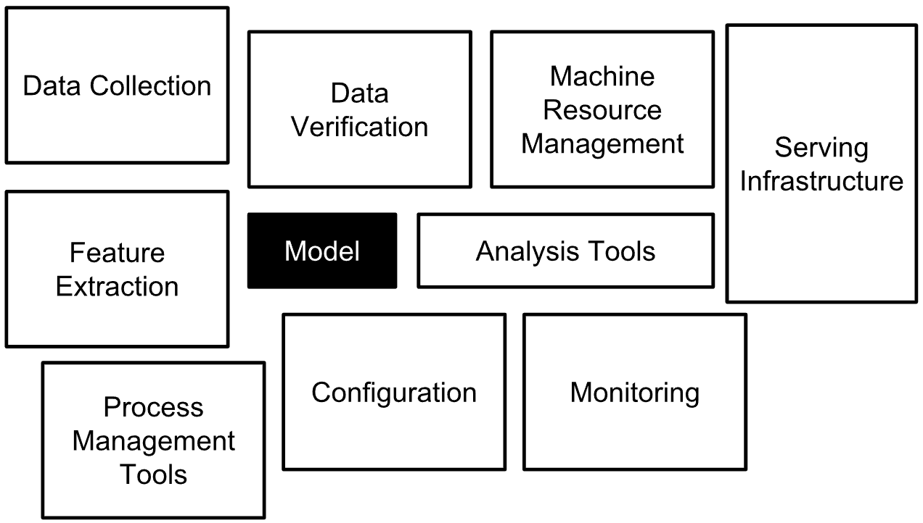
Modeling is a part of Deep Learning Pipeline
https://developers.google.cn/machine-learning/testing-debugging/pipeline/overview

Slide 3
Model = Architecture + Parameter
Successful model
Deep learning model is black-box. → It does not mean model is unknown.
When parameter changes, behave changes.
Garbage-in, garbage-out.
Inference is NOT training, should be generalize.
To serve model, always both should be deployed.
Although deep learning doesn’t like human-based rules…
“Good” models are based on human intuitions
“Good” input format is designed by humans
How to use output properly is human decision.
Input (Data)
Model
Parameter
Output (Data)

Slide 4
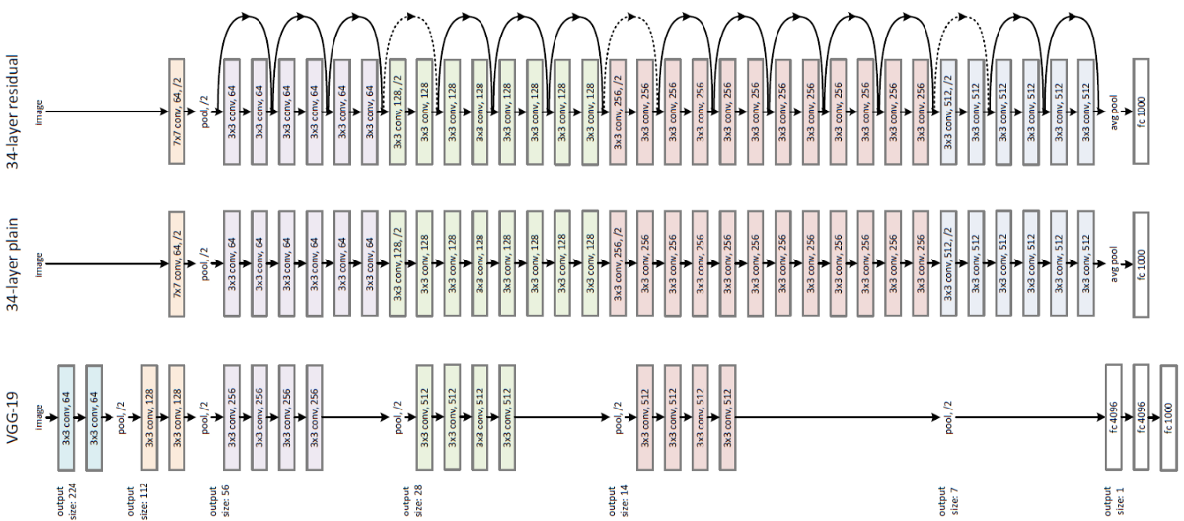
Deep Learning Models are just Layers
ResNet-34
ResNet-34 (w/o res.)
Same layers are stacked, but their parameters are different.

Slide 5
Layer = Operation(s) + (optional) Parameters
Layer is ambiguous and conventional concept
OOP design, to match the human understanding and code
Single operation can be a single layer
Multiple operation can be combined for a single layer
Any number of parameters is OK
Input (Data)
Layer
Parameter
Output (Data)
Layer
Block
Model
System

Slide 6
PyTorch: Layers = Modules, Operations = Functionals
import torch
import torch.nn as nn ← modules inside
import torch.nn.functional as F ← functionals inside
PyTorch supports many commonly used layers.
Conv2d, Linear, ReLU, Softmax, Sigmoid, …
Every layer should inherit nn.Module class.
Every parameter should inherit nn.Parameter class.
nn.Module needs at least two methods:
__init__(…) set up parameters (and optional sub-layers)
forward(…) set up operations = how input will be transformed to output

Slide 7
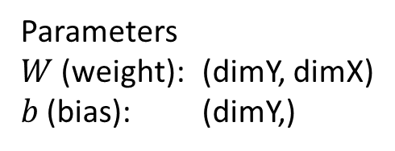
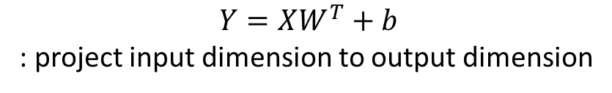
nn.Linear
$$Y=XW^{T}+b$$
: project input dimension to output dimension
Linear
(batch, dimX)
(batch, dimY)
(batch, dim1, dim2, dimX)
(batch, dim1, dim2, dimY)
Parameters
$W$ (weight): (dimY, dimX)
$b$ (bias): (dimY,)

Slide 8
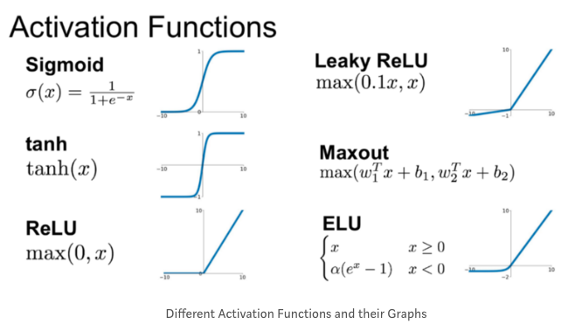
nn.ReLU
$$Y=max\left(x, 0\right)$$
: non-linear activation function, designed to ignore opposite vector dot-prod.
ReLU
(batch, dim)
(batch, dim)
(batch, dim1, dim2, dim3)
(batch, dim1, dim2, dim3)
No Parameters

Slide 9
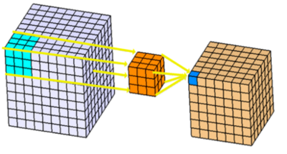
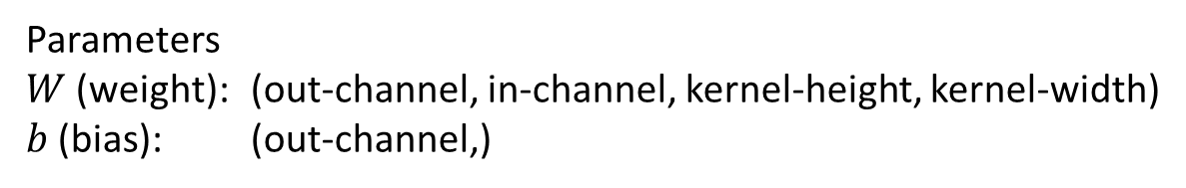
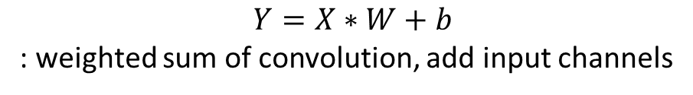
nn.Conv2d
$$Y=X∗W+b$$
: weighted sum of convolution, add input channels
Conv2d
(batch, in-channel, in-height, in-width)
(batch, out-channel, out-height, out-width)
Parameters
$W$ (weight): (out-channel, in-channel, kernel-height, kernel-width)
$b$ (bias): (out-channel,)
width
height
channel

Slide 10
Thank You!
Kyuhong Shim

