Slide 1
1. Introduction to NLP

Slide 2
Disclaimer
Some slides are based on Stanford NLP/IR book (and slides)
https://nlp.stanford.edu/fsnlp/promo/
https://nlp.stanford.edu/IR-book/
Some slides from Berkeley AI course
http://ai.berkeley.edu/home.html
All three courses are available on Youtube (excellent follow-up materials of this course)

Slide 3
Introducing NLP Applications: Question Answering (QA)
Won Jeopardy on February 16, 2011!
WILLIAM WILKINSON’S
“AN ACCOUNT OF THE PRINCIPALITIES OF WALLACHIA AND MOLDOVIA”
INSPIRED THIS AUTHOR’S
MOST FAMOUS NOVEL
Bram Stoker
Notes:
Answer → q
요즘 트렌드(ai speaker) q → a

Slide 4


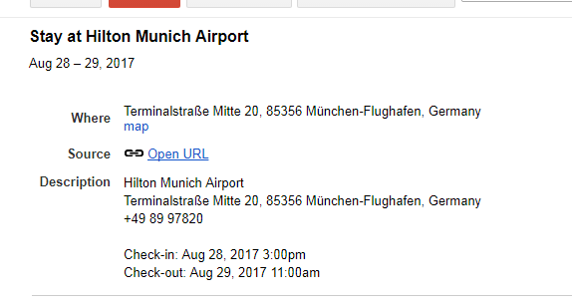
Information Extraction (IE)
Notes:
정보추출, 보험약관, 차 메뉴얼

Slide 5
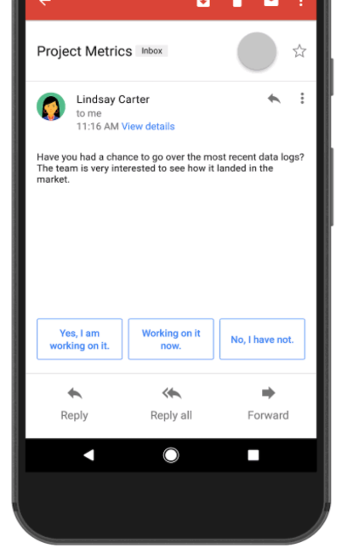
Dialogue (Limited)
Notes:
자유로운 대화는 어려움
완성도가 높은 대화, 단답형 이메일
이메일 & 이메일 답장 pairs
반사적인 반응에서는 꽤나 잘 workiing

Slide 6
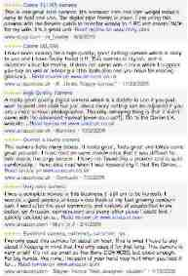

Sentiment Analysis
Attributes:
zoom
affordability
size and weight
flash
ease of use
Size and weight
✓
nice and compact to carry!
since the camera is small and light, I won't need to carry around those heavy, bulky professional cameras either!
the camera feels flimsy, is plastic and very light in weight you have to be very delicate in the handling of this camera
✓
✗
Notes:
직접 읽어보지 않고도
특정 attributes.
리뷰들을 정리 → 상품에 대한 의견 정리

Slide 7
2. Rule-based Approaches
Classification:
F(text) is {spam,non-spam}
{positive, negative}

Slide 8
Let’s build a rule-based spam filter
“Viagra” or “Cialis”
Is this a good rule?

Slide 9
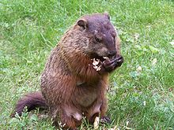
Regular expressions
A formal language for specifying text strings
How can we search for any of these?
woodchuck
woodchucks
Woodchuck
Woodchucks

Slide 10
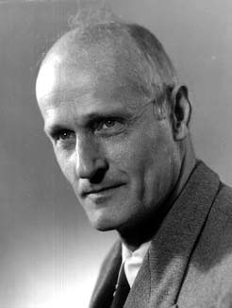
Regular Expressions: ? * + .
Pattern | Matches
colou?r | Optional previous char | color colour
oo*h! | 0 or more of previous char | oh! ooh! oooh! ooooh!
o+h! | 1 or more of previous char | oh! ooh! oooh! ooooh!
baa+ |  | baa baaa baaaa baaaaa
beg.n |  | begin begun begun beg3n
Stephen C Kleene
Kleene *, Kleene +

Slide 11
Example
Find me all instances of the word “the” in a text.
the
Misses capitalized examples
[tT]he
Incorrectly returns other or theology
[^a-zA-Z][tT]he[^a-zA-Z]

Slide 12
How do we know if our rule is good?
The process we just went through was based on fixing two kinds of errors
Matching strings that we should not have matched (there, then, other)
False positives (Type I)
Not matching things that we should have matched (The)
False negatives (Type II)

Slide 13
Precision vs. Recall
In NLP we are always dealing with these kinds of errors.
Reducing the error rate for an application often involves two antagonistic efforts:
Increasing accuracy or precision (minimizing false positives)
Increasing coverage or recall (minimizing false negatives).

Slide 14
The 2-by-2 contingency table
 | correct | not correct
selected | tp | fp
not selected | fn | tn
Notes:
precision, recall, f-measure [many have seen before]
there are two sets: CORRECT entities and SELECTED entities
2x2 contingency table, four possible outcomes
for precision & recall, you're ignoring bottom corner (where you get O right)
precision: what proportion of your guesses are correct?
note that correctness means (a) correct boundaries, and (b) correct label
recall: what proportion of true entities did you get right?
ASK STUDENTS HERE ABOUT WHY NOT TO USE ACCURACY
[note that there is typically a trade-off between precision and recall!]
[to get high precision, be very reluctant to make guesses – but then you may have poor recall]
[to get high recall, be very promiscuous in making guesses – but then you may have poor precision]

Slide 15
Precision and recall
Precision: % of selected items that are correct Recall: % of correct items that are selected
 | correct | not correct
selected | tp | fp
not selected | fn | tn
Notes:
Precision P = tp/(tp + fp)
Recall R = tp/(tp + fn)
Mention precision recall tradeoff.
precision, recall, f-measure [many have seen before]
there are two sets: CORRECT entities and SELECTED entities
2x2 contingency table, four possible outcomes
for precision & recall, you're ignoring bottom corner (where you get O right)
precision: what proportion of your guesses are correct?
note that correctness means (a) correct boundaries, and (b) correct label
recall: what proportion of true entities did you get right?
ASK STUDENTS HERE ABOUT WHY NOT TO USE ACCURACY
[note that there is typically a trade-off between precision and recall!]
[to get high precision, be very reluctant to make guesses – but then you may have poor recall]
[to get high recall, be very promiscuous in making guesses – but then you may have poor precision]

Slide 16
A combined measure: F
A combined measure that assesses the P/R tradeoff is F measure (weighted harmonic mean):
The harmonic mean is a very conservative average; see https://machinelearningmastery.com/arithmetic-geometric-and-harmonic-means-for-machine-learning/
People usually use balanced F1 measure
i.e., with β = 1 (that is, α = ½): F = 2PR/(P+R)
Notes:
a combined measure: F-measure: weighted harmonic mean between precision and recall
[why weighted? in some applications you may care more about P or R]
[why harmonic? it's conservative -- lower than arith or geo mean]
[if P and R are far apart, F tends to be near lower value]
[in order to do well on F1, need to do well on BOTH P and R]
[this way, can't beat the system by being either too reluctant or too promiscuous]
Comment: when ppl say f-measure w/o specifying beta, they mean balanced, and this is by far the most common way of doing it

Slide 17
3. Word (Lexical) Similarity
Definition

Slide 18
How similar are two strings?
Spell correction
The user typed “graffe”
Which is closest?
graf
graft
grail
giraffe
Computational Biology
Align two sequences of nucleotides
Resulting alignment:
AGGCTATCACCTGACCTCCAGGCCGATGCCC
TAGCTATCACGACCGCGGTCGATTTGCCCGAC
-AGGCTATCACCTGACCTCCAGGCCGA--TGCCC---
TAG-CTATCAC--GACCGC--GGTCGATTTGCCCGAC
Also for Machine Translation, Information Extraction, Speech Recognition

Slide 19
Edit Distance
The minimum edit distance between two strings
Is the minimum number of editing operations
Insertion
Deletion
Substitution
Needed to transform one into the other

Slide 20
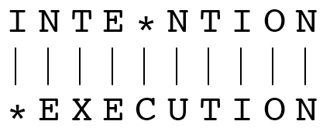
Minimum Edit Distance
Two strings and their alignment:

Slide 21
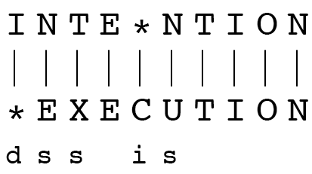
Minimum Edit Distance
If each operation has cost of 1
Distance between these is 5
If substitutions cost 2 (Levenshtein)
Distance between them is 8

Slide 22
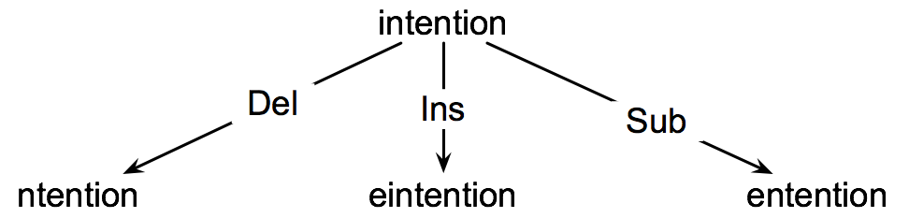
How to find the Min Edit Distance?
Searching for a path (sequence of edits) from the start string to the final string:
Initial state: the word we’re transforming
Operators: insert, delete, substitute
Goal state: the word we’re trying to get to
Path cost: what we want to minimize: the number of edits

Slide 23
Weighted Edit Distance
Why would we add weights to the computation?
Spell Correction: some letters are more likely to be mistyped than others
Biology: certain kinds of deletions or insertions are more likely than others

Slide 24
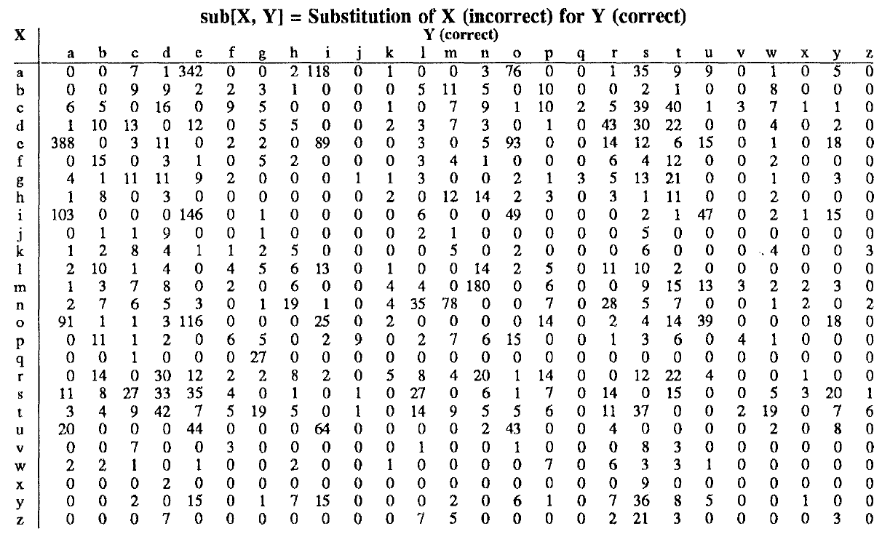
Confusion matrix for spelling errors

Slide 25
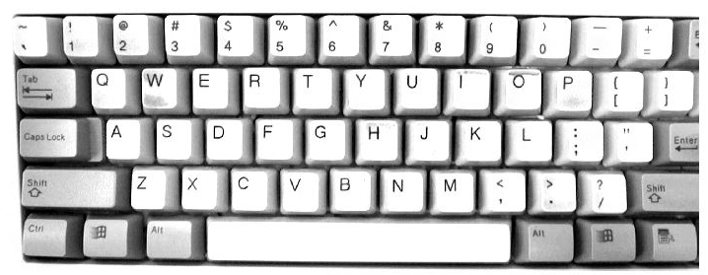
Keyboard used contributes significantly to model

