Slide 1
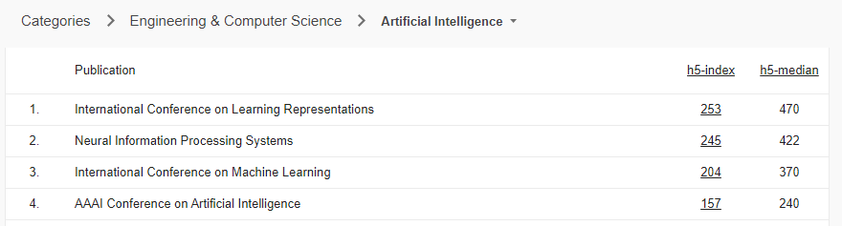
Representation Learning
ICML? ICRL?

Slide 2
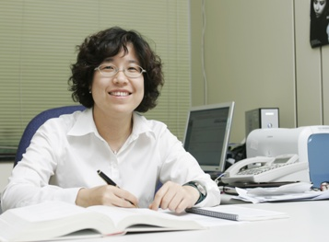
Representing SW in 4 bit
MBTI
?
I | ? | ? | ?
f
I | ? | ? | ?

Slide 3



Why ppl are crazy with MBTI?
What makes good representation?

Slide 4
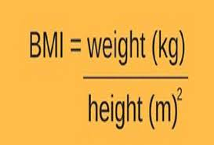

Representing SW in 1 real numbers
BMI
Why not 2*w? h^3? ➔ Black art of feature engineering
비만
BMI>25
BMI

Slide 5
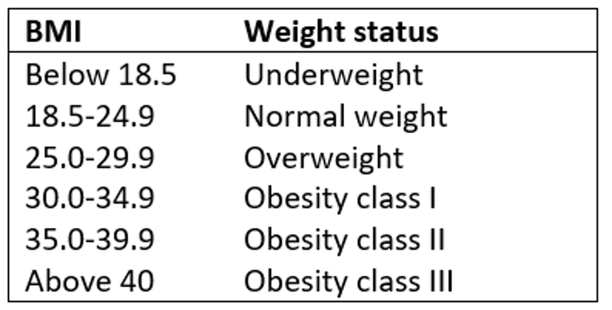
Useful but not perfect

Slide 6
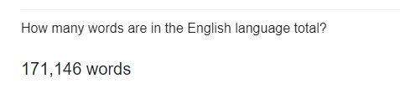
How do we represent this?
|V| bits
Seung-won Hwang is a Professor of Computer Science and Engineering at Seoul National University. Prior to SNU, she had been faculty at POSTECH and Yonsei…
1 | ? | ? | ?

Slide 7
Basic Text Processing
Word tokenization

Slide 8
Text Normalization
Every NLP task requires text normalization:
Tokenzing (segmenting) words
Normalizing word formats
Segmenting sentences

Slide 9
The first step: tokenizing
tr -sc ’A-Za-z’ ’\n’ < shakes.txt | head
THE
SONNETS
by
William
Shakespeare
From
fairest
creatures
We
...

Slide 10
The second step: sorting
tr -sc ’A-Za-z’ ’\n’ < shakes.txt | sort | head
A
A
A
A
A
A
A
A
A
...

Slide 11
More counting
Merging upper and lower case
tr ‘A-Z’ ‘a-z’ < shakes.txt | tr –sc ‘A-Za-z’ ‘\n’ | sort | uniq –c
Sorting the counts
tr ‘A-Z’ ‘a-z’ < shakes.txt | tr –sc ‘A-Za-z’ ‘\n’ | sort | uniq –c | sort –n –r
23243 the
22225 i
18618 and
16339 to
15687 of
12780 a
12163 you
10839 my
10005 in
8954 d
우리의 첫 언어모델!
What happened here?

Slide 12
I’d-> {I, d}
또 다른 문제가 있을까요?
아버지가방에들어가신다
아버지가방에들어가신다

Slide 13
Tokenization without spaces
Chinese, Japanese, Thai, don't use spaces to separate words

Slide 14
Word tokenization in Chinese
Chinese words are composed of characters called hanzi
Each one represents a meaning unit called a morpheme.
Each word has on average 2.4 of them.
But deciding what counts as a word is complex and not agreed upon.

Slide 15
How to do word tokenization in Chinese?
姚明进入总决赛 “Yao Ming reaches the finals”
3 words?
姚明 进入 总决赛
YaoMing reaches finals
5 words?
姚 明 进入 总 决赛
Yao Ming reaches overall finals
7 characters? (don't use words at all):
姚 明 进 入 总 决 赛
Yao Ming enter enter overall decision game

Slide 16
Basic Text Processing
Word tokenization

Slide 17
Basic Text Processing
Word Normalization and other issues

Slide 18
Word Normalization
Putting words/tokens in a standard format
U.S.A. or USA
uhhuh or uh-huh
Fed or fed
am, is be, are

Slide 19
Case folding
Applications like IR: reduce all letters to lower case
Since users tend to use lower case
Possible exception: upper case in mid-sentence?
e.g., General Motors
Fed vs. fed
SAIL vs. sail
For sentiment analysis, MT, Information extraction
Case is helpful (US versus us is important)

Slide 20
Lemmatization
Represent all words as their shared root, = dictionary headword form:
am, are, is → be
car, cars, car's, cars' → car
Spanish quiero (‘I want’), quieres (‘you want’) → querer ‘want'
He is reading detective stories → He be read detective story

Slide 21
어근과 언어적 특성을 고려한 섬세한 수공예방법
Morphemes:
The small meaningful units that make up words
Stems: The core meaning-bearing units
Affixes: Parts that adhere to stems, often with grammatical functions
Morphological Parsers:
Parse cats into two morphemes cat and s
Parse Spanish amaren (‘if in the future they would love’) into morpheme amar ‘to love’, and the morphological features 3PL and future subjunctive.

Slide 22
Stemming
언어적 특성을 고려했지만 무식한?? 방법
This was not the map we found in Billy Bones’s chest, but an accurate copy, complete in all things-names and heights and soundings-with the single exception of the red crosses and the written notes.
Thi wa not the map we found in Billi Bone s chest but an accur copi complet in all thing name and height and sound with the singl except of the red cross and the written note
.

Slide 23
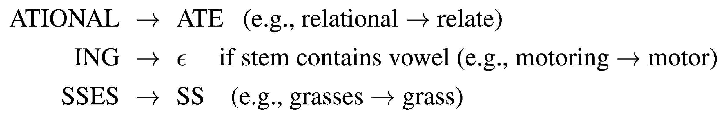
Porter Stemmer
Based on a series of rewrite rules run in series
A cascade, in which output of each pass fed to next pass
Some sample rules:

Slide 24
Basic Text Processing
Byte Pair Encoding tokenization

Slide 25
A third option for word segmentation
Use the data to tell us how to tokenize.
Subword tokenization (because tokens are often parts of words)
Can include common morphemes like -est or -er.
(A morpheme is the smallest meaning-bearing unit of a language; unlikeliest has morphemes un-, likely, and -est.)

Slide 26
Subword tokenization
Three common algorithms:
Byte-Pair Encoding (BPE) (Sennrich et al., 2016)
unigram language modeling tokenization (Kudo, 2018)
WordPiece (Schuster and Nakajima, 2012)
All have 2 parts:
A token learner that takes a raw training corpus and induces a vocabulary (a set of tokens).
A token segmenter that takes a raw test sentence and tokenizes it according to that vocabulary

Slide 27
Byte Pair Encoding (BPE)
Let vocabulary be the set of all individual characters
= {A, B, C, D,…,a, b, c, d….}
Repeat:
choose the two symbols that are most frequently adjacent in training corpus (say ‘A’, ‘B’),
adds a new merged symbol ‘AB’ to the vocabulary
replace every adjacent ’A’ ’B’ in corpus with ‘AB’.
Until k merges have been done.

Slide 28
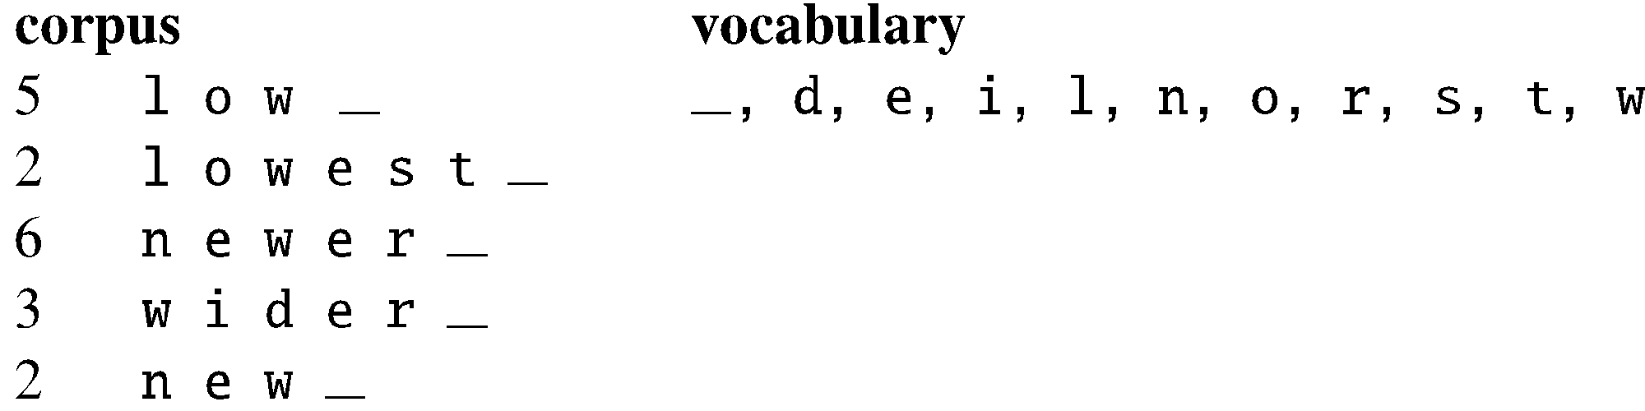
BPE token learner
Original (very fascinating🙄) corpus:
low low low low low lowest lowest newer newer newer newer newer newer wider wider wider new new
Add end-of-word tokens and segment:

Slide 29
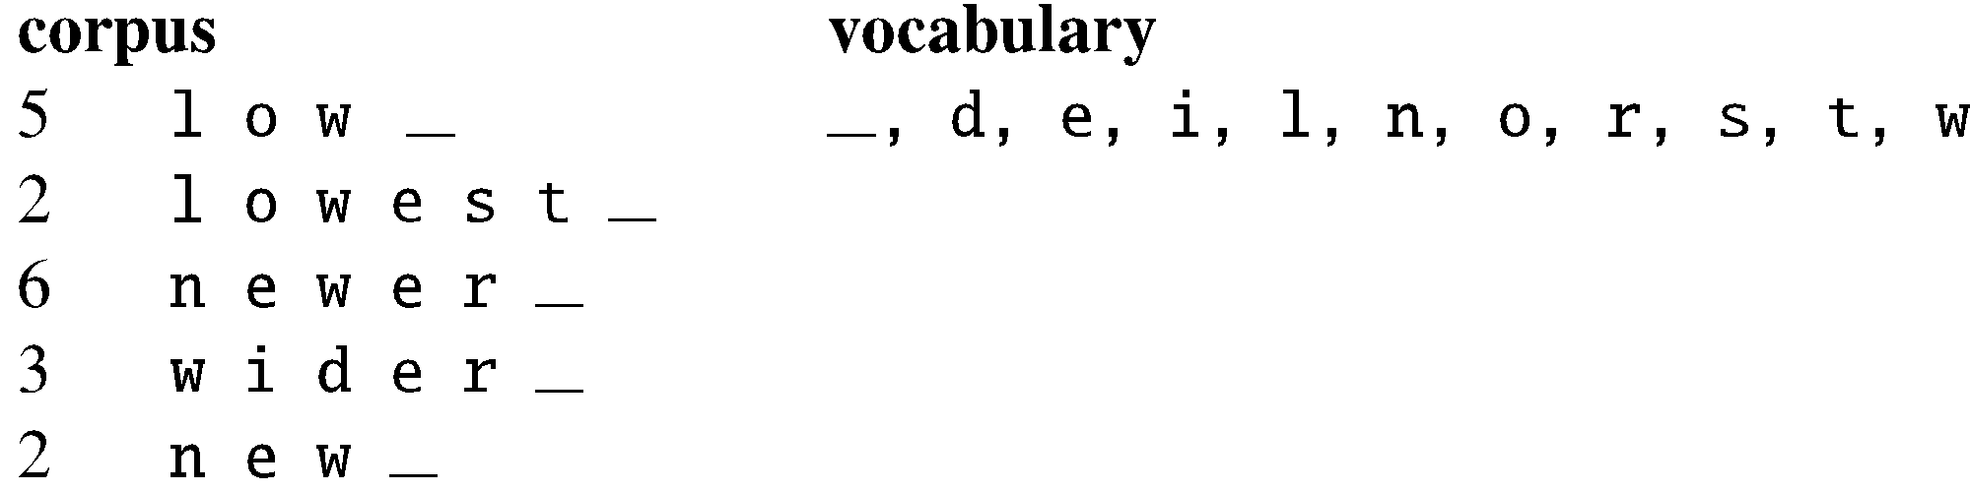
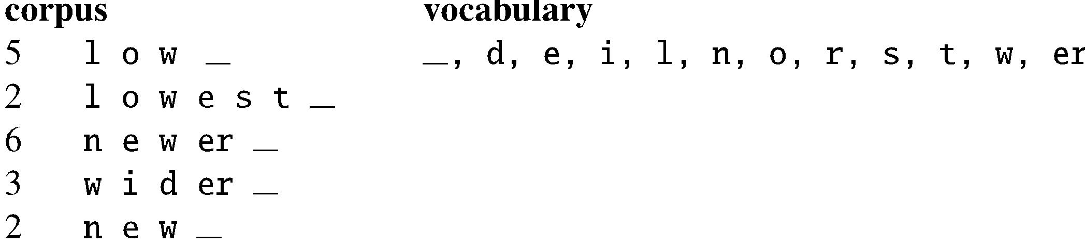
BPE token learner
Merge e r to er

Slide 30
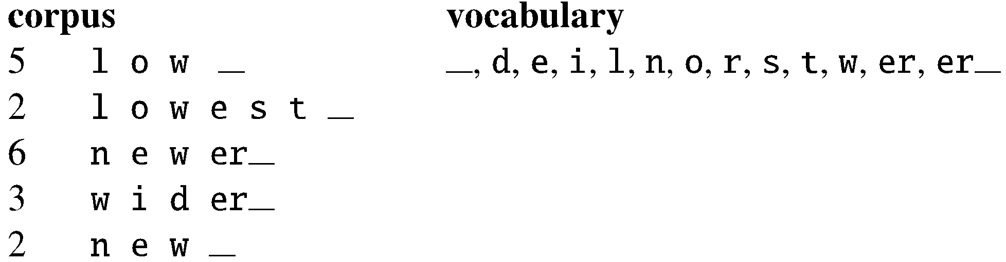
BPE
Merge er _ to er_

Slide 31
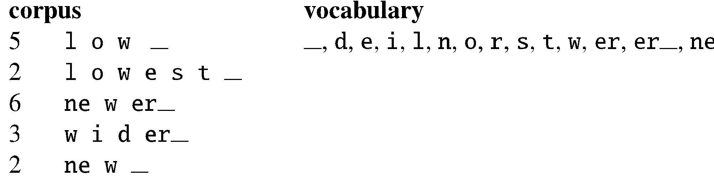
BPE
Merge n e to ne

Slide 32
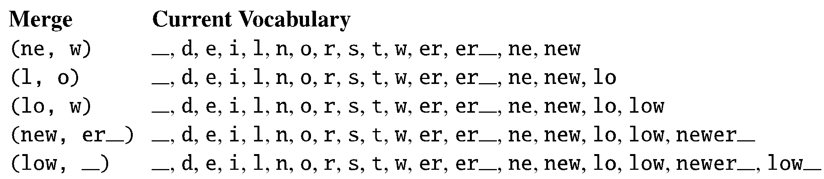
BPE
The next merges are:

