Slide 1
Basic Text Processing
Words and Corpora

Slide 2
Natural Language Toolkit (NLTK)
A comprehensive Python library for natural language processing and text analytics
Created in 2001 as part of a computational linguistics course at the University of Pennsylvania
Provides
Easy-to-use interfaces to over 50 corpora and lexical resources such as WordNet
Corpus 말뭉치 (복수 Corpora): 언어 연구를 위해 텍스트를 컴퓨터가 읽을 수 있는 형태로 모아 놓은 언어 자료
A suite of text processing libraries
Classification, Tokenization (토큰생성)
Stemming/Lemmatizing (어근찾기 / 대표어찾기)
Pos-Tagging(품사태깅)
Syntax parsing (구문분석)
Semantic reasoning (의미추론)

Slide 3
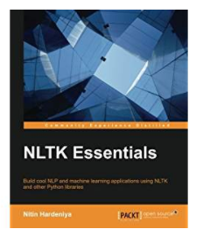
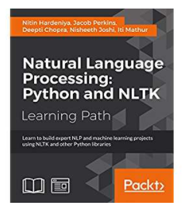
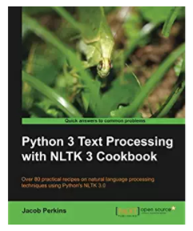
Many NLTK Books

Slide 4
Natural Language Toolkit (NLTK)
Language processing task | NLTK modules | Functionality
Accessing corpora | corpus | standardized interfaces to corpora and lexicons
String processing | tokenize, stem | tokenizers, sentence tokenizers, stemmers
Collocation discovery | collocations | t-test, chi-squared, point-wise mutual information
Part-of-speech tagging | tag | n-gram, backoff, Brill, HMM, TnT
Machine learning | classify, cluster, tbl | decision tree, maximum entropy, naive Bayes, EM, k-means
Chunking | chunk | regular expression, n-gram, named-entity
Parsing | parse, ccg | chart, feature-based, unification, probabilistic, dependency
Semantic interpretation | sem, inference | lambda calculus, first-order logic, model checking
Evaluation metrics | metrics | precision, recall, agreement coefficients
Probability and estimation | probability | frequency distributions, smoothed probability distributions
Applications | app, chat | graphical concordancer, parsers, WordNet browser, chatbots
Linguistic fieldwork | toolbox | manipulate data in SIL Toolbox format

Slide 5
Corpus
corpus (plural corpora) or text corpus
A large and structured set of texts collected for analysis
Usually but not necessarily purposefully collected
Usually but not necessarily structured
Usually but not necessarily annotated
Corpora are used to do statistical analysis and hypothesis testing, checking occurrences or validating linguistic rules within a specific language territory
Many corpora are designed to contain a careful balance of material in one or more genres

Slide 6
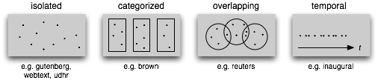
NLTK Corpora
Text corpus structure
A collection of isolated texts with no particular organization
Structured into categories such as genres
Some categorizations overlap such as topic categories
Temporal data

Slide 7
Accessing Text Corpora
>>> from nltk.corpus import some_corpus
Gutenberg Corpora
Brown Corpora
WordNet Corpora
Text from Web
공통이름의 function 들을 corpora 별로 자체구현해서 사용
Corpus의 특성상 전혀 다른 function 들도 존재
NLTK module에 있는 Text processing function들도 사용가능

Slide 8
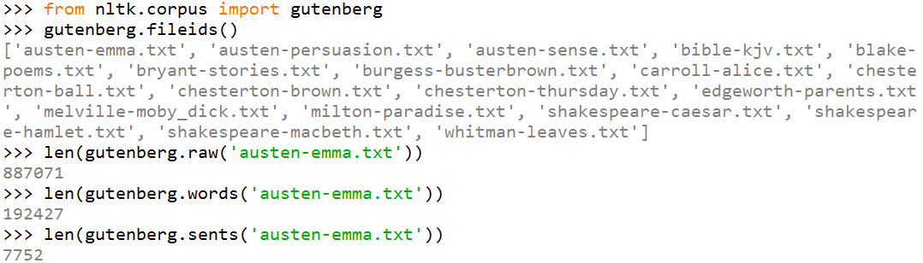
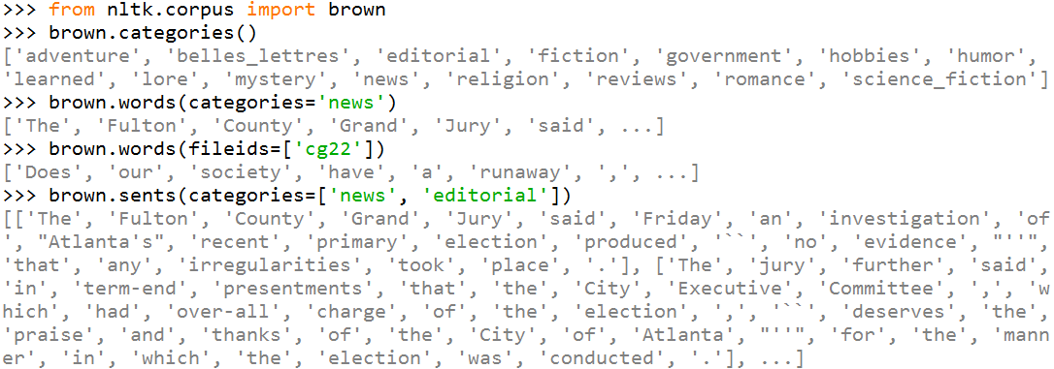
Functions for Accessing Corpora
fileids(categories = None)
Return a list of file identifiers for the files that make up the corpus, or that make up the given category(s) if specified
raw(fileids = None)
Return a list of a single string of the given file (file전체 1개 string)
words(fileids = None)
Return a list of words and punctuation symbols (구두점부호) in the given file
sents(fileids = None)
Return a list of sentences or utterances (발언) in the given file
categories(fileids=None)
Return a list of the categories that are defined for this corpus, or for the file
Corpus > Category > File > Sentence > Word

Slide 9
Functions & Classes in This NLTK PPT [1/2]
word_tokenize( ) ➔ 단어로 token화 하기
sent_tokenize( ) ➔ 문장으로 token화 하기
stem( ) ➔ 단어의 어근 찾기
lemmatize( ) ➔ 단어의 대표어 찾기
pos_tagging( ) ➔ 단순품사 붙이기
biagram( ) ➔ 붙어있는 단어 두덩어리씩 처리
Class Text(tokens, name=None)
(token들을 load해서 Text object 로 만들고 여러 편리한 기능들의 집합)
Its methods perform a variety of analyses on the text’s contexts and
display the results.

Slide 10
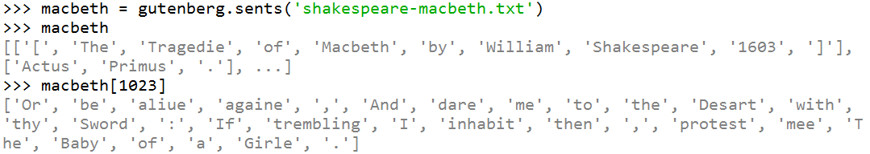
Example of Accessing Gutenburg Corpora

