Slide 1
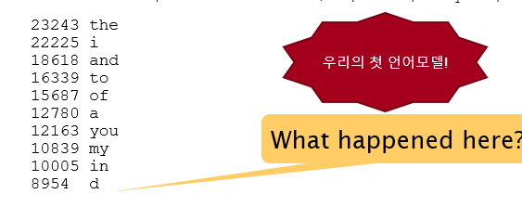

Language Modeling
N-grams

Slide 2
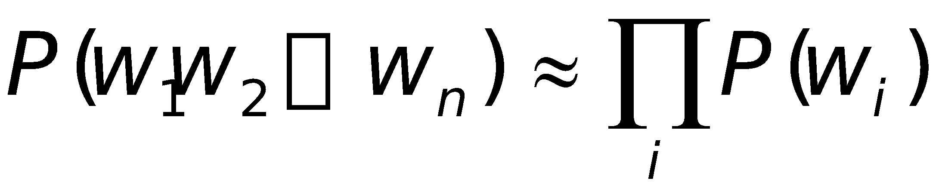
언어모델=(저질) AI 작가
…
Some automatically generated sentences from a unigram model
fifth, an, of, futures, the, an, incorporated, a, a, the, inflation, most, dollars, quarter, in, is, mass
thrift, did, eighty, said, hard, 'm, july, bullish
that, or, limited, the

Slide 3
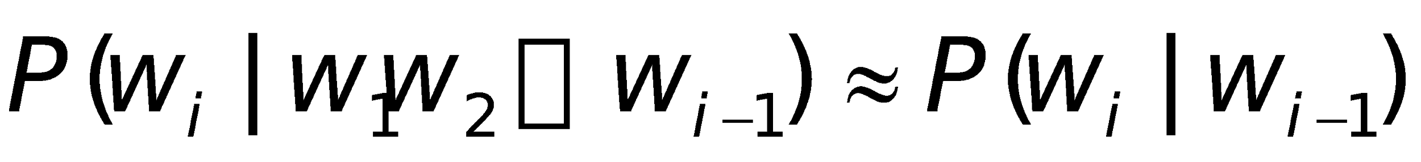
Bigram model
Condition on the previous word:
…
texaco, rose, one, in, this, issue, is, pursuing, growth, in, a, boiler, house, said, mr., gurria, mexico, 's, motion, control, proposal, without, permission, from, five, hundred, fifty, five, yen
outside, new, car, parking, lot, of, the, agreement, reached
this, would, be, a, record, november

Slide 4
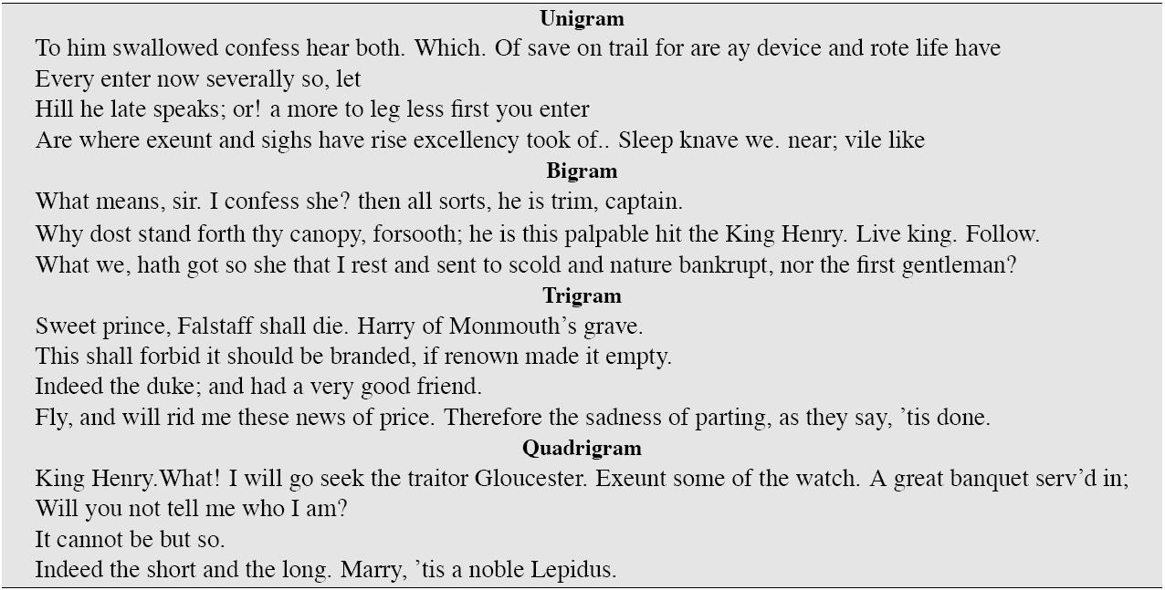
0- to N-th order trade off (Shakespeare)

Slide 5
N-gram models
We can extend to trigrams, 4-grams, 5-grams
In general this is an insufficient model of language
because language has long-distance dependencies:
“The computer which I had just put into the machine room on the fifth floor crashed.”
But we can often get away with N-gram models

Slide 6
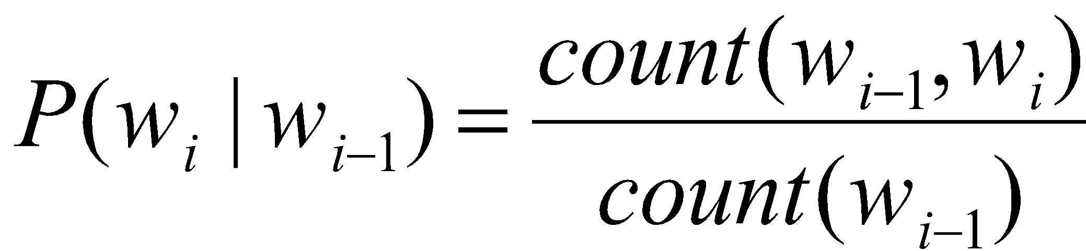
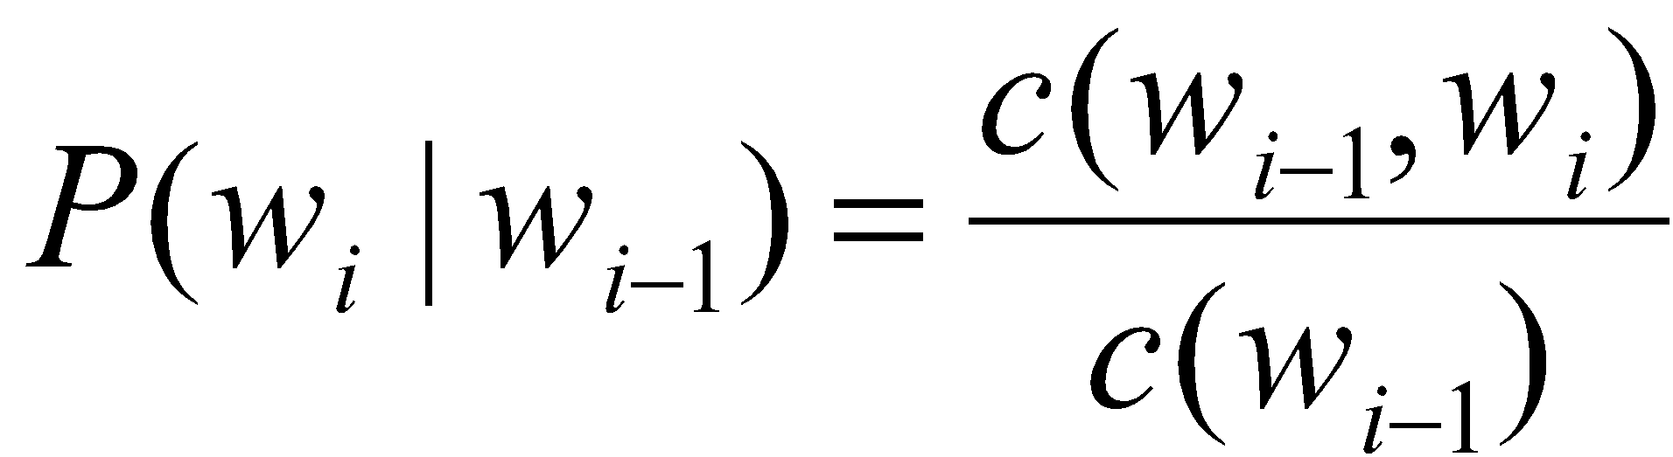
Estimating bigram probabilities
The Maximum Likelihood Estimate

Slide 7
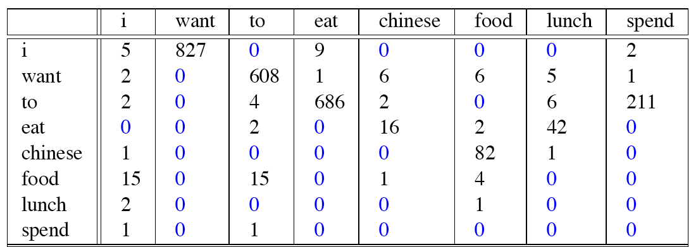
Raw bigram counts
Out of 9222 sentences

Slide 8
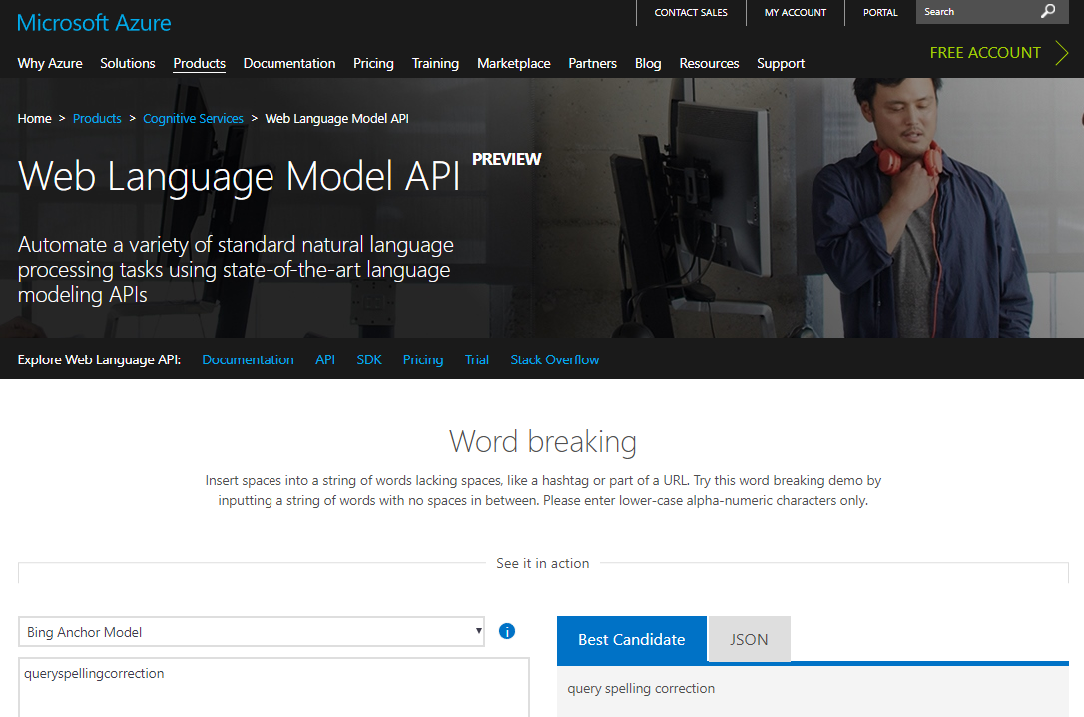
Google Book N-grams
Google
Microsoft
http://ngrams.googlelabs.com/

Slide 9
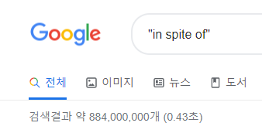
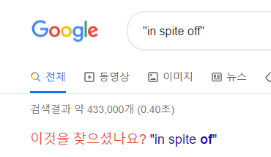
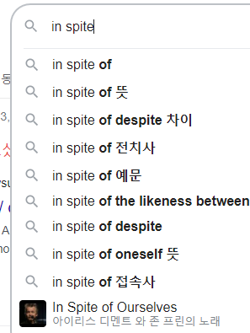
검색엔진은 언어모델일까?

Slide 10
Shakespeare as corpus
N=884,647 tokens, V=29,066
Shakespeare produced 300,000 bigram types out of V²= 844 million possible bigrams.
So 99.96% of the possible bigrams were never seen (have zero entries in the table)
Quadrigrams worse: What's coming out looks like Shakespeare because it is Shakespeare

Slide 11
The perils of overfitting
N-grams only work well for word prediction if the test corpus looks like the training corpus
In real life, it often doesn’t
We need to train robust models that generalize!
One kind of generalization: Zeros!
Things that don’t ever occur in the training set
But occur in the test set

Slide 12
Zeros
Training set:
… denied the allegations
… denied the reports
… denied the claims
… denied the request
P(“offer” | denied the) = 0
Test set
… denied the offer
… denied the loan

Slide 13
Language Modeling
Smoothing: Add-one smoothing

Slide 14
The intuition of smoothing (from Dan Klein)
When we have sparse statistics:
Steal probability mass to generalize better
P(w | denied the)
3 allegations
2 reports
1 claims
1 request
7 total
allegations
attack
man
reports
outcome
…
claims
request
P(w | denied the)
2.5 allegations
1.5 reports
0.5 claims
0.5 request
2 other
7 total
allegations
allegations
attack
man
outcome
reports
…
claims
request

Slide 15
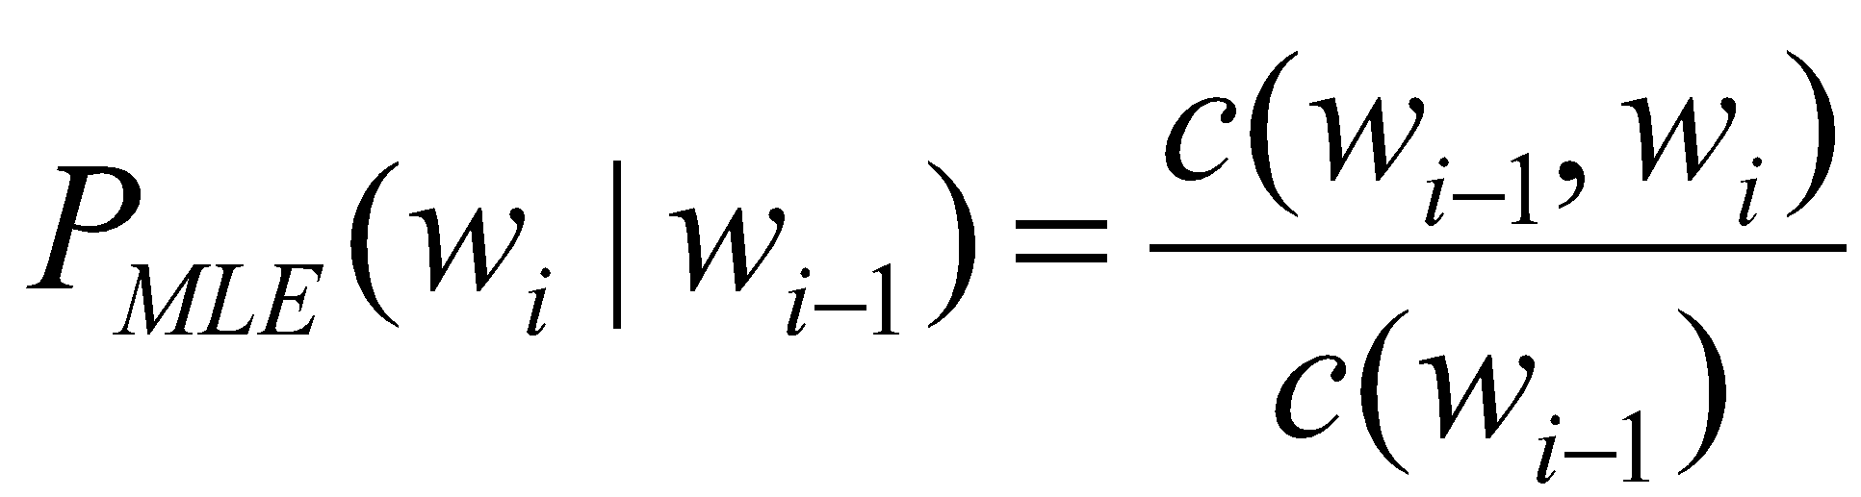
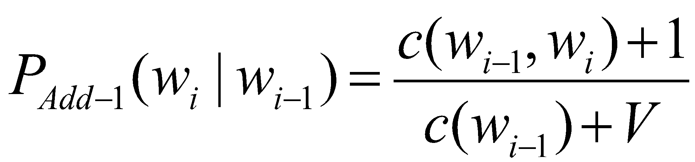
Add-one estimation
Also called Laplace smoothing
Pretend we saw each word one more time than we did
Just add one to all the counts!
MLE estimate:
Add-1 estimate:

Slide 16
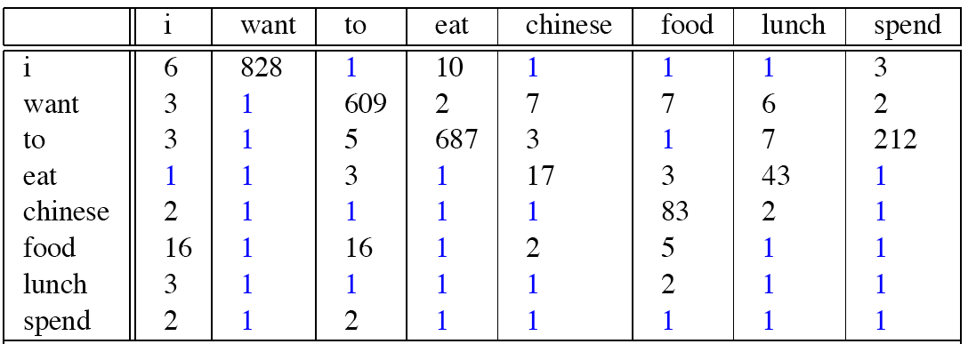
Berkeley Restaurant Corpus: Laplace smoothed bigram counts

Slide 17

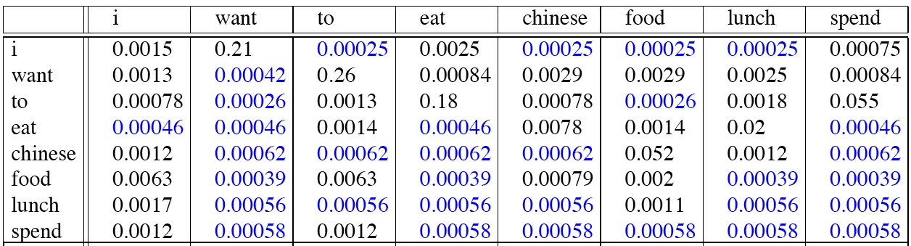
Laplace-smoothed bigrams

Slide 18
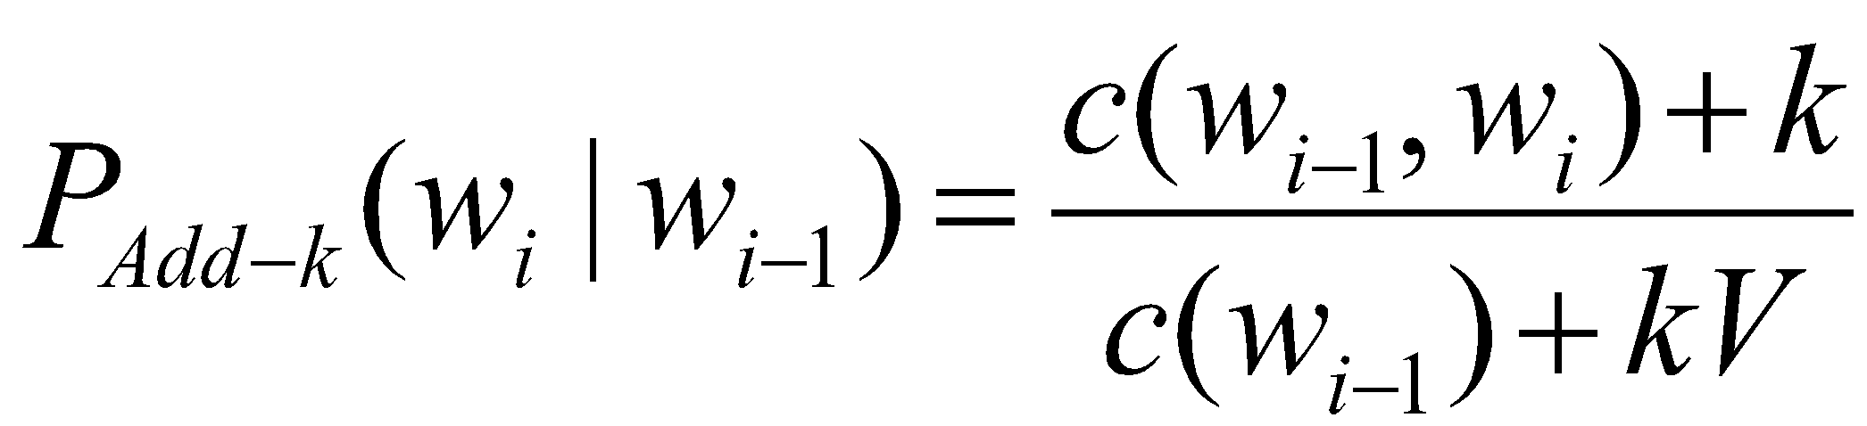
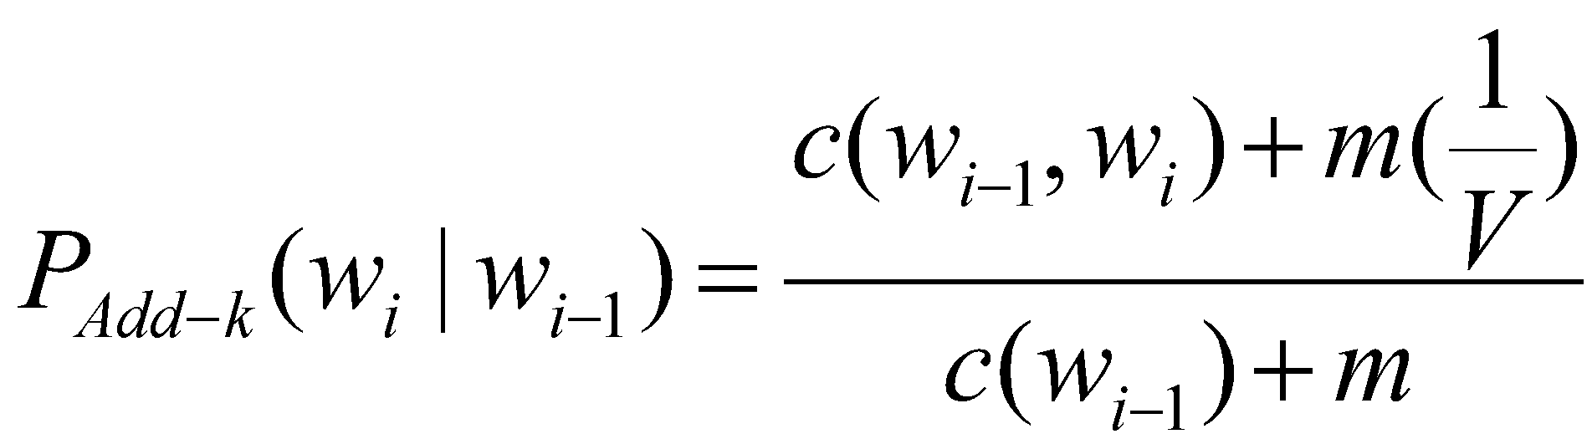
More general formulations: Add-k

