Slide 1
Recap
#1. What is natural language processing?
Brief History
Classical NLP (1960s~ early 1990) - Linguistic theory, manually-defined rules - Small-scale datasets and limited experimentation
Statistical NLP (1980~2013) - Supervised machine learning with annotated datasets - Linear models with manually-defined features - Linguistic knowledge used in annotation, features
Neural NLP (2012~) - Focus is on learning representations of language from large text corpora with deep neural networks - Less hand-crafting of features / use of linguistic structure
왜 NLP가 어려운가?
Ambiguity
Variability
We are here

Slide 2
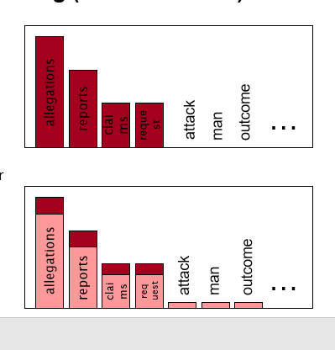
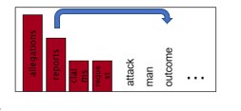
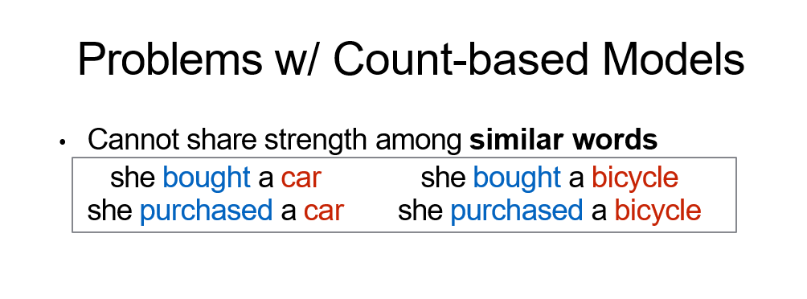
How about a radically different approach for representation learning?

Slide 3

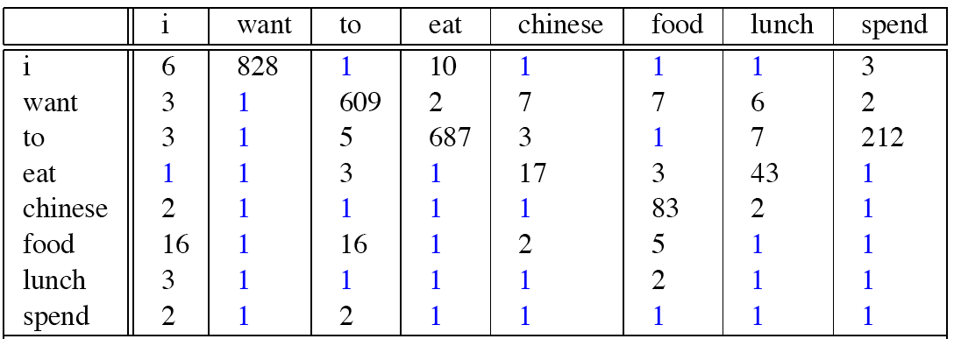
Replace table with AI
Corpus→Table
→ AI Model

Slide 4
Ludwig Wittgenstein
PI #43:
"The meaning of a word is its use in the language"

Slide 5
Let's define words by their usages
One way to define "usage":
words are defined by their environments (the words around them)
Zellig Harris (1954):
If A and B have almost identical environments we say that they are synonyms.

Slide 6
What does recent English borrowing ongchoi mean?
Suppose you see these sentences:
Ong choi is delicious sautéed with garlic.
Ong choi is superb over rice
Ong choi leaves with salty sauces
And you've also seen these:
…spinach sautéed with garlic over rice
Chard stems and leaves are delicious
Collard greens and other salty leafy greens
Conclusion:
Ongchoi is a leafy green like spinach, chard, or collard greens

Slide 7
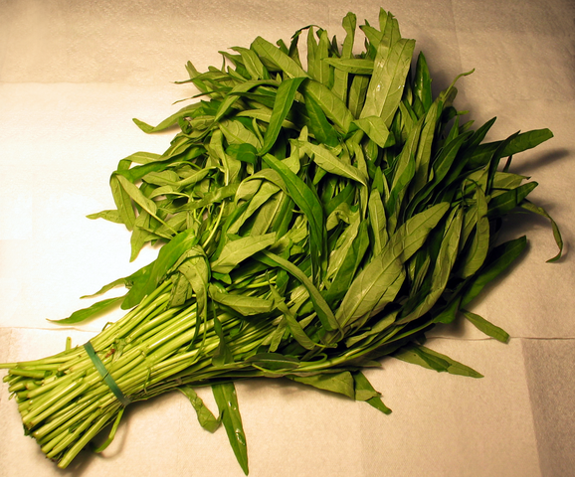
Ongchoi: Ipomoea aquatica "Water Spinach"
空心菜
kangkong
rau muống
…
Yamaguchi, Wikimedia Commons, public domain

Slide 8
A new model of meaning focusing on distributional similarity
Each word = a vector
Not just "word" or word45.
Similar words are "nearby in space"

Slide 9
We define a word as a vector
Word space 구축 (vector화)
Called an "embedding" because it's embedded into a space
The standard way to represent meaning in NLP
Every modern NLP algorithm uses embeddings as the representation of word meaning
Fine-grained model of meaning for similarity

Slide 10
pmi(information,data) = log₂ (
.3399 /
(.6575*.4842) )
= .0944
Resulting PPMI matrix (negatives replaced by 0)

Slide 11
Vector Semantics & Embeddings
Word2vec: Table→ neural model
f
(computer, pie)
4.38

Slide 12
Embeddings you can download!
Word2vec (Mikolov et al)
https://code.google.com/archive/p/word2vec/
Glove (Pennington, Socher, Manning)
http://nlp.stanford.edu/projects/glove/

Slide 13
Word2vec
Popular embedding method
Very fast to train
Code available on the web
Idea: predict rather than count

Slide 14
Word2vec
Instead of counting how often each word w occurs near "apricot"
Train a classifier on a binary prediction task:
Is w likely to show up near "apricot"?
We don’t actually care about this task
But we'll take the learned classifier weights as the word embeddings
Big idea: self-supervision:
A word c that occurs near apricot in the corpus asks as the gold "correct answer" for supervised learning
No need for human labels
Bengio et al. (2003); Collobert et al. (2011)

Slide 15
Word2Vec: Skip-Gram Task
Word2vec provides a variety of options. We'll do:
skip-gram with negative sampling (SGNS)

Slide 16
Approach: predict if candidate word c is a "neighbor"
Treat the target word t and a neighboring context word c as positive examples.
Randomly sample other words in the lexicon to get negative examples
Use logistic regression to train a classifier to distinguish those two cases
Use the learned weights as the embeddings

Slide 17
Skip-Gram Training Data
Assume a +/- 2 word window, given training sentence:
…lemon, a [tablespoon of apricot jam, a] pinch…
c1 c2 [target] c3 c4

Slide 18
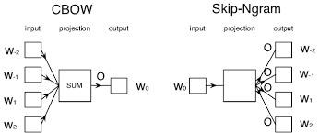
Skip-Gram Classifier
(assuming a +/- 2 word window)
…lemon, a [tablespoon of apricot jam, a] pinch…
c1 c2 [target] c3 c4
Goal: train a classifier that is given a candidate (word, context) pair
(apricot, tablespoon)
(apricot, aardvark)
…
And assigns each pair a probability:
P(+|w, c)

Slide 19

포켓몬 빵을 사서, 빵은 버리고 띠부띠부씰을 가짐
언어모델임, 표/검색엔진을 뉴럴넷이 대체한 ☺

Slide 20
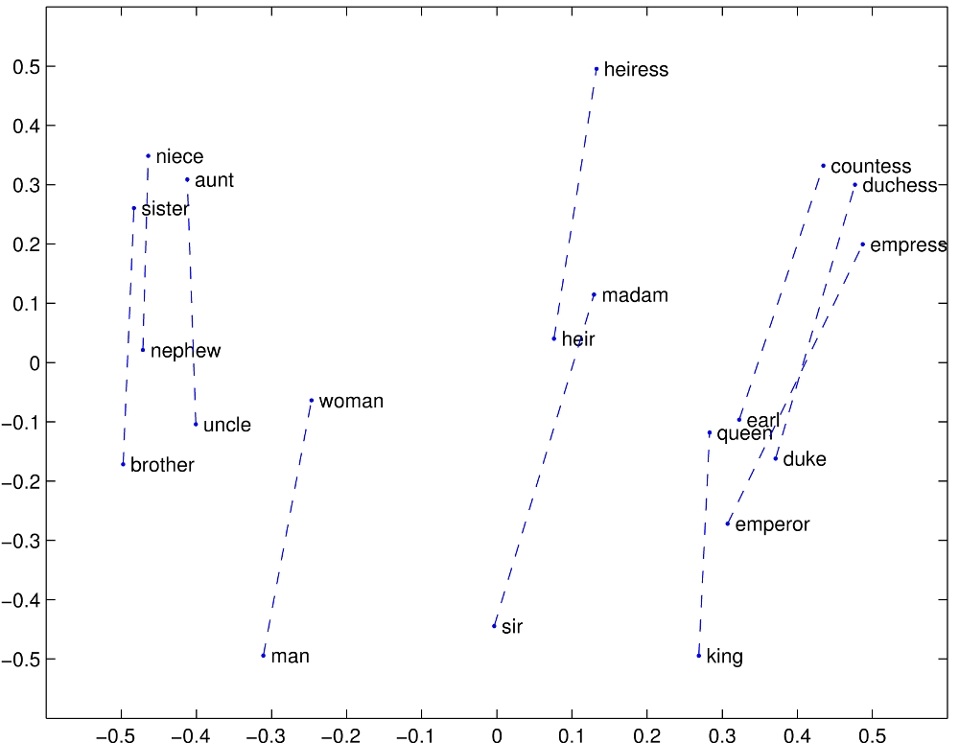
Structure in GloVE Embedding space

Slide 21
Caveats with the parallelogram method
It only seems to work for frequent words, small distances and certain relations (relating countries to capitals, or parts of speech), but not others. (Linzen 2016, Gladkova et al. 2016, Ethayarajh et al. 2019a)
Understanding analogy is an open area of research (Peterson et al. 2020)

Slide 22
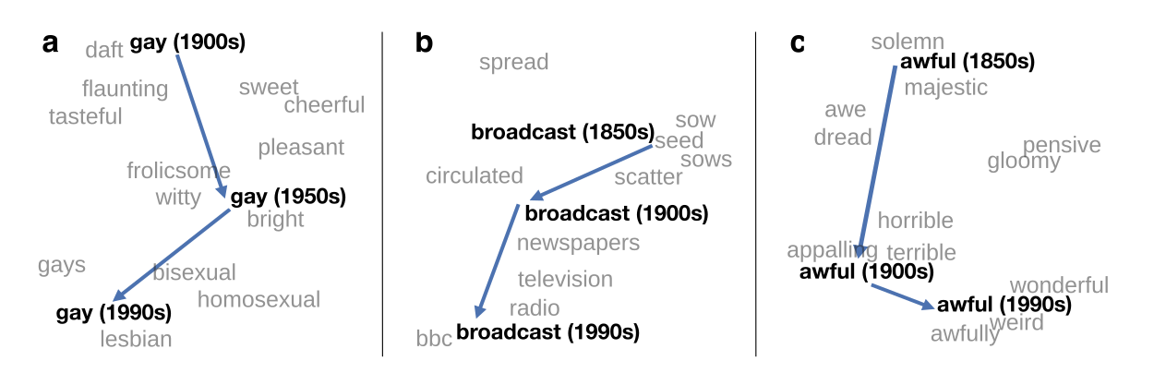
Embeddings as a window onto historical semantics
Train embeddings on different decades of historical text to see meanings shift
~30 million books, 1850-1990, Google Books data
William L. Hamilton, Jure Leskovec, and Dan Jurafsky. 2016. Diachronic Word Embeddings Reveal Statistical Laws of Semantic Change. Proceedings of ACL.

Slide 23
Embeddings reflect cultural bias!
Bolukbasi, Tolga, Kai-Wei Chang, James Y. Zou, Venkatesh Saligrama, and Adam T. Kalai. "Man is to computer programmer as woman is to homemaker? debiasing word embeddings." In NeurIPS, pp. 4349-4357. 2016.
Ask “Paris : France :: Tokyo : x”
x = Japan
Ask “father : doctor :: mother : x”
x = nurse
Ask “man : computer programmer :: woman : x”
x = homemaker
Algorithms that use embeddings as part of e.g., hiring searches for programmers, might lead to bias in hiring

Slide 24
Historical embedding as a tool to study cultural biases
Garg, N., Schiebinger, L., Jurafsky, D., and Zou, J. (2018). Word embeddings quantify 100 years of gender and ethnic stereotypes. Proceedings of the National Academy of Sciences 115(16), E3635–E3644.
Compute a gender or ethnic bias for each adjective: e.g., how much closer the adjective is to "woman" synonyms than "man" synonyms, or names of particular ethnicities
Embeddings for competence adjective (smart, wise, brilliant, resourceful, thoughtful, logical) are biased toward men, a bias slowly decreasing 1960-1990
Embeddings for dehumanizing adjectives (barbaric, monstrous, bizarre) were biased toward Asians in the 1930s, bias decreasing over the 20th century.
These match the results of old surveys done in the 1930s

