Slide 1
Text Classification and Naïve Bayes
Now we know how to represent word..

Slide 2
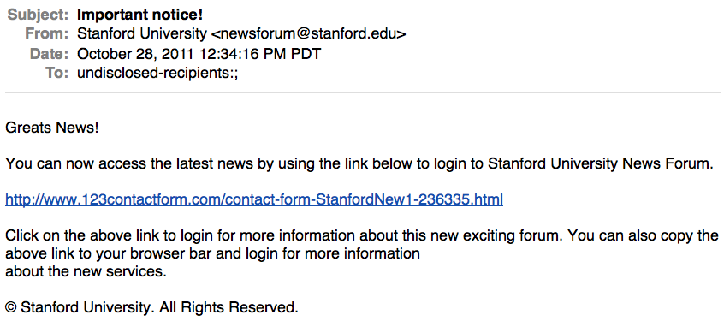
Is this spam?

Slide 3
Male or female author?
By 1925 present-day Vietnam was divided into three parts under French colonial rule. The southern region embracing Saigon and the Mekong delta was the colony of Cochin-China; the central area with its imperial capital at Hue was the protectorate of Annam…
Clara never failed to be astonished by the extraordinary felicity of her own name. She found it hard to trust herself to the mercy of fate, which had managed over the years to convert her greatest shame into one of her greatest assets…
S. Argamon, M. Koppel, J. Fine, A. R. Shimoni, 2003. “Gender, Genre, and Writing Style in Formal Written Texts,” Text, volume 23, number 3, pp. 321–346
Notes:
#1: Saigon. Grey, Anthony
#2: Jerusalem the Golden. Drabble, Margaret
From shlomo argamon

Slide 4


Positive or negative movie review?
unbelievably disappointing
Full of zany characters and richly applied satire, and some great plot twists
this is the greatest screwball comedy ever filmed
It was pathetic. The worst part about it was the boxing scenes.

Slide 5
Text Classification
Assigning subject categories, topics, or genres
Spam detection
Authorship identification
Age/gender identification
Language Identification
Sentiment analysis
…

Slide 6
Text Classification: definition
Input:
a document d
a fixed set of classes C = {c₁, c₂,…, c_{J}}
Output: a predicted class c ∈ C

Slide 7
Classification Methods: Hand-coded rules
Rules based on combinations of words or other features
spam: black-list-address OR (“dollars” AND“have been selected”)
Accuracy can be high
If rules carefully refined by expert
But building and maintaining these rules is expensive

Slide 8
Classification Methods: Supervised Machine Learning
Input:
a document d
a fixed set of classes C = {c₁, c₂,…, c_{J}}
A training set of m hand-labeled documents (d₁,c₁),....,(d_{m},c_{m})
Output:
a learned classifier γ:d → c

Slide 9
Classification Methods: Supervised Machine Learning
Any kind of classifier
Naïve Bayes
Logistic regression
Support-vector machines
k-Nearest Neighbors
…

Slide 10
Text Classification and Naïve Bayes
Naïve Bayes

Slide 11
Naïve Bayes Intuition
Simple (“naïve”) classification method based on Bayes rule
Relies on very simple representation of document
Bag of words

Slide 12
The bag of words representation
I love this movie! It's sweet, but with satirical humor. The dialogue is great and the adventure scenes are fun… It manages to be whimsical and romantic while laughing at the conventions of the fairy tale genre. I would recommend it to just about anyone. I've seen it several times, and I'm always happy to see it again whenever I have a friend who hasn't seen it yet.
γ(
)=c

Slide 13
The bag of words representation
I love this movie! It's sweet, but with satirical humor. The dialogue is great and the adventure scenes are fun… It manages to be whimsical and romantic while laughing at the conventions of the fairy tale genre. I would recommend it to just about anyone. I've seen it several times, and I'm always happy to see it again whenever I have a friend who hasn't seen it yet.
γ(
)=c

Slide 14
The bag of words representation: using a subset of words
x love xxxxxxxxxxxxxxxx sweet xxxxxxx satirical xxxxxxxxxx xxxxxxxxxxx great xxxxxxx xxxxxxxxxxxxxxxxxxx fun xxxx xxxxxxxxxxxxx whimsical xxxx romantic xxxx laughing xxxxxxxxxxxxxxxxxxxxxxxxxxxxxxxxxxxxxxxxxxxx recommend xxxxx xxxxxxxxxxxxxxxxxxxxxxxxxxxxxxxx several xxxxxxxxxxxxxxxxx xxxxx happy xxxxxxxxx again xxxxxxxxxxxxxxxxxxxxxxxxxxxxxxxxxxxxxxxxxxxxxxx
γ(
)=c

Slide 15
The bag of words representation
great | 2
love | 2
recommend | 1
laugh | 1
happy | 1
... | ...
γ(
)=c

Slide 16
Binary term-document incidence matrix
Sec. 6.2
Each document is represented by a binary vector ∈ {0,1}^{|V|}

Slide 17
Term-document count matrices
Sec. 6.2
Consider the number of occurrences of a term in a document:
Each document is a count vector in ℕ^{v}: a column below

Slide 18
Bag of words model
Vector representation doesn’t consider the ordering of words in a document
John is quicker than Mary and Mary is quicker than John have the same vectors
This is called the bag of words model.
In a sense, this is a step back: The positional index was able to distinguish these two documents.
We will look at “recovering” positional information later in this course.
For now: bag of words model

Slide 19
Term frequency tf
The term frequency tf_{t,d} of term t in document d is defined as the number of times that t occurs in d.
We want to use tf when computing query-document match scores. But how?
Raw term frequency is not what we want:
A document with 10 occurrences of the term is more relevant than a document with 1 occurrence of the term.
But not 10 times more relevant.
Relevance does not increase proportionally with term frequency.
NB: frequency = count in IR

Slide 20
Log-frequency weighting
Sec. 6.2
The log frequency weight of term t in d is
0 → 0, 1 → 1, 2 → 1.3, 10 → 2, 1000 → 4, etc.
Score for a document-query pair: sum over terms t in both q and d:
score
The score is 0 if none of the query terms is present in the document.

Slide 21
Document frequency
Sec. 6.2.1
Rare terms are more informative than frequent terms
Recall stop words (ex. A, the)
Consider a term in the query that is rare in the collection (e.g., arachnocentric)
A document containing this term is very likely to be relevant to the query arachnocentric
→ We want a high weight for rare terms like arachnocentric.

Slide 22
Document frequency, continued
Sec. 6.2.1
Frequent terms are less informative than rare terms
Consider a query term that is frequent in the collection (e.g., high, increase, line)
A document containing such a term is more likely to be relevant than a document that doesn’t
But it’s not a sure indicator of relevance.
→ For frequent terms, we want high positive weights for words like high, increase, and line
But lower weights than for rare terms.
We will use document frequency (df) to capture this.

Slide 23
idf weight
Sec. 6.2.1
df_{t} is the document frequency of t: the number of documents that contain t
df_{t} is an inverse measure of the informativeness of t
df_{t} ≤ N
We define the idf (inverse document frequency) of t by
We use log (N/df_{t}) instead of N/df_{t} to “dampen” the effect of idf.

Slide 24
idf example, suppose N = 1 million
Sec. 6.2.1
term | df_{t} | idf_{t}
calpurnia | 1
animal | 100
sunday | 1,000
fly | 10,000
under | 100,000
the | 1,000,000
There is one idf value for each term t in a collection.
Notes:
6 4 3 2 1 0

Slide 25
Effect of idf on ranking
Does idf have an effect on ranking for one-term queries, like
iPhone
idf has no effect on ranking one term queries
idf affects the ranking of documents for queries with at least two terms
For the query capricious person, idf weighting makes occurrences of capricious count for much more in the final document ranking than occurrences of person.

Slide 26
Collection vs. Document frequency
Sec. 6.2.1
The collection frequency of t is the number of occurrences of t in the collection, counting multiple occurrences.
Example:
Which word is a better search term (and should get a higher weight)?
Word | Collection frequency | Document frequency
insurance | 10440 | 3997
try | 10422 | 8760
Notes:
Why do you get these numbers?
Suggests df is better.

Slide 27
tf-idf weighting
Sec. 6.2.2
The tf-idf weight of a term is the product of its tf weight and its idf weight.
Best known weighting scheme in information retrieval
Note: the “-” in tf-idf is a hyphen, not a minus sign!
Alternative names: tf.idf, tf x idf
Increases with the number of occurrences within a document
Increases with the rarity of the term in the collection

Slide 28
Score for a document given a query
Sec. 6.2.2
There are many variants
How “tf” is computed (with/without logs)
Whether the terms in the query are also weighted
…

Slide 29
Binary → count → weight matrix
Sec. 6.3
Each document is now represented by a real-valued vector of tf-idf weights ∈ R^{|V|}

Slide 30
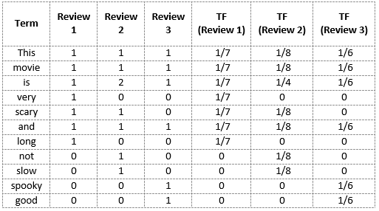
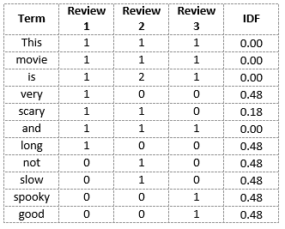
BoW with weights = 검색엔진 e.g., q=“good movie”
TF (Term Frequency)
IDF (Inverse Doc Frequency)

Slide 31
Text Classification and Naïve Bayes
Formalizing the Naïve Bayes classifier

Slide 32
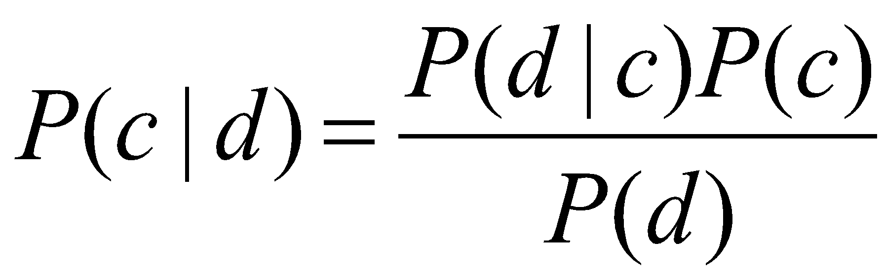
Bayes’ Rule Applied to Documents and Classes
For a document d and a class c
식에 언어모델이 숨어있다?

Slide 33
Each class = a unigram language model
Sec.13.2.1
Assigning each word: P(word | c)
Assigning each sentence: P(s|c)=Π P(word|c)
Class pos
0.1 I
0.1 love
0.01 this
0.05 fun
0.1 film
…
I
love
this
fun
film
0.1
0.1
0.01
0.05
0.1
P(s | pos) = 0.0000005

Slide 34
Naïve Bayes as a Language Model
Sec.13.2.1
Which class assigns the higher probability to s?
Model pos
Model neg
0.2 I
0.001 love
0.01 this
0.005 fun
0.1 film
0.1 I
0.1 love
0.01 this
0.05 fun
0.1 film
I
love
this
fun
film
0.1
0.1
0.01
0.05
0.1
0.2
0.001
0.01
0.005
0.1
P(s|pos) > P(s|neg)

Slide 35
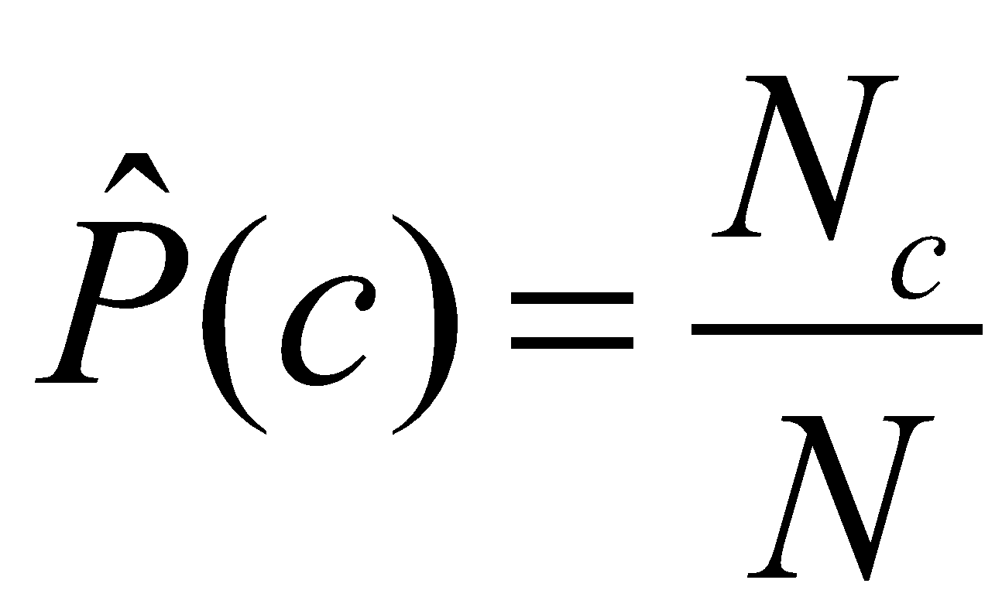
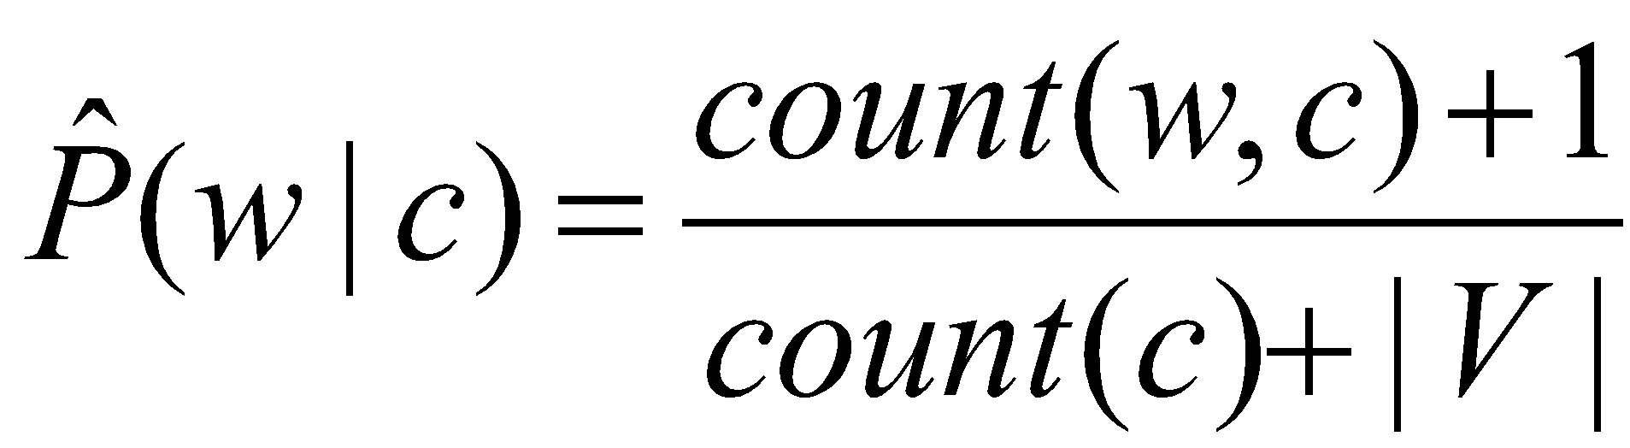

 | Doc | Words | Class
Training | 1 | Chinese Beijing Chinese | c
 | 2 | Chinese Chinese Shanghai | c
 | 3 | Chinese Macao | c
 | 4 | Tokyo Japan Chinese | j
Test | 5 | Chinese Chinese Chinese Tokyo Japan | ?
Priors:
P(c)=
P(j)=
3
4
1
Choosing a class:
P(c|d5)
P(j|d5)
4
3/4 * (3/7)³ * 1/14 * 1/14
≈ 0.0003
Conditional Probabilities:
P(Chinese|c) =
P(Tokyo|c) =
P(Japan|c) =
P(Chinese|j) =
P(Tokyo|j) =
P(Japan|j) =
(5+1) / (8+6) = 6/14 = 3/7
(0+1) / (8+6) = 1/14
1/4 * (2/9)³ * 2/9 * 2/9
≈ 0.0001
(0+1) / (8+6) = 1/14
(1+1) / (3+6) = 2/9
(1+1) / (3+6) = 2/9
(1+1) / (3+6) = 2/9

Slide 36
Summary: Naive Bayes Naïve but Not so Naive
Very Fast, low storage requirements
Robust to Irrelevant Features
Irrelevant Features cancel each other without affecting results
Very good in domains with many equally important features
Decision Trees suffer from fragmentation in such cases – especially if little data
Optimal if the independence assumptions hold: If assumed independence is correct, then it is the Bayes Optimal Classifier for problem
But language is order-dependent
Sparse observation can benefit from distributed vector

