Slide 1
Web Search

Slide 2
Ranked retrieval
Ch. 6
Thus far, our queries have all been Boolean.
Documents either match or don’t.
Good for expert users with precise understanding of their needs and the collection.
Also good for applications: Applications can easily consume 1000s of results.
Not good for the majority of users.
Most users incapable of writing Boolean queries (or they are, but they think it’s too much work).
Most users don’t want to wade through 1000s of results.
This is particularly true of web search.

Slide 3
Problem with Boolean search: feast or famine
Ch. 6
Boolean queries often result in either too few (=0) or too many (1000s) results.
Query 1: “standard user dlink 650” → 200,000 hits
Query 2: “standard user dlink 650 no card found”: 0 hits
It takes a lot of skill to come up with a query that produces a manageable number of hits.
AND gives too few; OR gives too many
Notes:
Cf. our discussion of how Westlaw Boolean queries didn’t actually outperform free text querying

Slide 4
Ranked retrieval models
Rather than a set of documents satisfying a query expression, in ranked retrieval, the system returns an ordering over the (top) documents in the collection for a query
Free text queries: Rather than a query language of operators and expressions, the user’s query is just one or more words in a human language
In principle, there are two separate choices here, but in practice, ranked retrieval has normally been associated with free text queries and vice versa

Slide 5
Feast or famine: not a problem in ranked retrieval
Ch. 6
When a system produces a ranked result set, large result sets are not an issue
Indeed, the size of the result set is not an issue
We just show the top k ( ≈ 10) results
We don’t overwhelm the user
Premise: the ranking algorithm works

Slide 6
Scoring as the basis of ranked retrieval
Ch. 6
We wish to return in order the documents most likely to be useful to the searcher
How can we rank-order the documents in the collection with respect to a query?
Assign a score – say in [0, 1] – to each document
This score measures how well document and query “match”.

Slide 7
Query-document matching scores
Ch. 6
We need a way of assigning a score to a query/document pair
Let’s start with a one-term query
If the query term does not occur in the document: score should be 0
The more frequent the query term in the document, the higher the score (should be)
We will look at a number of alternatives for this.

Slide 8
Take 1: Jaccard coefficient
Ch. 6
Recall from Lecture 3: A commonly used measure of overlap of two sets A and B
jaccard(A,B) = |A ∩ B| / |A ∪ B|
jaccard(A,A) = 1
jaccard(A,B) = 0 if A ∩ B = 0
A and B don’t have to be the same size.
Always assigns a number between 0 and 1.

Slide 9
Jaccard coefficient: Scoring example
Ch. 6
What is the query-document match score that the Jaccard coefficient computes for each of the two documents below?
Query: ides of march
Document 1: caesar died in march
Document 2: the long march

Slide 10
Issues with Jaccard for scoring
Ch. 6
It doesn’t consider term frequency (how many times a term occurs in a document)
Rare terms in a collection are more informative than frequent terms. Jaccard doesn’t consider this information
We need a more sophisticated way of normalizing for length
Later in this lecture, we’ll use
. . . instead of |A ∩ B|/|A ∪ B| (Jaccard) for length normalization.

Slide 11
Binary → count → weight matrix
Sec. 6.3
Each document is now represented by a real-valued vector of tf-idf weights ∈ R^{|V|}

Slide 12
Documents as vectors
Sec. 6.3
So we have a |V|-dimensional vector space
Terms are axes of the space
Documents are points or vectors in this space
Very high-dimensional: tens of millions of dimensions when you apply this to a web search engine
These are very sparse vectors - most entries are zero.

Slide 13
Queries as vectors
Sec. 6.3
Key idea 1: Do the same for queries: represent them as vectors in the space
Key idea 2: Rank documents according to their proximity to the query in this space
proximity = similarity of vectors
proximity ≈ inverse of distance
Recall: We do this because we want to get away from the you’re-either-in-or-out Boolean model.
Instead: rank more relevant documents higher than less relevant documents

Slide 14
Formalizing vector space proximity
Sec. 6.3
First cut: distance between two points
( = distance between the end points of the two vectors)
Euclidean distance?
Euclidean distance is a bad idea . . .
. . . because Euclidean distance is large for vectors of different lengths.

Slide 15
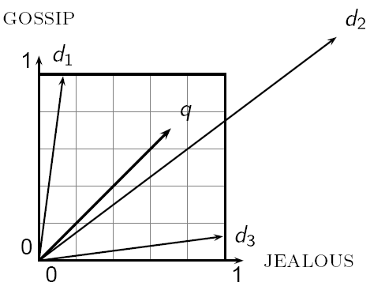
Why distance is a bad idea
Sec. 6.3
The Euclidean distance between q
and d₂ is large even though the
distribution of terms in the query q and the distribution of
terms in the document d₂ are
very similar.

Slide 16
Use angle instead of distance
Sec. 6.3
Thought experiment: take a document d and append it to itself. Call this document d′.
“Semantically” d and d′ have the same content
The Euclidean distance between the two documents can be quite large
The angle between the two documents is 0, corresponding to maximal similarity.
Key idea: Rank documents according to angle with query.

Slide 17
From angles to cosines
Sec. 6.3
The following two notions are equivalent.
Rank documents in decreasing order of the angle between query and document
Rank documents in increasing order of cosine(query,document)
Cosine is a monotonically decreasing function for the interval [0º, 180º]

Slide 18
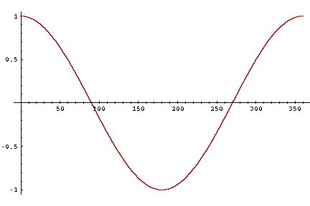
From angles to cosines
Sec. 6.3
But how – and why – should we be computing cosines?

Slide 19
Length normalization
Sec. 6.3
A vector can be (length-) normalized by dividing each of its components by its length – for this we use the L₂ norm:
Dividing a vector by its L₂ norm makes it a unit (length) vector (on surface of unit hypersphere)
Effect on the two documents d and d′ (d appended to itself) from earlier slide: they have identical vectors after length-normalization.
Long and short documents now have comparable weights

Slide 20
cosine(query,document)
Sec. 6.3
Dot product
Unit vectors
q_{i} is the tf-idf weight of term i in the query
d_{i} is the tf-idf weight of term i in the document
cos(q,d) is the cosine similarity of q and d … or,
equivalently, the cosine of the angle between q and d.
Notes:
See Law of Cosines (Cosine Rule) wikipedia page

Slide 21
Cosine for length-normalized vectors
For length-normalized vectors, cosine similarity is simply the dot product (or scalar product):
for q, d length-normalized.

Slide 22
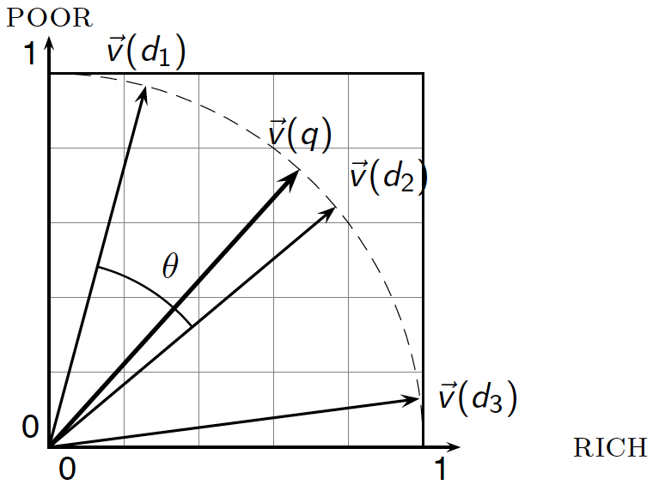
Cosine similarity illustrated

Slide 23
Cosine similarity amongst 3 documents
Sec. 6.3
How similar are
the novels
SaS: Sense and
Sensibility
PaP: Pride and
Prejudice, and
WH: Wuthering
Heights?
term | SaS | PaP | WH
affection | 115 | 58 | 20
jealous | 10 | 7 | 11
gossip | 2 | 0 | 6
wuthering | 0 | 0 | 38
Term frequencies (counts)
Note: To simplify this example, we don’t do idf weighting.

Slide 24
3 documents example contd.
Sec. 6.3
Log frequency weighting
After length normalization
term | SaS | PaP | WH
affection | 3.06 | 2.76 | 2.30
jealous | 2.00 | 1.85 | 2.04
gossip | 1.30 | 0 | 1.78
wuthering | 0 | 0 | 2.58
term | SaS | PaP | WH
affection | 0.789 | 0.832 | 0.524
jealous | 0.515 | 0.555 | 0.465
gossip | 0.335 | 0 | 0.405
wuthering | 0 | 0 | 0.588
cos(SaS,PaP) ≈
0.789 × 0.832 + 0.515 × 0.555 + 0.335 × 0.0 + 0.0 × 0.0
≈ 0.94
cos(SaS,WH) ≈ 0.79
cos(PaP,WH) ≈ 0.69
Why do we have cos(SaS,PaP) > cos(SaS,WH)?

Slide 25
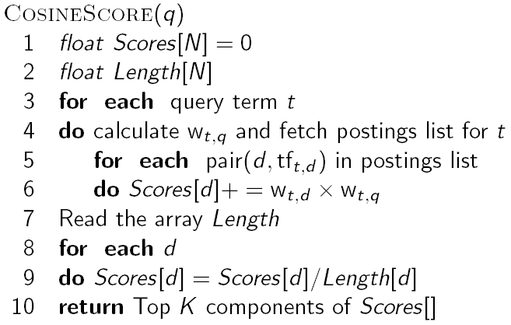
Computing cosine scores
Sec. 6.3

Slide 26
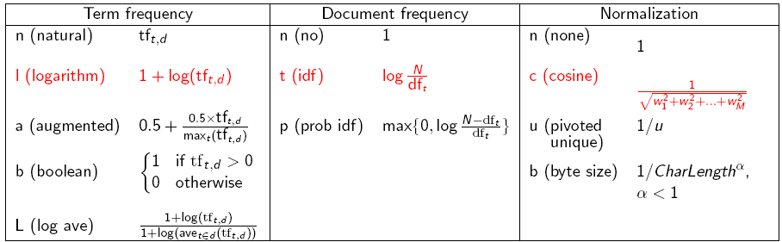
tf-idf weighting has many variants
Sec. 6.4
Columns headed ‘n’ are acronyms for weight schemes.
Why is the base of the log in idf immaterial?
Notes:
n default is just term frequency
ltc is best known form of weighting

Slide 27
Weighting may differ in queries vs documents
Sec. 6.4
Many search engines allow for different weightings for queries vs. documents
SMART Notation: denotes the combination in use in an engine, with the notation ddd.qqq, using the acronyms from the previous table
A very standard weighting scheme is: lnc.ltc
Document: logarithmic tf (l as first character), no idf and cosine normalization
Query: logarithmic tf (l in leftmost column), idf (t in second column), no normalization …
A bad idea?
Notes:
Leaving off idf weighting on documents is good for both efficiency and system effectiveness reasons.

Slide 28
tf-idf example: lnc.ltc
Sec. 6.4
Document: car insurance auto insurance
Query: best car insurance
Term | Query |  |  |  |  |  | Document |  |  |  | Prod
 | tf-raw | tf-wt | df | idf | wt | n’lize | tf-raw | tf-wt | wt | n’lize
auto | 0 | 0 | 5000 | 2.3 | 0 | 0 | 1 | 1 | 1 | 0.52 | 0
best | 1 | 1 | 50000 | 1.3 | 1.3 | 0.34 | 0 | 0 | 0 | 0 | 0
car | 1 | 1 | 10000 | 2.0 | 2.0 | 0.52 | 1 | 1 | 1 | 0.52 | 0.27
insurance | 1 | 1 | 1000 | 3.0 | 3.0 | 0.78 | 2 | 1.3 | 1.3 | 0.68 | 0.53
Exercise: what is N, the number of docs?
Doc length =
Score = 0+0+0.27+0.53 = 0.8

Slide 29
Summary – vector space ranking
Represent the query as a weighted tf-idf vector
Represent each document as a weighted tf-idf vector
Compute the cosine similarity score for the query vector and each document vector
Rank documents with respect to the query by score
Return the top K (e.g., K = 10) to the user

Slide 30
Basic crawler operation
Sec. 20.2
Begin with known “seed” URLs
Fetch and parse them
Extract URLs they point to
Place the extracted URLs on a queue
Fetch each URL on the queue and repeat

Slide 31
Crawling picture
Sec. 20.2
URLs crawled
and parsed
Unseen Web
Seed
pages
URLs frontier
Web

Slide 32
Simple picture – complications
Sec. 20.1.1
Web crawling isn’t feasible with one machine
All of the above steps distributed
Malicious pages
Spam pages
Spider traps – incl dynamically generated
Even non-malicious pages pose challenges
Latency/bandwidth to remote servers vary
Webmasters’ stipulations
How “deep” should you crawl a site’s URL hierarchy?
Site mirrors and duplicate pages
Politeness – don’t hit a server too often

Slide 33
What any crawler must do
Sec. 20.1.1
Be Polite: Respect implicit and explicit politeness considerations
Only crawl allowed pages
Respect robots.txt (more on this shortly)
Be Robust: Be immune to spider traps and other malicious behavior from web servers

Slide 34
What any crawler should do
Sec. 20.1.1
Be capable of distributed operation: designed to run on multiple distributed machines
Be scalable: designed to increase the crawl rate by adding more machines
Performance/efficiency: permit full use of available processing and network resources

Slide 35
What any crawler should do
Sec. 20.1.1
Fetch pages of “higher quality” first
Continuous operation: Continue fetching fresh copies of a previously fetched page
Extensible: Adapt to new data formats, protocols

Slide 36
Updated crawling picture
Sec. 20.1.1
URLs crawled
and parsed
Unseen Web
Seed
Pages
URL frontier
Crawling thread

Slide 37
URL frontier
Sec. 20.2
Can include multiple pages from the same host
Must avoid trying to fetch them all at the same time
Must try to keep all crawling threads busy

Slide 38
Explicit and implicit politeness
Sec. 20.2
Explicit politeness: specifications from webmasters on what portions of site can be crawled
robots.txt
Implicit politeness: even with no specification, avoid hitting any site too often

Slide 39
Robots.txt
Sec. 20.2.1
Protocol for giving spiders (“robots”) limited access to a website, originally from 1994
www.robotstxt.org/wc/norobots.html
Website announces its request on what can(not) be crawled
For a server, create a file /robots.txt
This file specifies access restrictions

Slide 40
Robots.txt example
Sec. 20.2.1
No robot should visit any URL starting with "/yoursite/temp/", except the robot called “searchengine":
User-agent: *
Disallow: /yoursite/temp/
User-agent: searchengine
Disallow:

Slide 41
Processing steps in crawling
Sec. 20.2.1
Which one?
Pick a URL from the frontier
Fetch the document at the URL
Parse the URL
Extract links from it to other docs (URLs)
Check if URL has content already seen
If not, add to indexes
For each extracted URL
Ensure it passes certain URL filter tests
Check if it is already in the frontier (duplicate URL elimination)
E.g., only crawl .edu, obey robots.txt, etc.

Slide 42
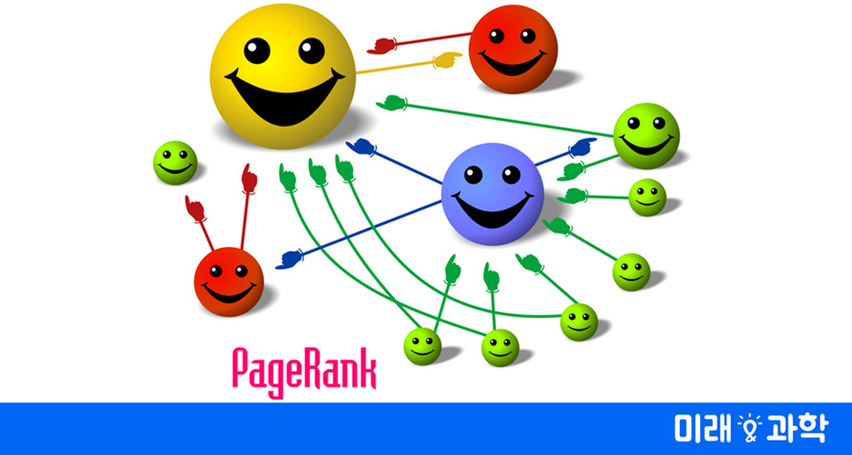
Search = PageRank + Relevance

