Slide 1
Neural NLP Quick Review

Slide 2
Language Modeling: Models of P(text)

Slide 3

Count-based Language Models
Count up the frequency and divide:
https://books.google.com/ngrams
Any problem?

Slide 4
Problems w/ Count-based Models
Cannot share strength among similar words
she bought a car she purchased a car
she bought a bicycle she purchased a bicycle
Cannot handle long-distance dependencies
for tennis class he wanted to buy his own racquet
for programming class he wanted to buy his own computer

Slide 5
A Slight Simplification: Sentence Classification Models of P(label | text)

Slide 6
An Example Prediction Problem: Sentence Classification
very good good
I hate this movie
neutral bad very bad
very good good neutral bad
very bad
I love
this
movie

Slide 7






Word Representation (task-specific)
Each word has its own 5 elements corresponding to [very good, good, neutral, bad, very bad]
“hate” will have a high value for “very bad”, etc.

Slide 8























A First Try:
Bag of Words (BOW)
I
hate this movie
lookup
lookup lookup lookup
+ +
bias scores
+
+
=
probs
softmax

Slide 9
Adversarial Examples
very good good neutral bad
very bad
I don’t love this movie
very good good neutral bad
very bad
There’s nothing I don’t
love about this movie

Slide 10
Combination Features
Does it contain “don’t” and “love”?
Does it contain “don’t”, “i”, “love”, and “nothing”?

Slide 11





























Idea 1: Neural Networks
I hate this movie
lookup lookup lookup lookup
scores
some complicated function to extract combination features
(neural net)
probs
softmax

Slide 12



























Idea 2: Continuous Bag of Words (CBOW)
I hate this movie
lookup lookup lookup lookup
+ +
=
+
W
+
=
bias
scores

Slide 13



CBOW
(Mikolov et al. 2013)
•
Predict word based on sum of surrounding embeddings
giving a
lookup lookup
***
at the
lookup lookup
+
=
+
+
talk
W
=
loss
softmax
scores
probs

Slide 14
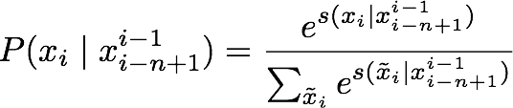
Softmax
Convert scores into probabilities by taking the exponent and normalizing (softmax)
-3.2
-2.9
1.0
2.2
0.002
0.003
s=
p= 0.329
0.444
0.090
…
0.6
…

Slide 15
Skip-gram
(Mikolov et al. 2013)
Predict each word in the context given the word
•
talk
giving
lookup
a
W
=
at
loss
the

Slide 16
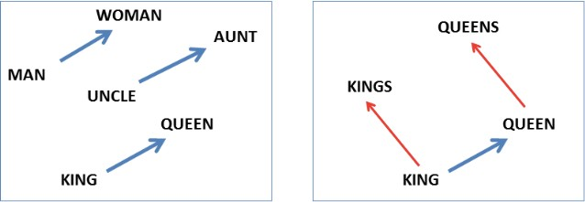
Word Embeddings
•
“What is the female equivalent of king?” is not easily accessible in many traditional resources

Slide 17
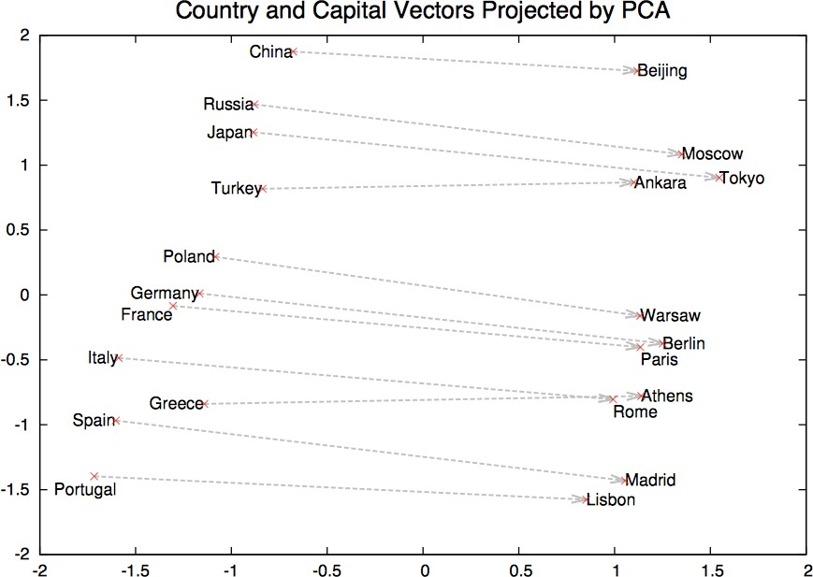
Visualization of Embeddings
Reduce high-dimensional embeddings into 2/3D for visualization (e.g. Mikolov et al. 2013)
Capital?
(Korea,?, Seoul) = True
If h+?=t

Slide 18





























Time Delay Neural Networks
(Waibel et al. 1989)
I hate this movie
tanh(
tanh(
tanh(
These are soft 2-grams!
W*[x1;x2]
+b)
W*[x2;x3]
+b)
W*[x3;x4]
+b)
probs
softmax( W*h + b)
pooling

Slide 19
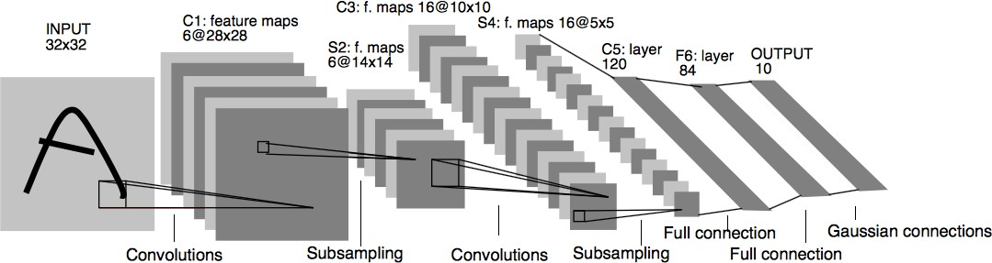
Convolutional Networks
(LeCun et al. 1997)
Parameter extraction performs a 2D sweep, not 1D

Slide 20
Pooling
Calculate some reduction function feature-wise
Max pooling: “Did you see this feature anywhere in the range?” (most common)
Average pooling: “How prevalent is this feature over the entire range”
k-Max, Dynamic, ...

Slide 21
Weaknesses of CNNs
CNNs are great for short-distance feature extractors
But don't have holistic view of the sentence to capture long-distance dependencies

Slide 22
Long-distance Dependencies in Language
Agreement in number, gender, etc.
He does not have very much confidence in himself. She does not have very much confidence in herself.
Selectional preference
The reign has lasted as long as the life of the queen. The rain has lasted as long as the life of the clouds.

Slide 23


















Remember History w/ RNNs
What does processing a sequence look like?
I hate this movie
RNN
RNN
RNN
RNN
predict
label

Slide 24
Weaknesses of RNNs
Indirect passing of information, credit assignment more difficult
Made better by LSTMs/GRUs/etc. but not perfect
Can be slow, due to incremental processing

Slide 25
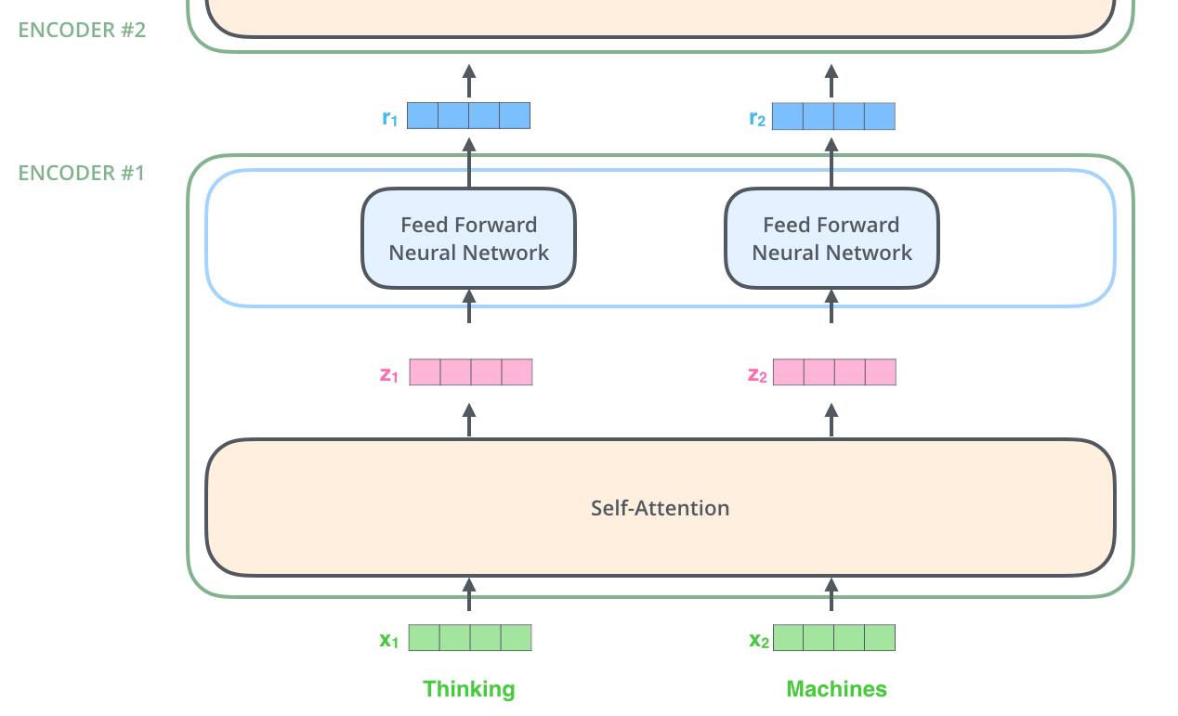
Transformer: attention is all you need

Slide 26
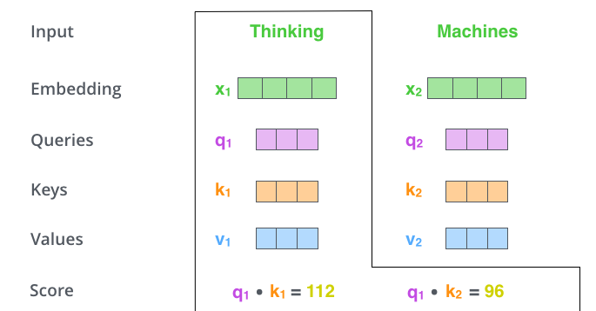

Slide 27
Sequence Transduction: Models of P(text | text)

Slide 28
Conditioned Language Models
Not just generate text, generate text according to some specification
Input X Structured Data
English Document Utterance Image Speech
Output Y (Text) NL Description
Japanese Short Description
Response Text Transcript
Task
NL Generation
Translation Summarization Response Generation Image Captioning Speech Recognition

Slide 29
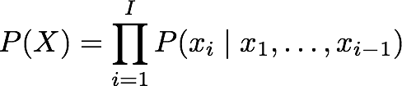
Calculating the Probability of a Sentence
Next Word
Context

Slide 30
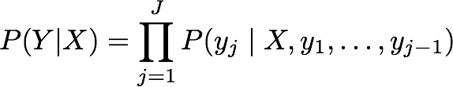
Conditional Language Models
Added Context!

Slide 31


























(One Type of) Language Model
(Mikolov et al. 2011)
<s> I hate this
movie
LSTM
LSTM
LSTM
LSTM
LSTM
predict
predict
predict
predict
predict
I
hate
this
movie
</s>

Slide 32















































(One Type of) Conditional Language Model
(Sutskever et al. 2014)
eiga ga
Encoder
kono
kirai
</s>
LSTM
LSTM
LSTM
LSTM
LSTM
I
hate
this
movie
LSTM
LSTM
LSTM
LSTM
argmax
argmax
argmax
argmax
argmax
I
Decoder
</s>
hate
this
movie

Slide 33
The Generation Problem
We have a model of P(Y|X), how do we use it to generate a sentence?
Two methods:
Sampling: Try to generate a random sentence according to the probability distribution.
Argmax: Try to generate the sentence with the
highest probability.

Slide 34
Ancestral Sampling
Randomly generate words one-by-one.
while yj-1 != “</s>”:
yj ~ P(yj | X, y1, …, yj-1)
An exact method for sampling from P(X), no further work needed.

Slide 35
Argmax Search
Greedy search: One by one, pick the single highest- probability word
while yj-1 != “</s>”:
yj = argmax P(yj | X, y1, …, yj-1)
Beam search: keep multiple hypotheses

Slide 36






Representing Sentences as Vectors
Problem!
“You can’t cram the meaning of a whole %&!$ing sentence into a single $&!*ing vector!”
— Ray Mooney
But what if we could use multiple vectors, based on the length of the sentence.
this is an example
this is an example

Slide 37
"Attention"!
(Bahdanau et al. 2015)
Encode each word in the sentence into a vector
When decoding, perform a linear combination of
these vectors, weighted by “attention weights”
Use this combination in picking the next word

Slide 38















Calculating Attention (1)
Use “query” vector (decoder state) and “key” vectors (all encoder states)
For each query-key pair, calculate weight
Normalize to add to one using softmax
kono eiga ga kirai
Key Vectors
I hate
a1=2.1 a2=-0.1
a3=0.3 a4=-1.0
Query Vector
softmax
α1=0.76 α2=0.08 α3=0.13 α4=0.03

Slide 39




Calculating Attention (2)
Combine together value vectors (usually encoder states, like key vectors) by taking the weighted sum
kono eiga ga kirai
Value Vectors
* * *
α1=0.76 α2=0.08 α3=0.13
*
α4=0.03
Use this in any part of the model you like

Slide 40
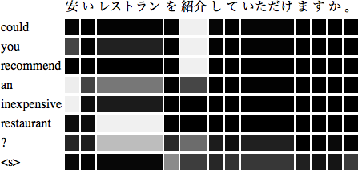
Work also as Explanation

Slide 41
Learn More!

Slide 42
Learn More!
NLP is a big field, too big for 1hr
Lots of nice resources online, e.g.:
Stanford CS224n: Natural Language Processing with Deep Learning https://web.stanford.edu/class/cs224n/
CMU CS11-747: Neural Networks for Natural Language Processing http://phontron.com/class/nn4nlp2018/

