Slide 2
VPTR (Video Prediction Transformer)
Input
Navier-Stokes Timeseries 2d data
f_{ns}(initial_field, viscosity, initial_density map)
Initial_field: Gaussian random field
Viscosity: 1e-2, 1e-3, 1e-4
Initial_density_map: constant
Viscosity마다 10000 train, 2000 test
ResNet Decoder:
(out=528, C, ndown=3, padding=reflect)
->(Input: (B, T, out, 8, 8), output: (B, T, C, 64, 64))
Up [
ConvTranspose(out, 64*4, 3,2,1,1)
ConvTranspose(64*4, 64*2, 3,2,1,1)
ConvTranspose(64*2, 64, 3,2,1,1)
]
Conv(64, C, 7, 1, 3)
Tanh
ResNet Encoder:
(C, out=528, ndown=3, padding=reflect)
-> (Input: (B, T, C, 64, 64), output: (B, T, out, 8, 8))
Conv(C, 64, 7, 1, 0)
Down [
Conv(64, 64*2, 3,2,1)
Conv(64*2, 64*4, 3,2,1)
Conv(64*4, out, 3,2,1)]
9X[Conv(out, out, 3, 1, refP1), Conv(out, out, 3, 1, refP1), +x]
PatchGAN discriminator()
-> (Input: (B, T, C, 64, 64), output: (B, T, 1, 6, 6))
Conv(C, 64, 4, 2, 1)
Conv(64, 64*2, 4, 2, 1)
Conv(64*2, 64*4, 4, 2, 1)
Conv(64*4, 64*8, 4, 1, 1)
Conv(64*8, 1, 4, 1, 1)
Gan loss: vanilla (logBCE)

Slide 3
VPTR (Video Prediction Transformer)
Input
Navier-Stokes Timeseries 2d data
f_{ns}(initial_field, viscosity, initial_density map)
Initial_field: Gaussian random field
Viscosity: 1e-2, 1e-3, 1e-4
Initial_density_map: constant
Viscosity마다 10000 train, 2000 test
VPTR fully autoregressive
(input: (B,T,528,8,8), output: (B,T,528,8,8))
num_past_frames: 10
num_future_frames: 10
encH: 8
encW: 8
d_model: 528,
Nhead: 8,
num_encoder_layers: 12,
Dropout: 0.1
window_size: 4,
Spatial_FFN_hidden_ratio: 4
rpe: False
VidHRFormerBlockEnc x num_encoder_layers (12)
Layer norm
VidHRFormerBlockEnc
(B, 0:T, 528, 8, 8), PosEmb(w, w, 528), TempEmb(0:T, 528)
(B, 1:T+1, 528, 8, 8)
[layerNorm, SpatialLocalMultiheadAttention]
[LayerNorm, SpatialFFN]
[LayerNorm, TemporalMultiheadAttention(w/ attn_mask]
[LayerNorm, MLP(528, 528*4, 528)]
ResNet Decoder:
ResNet Encoder:

Slide 4
VPTR (Video Prediction Transformer)
Input
Navier-Stokes Timeseries 2d data
f_{ns}(initial_field, viscosity, initial_density map)
Initial_field: Gaussian random field
Viscosity: 1e-2, 1e-3, 1e-4
Initial_density_map: constant
Viscosity마다 10000 train, 2000 test
VPTR None autoregressive
(input: (B,T,528,8,8), output: (B,T,528,8,8))
num_past_frames: 10
num_future_frames: 10
encH: 8
encW: 8
d_model: 528,
Nhead: 8,
num_encoder_layers: 12,
Dropout: 0.1
window_size: 4,
Spatial_FFN_hidden_ratio: 4
rpe: False
VidHRFormerBlockEnc x num_encoder_layers (12)
Layer norm
VidHRFormerBlockEnc
(B, 0:T, 528, 8, 8), PosEmb(w, w, 528), TempEmb(0:T, 528)
(B, 1:T+1, 528, 8, 8)
[layerNorm, SpatialLocalMultiheadAttention]
[LayerNorm, SpatialFFN]
[LayerNorm, TemporalMultiheadAttention(w/ attn_mask]
[LayerNorm, MLP(528, 528*4, 528)]
ResNet Decoder:
ResNet Encoder:

Slide 5
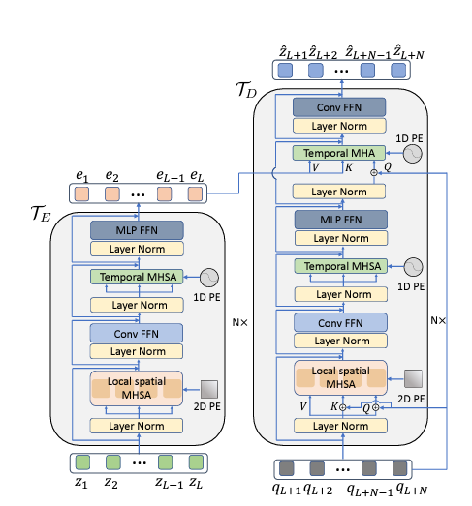
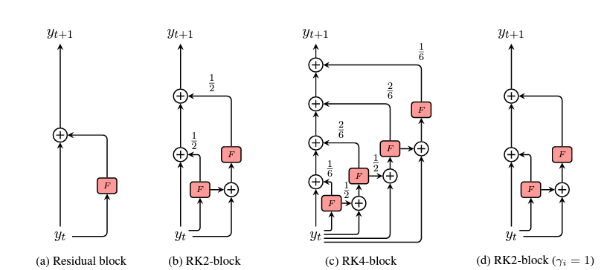
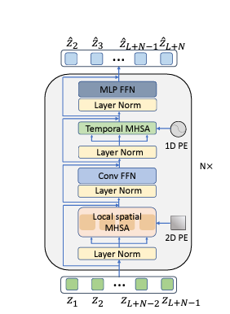
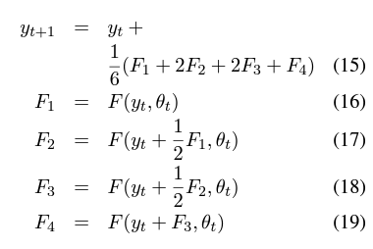

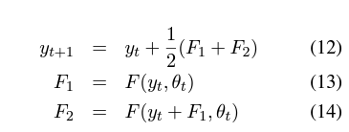
ODE transformer and VPTR
F for ODE
F for ODE
Euler method
VPTR-FAR
VPTR-NAR
2nd order Runge-Kutta
4th order VPTR-NAR

Slide 6
Data tune & normalization
w (1ch) → w, w0, f, dw/dx, dw/dy, d2w/dxdy, v (7ch)
Normal distribution
MinMax tune (0to1)

Slide 7
Metric:
MSE
SSIM
PSNR
RelativeError
Model:
FNO
VPTR
Galerkin transformer
Dataset: 2D Navier-Stokes
V100_Ffix_10to10
V100_Ffix_10to40
V1000_Ffix_10to10
V1000_Ffix_10to40
V10000_Ffix_10to10
V10000_Ffix_10to40
V100_Fvar_10to10
V100_Fvar_10to40
V1000_Fvar_10to10
V1000_Fvar_10to40
V10000_Fvar_10to10
V10000_Fvar_10to40
Vvar_Fvar_10to10

Slide 8
Define problem
Prediction time series data from given time series data
{(t₀,…,t_{l}),(u₀,…,u_{l})} → {(t_{l+1},…,t_{l+m}),(u_{l+1},…,u_{l+m})}
Find Hilbert space H1 from given input set and predict new Hilbert space H2
1. {(t₀,…,t_{l}),(u₀,…,u_{l})} → H1
2. T:H1 → H2
3. H2 → {(t_{l+1},…,t_{l+m}),(u_{l+1},…,u_{l+m})}
(1 + 2)*. Fully autoregressive: (t₀,…,t_{l}) → (t₁,…,t_{l+1})
1* + 2*. Non autoregressive:
T:[(t₀,…,t_{l}) → (t₀,…,t_{l})] → (t_{l+1},…,t_{l+m})
3*. Decoding H2
1*. Using self attention, find H1
2*. Mapping H2 from H1: transformer as operator learner
3*. Decoding H2
Exp1. Is found H1 good ?
{(t₀,…,t_{l}),(u₀,…,u_{l})} → {(t₀,…,t_{l}),(u₀,…,u_{l})}
Temporal attention…. And temporal emb

