Slide 1
Continuing with Music Beyond High School
Pictures have been removed to reduce file size. Check the “notes” section for more information!
Presented by: Kappa Kappa Psi

Slide 2
Overview
Introductions
Why continue with music?
University music programs in WA
UW’s ensembles
Community Bands
Kappa Kappa Psi
Notes:
Introductions
Name, major, hometown, instrument (you can point out here that you can continue with music without being a music major)

Slide 3
Why continue at the university level?
Meet new friends
More to college than just schoolwork
Extracurricular activities
Notes:
Interaction with high schoolers
Ask (and provide your own responses too!)
Why did you join band?
What is your favorite part of band?
Talking points (provide your own personal stories)
UW’s current student population is 40,000, much more than in high school, so band offers a smaller group of people In high school, you probably hang out with band people all the time, you can do that in college too
Easy way to meet new people
Break from your classes and schoolwork
Fun!

Slide 4
Traveling
Notes:
Many different travelling opportunities:
Husky Band (pep bands, bowl games, high school gigs, WSU, VA band trips)
Wind Ensemble (trip to China last year)
KKPsi district events – can talk about how meeting people from around the country makes travelling more fun!
Performing concerts off-campus in the community

Slide 5
Opportunities Post-High School
University Bands
Community College Bands
Community Bands
Small-Scale
Notes:
Emphasize that it’s important to continue with music no matter how or in what capacity

Slide 6
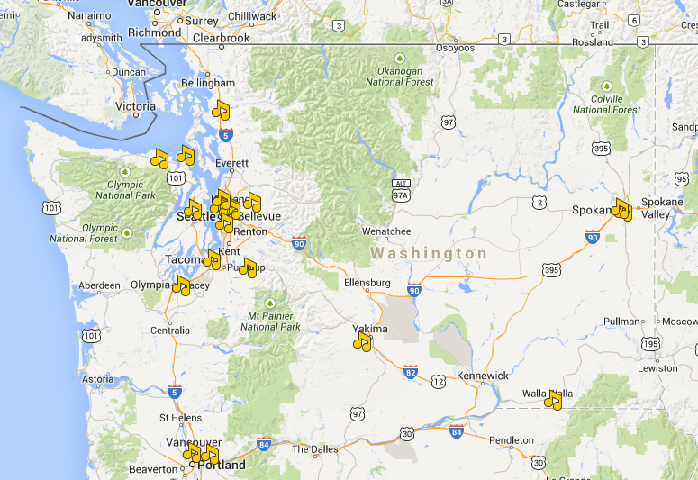
Community Bands in Washington
Notes:
Talking points
These are just a few of the community bands in Washington
Some audition, some non-audition
Continue with music even if you’re not going to a four-year university
Can join these groups now!

Slide 7
Washington Universities

Slide 8
Central Washington University
Notes:
Ensembles
Wind Ensemble
It has reached reputation as being one of the nations
outstanding undergrad wind ensembles. By audition.
Symphonic Band
A highly qualified auditioned ensemble. This is made
mostly of music majors and minors.
Various Jazz Bands There are a number of small and large ensemble jazz bands within the music school and jazz program.
CWU Marching Band About 150 large, performs at all home football games. Mostly music majors with 5 hr/week rehearsal. Non audition.
Central is one of the best schools in WA for music, “one of the best programs in the northwest.”

Slide 9
Eastern Washington University
Notes:
ensembles
Marching Band
Performs at every home football game and other
events on campus.
Symphonic Band
EWU’s full sized concert band opened to all students
and non audition.
Wind Ensemble Comprised of the most outstanding wind students by audition. The group practices extensively on and off campus.
Jazz Band One of the most exciting and progressive in the Northwest! They play standard jazz repertory to new literature and arrangements.

Slide 10
Western Washington University
Notes:
ensembles
Wind Symphony Top group of Westerns musicians. Audition is
required.
Symphonic Band
An 80 plus member ensemble that plays classical to
contemporary music.
Jazz Ensembles
The program offers large and small instrumental
jazz for improvisation and arrangement.
Viking Band WWU’s pep band, which attends Volleyball and Basketball games to support the school with high-energy music.

Slide 11
Washington State University
Notes:
Ensembles
WSU Symphonic Wind Ensemble
The highest group of musicians in the university,
comprised mostly of music majors. Audition
required.
Symphonic Band
Open to all WSU students no matter the major and
non audition. A lower key environment to keep
playing.
Cougar Marching Band
a 200+ marching band. They perform at many
sporting events on campus as a spirit section of the
university. Audition for part placement only.
Jazz Ensembles Various jazz ensembles of different sizes and instrumentation.
Kkpsi/TBS

Slide 12
At the UW…

Slide 13
Concert/Campus Band
Directed by graduate students
Meet once a week Wed 7-9PM
Members from the community participate as well
No audition

Slide 14
Symphonic Band
Meet twice a week, Mon and Wed 3:30-5:30PM
Directed by Dr. Steven Morrison
Auditions every quarter

Slide 15
Wind Ensemble
Meet twice a week
Directed by Prof. Tim Salzman
Audition every September
Travelling opportunities

Slide 16
Jazz Bands
Big Band
Modern
Combos
Notes:
Auditioned groups; meet twice a week

Slide 17
Other Musical Ensembles
Steel Drum Band
Symphony Orchestra
Notes:
Mention that many people play outside of the official ensembles (such as for the musicals, accompanying vocalists, etc.)

Slide 18
Husky Marching Band
Under the direction of Dr. Brad McDavid
240 members
Traditional chair-stepping band
Part of the Athletic Dept.
Practice 4 days/week
Perform many sporting events
Auditions
Drumline: June
Winds: September 7th

Slide 19
Husky Band Jr/Sr Day
Play with the Husky Band in Husky Stadium
Experience what it’s like to be in HMB
UW Football Spring Game
April 19th 8:00 am – 3:00 pm
Notes:
Many current members in HMB went to Jr/Sr and decided to audition for HMB and go to UW
You don’t need to be a student at UW to do HMB, nor is prior marching experience required
Jr/Sr day isn’t required to audition for HMB

Slide 20


Kappa Kappa Psi
National Honorary Band Service Co-Ed Fraternity
Build leadership experience
Meet musicians from other schools
Notes:
Not a whole lot of emphasis on this, mostly just talk about getting to meet musicians from other schools, and serving band programs by doing things like this high school talk
WSU has a KKPsi and TBS chapter

Slide 21
Kappa Kappa Psi
Serve bands and music programs
Notes:
Service project examples: organizing music libraries, painting stands, playing for elementary/middle/high school students, instrument petting zoo, boy scouts music badge, coming to high schools like this

Slide 22
Contact Info
University of Washington School of Music:
http://www.music.washington.edu
Husky Marching Band:
http://www.huskymarchingband.org
Husky Drumline
http://depts.washington.edu/drumpage/
Junior/Senior Day
http://students.washington.edu/kkpsi/jrsrday/
Kappa Kappa Psi:
http://students.washington.edu/kkpsi
Notes:
Q&A, talk about your favorite parts of band, etc.
Hand out fliers

