Slide 1


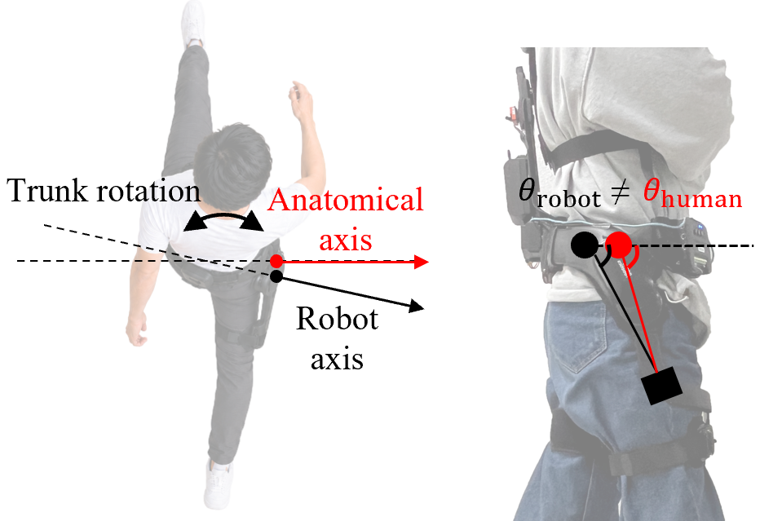
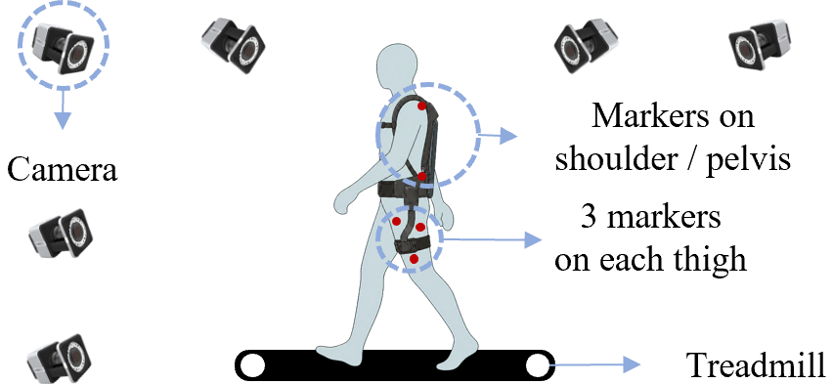
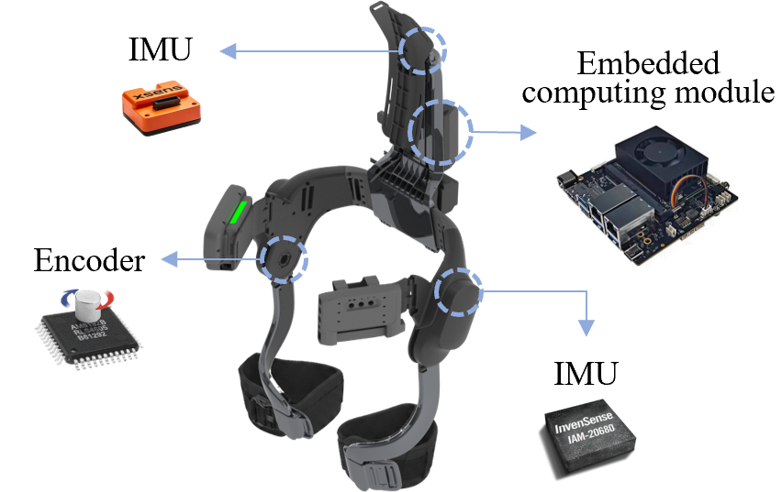
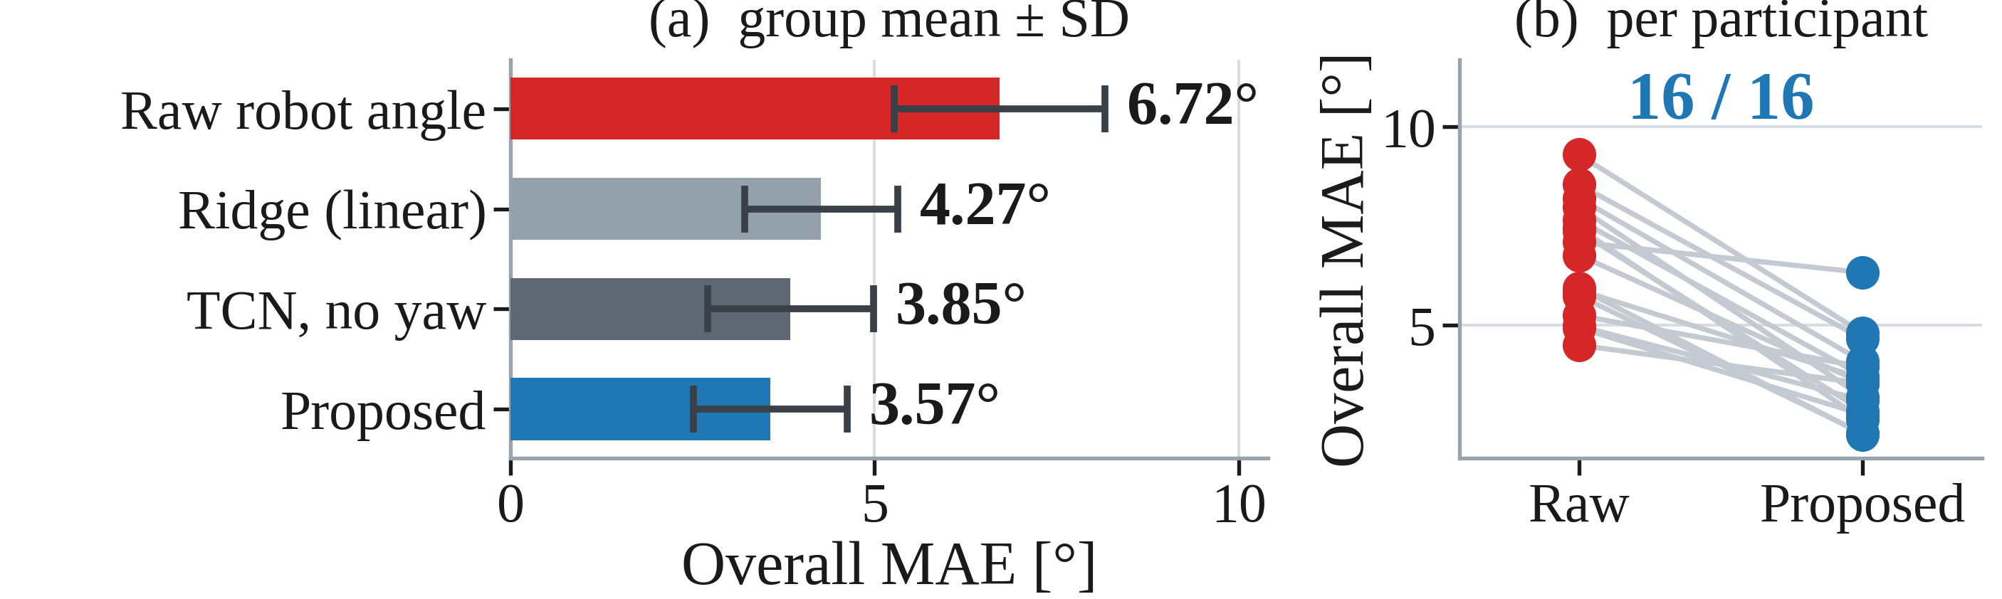
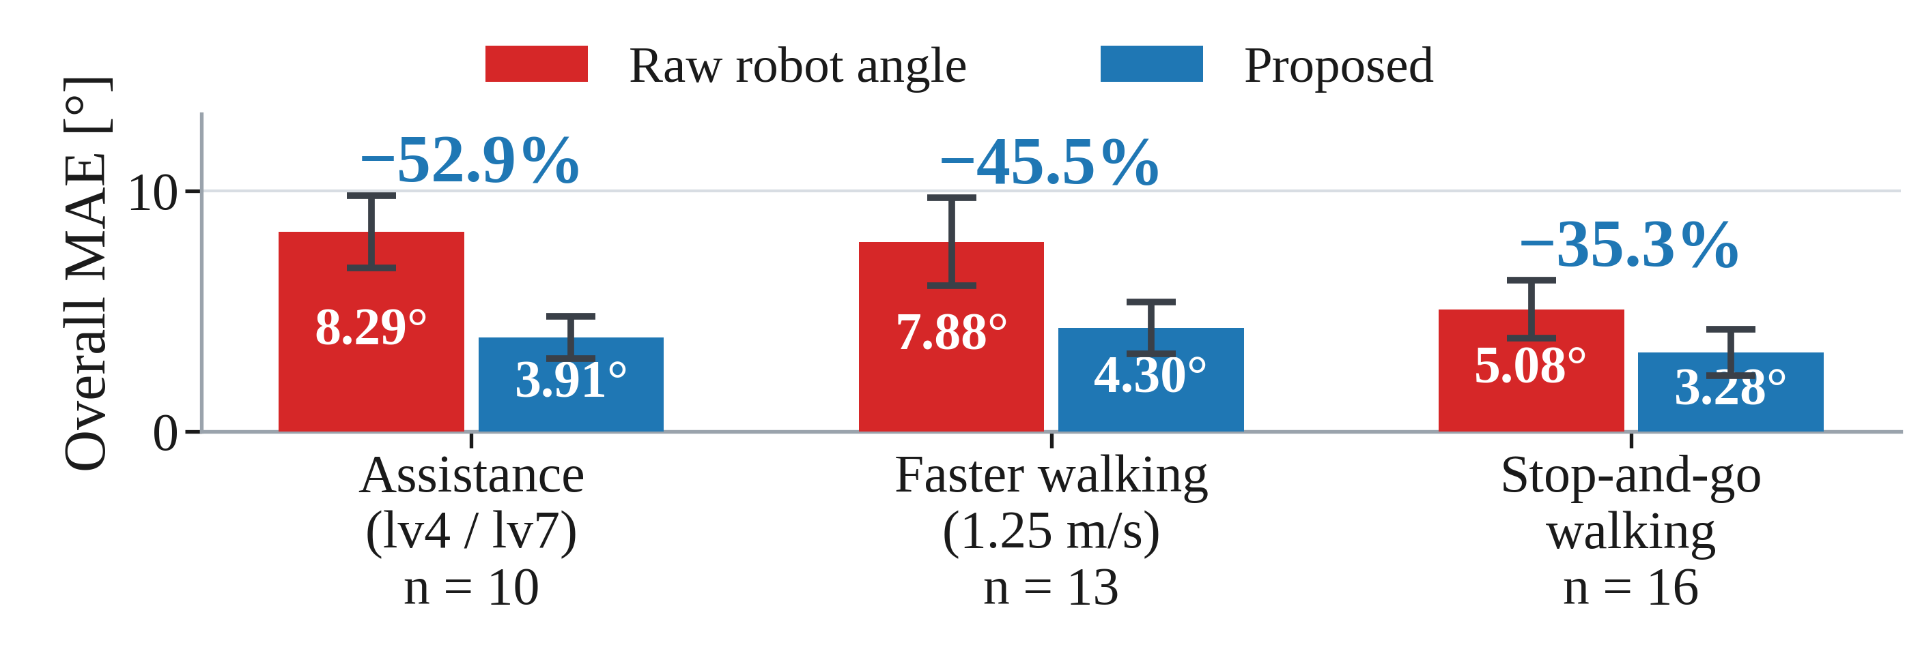
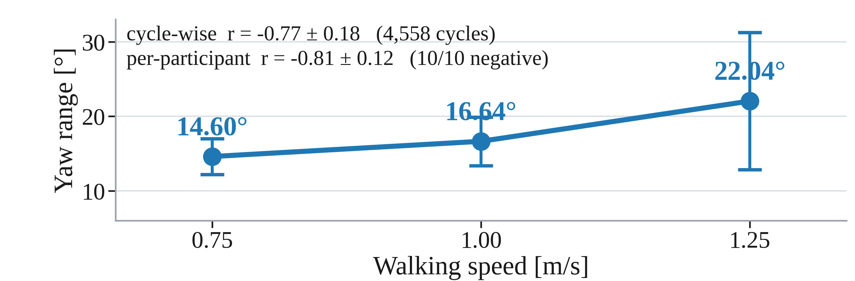
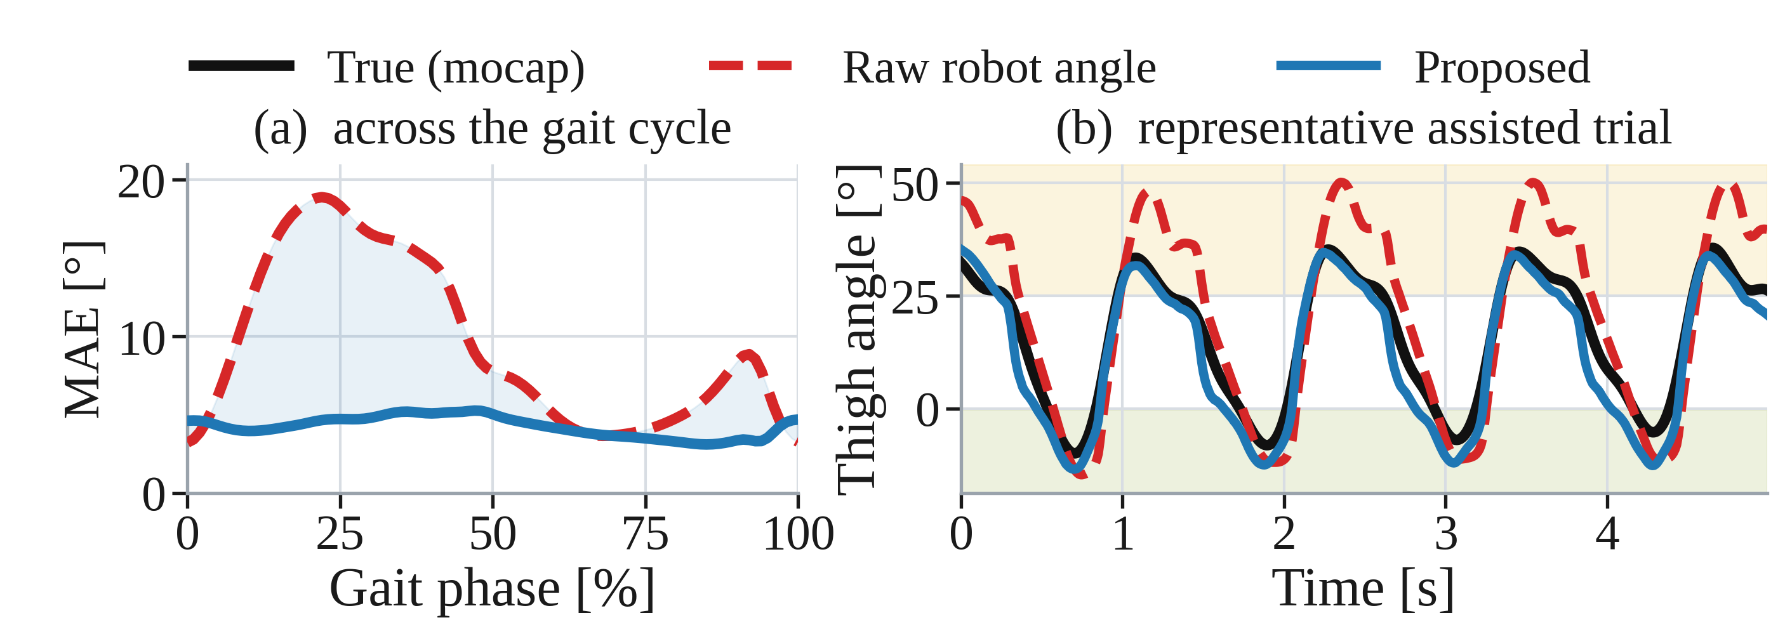
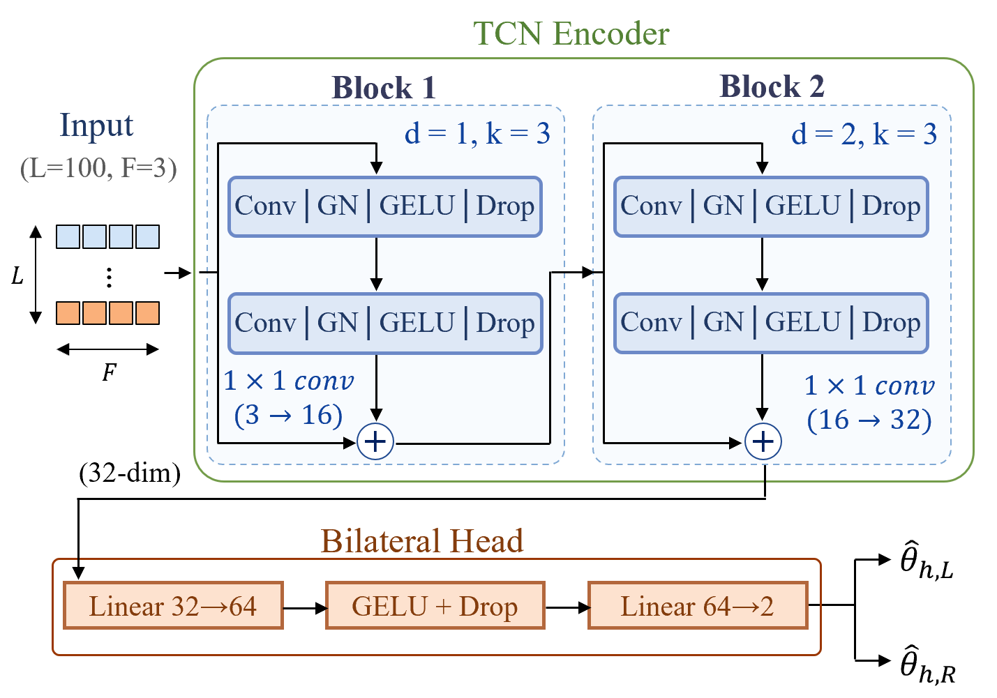
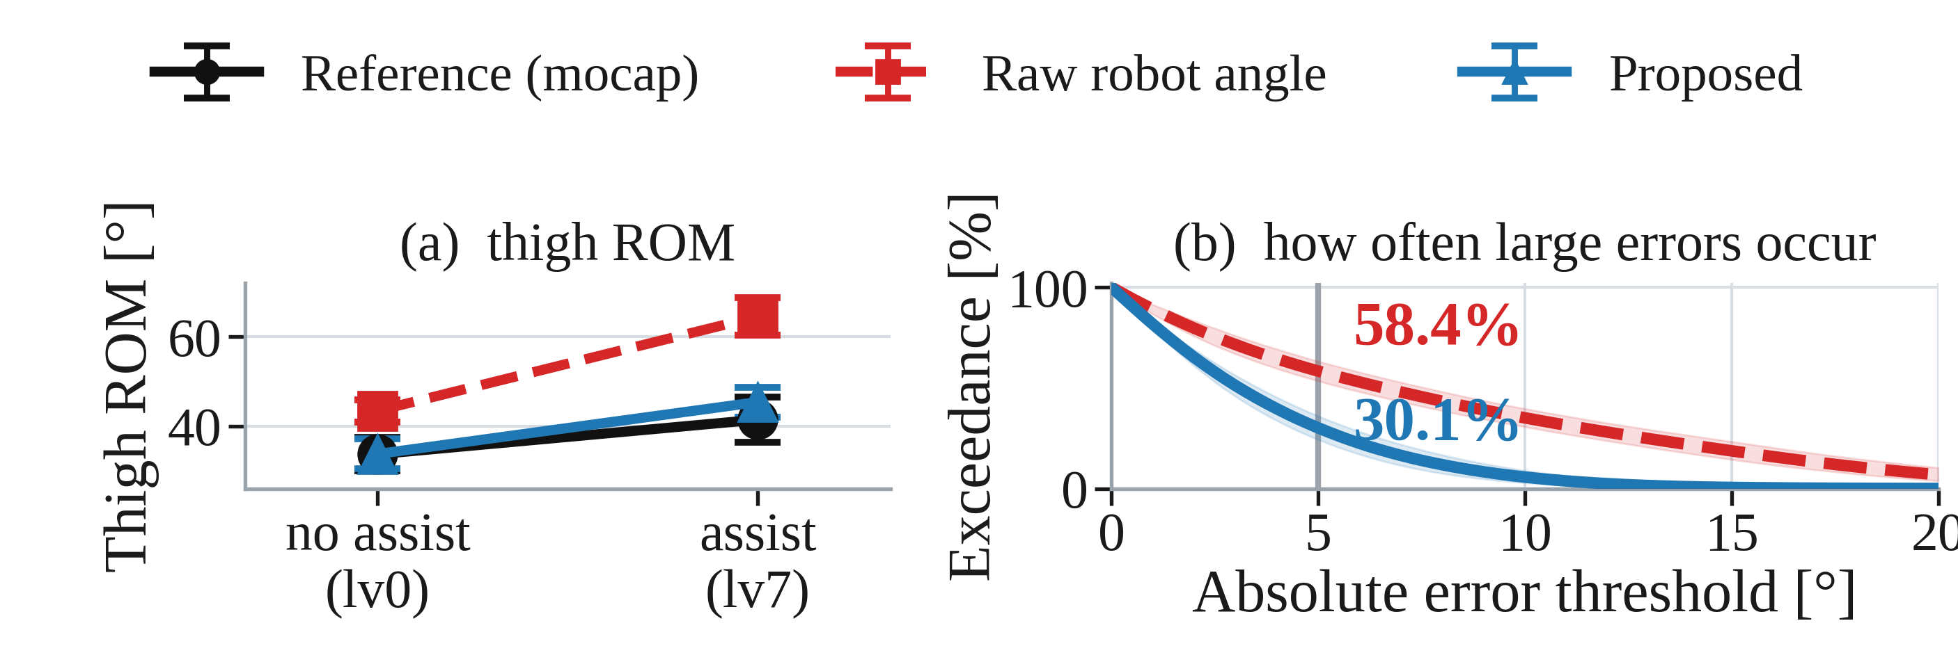
ICNR 2026
EXOSKELETON LABORATORY
Data-Driven Compensation of Human–Robot Misalignment for Human Hip Kinematics Estimation in Wearable Robots
Chanyoung Ko and Kyoungchul Kong*
Exoskeleton Laboratory, Department of Mechanical Engineering, KAIST, Daejeon, Republic of Korea · kkyle0927@kaist.ac.kr; kckong@kaist.ac.kr (*corresponding author)
The wearer's own thigh angle, read from the robot's own sensors. No body-worn sensors, no motion capture.
Background
Experiment
• Robot-mounted sensors measure the robot, not the wearer's anatomical thigh angle.
• Trunk rotation skews the trunk-fixed robot frame off the anatomical hip axis.
• Body-worn IMUs would fix this, at a usability and form-factor cost.
• The raw robot angle is off by 6.72° on average, worse when assistance is on.
• 16 healthy adults · 11.7 h of robot–mocap data at 100 Hz
• 0.75 / 1.00 / 1.25 m/s and stop-and-go; assist lv0 / lv4 / lv7
• Reference: 12-camera Vicon, three thigh markers, T-pose zeroed
• Leave-one-subject-out over participants
• Motion capture trains and scores the estimate; never used at inference.
Robot System
Results
• Bilateral hip exoskeleton (Angel KIT H10), 10 N·m per side
• Onboard sensing: hip encoders, trunk IMU, pelvis-side robot-frame IMU
• θ_{robot} = θ_{encoder} − θ_{IMU} − θ_{calibration}, from a T-pose standing calibration after donning
• τ_{peak} = 4 / 7 N·m (lv4 / lv7), T_{p} = 0.1 s
• Embedded module: NVIDIA Jetson Orin NX
• Everything the estimator needs is already mounted on the robot.
• Accuracy on unseen participants
• 16-fold leave-one-subject-out: −3.15° vs the raw robot angle (95% CI −3.79 to −2.47°, p < 0.001), lower in all 16 held-out participants.
• −0.28° vs the no-yaw network (p = 0.039); −0.70° vs linear Ridge (p = 0.002).
• Conditions the model never saw
Methodology
Biomechanical cue
Trunk and pelvis counter-rotate during gait, and the robot frame rides on the trunk, so trunk yaw carries information about the discrepancy that the robot's own IMU already measures.
• Each target condition (assistance, faster walking, stop-and-go) was excluded from training, validation and model selection.
• Overall MAE fell 35–53% relative to the raw robot angle across all three shifts.
• Where the raw angle fails most
Relative yaw grows with walking speed and is negatively correlated with the discrepancy in all ten participants analysed.
Estimator
θ_{robot} (left hip)
θ_{robot} (right hip)
θ̃_{yaw} trunk-IMU yaw (0.1 Hz high-pass)
Calibration: one 1.0-s standing window after donning. No motion-capture label is used at any point during inference.
• High-flexion MAE: 14.23° → 4.21° (−70.4%) under assistance.
• Raw error grows with assistance level (7.67° → 8.94°); Proposed stays flat (3.74° → 4.09°).
• What this makes possible
8,658 parameters · fully causal · no actuator current · no body-worn sensor
• Raw overstates the lv0→lv7 ROM change by 172%, Proposed only 50%; samples above 5° error fall from 58.4% to 30.1%.
• 2.642 ms mean latency and 8,658 parameters on a Jetson Orin NX may enable estimator-in-the-loop use; closed-loop control was not verified.
A biomechanically motivated input, compact enough for the robot's own embedded computer.
Evaluated in 16 healthy adult male participants, one hip exoskeleton and one low-magnitude assistance profile. · KAIST IRB 2025-295 · Supported by NRF Korea (MSIT) No. 2022R1A3B1077880

