Slide 1
Zuul网关

Slide 2
Http Request
Http Request
Gateway core
Zuul servlet
Filter loader
Zuul Filter Runner
Filter loader
1
2
3
Filter file manager
Request context
Grovy Filter
Grovy Filter
Grovy Filter
Pre routing filter
Routing filter
Post routing Filter
Grovy Filter
Grovy Filter
Grovy Filter
Grovy Filter
Filter Directory
Grovy Filter
Filter manager
Filter publisher
Filter Persister
Filter poller

Slide 3
Filter manager
加载过滤器
Filter loader
扫描数据是否发生变更
过滤器上传
加载至zuul filter
Gateway 过滤链
pre routing filter
Post routing filter
Routing filter

Slide 4
HTTP Request
Pre filters
routing filters
post filters
error filters
service

Slide 5
过滤器的核心概念
类型TYPE
执行顺序Execution Order
条件criteria
定义在路径 中，过滤器被应用的阶段
在同一个type中，定义过滤器的执行顺序
过滤器被执行必须满足的条件
动作Action
如果条件被满足，过滤器将被执行的动作

Slide 6
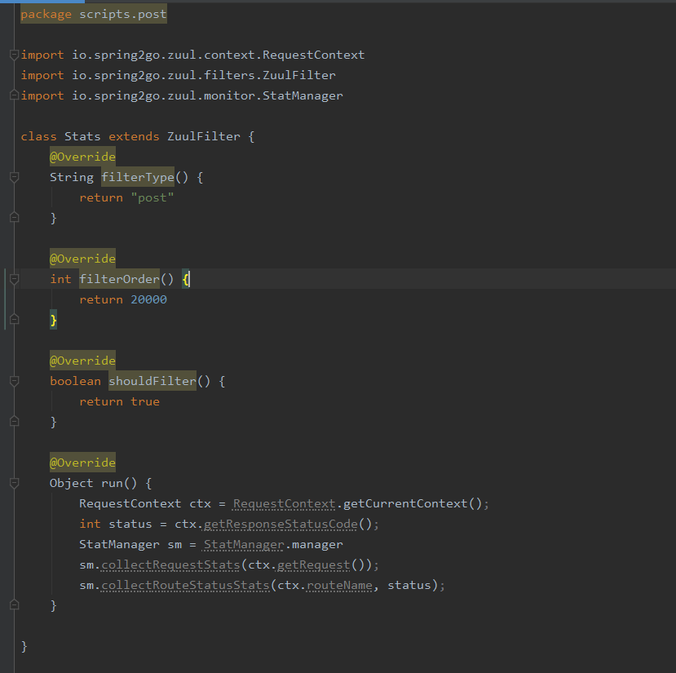
Filter Type
Filter order
Should Filter
过滤器类型 :pre routing post
定义同一类型的顺序
过滤器是否被加载，由此来判断，返回一个boolean类型
Run
被满足后执行的代码

