Slide 1

HouseBoard A bridge to your ideal home
TEAM MEMBERS (GROUP 2) :
Otokpa Jeremiah (8976728)
Licheng Wang (8990916)
Shilpa Singh (8895808)
Shivam Nyati (8907121)
Silviya Nancy John Mari Vienni (8992057)
Xun Zhong (8941794)

Slide 2

AGENDA
Product Vision
User Story Mapping
Dataset
Team Collaboration on JIRA
ML Use Cases Implementation Roadmap

Slide 3
PRODUCT VISION A one – stop solution for up-to-date listings and recommendations saves landlords and tenants time and energy – a national housing data hub for decision makers.
Target groups | Needs | Product | Business Goals
Students Employees Realtors People with similar needs | People often find it hard to locate ideal housing options, let alone personalized choices. | Personalized recommendations Easy Comparison Fraud Prevention | Valuable housing data and customer data
ABOUT US

Slide 4
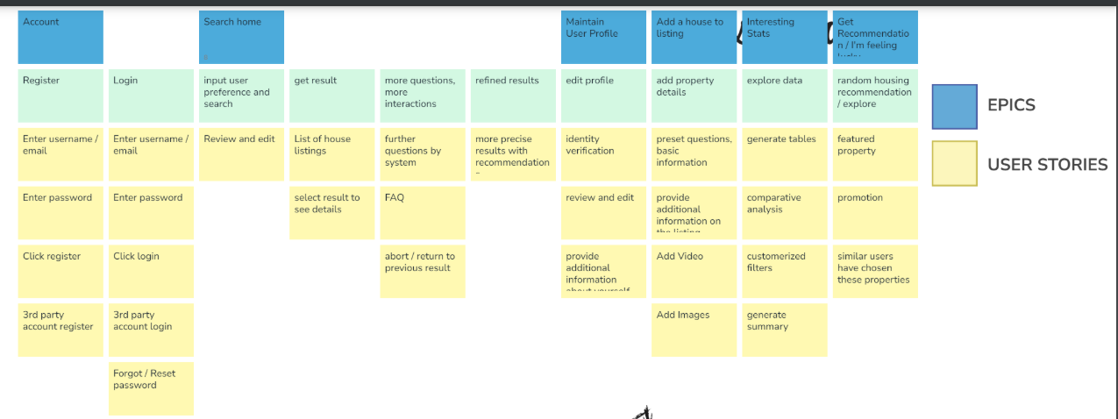
User Story Mapping

Slide 5
ML Use Cases Implementation Roadmap

Slide 6
ML Use case 1 - Predict house prices
https://github.com/kkzxak47/HouseBoard/blob/main/PricePrediction/HouseBoard.ipynb

Slide 7
ML Use case 2 - Provide rankings for the houses users choose based on preferences.
https://github.com/kkzxak47/HouseBoard/blob/main/Rankings/Ranking%20System.png

Slide 8
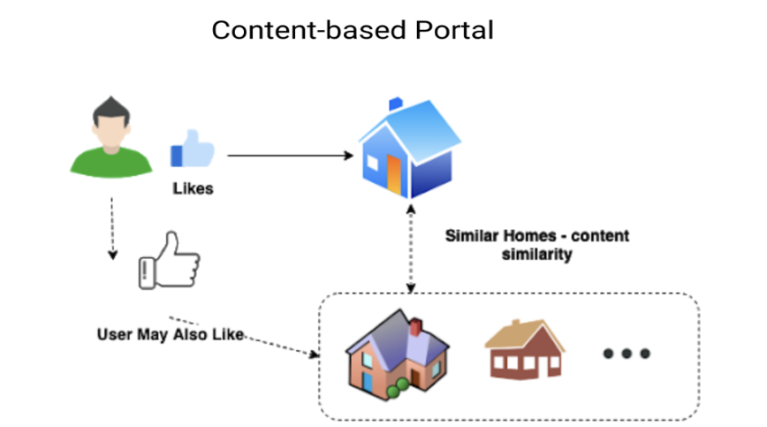
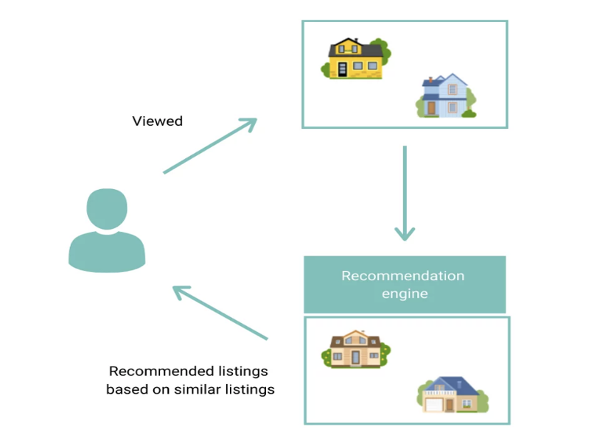
ML Use case 3 - Provide recommendations based on user search history, customer reviews, and feedback
https://github.com/kkzxak47/HouseBoard/tree/main/RecommendSystem

Slide 9
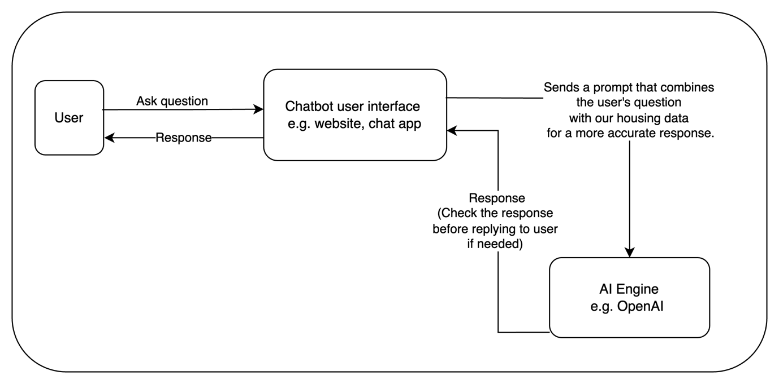
ML Use case 4 - Chatbot for searching housing preferences

Slide 10
ML Use case 4 - Chatbot for searching housing preferences
Introduction of our Housing Data Chatbot
Our housing data chatbot is designed to seamlessly integrate with our housing data system, providing users with accurate and timely information through an intuitive interface.
Operation Flow:
User Interaction: The user asks a question through the chatbot user interface, which can be embedded in a website or a chat application.
Data Integration: The chatbot sends a prompt to the AI engine (e.g., OpenAI) that combines the user's question with relevant housing data stored in our system. This ensures that responses are accurate and contextually relevant.
AI Response: The AI engine processes the combined prompt and generates a response.
Response Delivery: The response is sent back through the chatbot interface to the user, providing them with the information they requested. If needed, we can check the response first to ensure it is appropriate before replying to user.
This system enhances user experience by providing quick, accurate answers to housing-related inquiries, leveraging the power of AI and real-time data integration

Slide 11
ML Use case 4 - Chatbot for searching housing preferences
Choosing a chatbot as a housing consultant has several key benefits:
24/7 Availability
Quick Response
Standardized Answers
Handling Large Volumes of Inquiries
Data Analysis
Personalized Recommendations
Cost Savings
No Interpersonal Interaction Pressure

Slide 12
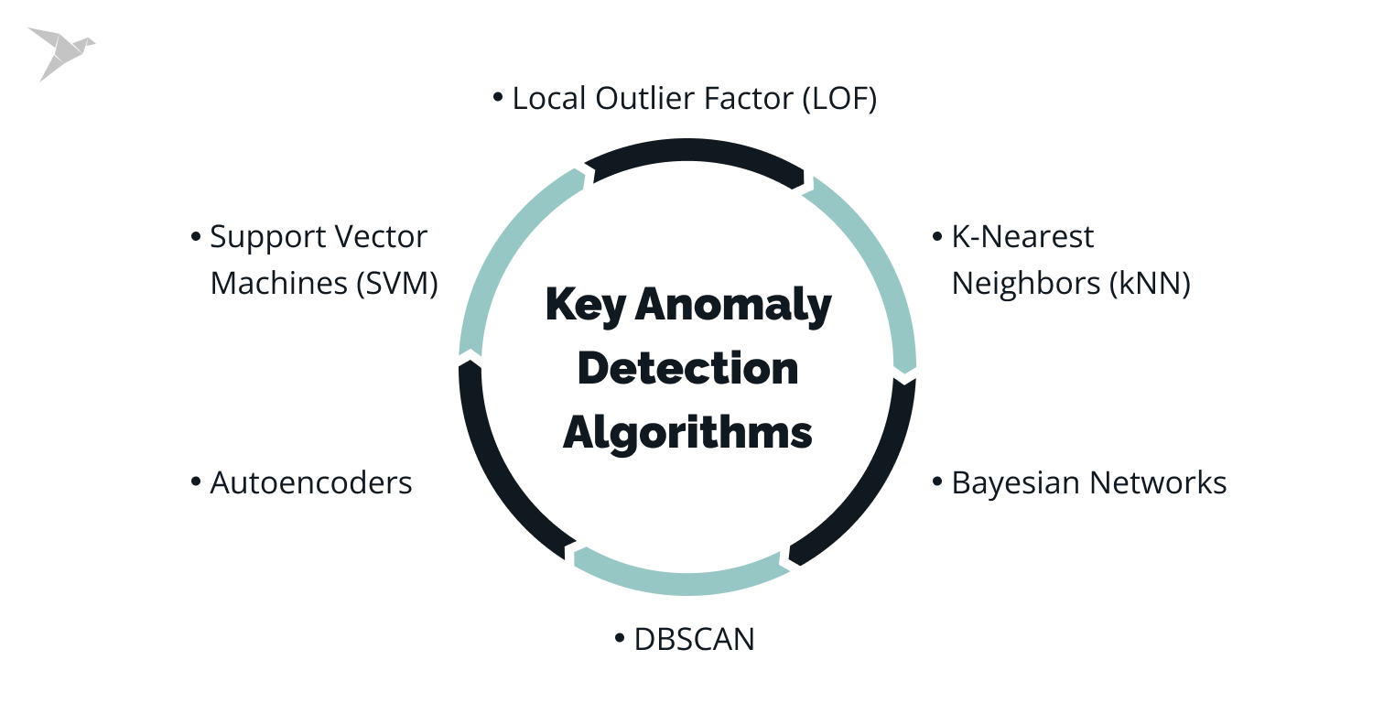
ML Use case 5 - Fraud prevention
https://github.com/kkzxak47/HouseBoard/blob/main/FraudDetection/Know%20your%20enemy.pdf

Slide 13


https://conestogac-team-gohb30o9.atlassian.net/jira/projects?selectedProjectType=software
GitHub : https://github.com/kkzxak47/HouseBoard/tree/main/RecommendSystem

Slide 14

THANK YOU

