Slide 1
A framework for communicating with Android apps from the browser
Kalle Lindström

Slide 2
Background
Companies want to target the mobile market
Companies want to reuse existing functionality
Developing native apps for multiple platforms is expensive

Slide 3
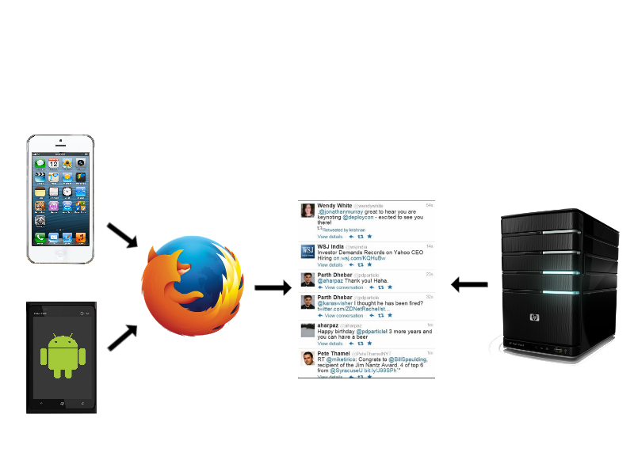
A solution: webapps

Slide 4
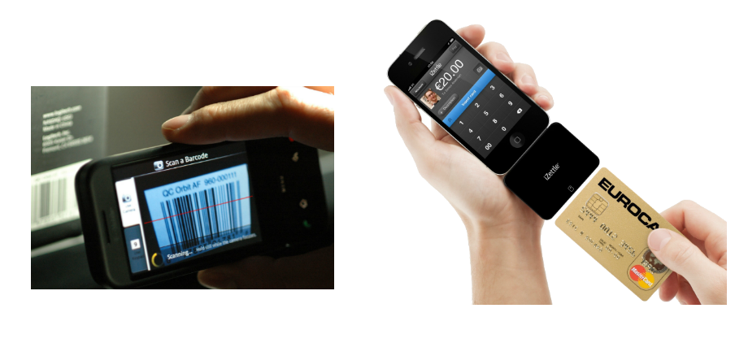
How do you access native functionality?

Slide 5
The Framework
Starts a native application from the web page by clicking a link
Returns a result to the web page
Handles data formats and communication

Slide 6
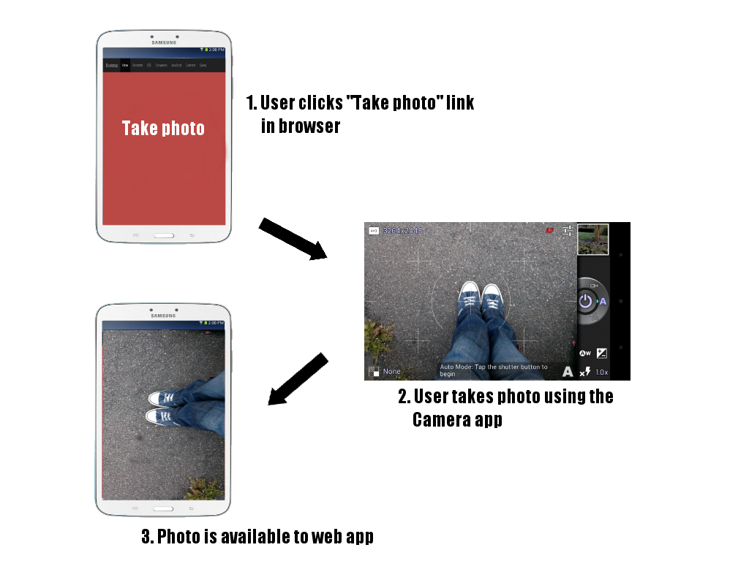
Example use case

Slide 7
Requirements
No limit on the number of applications that can be handled
Easy to integrate new applications with the framework
Security

Slide 8
Starting an Android app by clicking a link
Register an intent filter in the Manifest
<intent-filter>
<action android:name="android.intent.action.VIEW"/>
<category android:name="android.intent.category.DEFAULT"/>
<category android:name="android.intent.category.BROWSABLE"/>
<data android:scheme="app"/>
</intent-filter>

Slide 9
Defining the link format
Format
app://PLUGIN/HANDLER
Example
app://BARCODE_SCANNER/HTTP_POST

Slide 10
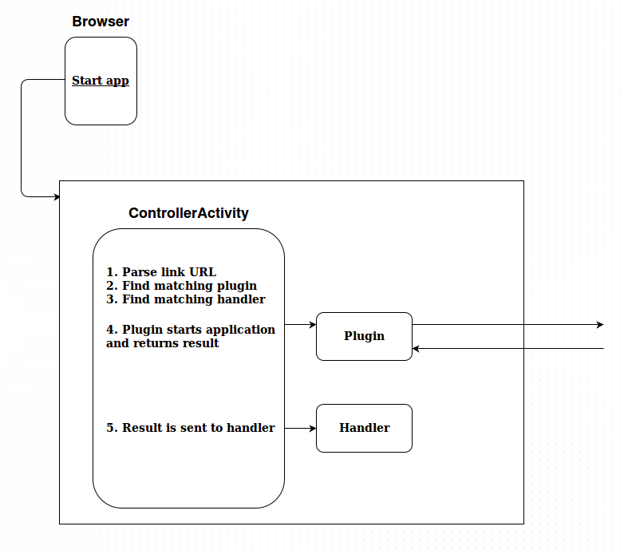
System overview

Slide 11
Plugins
Responsible for starting and handling the result of an application
The app's result is parsed to JSON
Written as a single Java class
Barcode scanner, Contact picker ...

Slide 12
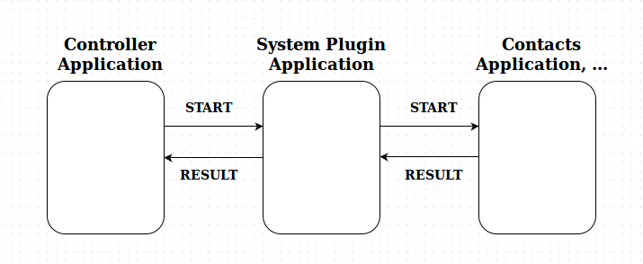
System plugins
Written as separate applications

Slide 13
Handlers
Responsible for returning the plugin's JSON result to the web page
Written as a single Java class
HTTP, HTTPS and web server handlers are included

Slide 14
Web page uses AJAX to poll for the result
Polls a server for the result and adds it to the page using the DOM
The server could be the web app's server or the Android local web server

Slide 15
Performance measurements
Time taken from clicking the link to a result being displayed in the browser
Test app started that returns immediately
HTTP POST and web server handlers tested
Measured with JavaScript in the browser

Slide 16
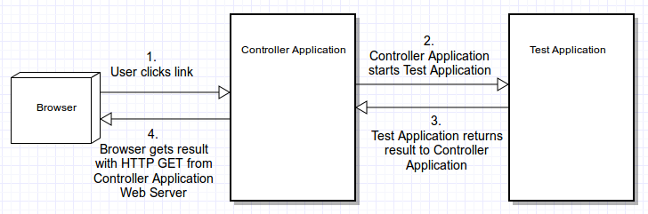
Local web server

Slide 17
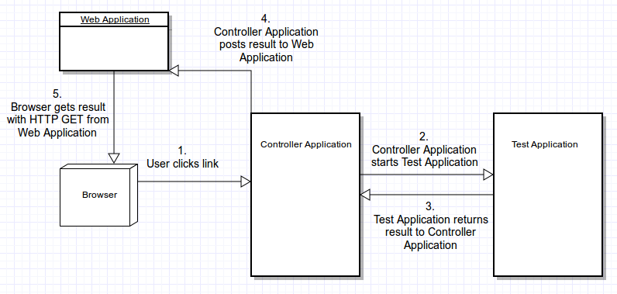
Local HTTP Post

Slide 18
Results over 1000 measurements
 | Mean | Standard Deviation | Min | Max | 95 % Confidence Interval
Built-in web app | 323.23 | 79.7 | 153 | 627 | ±4.94
Built-in web server | 304.16 | 78.9 | 151 | 634 | ±4.89
System web app | 394.87 | 95.9 | 197 | 914 | ±5.94
System web server | 382.12 | 90.9 | 187 | 676 | ±5.63
Unit: milliseconds

Slide 19
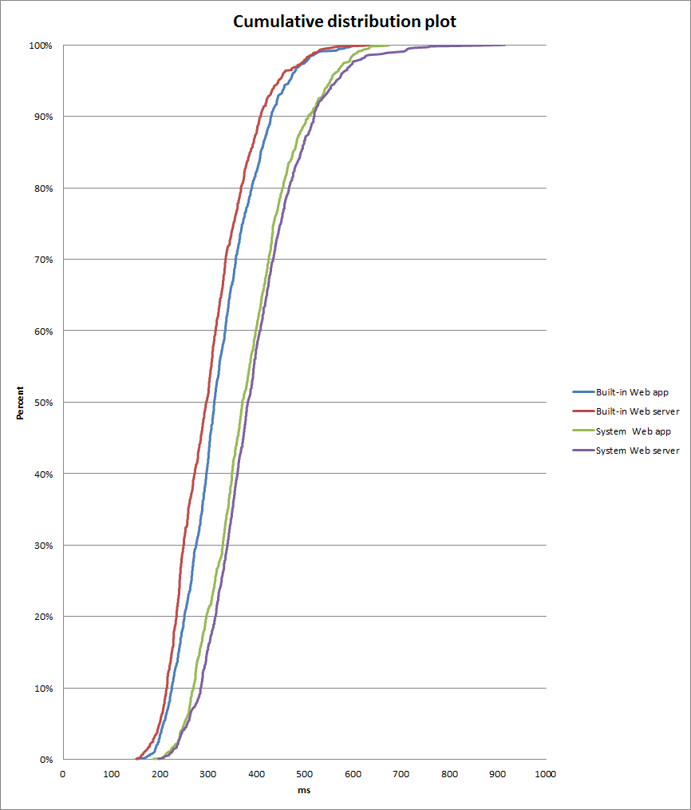

Slide 20
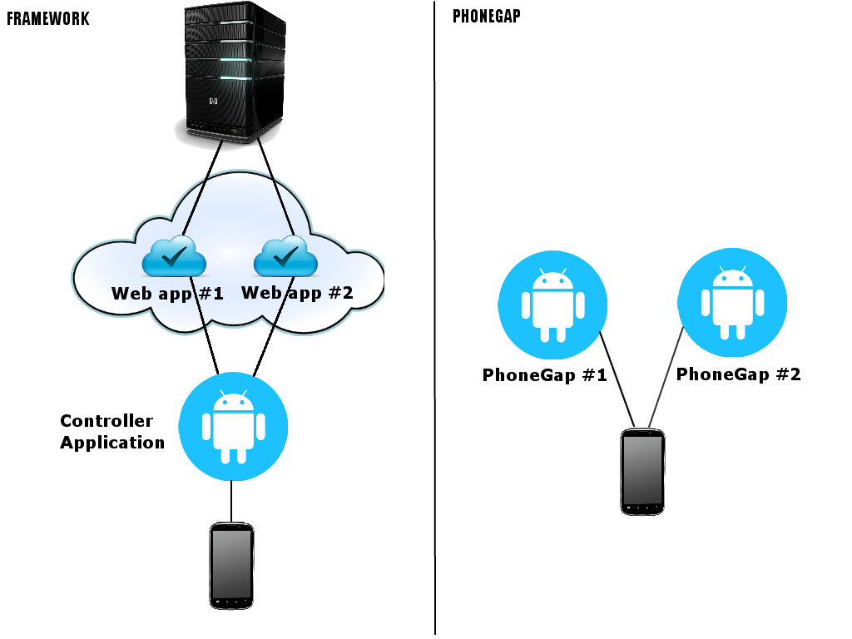
Comparision with PhoneGap

Slide 21
Conclusions
The system is fast enough
Security can be achieved with the HTTPS handler
Flexibility is accomplished with a plugin
architecture

Slide 22
Future work
Make a comprehensive performance/feature/use case comparision with PhoneGap
Expand on the measurements
Make implicit intents (system plugins) more secure

Slide 23
Thanks for listening!

