Slide 1
Wireless Networks and Power Management
Assignment # 2
Ayman, Robert

Slide 2
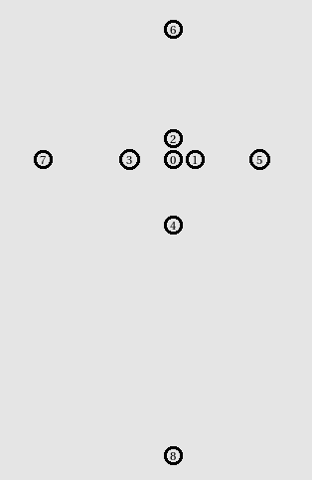
Topology
8 nodes, 1 access point (node 0)
1,2: 25 meters
3: 50 meters
4: 75 meters
5: 100 meters
6,7: 150 meters
8: 340 meters

Slide 3
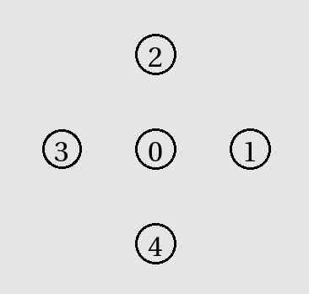
Topology
4 nodes, 1 access point
All 50 meters from node 0

Slide 4
Setup details
Simulation time: 150 sec
dataRate_ fixed at 54 Mb/Sec for all simulations
8 TCP connections using FTP applications
Odd numbered nodes send packets of random sizes, changes every second
Packet sizes between 500 and 5000 bytes
Even numbered nodes send fixed packet sizes of 1500 bytes
Transmission Power ( Pt_ ) set between 100 (802.11g standard) and 4 mW

Slide 5
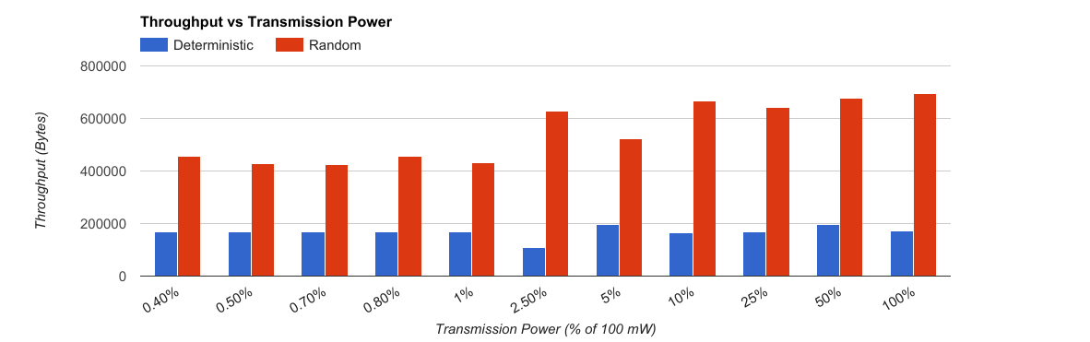
Throughput
Notes:
Random, on average, has a higher packet size compared to deterministic, which yield higher throughput
As we reduce power, fewer nodes are within the transmission range, so the overall throughput decreases

Slide 6
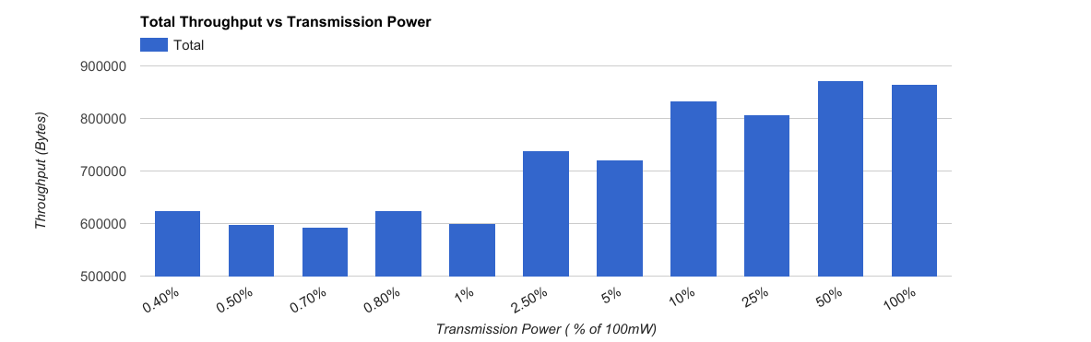
Throughput

Slide 7
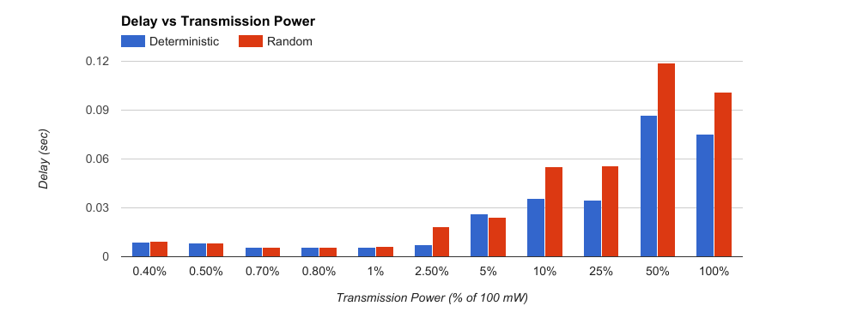
Delay
Notes:
Higher transmission power yields higher delays, since higher transmission power means more nodes are sending packets the access point and consequently incur higher delays

Slide 8
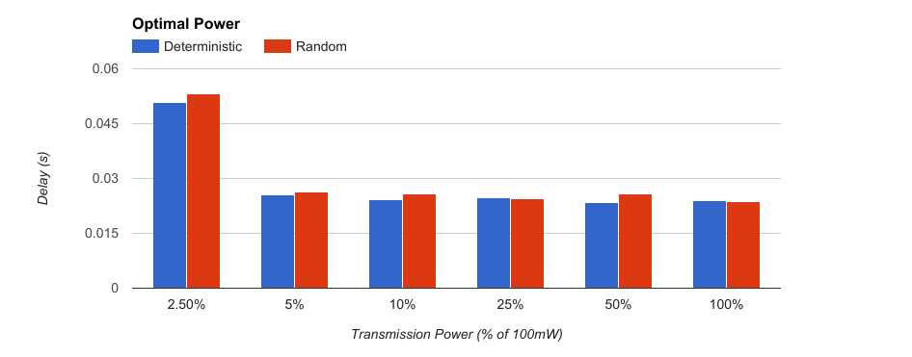
Optimal Power
Notes:
If most users are within 50 meters, then there is no need to use more than 5mW

Slide 9
Q & A

