Slide 1
Delay and Buffering in Wireless Networks
Assignment # 3
Ayman, Robert

Slide 2

Topology
2 nodes, 1 access point
Nodes 1 and 2 send to 0, each 10 meters apart from receiver

Slide 3
Setup details
Simulation time: 150 sec
dataRate_ fixed at 11 Mb/Sec (IEEE 802.11b)
2 TCP connections using FTP applications
Packet Size
Deterministic: 1500 bytes
Random: 500 - 5000 bytes
Queueing Strategies
Drop Tail
Priority Queues
Buffer Size ranges from 3 to 20

Slide 4
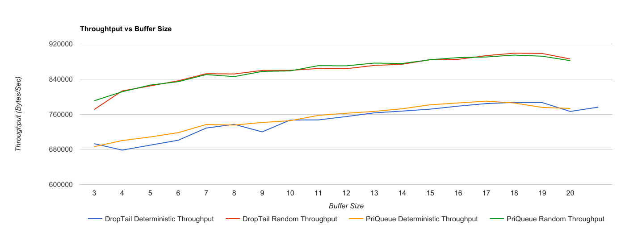
Throughput
Notes:
Random is higher as expected
The buffer increases almost linearly, peaks around 17 packets

Slide 5
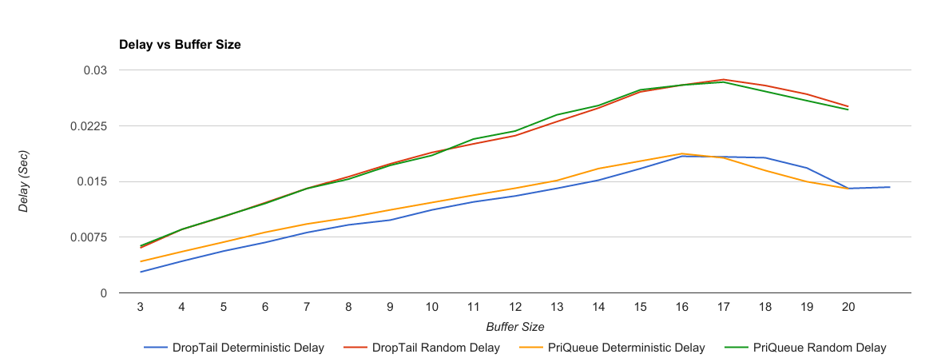
Delay
Notes:
Random is higher as expected due to bigger packets
Increases linearly, it hits a plateau around 16
16 has higher delay than 20, due to retransmissions and waiting times

Slide 6
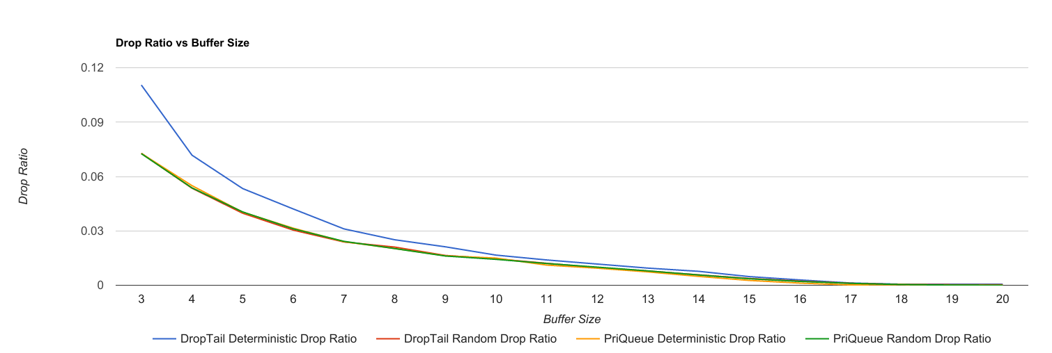
Drop Ratio
Notes:
We can see that priority queue has consistently fewer drops especially with lower buffer sizes
Packet size doesn’t affect the drop ratio as expected, the queueing strategy does

Slide 7
Optimal Buffer Size
Depends on Evaluation metric
Want to maximize Throughput?: 18 buffer size (gain 20kBps throughput, gain 3ms delay)
Want to minimize Delay?: 3 buffer size (lose 50kBps throughput, lose 12ms delay)
Middle Ground
10 ~ 14
Having Buffer size ranging between 10 and 14 strikes a good balance between Throughput and Delay
Changing the buffer size from 20 to 10 loses only 20kBps, but loses 3ms in delay
Notes:
As the buffer size decreases, throughput and delay also decreases almost linearly

Slide 8
Q & A

