Slide 1
CS 244: Assignment #1
Wireless Networks
Robert, Ayman

Slide 2
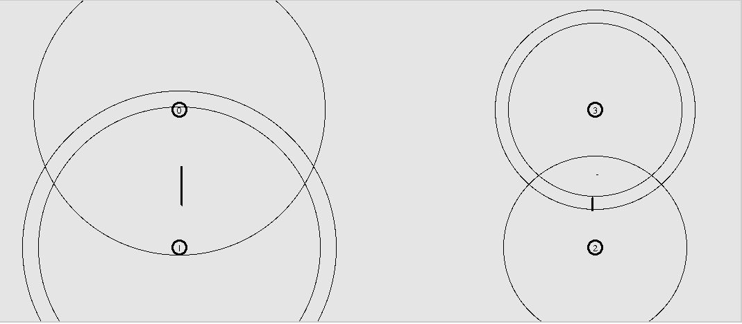
Topology
Nodes 0 and 1 are random
Nodes 2 and 3 are deterministic
Notes:
Node 0 sends packets to node 1 with random size in each second ranging from 500 - 5000,
Node 2 sends packets to node 3 deterministically with a fixed packet size of 1500
The random and deterministic setups are placed away from each other to eliminate interference (2000M along the x axis)

Slide 3
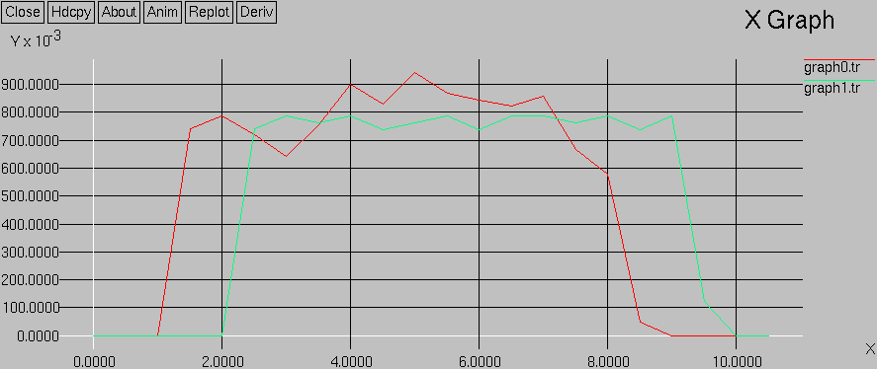
Throughput vs time
Throughput (kbps)
Time (s)
Notes:
Green line represent the deterministic throughput, the red one represents the random throughput
The random connection starts sending after 1 second time and stops at 8 seconds time, deterministic starts at 2 seconds time, stops at 9 seconds time.
The values are calculated at ½ second intervals
We can see that there is a dip in the random throughput (red line), we believe that is because that dip coincides with a large packet size

Slide 4
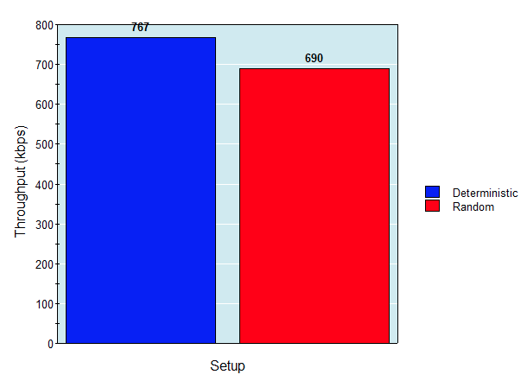
Average Throughput
Notes:
The average throughput for the random and deterministic setups, we can see that on average, the deterministic setup has higher throughput
We believe that is due to the fact that the random setup has a larger packet size on average

Slide 5
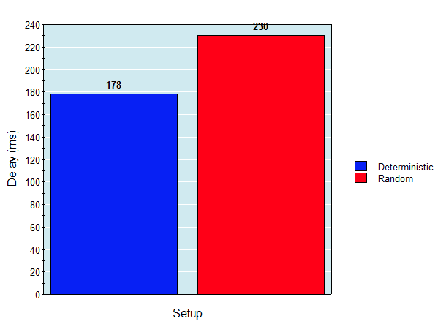
Average Packet Delay
Notes:
Deterministic has less delay
We believe that is also due to random setup having larger packet size, which leads to more delay

Slide 6
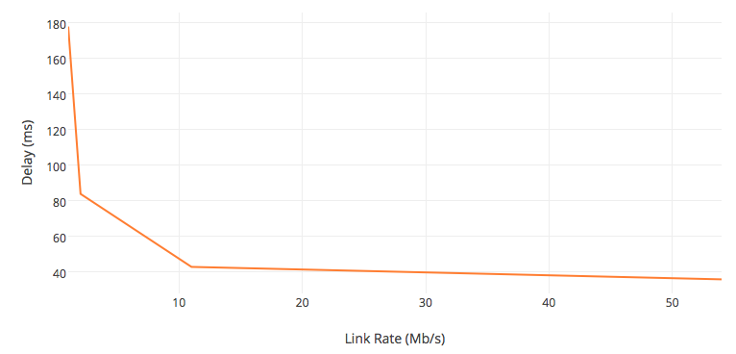
Link Rate vs Average Delay
Notes:
Transmission delay is caused by the link rate, the higher the link rate, the lower the transmission delay
We see that the drop in the delay saturates as we increase the link rate. We believe that this saturation is due to utilizing the maximum bandwidth and the impossibility of going beyond that

