Slide 1
NETWORKING PROJECT • P072
Azure Load Balancer
Outbound Rules & SNAT Planning
How Azure VMs reach the internet, and how we plan enough SNAT ports for busy applications.
TEAM T174
T. Sai Lokesh
M. Brahmani
A. Varshitha Sai
S.S. Sandeep
Azure Load Balancer • Outbound Rules & SNAT Planning • P072

Slide 2




1. PROBLEM STATEMENT
Why Can an App Suddenly Stop Connecting?
Every outbound connection from a VM needs a port. Azure translates the VM's private IP to a public one using SNAT — but if too many connections use up the available ports, new connections start to fail.
›
›
›
App sends
many requests
Each connection
needs a port
Available ports
run out
New connections
fail
The result: timeouts, resets, or random errors that look like an application bug — but are really an outbound capacity limit.
Azure Load Balancer • Outbound Rules & SNAT Planning • P072
2

Slide 3




2. ARCHITECTURE
How Traffic Actually Flows
›
›
›
Backend VMs
Load Balancer
SNAT
Internet
Private IPs only
Applies the Outbound Rule
Translates to a public IP
Sees only the public address
No public IP is required on any VM — the Load Balancer and SNAT handle translation for every outbound connection.
Optional: NAT Gateway
For very chatty workloads, NAT Gateway can be used as a separate outbound-capacity approach — it is not the main flow shown above.
Azure Load Balancer • Outbound Rules & SNAT Planning • P072
3

Slide 4
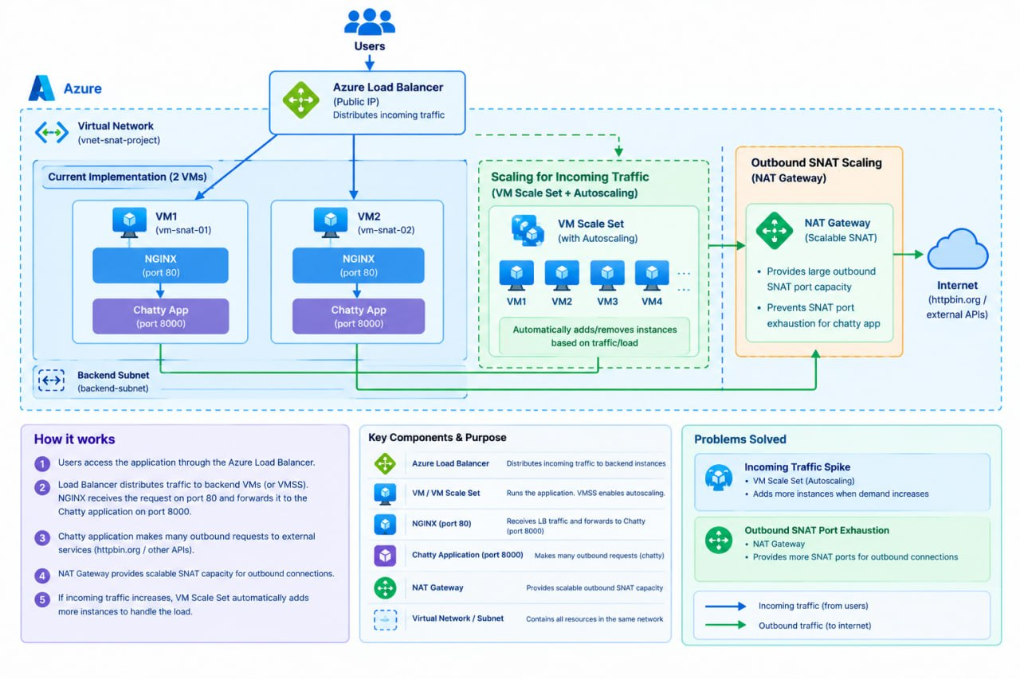
|Architecture:

Slide 5




3. OUR OBJECTIVES
What We Set Out to Do
Understand SNAT
Learn how a private VM reaches the internet using a public IP.
Find the Cause
Identify why ports run out when an app creates many connections.
Configure Outbound Rules
Give each backend VM a planned amount of SNAT capacity.
Calculate Port Needs
Plan capacity using peak connections and maximum VM count.
Azure Load Balancer • Outbound Rules & SNAT Planning • P072
4

Slide 6


4. DEMONSTRATION & RESULTS
Using a Chatty Application to Prove It
The Setup
What We Observed
We used a chatty / busy application on the test VM — one that opens many outbound connections quickly — to simulate real-world traffic that consumes SNAT ports fast.
VM PRIVATE IP
10.0.1.4
PUBLIC IP SEEN ONLINE
Test command run from the VM:
48.223.130.231
curl -4 https://api.ipify.org
OUTBOUND PATH
Confirmed working — private IP successfully translated to public
Repeated while watching SNAT port usage in Azure Monitor as the traffic ramped up.
UNDER SUSTAINED LOAD
SNAT port usage climbed steadily, confirming a busy app can approach the port limit
Azure Load Balancer • Outbound Rules & SNAT Planning • P072
5

