Slide 1


Azure ML Workshop
Kleopatra Chatziprimou
Yeliz Kilinc

Slide 2
Agenda
Azure Machine Learning Overview & Use Cases
Datastores & Datasets
Lab: Data Basics
Automl Configurations Overview
Lab: Automl Featurisation
Training & Inference Pipelines
Lab: Azure ML Pipelines
Scaling with Many Models
Lab Many Models Accelerator

Slide 3
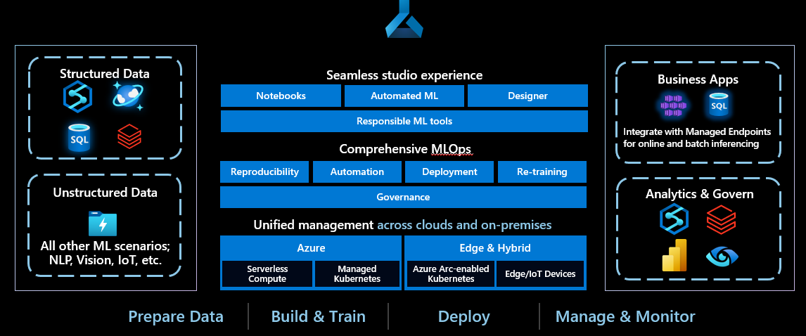
Azure Machine Learning

Slide 4
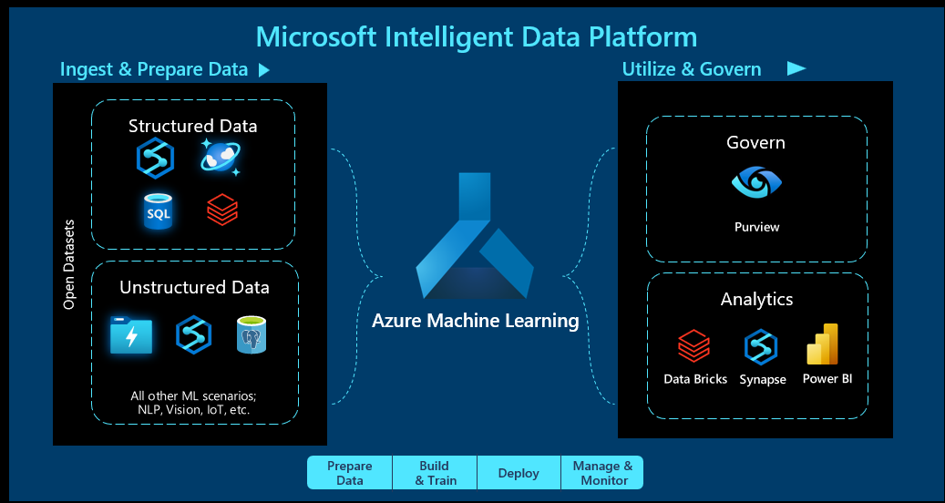
Turning Data Into Business Insights

Slide 5
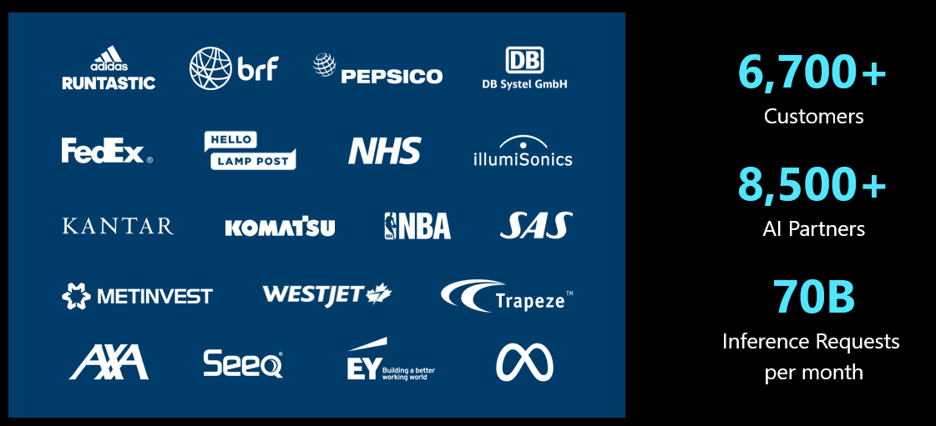
Azure Machine Learning Momentum

Slide 6
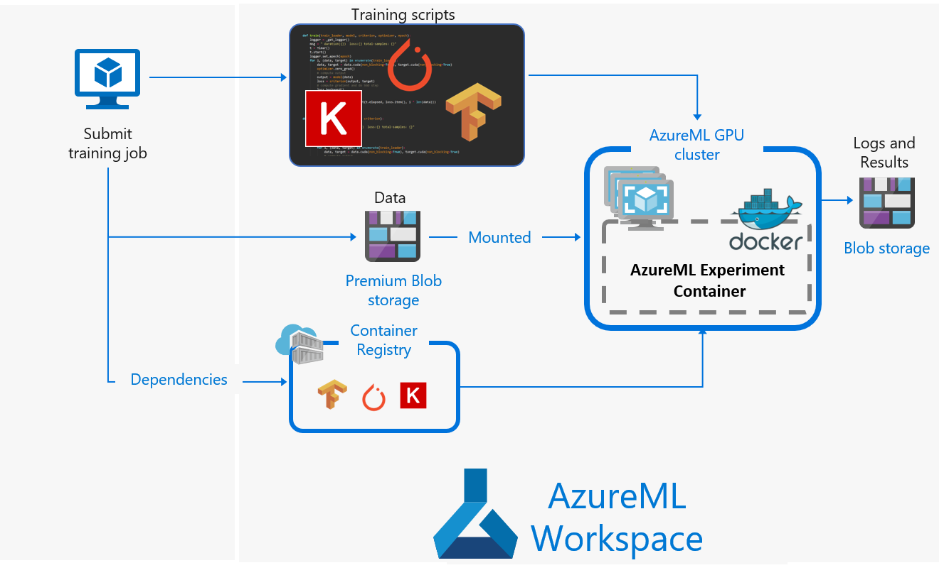
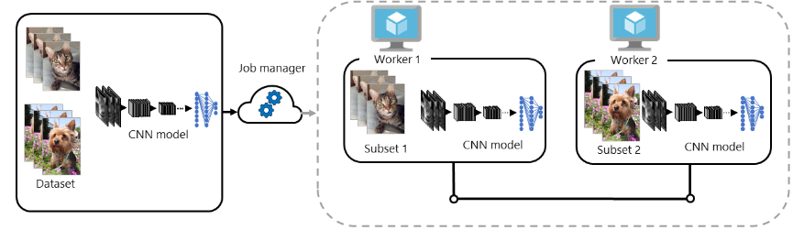
Azure Machine Learning Use Cases
Image classification
Deep Learning with CNN
Parallel Training with synchronous updates on GPUs -
ResNet50CNN on Horovod

Slide 7
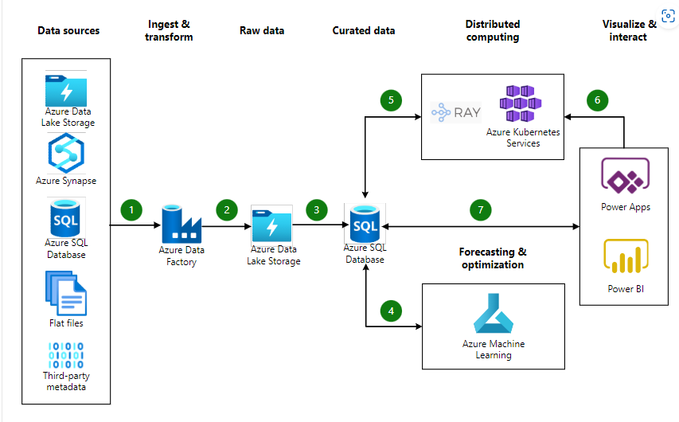
Azure Machine Learning Use Cases
Demand Forecasting
Ray on K8s
Power Apps interface to business users
Potential cases
Forecast commodity prices
Predict seasonal changes
Analyse stock variability

Slide 8
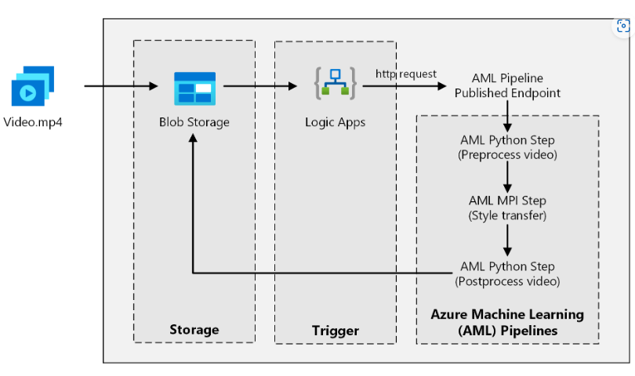
Azure Machine Learning Use Cases
Batch Scoring for Deep Learning using Azure ML Pipelines
Neural style transfer in video
GPU/CPU clusters

Slide 9
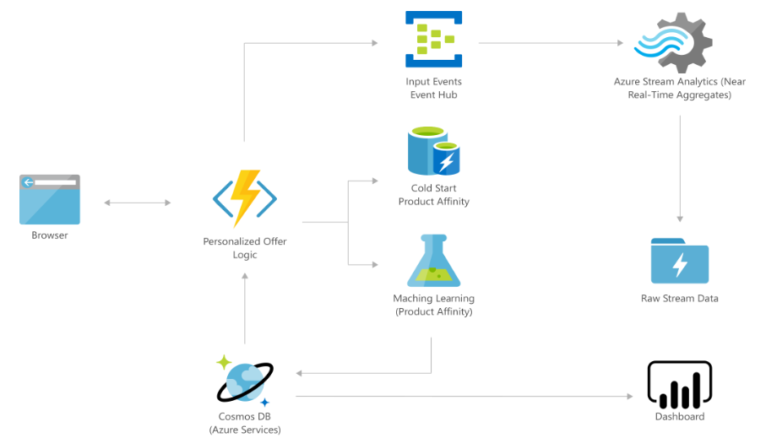
Azure Machine Learning Use Cases
Real time personalised marketing solutions
Customer loyalty through individualised experience

Slide 10
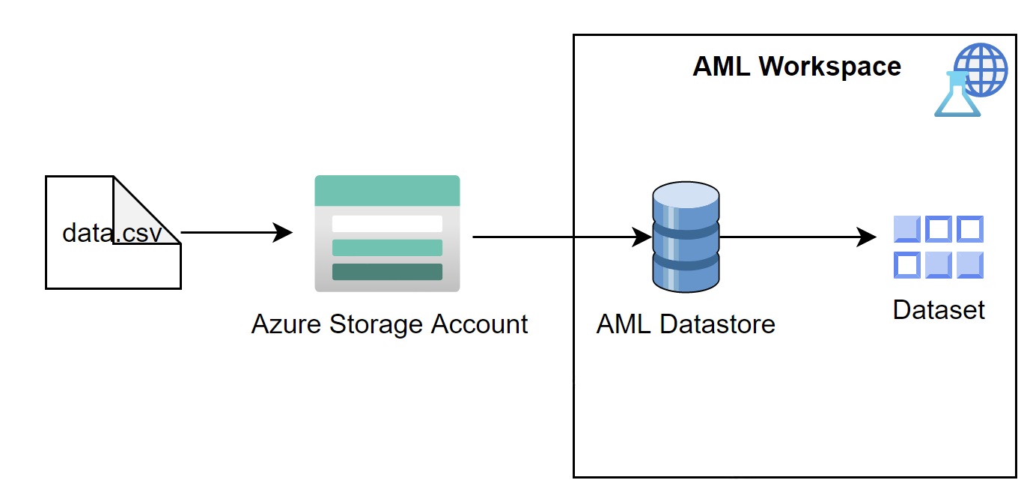
Datastores & Datasets
Notes:
Datastore is used to store connection information to Azure storage services.
Dataset are keeping the metadata and reference , versioned data objects to be used in experiments.

Slide 11
Datasets: Tabular vs File
Structured Data
Unstructured Data
Create Tabular Dataset
Create File Dataset
Use directly in training script for experiment
REGISTER
Reload the dataset and Use
Notes:
A dataset is basically a schema or a versioned data object for experiments.
FileDatasets create references to single or multiple files like images or public URLs. Whereas TabularDatasets represent your data in a table format. You can create TabularDatasets from .csv, .tsv, .parquet, .jsonl files, and from SQL query results.
You can transform it into pandas or spark dataframe and continue…
create a dataset = package your data into a consumable object for machine learning tasks.
Register the dataset to your workspace to share and reuse it across different experiments without data ingestion complexities. By creating a dataset, you create a reference to the data source location, along with a copy of its metadata. The data remains in its existing location.
** Automated ml supports only tabular dataset.
A typical approach for data scientists is to use the pandas library to process tabular data. When working with large volumes of data however, it can take a long time to load and manipulate your data with pandas on CPUs. Next to a decline in performance, you may run into memory issues. To improve performance and avoid memory issues on your compute, use GPUs to process large data more quickly. As pandas only works with CPUs, you'll have to use the cuDF library to work with GPUs.
Parquet files vs CSV file
------------------------
Use directly in training script:
1)Use to_pandas_dataframe() method to load that dataset into a pandas dataframe for preparation
(NaN->Null)
2) Load the prepared data into a new dataset from an in-memory pandas dataframe, write the data to a local file, like a parquet
3) Create dataset from local file

Slide 12
Advantages of creating datasets
Seamlessly access data during model training without worrying about connection strings or data paths.
Data remains in its location
No extra storage cost
Share data and collaborate with other users.
Version and track dataset lineage
Improve ML workflow performance speeds
No risk unintentionally change your original data sources
Monitor your dataset for data drift detection

Slide 13
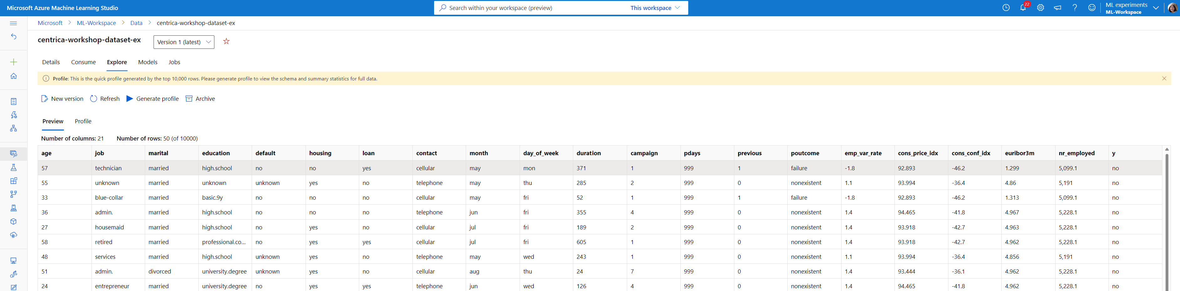
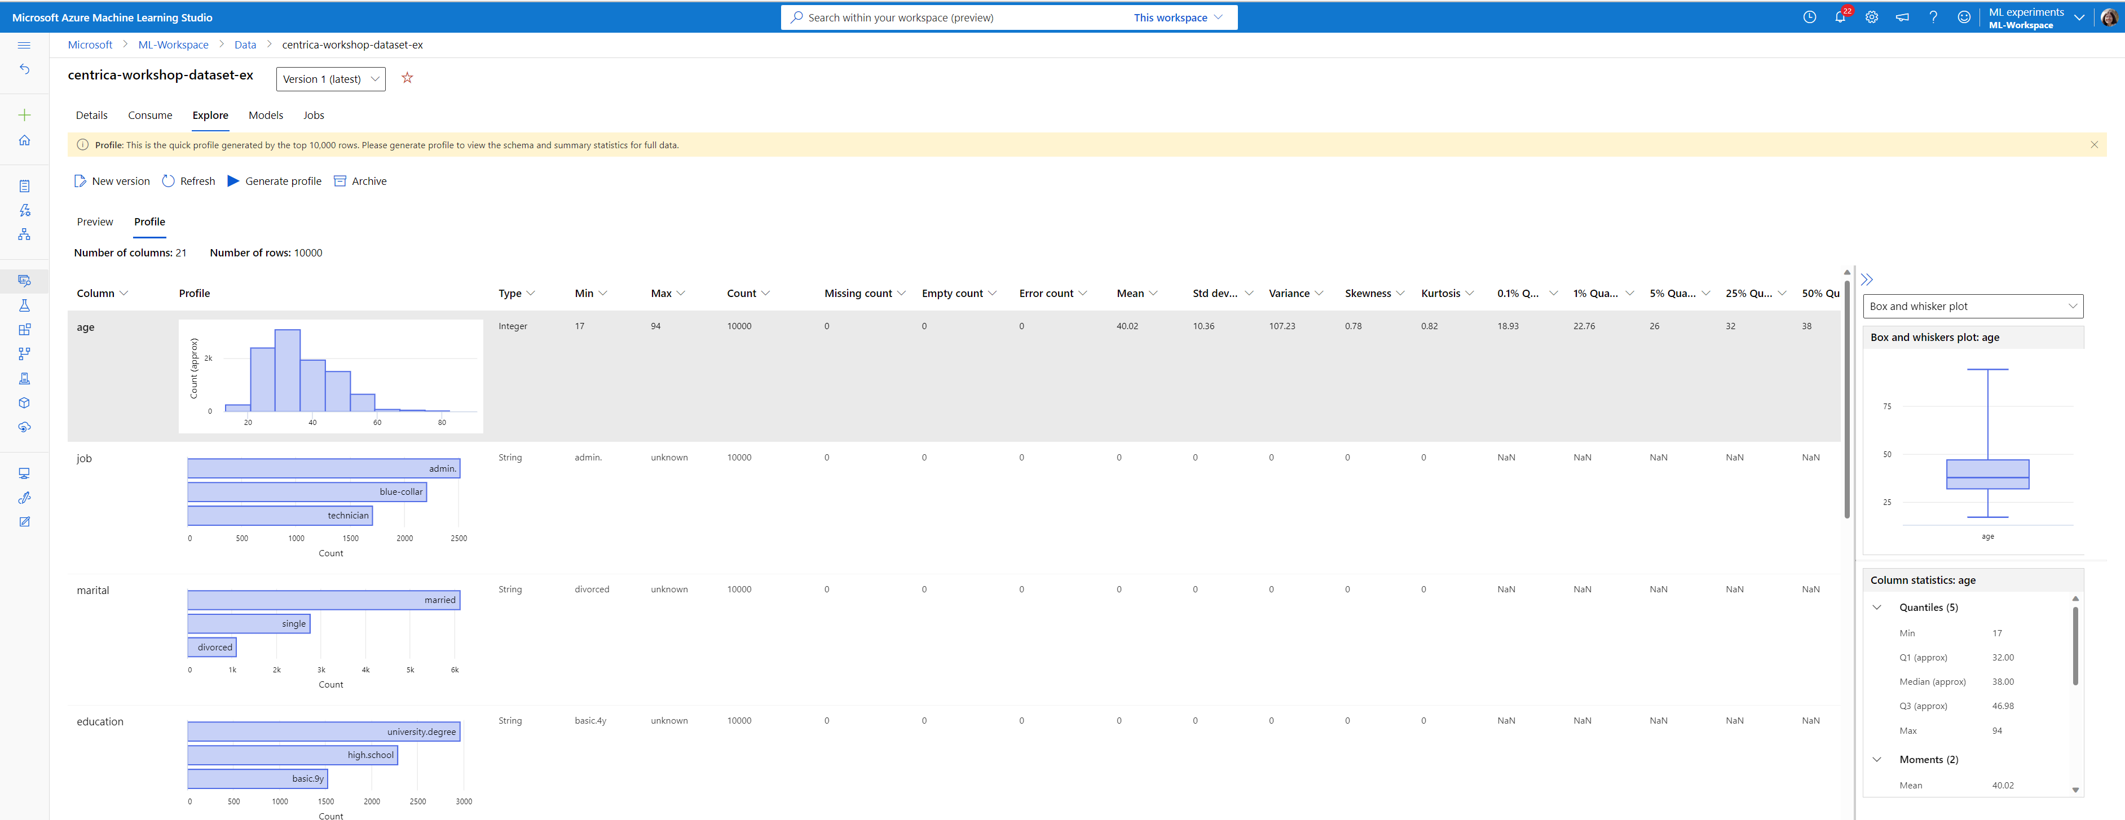
Datasets: Preview & Profile
Notes:
You can get a vast variety of summary statistics across your data set to verify whether your data set is ML-ready. For non-numeric columns, they include only basic statistics like min, max, and error count. For numeric columns, you can also review their statistical moments and estimated quantiles.
Exploratory Analysis is very critical in datascience.

Slide 14
Datastores
Datasets
Consumption
filter(), take(), random_split(),
drop_columns(), take_sample(),
time_after(), time_before(),
time_between(), time_recent(),
…
SQL
from_sql_query()
TabularDataset
to_pandas_dataframe()
to_spark_dataframe()
Azure Blob
File Share
ADLS g1/g2
Dataframe
from_delimited_files()
from_parquet_files()
from_json_lines_files()
to_csv_files()
to_parquet_files()
Mount
mount()
from_files()
FileDataset
HTTP/Web
Download
download()
skip(), random_split(),
take(), take_sample(),
…
Notes:
From Azure storage:
Azure Blob Storage,
Azure File Share,
Azure Data Lake Storage Gen1,
Azure Data Lake Gen2
From SQL databases
From Azure Open Datasets
From local files
From web files

Slide 15
ADLS Gen 2
ADLS Gen 2= File Storage + Blob Storage
Store both your structured and unstructured data from different sources.
With the hierarchical namespace, you can use a nested folder structure to optimize listing operations. (performance & sclability)
File Level Access Control
Define hot or cool access tier while creating ADLS gen2.
Partition is critical -> Find optimal way of storing data to reduce processing time
Easily and securely access the data from the Azure Machine Learning workspace
Avoid small files: Reading a 1000 small files is much slower than reading one file with 1000x the size.
Notes:
The best solution when working with Azure Machine Learning is to store the data in an Azure Data Lake Storage Gen2, no matter the size of the data.
Use nested folder structure based on x(time): The reason why it's more efficient to use a data lake instead of a flat object storage, is because it's best to avoid putting all your files in one folder. If all files are stored in one folder, regardless of which storage solution you choose, reading the files will be demanding for your compute.
Blobstorage does not support hierarchical namespace.

Slide 16
Hands-on Lab #1 Data Basics Exercise DataBasics.ipynb
Notes:
3. Many models (Python SDK)

Slide 17
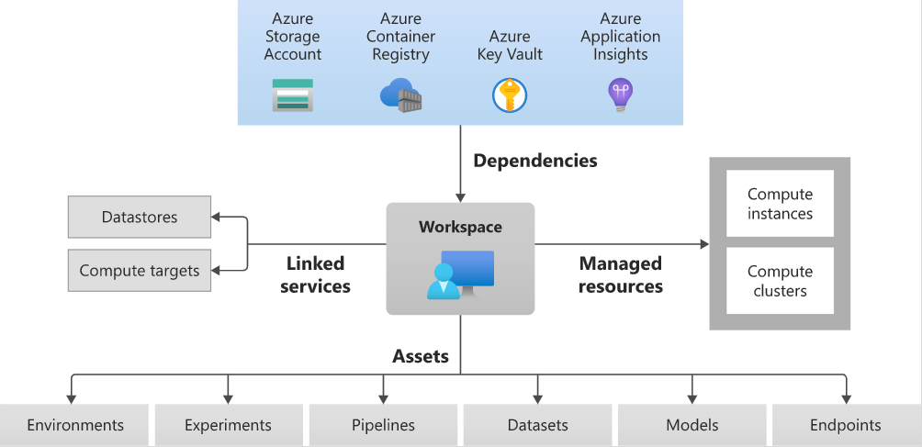
Azure ML Overview

Slide 18

Automated Machine Learning
Identify ML problem
Specify source + format of training data
Configure compute target
Configure parameters, primary metric, exit criteria, concurrency
Submit training
User inputs
Feature engineering
Algorithm selection
Hyperparameter tuning
Model Leaderboard
 | Year
 | Month
 | Day
 | …
 | Hour
 | Minute
 | …
Rank | Model | Score
1 |  | 95%
2 |  | 76%
3 |  | 53%
Dataset
76% | 34% | 82%
41% | 88% | 72%
81% | 54% | 73%
88% | 90% | 91%
95% | 68% | 56%
89% | 89% | 79%
…
Configuration & Constraints

Slide 19
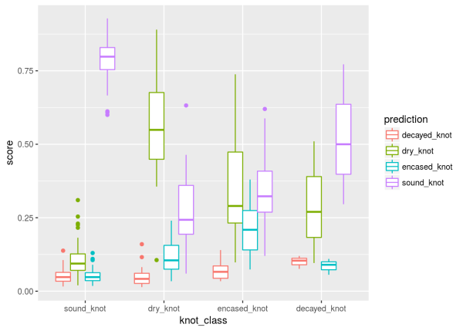
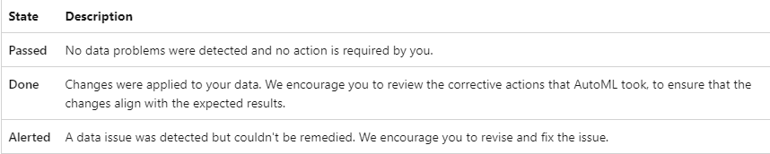
Auto ML Configuration – Featurisation
Process of creating additional features to better define patterns
Data scaling & normalisation techniques
Automatic featurization
Drop high cardinality
Impute missing values
Generate Features ( eg dates)
One hot encoding
One hot hash
Word Embeddings
Cluster Distance
Scalers
PCA
Deep Learning based featurisation
Data Guardrails help identify imbalances

Slide 20
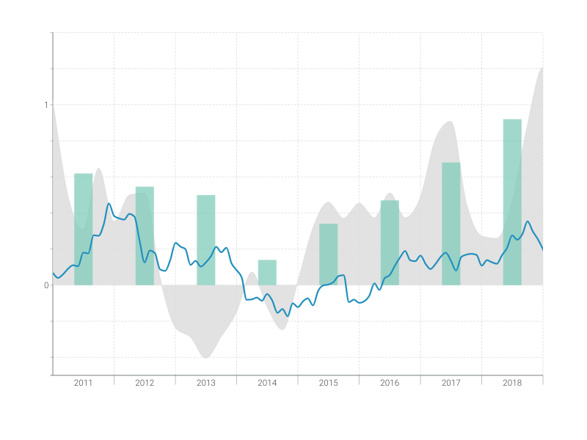
Auto ML Configuration – Timeseries Featurisation
Detect time-series sample frequency
Impute missing values in the target and feature columns
Create features to enable fixed effects across different series
Create time-based features to assist in learning seasonal patterns
Encode categorical variables to numeric quantities
Detect the non-stationary time series and automatically differencing them to mitigate the impact of unit roots.

Slide 21
AutoML configuration- Custom Featurisation
Set "featurization": FeaturizationConfig in AutoMLConfig object
Override feature type for a column
Transformer specification – eg CategoricalHash
Drop columns – Imputer strategy definition
Block transformers

Slide 22

Auto ML Configuration – Training
Classification – categorical target
Regression – numerical target
Time-series forecasting
Holiday detection
DNN option
Configurable lags, rolling window
Parameters
Computer vision – image data
NLP
Labeling
Distributed training with Horovod
DNN, BERT
Multi-language support with 104 languages

Slide 23
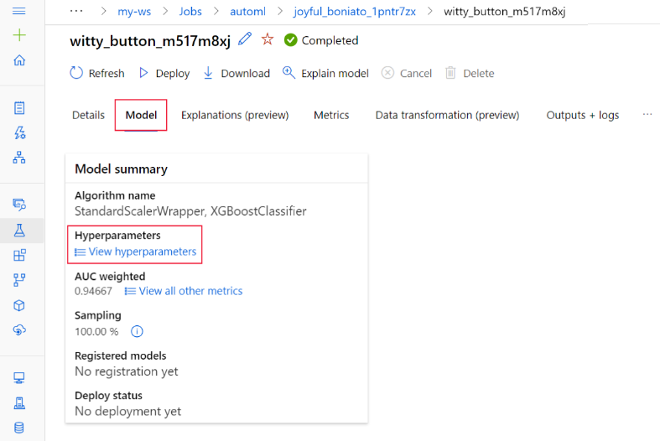
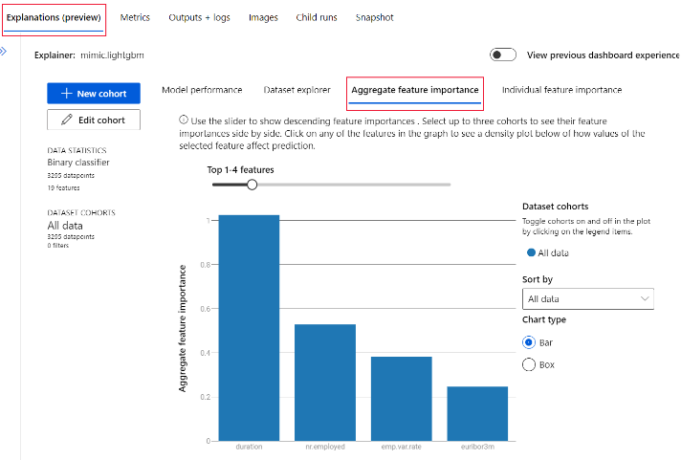
View Completed Job Training Details

Slide 24
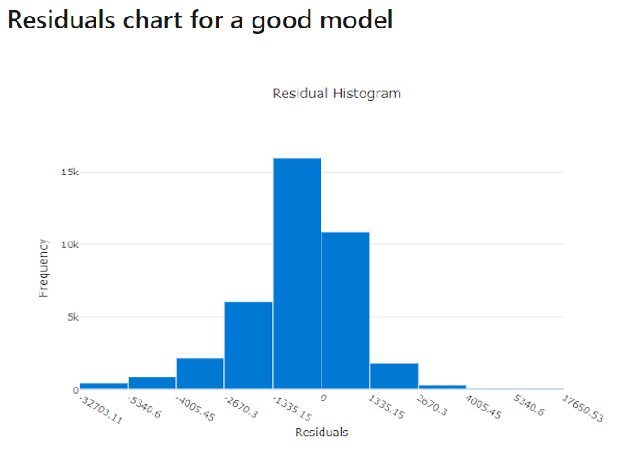
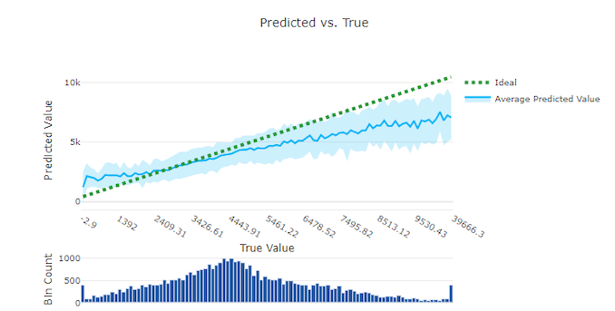
AutoML – Evaluation
Metrics
Residuals – good model peaks at 0
Predicted vs True

Slide 25
Hands-on Lab #2 Featurisation Exercise auto-ml-forecasting-bike-share.ipynb auto-ml-forecasting-orange-juice-sales.ipynb regression-automl-nyc-taxi-data.ipynb
Notes:
3. Many models (Python SDK)

Slide 26
Azure ML Pipelines
Training Pipeline
Prep_Step
AutoML Step
Register Model Step
Run Pipeline with Steps
Publish Pipeline
Schedule Pipeline
Inference Pipeline
Prep_Step
Score Step
Run Pipeline with Steps
Publish Pipeline
Schedule Pipeline

Slide 27
Hands-on Lab #3 Exercise
Notes:
3. Many models (Python SDK)

Slide 28

Scaling AutoML with Many Models
Many Problems are too complext to be solved by single ML model
Energy and utility companies building predictive maintenance models for thousands of oil wells, hundreds of wind turbines or hundreds of smart meters
Retail organizations building workforce optimization models for thousands of stores, campaign promotion propensity models
Enterprises building revenue forecasting models at each division level
Banks and financial institutes building models for cash replenishment for ATM Machine and for several ATMs or building personalized models for individuals

Slide 29
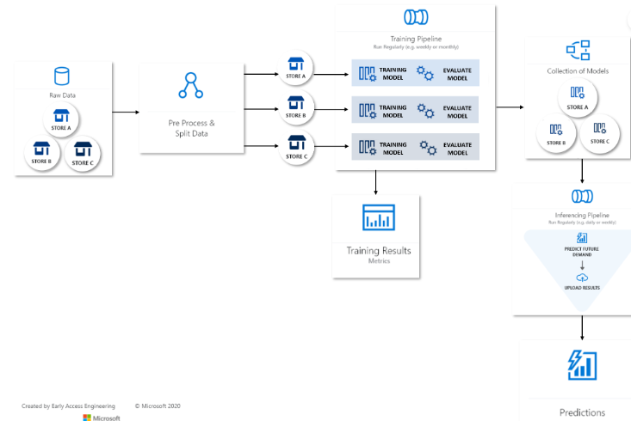
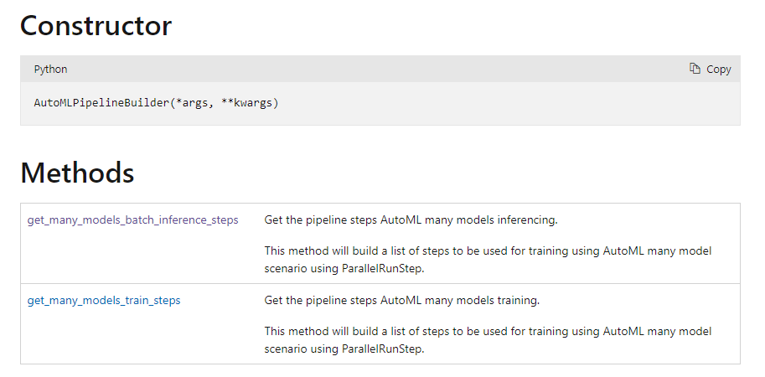
Scaling AutoML with Many Models

Slide 30
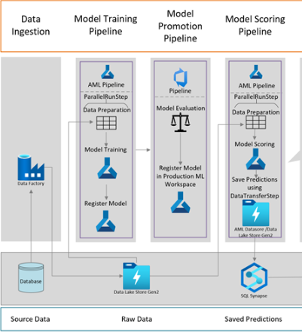
Implementing Many Models using Azure ML Parallel Run Step
Azure Parallel Run Step is a powerful option to run any sort of ML Many Model Training & Inferencing
PRS splits data by number of files or size or by a column value
Then apply ML script on thousands of partitions in parallel

Slide 31
Hands-on Lab #4 Exercise microsoft/solution-accelerator-many-models (github.com) kl3lia/automl-workshop at master (github.com)
Notes:
3. Many models (Python SDK)

Slide 32
Appendix

Slide 33
Data Integration with Databricks Data Lake?
Do you plan to use whole data for inference?
Or “delta data” ?
Daily New Data in ?
Data Lake
Reach Data and Create Dataset for Inference
AML Inference Pipeline
Notes:
Put Appendix

