Slide 1
Multiple Sequence Alignment
Kevin lin

Slide 2
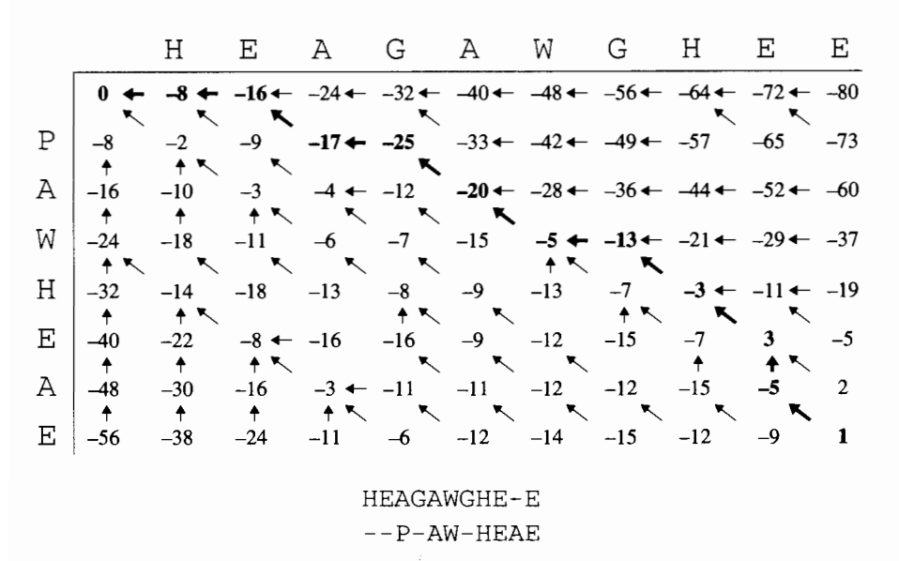

Motivation
Requirement for many other algorithms
$F\left(i,j\right)= \left\{\begin{aligned}F(i−1, j−1)+s_{x_{i}y_{j}} \\ F\left(i−1,j\right)−d \\ F\left(i,j−1\right)−d\end{aligned}\right.$
Use of score matrix
DP optimizes to $O(mn)$ time
Extension to arbitrary dimensions $N$?

Slide 3
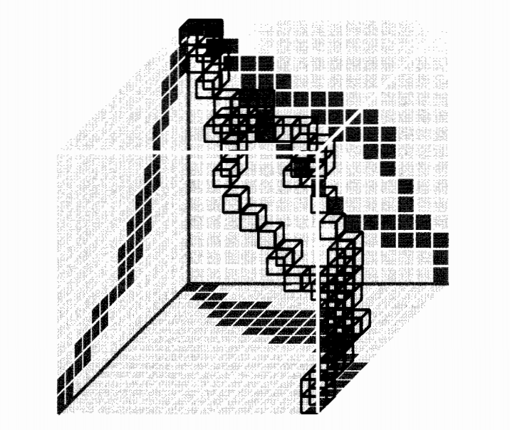
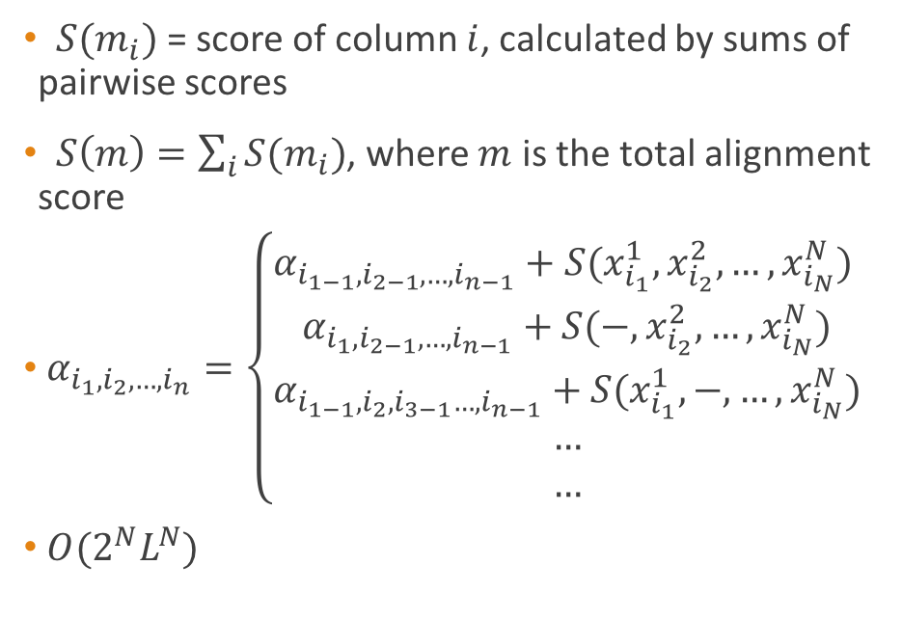
Direct Extension
$S(m_{i})$ = score of column $i$, calculated by sums of pairwise scores
$S\left(m\right)=\sum_{i}{S(m_{i}})$, where $m$ is the total alignment score
$α_{i_{1},i_{2},…,i_{n}}=\left\{\begin{aligned}α_{i_{1−1},i_{2−1},…,i_{n−1}}+S(x_{i_{1}}^{1},x_{i_{2}}^{2},…,x_{i_{N}}^{N}) \\ α_{i_{1},i_{2−1},…,i_{n−1}}+S(−,x_{i_{2}}^{2},…,x_{i_{N}}^{N}) \\ α_{i_{1−1},i_{2},i_{3−1}…,i_{n−1}}+S(x_{i_{1}}^{1},−,…,x_{i_{N}}^{N}) \\ … \\ …\end{aligned}\right.$
$O(2^{N}L^{N})$

Slide 4
Progressive Approach - ClustalW
Iteratively align 2 sequences at a time until 1 remain
Decisions
Order of performing alignments
Linear or tree structure
Scoring sequences against alignments
ClustalW
Compute distance matrix with pairwise alignment
Construct guide tree with neighbor join
Post-order alignment in order of decreasing similarity
Align alignments-alignments, alignments-sequences by average weighted sum of pairs

Slide 5
Data
Robin Gutell’s Comparative RNA Website: RNA sequences
Bioinformatics at Vrije Universiteit Brussel: amino acid sequences
Simulate different sequence similarities by:
Setting seed sequence
Using HMM-like approach
States: follow seed sequence or not
Transition: based on sequence similarity
Epsilon error (insertion, deletion, mutation)

Slide 6
Sources
Durbin, Richard, et al. Biological Sequence Analysis: Probabalistic Models of Proteins and Nucleic Acids. Cambridge University Press, 2013.
http://www.rna.ccbb.utexas.edu/DAT/3C/Alignment/
http://bioinformatics.vub.ac.be/databases/databases.html

